Slide 1
SciScope: A Data Discovery and Retrieval Tool for Environmental Science
Bora Beran, Catharine van Ingen
Microsoft Research

Slide 2
It is often useful and sometimes necessary for scientists and engineers to work with data from multiple sources… WHY?

Slide 3
For data variety
USGS
NOAA

Slide 4
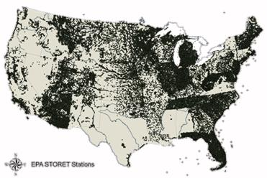
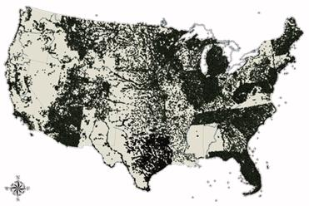
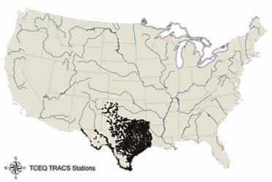
For better spatial coverage
STORET has 758 sites in Texas, TCEQ has 8407.
STORET has 47,602 sites in Florida, NWIS has 27,906.
NWIS has 121,545 in Minnesota, STORET has 22,260.
TCEQ data from David Maidment, UTX-Austin

Slide 5
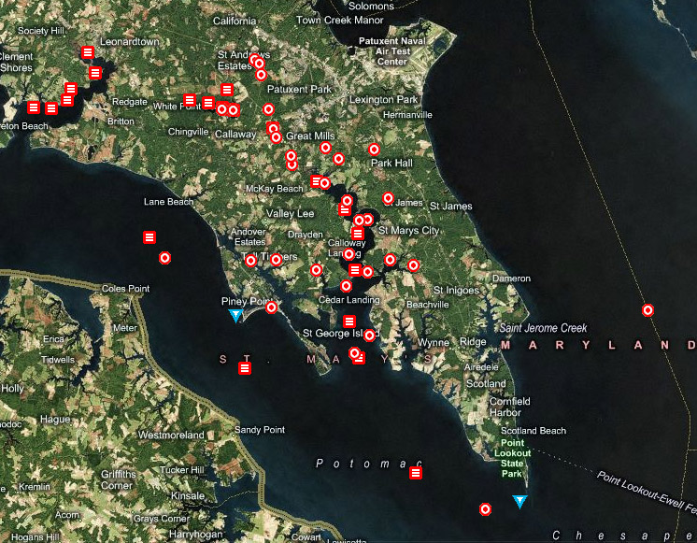
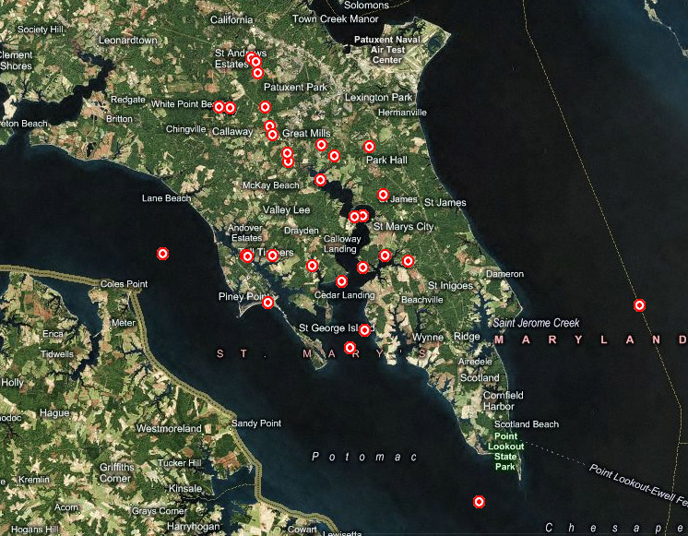
For better temporal coverage
1957-1977
1977-2003
2003-2007
Nitrogen

Slide 6
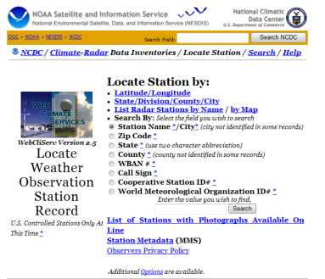
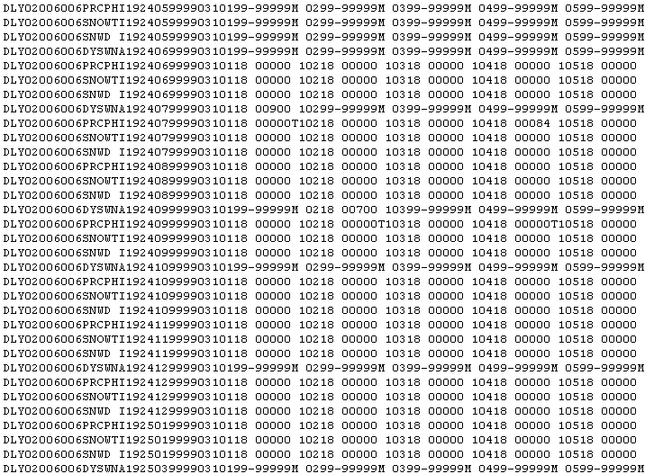
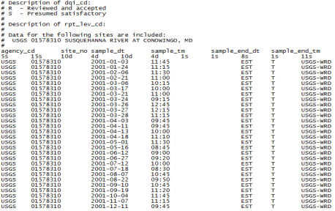
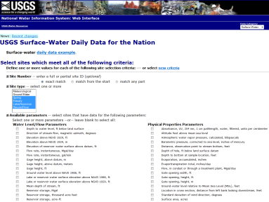
Data Discovery/Retrieval today
1 month later
What sites are in Russian River basin?
Rainfall vs. Runoff in Russian River

Slide 7
What do we need?
A search engine that creates a unified view over
multiple heterogeneous data repositories allowing
scientists to discover and retrieve data in a simple and intuitive
way.
In technical terms:
A searchable metadata repository/aggregator
A mediator (semantics/syntax/structure)
A light-weight web GIS

Slide 8
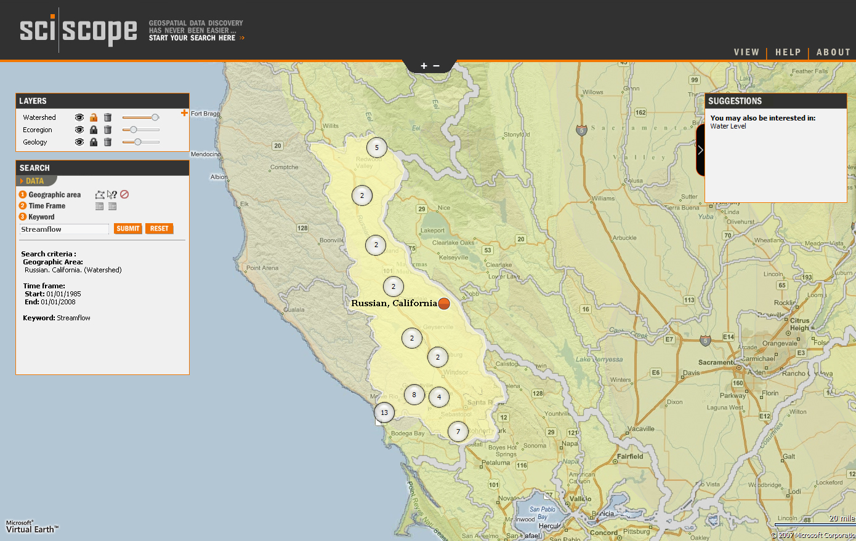
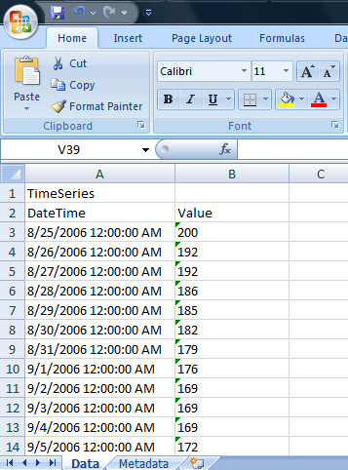
www.sciscope.org
Automated download
+ Download data
+ Add to favorites

Slide 9
SCISCOPE DEMO

Slide 10
SciScope Stack

Slide 11
Microsoft Virtual Earth
Geographical Features Catalog
A free JavaScript based mapping tool
Collection of features such as dams, aquifers, geologic formations, watersheds, sensors
Based on data and maps from USGS, EPA, National Atlas
Metadata Repository
Contains information on where, when (time frame) and what is being measured for about 1.7 million sites in the US
Scraped/crawled on a regular basis

Slide 12
Knowledge base
Relationships are stored as RDF triples in a relational database
Supports transitive, symmetric and inverse properties
Inferred statements are pre-computed
‘Escherichia coli’ = ‘E. coli’
‘E. coli’ is-a ‘Indicator Organism’
‘Nitrogen’ is-a ‘Macronutrient’
‘Macronutrient’ is-a ‘Nutrient’
‘Hypoxia’ isMeasuredUsing ‘DissolvedOxygen’
‘Hypoxia’ isRelatedTo ‘Eutrophication’

Slide 13
Inference
Transitive
‘Nitrogen’ is-a ‘Macronutrient’
‘Macronutrient’ is-a ‘Nutrient’
Inferred: ‘Nitrogen’ is-a ‘Nutrient’
Symmetric
‘Hypoxia’ isRelatedTo ‘Eutrophication’
Inferred: ‘Eutrophication’ isRelatedTo ‘Hypoxia’
Inverse
‘Macronutrient’ is-a ‘Nutrient’
Inferred: ‘Nutrient’ isBroaderThan ‘Macronutrient’

Slide 14
Definitions and related material
Definitions of search terms from various glossaries
Pointers to relevant records in Integrated Taxonomic Information System (ITIS) and EPA Substance Registry System (SRS).

Slide 15
Data retrieval
SciScope currently hosts only metadata.
Data are requested on the fly from the original publisher using web service wrappers written specifically for each data source.
Data are reformatted to provide a unified view over the repositories.

Slide 16
Future outlook & potential use cases
SciScope as a data publishing/sharing platform
SciScope as a service
SciScope as a tool for general consumer use

Slide 17
Thank you
www.sciscope.org

