Slide 1
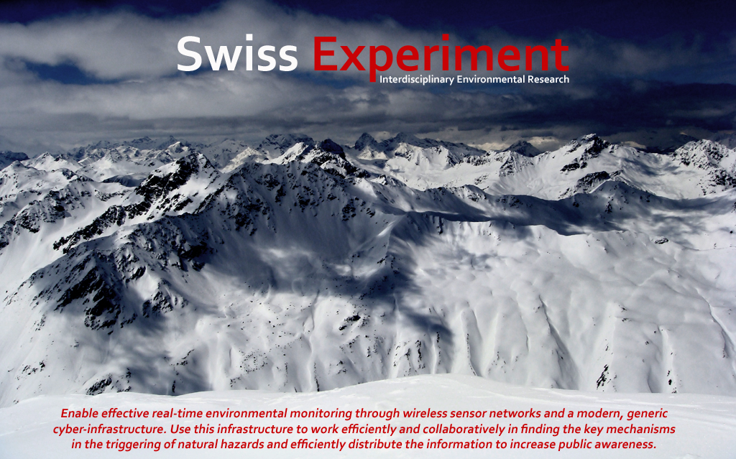
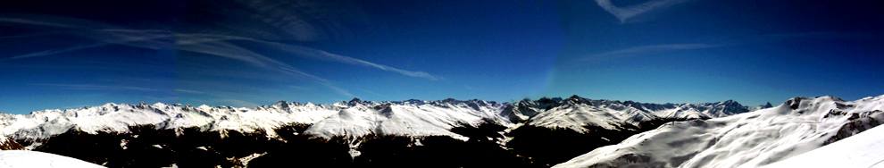
Querying and Visualizing Data Cubes in Mathematica for Environmental Science Applications
Anshul Jain, Yongluan Zhou, Karl Aberer, Sebastian Michel
Ecole Polytechnique Fédérale de Lausanne, Switzerland & University of Southern Denmark

Slide 2
Outline
What we do in Switzerland (short intro)
Motivation/Problem Statement
Our Approach
Review of used Technology
System Architecture
Example Usage
Some Plots
Conclusion

Slide 3
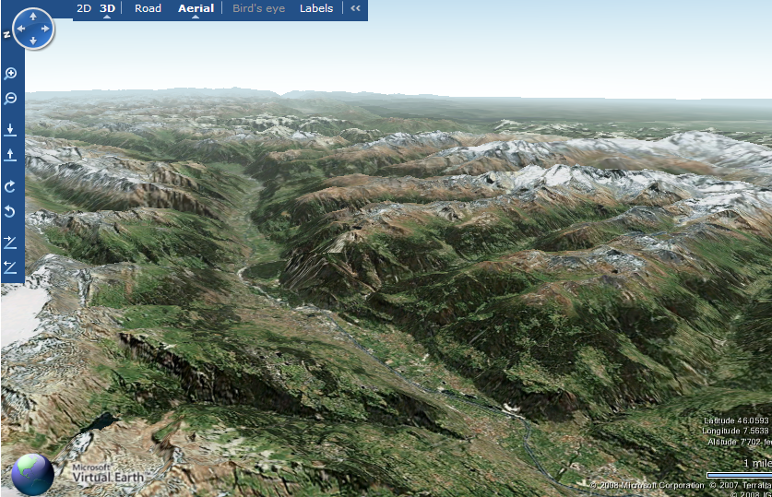
Swiss Experiment
Interdisciplinary Environmental Research
Swiss Experiment:
Provision of a generic infrastructure of:
web based technologies
wireless communications
low cost high density sensors
to serve the environmental science community
encourage collaboration
provide a portal for public information on environmental research
www.swiss-experiment.ch

Slide 4
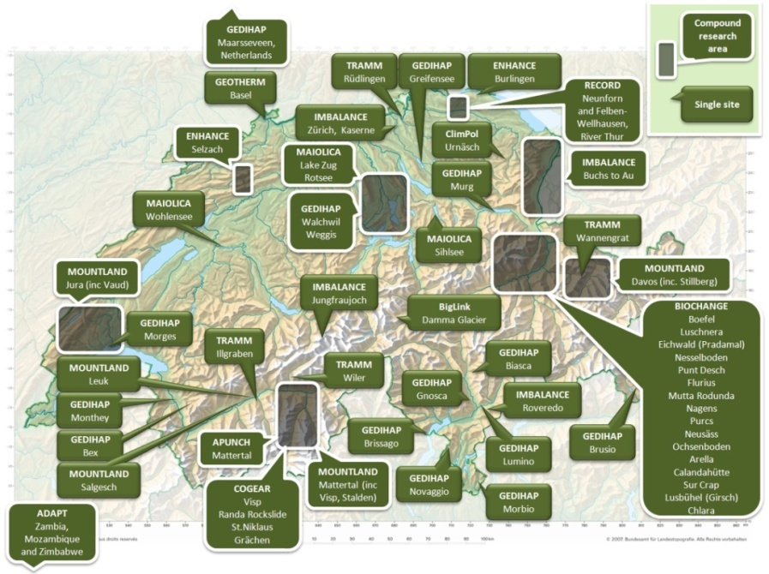
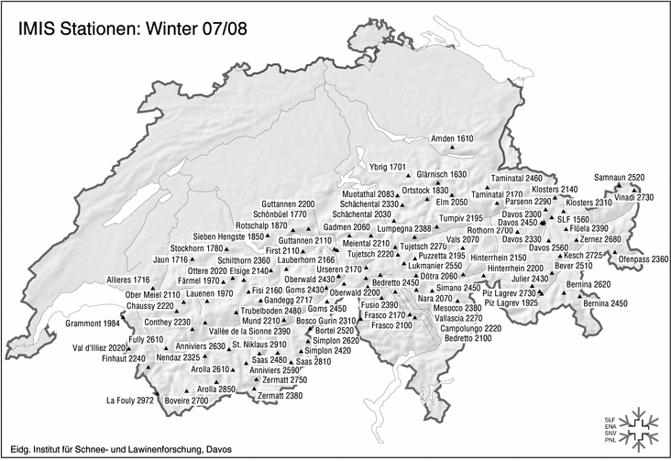
SwissEx Infrastructure
SwissEx infrastucture is built to serve many environmental research projects
Where experimental areas overlap, projects can work more efficiently by sharing data
Projects can benefit from external data sources

Slide 5
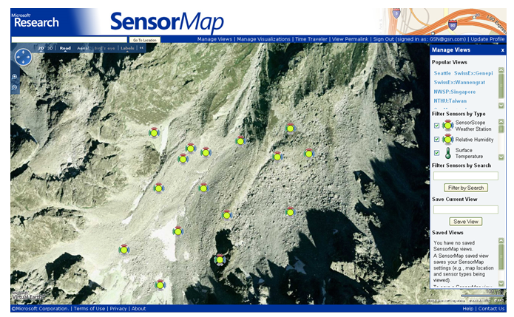
Example Deployment
Le Genepi Glacier, close to Martigny, Switzerland

Slide 6
Previous State
(Near) Future
Lack of communication
Information Sharing in online communities
Randomly distributed data files
Data repository with single access point
Data loss
No data loss
Loss of knowledge on data collection
Provenance tracking
Waste of resources replicating data collection
Data reuse
Small user community
Open access

Slide 7
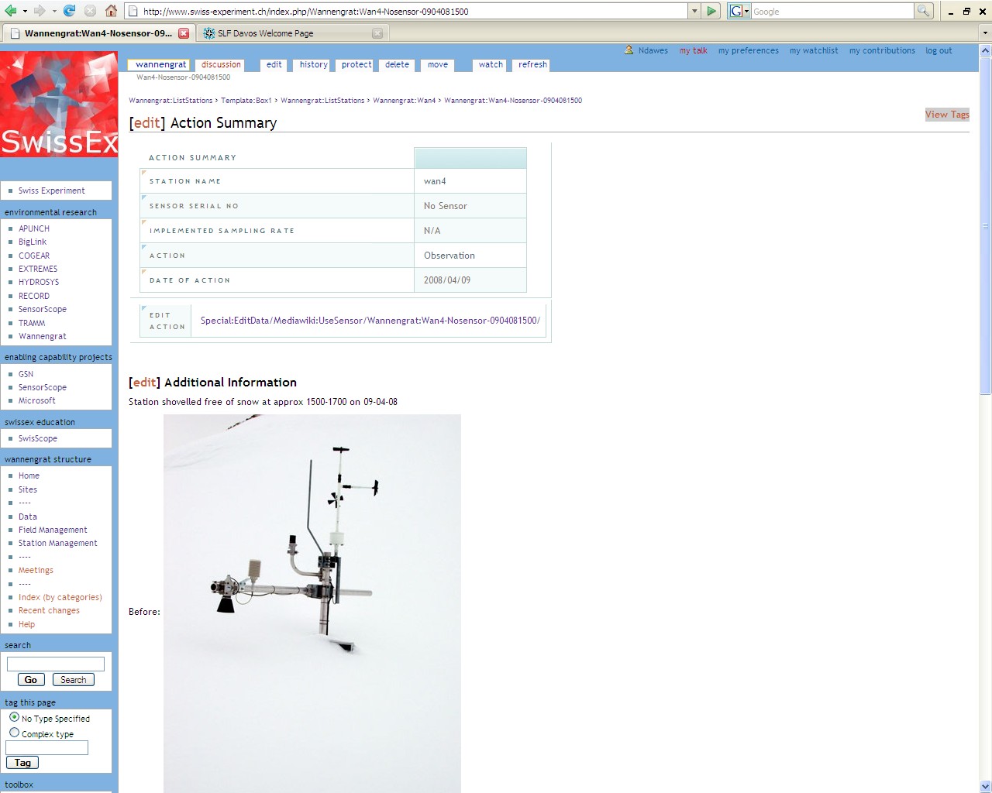
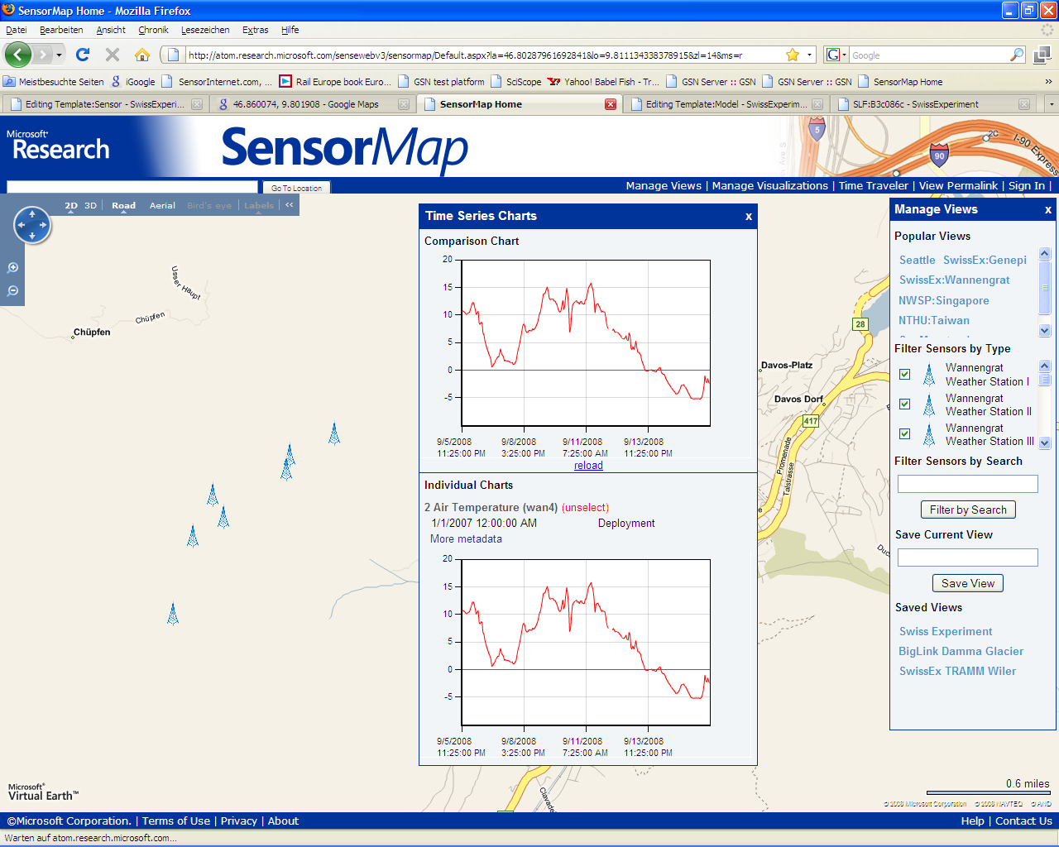
Visualization/Sharing/Metadata Capturing
Talk this Thursday afternoon @ eScience conference

Slide 8
Observations
Large amounts of data
Environmental scientists (avalanche research, hydrology, ....)
Scientists analyze data (statistics,....)
No time to learn new CS tools (science is what matters at the first place)
Scientists store data in relational DBs (SQL queries), or files

Slide 9
Using SQL ?
SELECT avg (val),avg (nod),mi
FROM
(SELECT d_value, n_id, dateadd
(minute,floor ( Datediff (minute,'20000101',d_time)/60)*60,' 20000101')
FROM mathTable
WHERE n_id=2 AND s_id = 1 ) as w(val,nod,mi)
WHERE (mi < SQLDateTime{2007,9,27,11,0,0} AND mi>=SQLDateTime{2007,9,27,10,0,0})
GROUP BY mi order by mi asc
SQL query for calculating smoothened (over 60 mins) AmbientTemperature value

Slide 10

Problem Statement / Wish list
Visualization of huge data sets (data sensed by sensor network over a long period)
Support of features which other front end tools lack for plotting graphs
Interaction with mathematical tools scientists use already

Slide 11
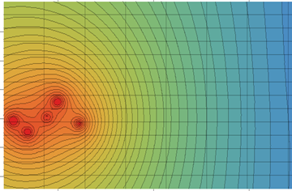
Approach
Create a data cube over the environmental data
Provide a Web service interface
Extend mathematical tools
query the cube (without learning MDX)
standard plots

Slide 12
Data Cubes
Quickly provide answers to analytical queries that are multi-dimensional in nature
Pre-calculation of data and storage cube form
Typical applications:
business reporting for sales
marketing
management reporting
budgeting and forecasting, financial reporting and similar areas
data mining in general

Slide 13
Technologies Used
Microsoft SQL server 2005 and Microsoft SQL Server Analysis Services
Microsoft Visual Studio 2008
Wolfram Mathematica 7
Microsoft Internet Information Services

Slide 14
Web Services
Web Service
In common usage the term refers to clients and servers that communicate using XML messages
Server will host the service
Any computer on the network can use the service
Messages follow the SOAP (Simple Object Access Protocol) standard
Machine-readable description of the operations offered by the service written in the Web Services Description Language (WSDL)
Drawback
Message size increases because of XML

Slide 15
Web Services and their Applications
Using Web services is supported in
tools like Mathematica and MATLAB
For plotting one graph:
amount of data transferred in our architecture is very small
E.g., ~2 Kilobytes of data is transferred for one plot from the analysis server to the client.

Slide 16
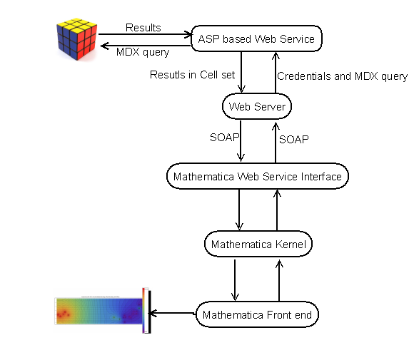
System Architecture

Slide 17
Database Schema

Slide 18
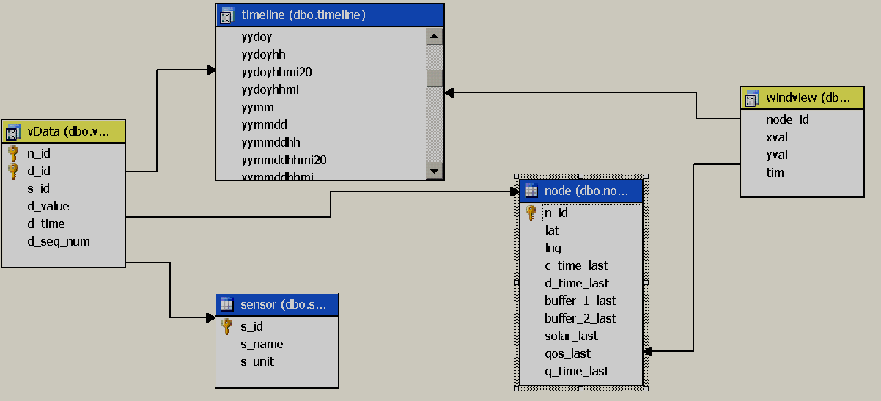
Data Cube Design

Slide 19
Steps for Plotting and Analysis
Install the Web service
Import Mathematica packages
Define data source
Define cube elements( dimensions, hierarchy, members on rows and columns) to be used
Define measure(e.g., average)
Generate the MDX query
Execute query using Web services
Parse the data(XML) returned by web service
Call the desired plotting function

Slide 20
MDX Query Generation
sensorID = "1";(*getting the ambient temperature*)
measure = "[measures].[sum]/[measures].[count]";(* This measure is for getting the average*)
cubeelements = {{"node","node",{"32","31", "29"}},
{"timeline","[yymmddhh]",{"2007-09-27 00","2007-09-27 01","2007-09-27 02","2007-09-27 03","2007-09-27 04","2007-09-27 05","2007-09-27 06","2007-09-27 07","2007-09-27 08","2007-09-27 09","2007-09-27 10","2007-09-27 11","2007-09-27 12","2007-09-27 13","2007-09-27 14","2007-09-27 15","2007-09-27 16","2007-09-27 17","2007-09-27 18","2007-09-27 19","2007-09-27 20","2007-09-27 21","2007-09-27 22","2007-09-27 23"}},
{"sensor","sensor",{sensorID}}} ;
datasource = "[stbernard]";
mdxquery = getQuery[datasource, measure, cubeelements];

Slide 21
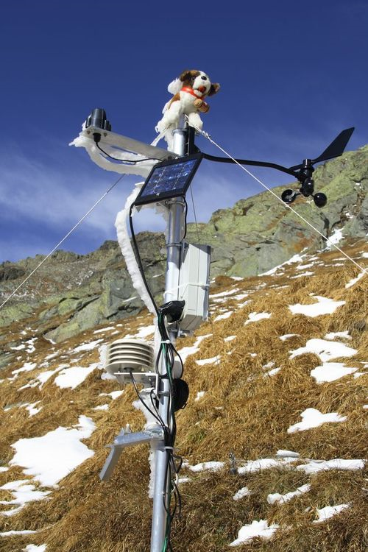
Parameters Monitored
Ambient temperature
Surface temperature
Solar radiation
Relative humidity
Soil moisture
Water mark
Rain meter
Wind speed
Wind direction
http://sensorscope.epfl.ch/

Slide 22
Calculations
Average Wind Speed
Sqrt[Average wind speed in North direction²+ Average wind speed in East direction²]
Sensible Heat Flux = -C_{h}ρc_{P}u(T_{air}-T_{sfc})
C_{h}: Heat transfer Coefficient
ρ:air density
c_{P}: Specific heat for dry air
u: wind speed
Contour plots
Inverse Distance Interpolation

Slide 23
Contour Plot

Slide 24
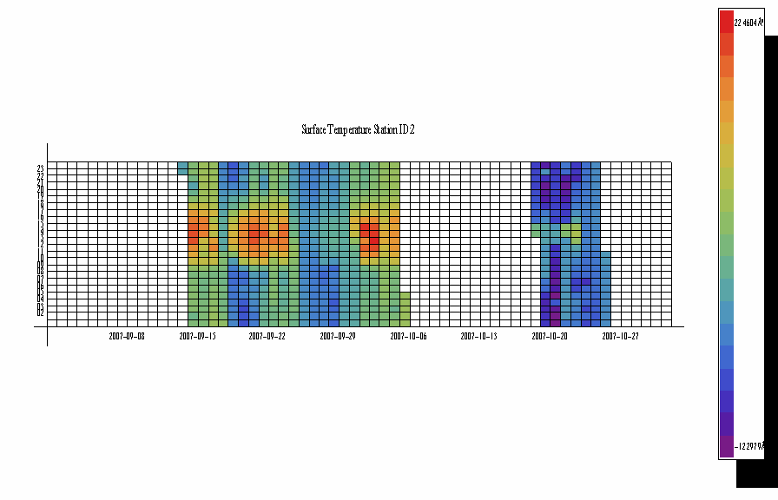
Phenomenon Plot

Slide 25
Scatter Plot

Slide 26
Wind Speed Plot

Slide 27
Sensible Heat Flux Plot

Slide 28
Conclusion
Web service interface between Mathematical tools and the data cube
Several visualization functions are provided in a package
Pre-calculation of certain aggregates for faster query execution and less data transfer
Automatic MDX query generation
Easy to install, easy to use

Slide 29
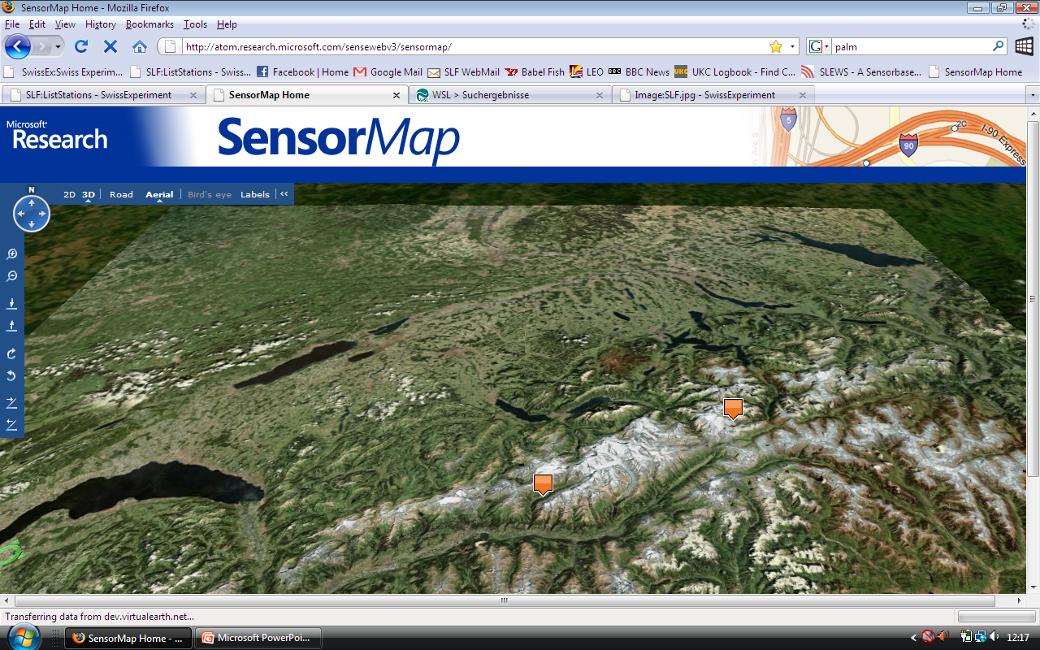
Swiss Experiment
Questions
Interdisciplinary Environmental Research

