Slide 1



Everything, that's going on around you!

Slide 2
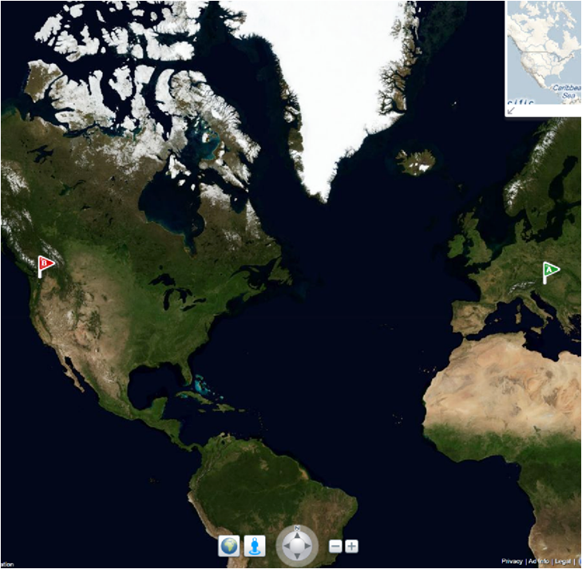
Cloud Computing Centre
University of Maribor under coverage of Science Park established the first Slovenian Cloud Computing Centre.
Next step of UM SOA Competence Centre
Important partners, such as Microsoft, Oracle and IBM.
Team
Tech
Solutions
Aims to transfer the knowledge and technologies from academic sphere to business and develop innovative solutions related to:
Cloud Computing
Service-oriented Architecture (SOA)
Offers:
Competitive unprofitable team of experts
Service oriented technology and private cloud
Solutions as “proof-of-concept
and technology”
Notes:
Hello, my name is actually Gregor Srdic, Matej is my colleague, who we thought at first would be replacing me here. Either way, we both work at University of Maribor in Slovenia and we are a part of cloud computing centre there. This centre, first of a kind in our country, was established in cooperation with industry-leading partners, such as Microsoft, IBM and Oracle. Its is aimed to transfer the knowledge and technologies between academic sphere and business, and to develop innovative solutions relative to service oriented architecture and cloud computing.
Besides researching and preparing our phds, me and my colleagues also assist at pre-graduate student programs and we wanted to motivate students by including the newest concepts of computer technology into our classes. As a practical part of one of the courses, students were given an assignment to write down a few ideas for practical use of cloud computing. We reviewed the ideas, selected a few of the most interesting ones and prepared high level architecture of the solutions. Students were then divided into several groups and each group implemented it’s individual part of functionality. At the end of semester we integrated partial solutions into the final applications. Project SkyInfo, which I am here to present, was one of these projects, and it showed enough potential that we decided to continue with its development even after the end of the course.

Slide 3

Problem
Large amount of data around us
Difficulty to extract relevant information
Short information validity
Information's significance depends on our current location
Notes:
The problem this project is referring to, is I’m sure well known to everybody. In today’s information society, every individual is overwhelmed with large amount of data, generated on every single step of his way. Most of this data carries no significant meaning and actually it only makes it harder for a person to find valuable information, he is looking for. As a lot of time is wasted on filtering this vast amount of data, much valuable information can already become obsolete by the time we discover it.

Slide 4
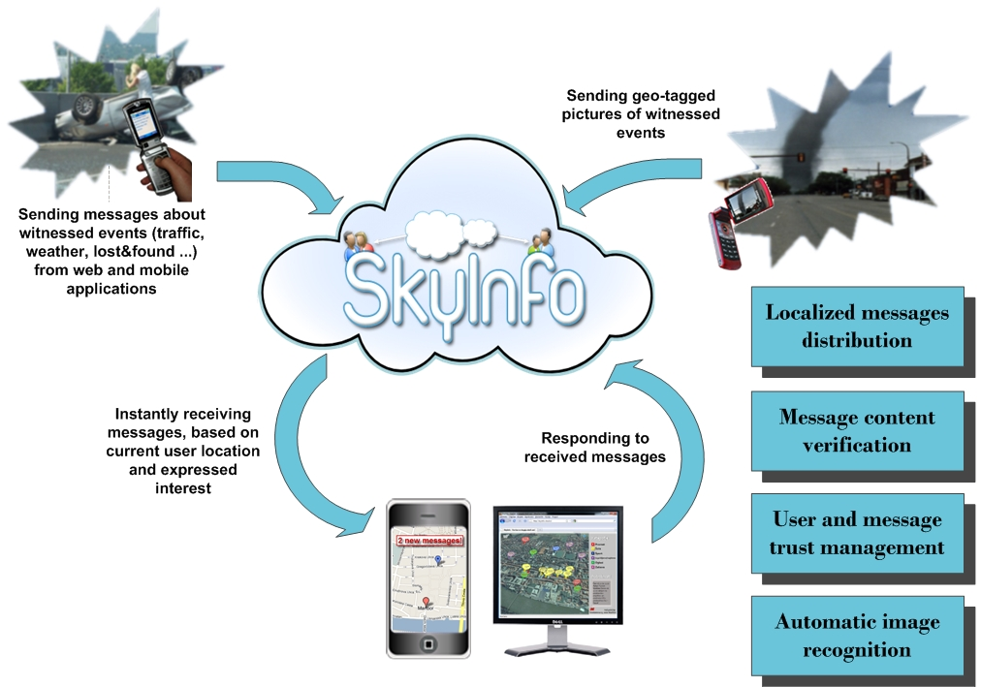
Notes:
To overcome this problems, we have decided to filter all available data in relation to individuals current location and expressed interest.
Therefore SkyInfo is designed to offer an intelligent anytime anywhere available information service, which provides users with relevant, localized and personalized information.
The idea is, that users on one side report about events in their proximity, either by submitting a message or a picture of the event (or even both).
On the other side they receive information about messages submitted by other users, based on their current position and subscriptions. Each subscription defines a category of messages to be retrieved, maximum distance from current location and maximum time validity of a message.
Considering this solution, we have encountered a few problems.
As many users can witness the same event, we have included an algorithm that will identify possible duplicates and treat them properly.
Another issue is managing user and message trust. If a certain user sends a few false messages, his integrity should obviously be questioned. For this purpose we have developed a rating system, based on users feedback. Users, who receive a certain message, can reply either by confirming or denying this message. Consequently authors and messages rating is updated, based on distance and time difference between original message and corresponding feedback.

Slide 5



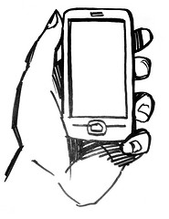



SkyInfo in action
Notes:
Possible use cases of our application include reporting of traffic accidents, jams and other traffic information, warning about approaching weather conditions, reporting lost and found objects, localized advertising, etcetera …
Let’s take a look at one of these scenarios.
Mary is walking in the park on a sunny afternoon.
She notices a sad puppy that got lost.
She takes a picture and sends it to SkyInfo.
Puppies owner, who is already searching for him nearby, is luckily also using SkyInfo and he instantly receives a message.
Thanks to SkyInfo puppy and his master are joined back together and happy once again.

Slide 6
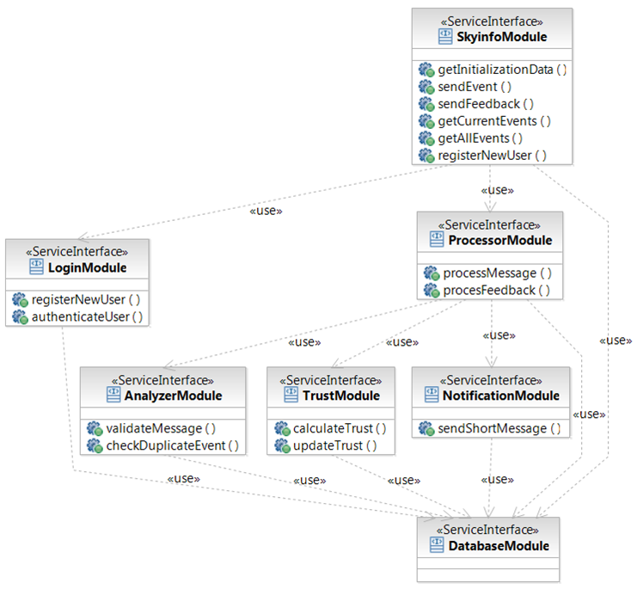
High level architecture
Notes:
This is the high level architecture of the solution. We have decomposed main application into several modules to enable loose coupling of it’s components. Later, we have implemented each of this components using web service technology.

Slide 7
Message distribution
To send a message, user has to:
Provide description of the event
Select appropriate category
Client automatically determines users location
Messages are delivered to users mobile client, which continuously reports his position to the system
Urgent messages are delivered through SMS
Notes:
With SkyInfo, we have tried to develop an innovative approach to exchanging data about occurred events. Besides considering location and time frame, our goal was to simplify process of submitting and receiving messages. To submit a message, user only has to fill out description and select appropriate category. Client automatically adds location, which is retrieved from internal or external gps or other available methods.
Messages are then distributed back to mobile clients, which continuously report their location to the system and retrieve new messages.
At the request of the user, messages from categories marked as urgent, can also be send directly to users mobile device via short messaging.

Slide 8
Extracting message from picture
User sends geo-tagged picture (web service, e-mail, mms)
System extracts location from the picture
Picture is classified using human resources in the cloud
Notes:
Besides sending messages, which to me already seems to be as simple as it could possibly be, we have developed another innovative approach to exchanging data about events, even faster and more efficient. Instead of a complete message, users can submit only a picture that includes geo-tag. Many mobile phones and cameras nowadays support this feature. Picture can either be submitted to a web service or sent through e-mail or multimedia messaging account. System then extracts location from the picture and classifies it into one of available categories using amazon’s service called Mechanical Turk, which provides programming interface for creating human tasks that are available online for any user to work on.

Slide 9
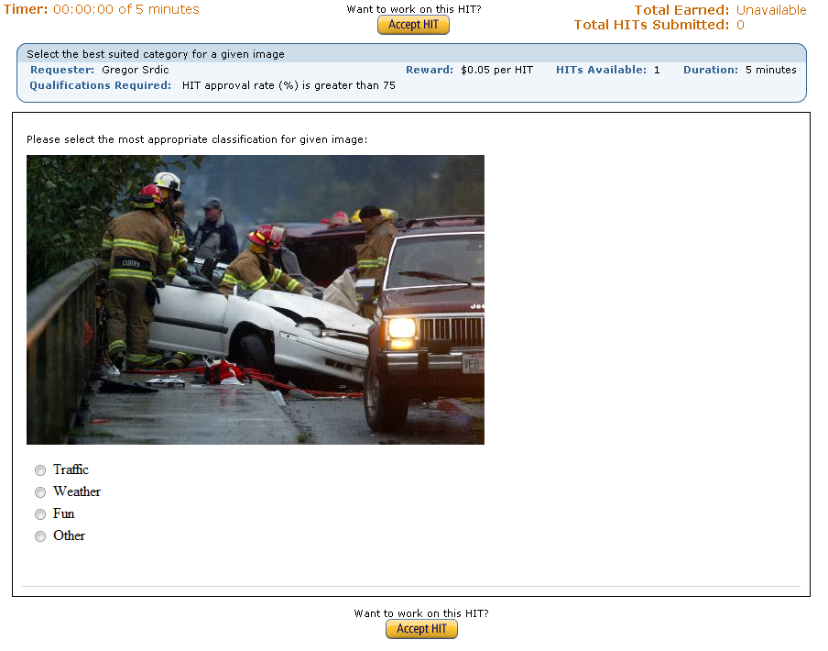
Notes:
Here is an example of such a task, created by our system. This task is designed for let’s call it “semi-automatic” image classification using human resources in the cloud. In my opinion, this is a very interesting and effective alternative to complex computer algorithms, as to humans this task is much more trivial than to computers.

Slide 10
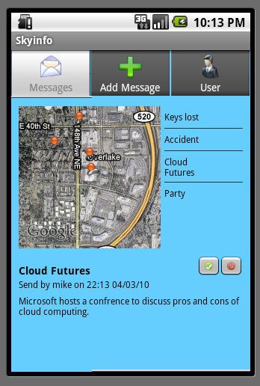
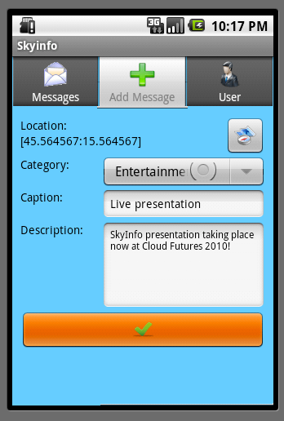
SkyInfo Mobile Client
Notes:
SkyInfo is still work in progress. So far we have build a first version of core web services for distributing messages and prototypes of web and mobile clients.
As we aim to distribute messages to users anytime anywhere, our main concern is building an attractive, efficient and user-friendly clients for smart mobile devices. Here we have two screenshots of SkyInfo mobile client prototype, build for Android platform and we are planning to build another one for Windows Mobile platform. On the first screenshot you can see presentation of current user messages on a map on the left and in a list on the right. When user selects a specific message, its details are displayed in the area bellow. User can also respond to received message by submitting his feedback. The other screenshot displays a form for adding new messages, where user selects appropriate category, enters caption and description and submits the message to our service.

Slide 11
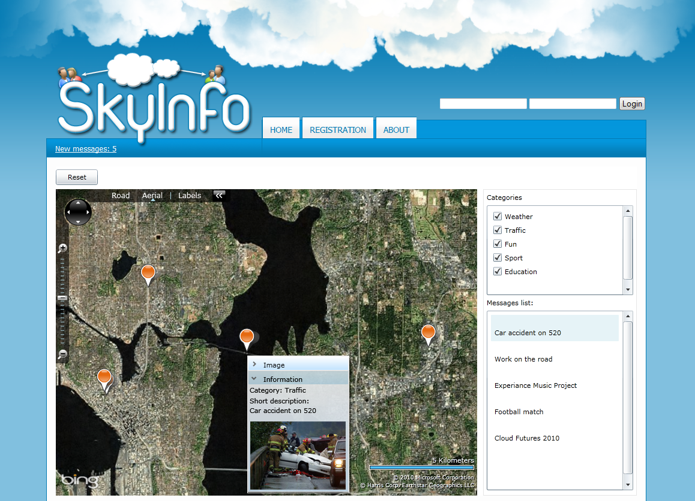

SkyInfo Web Application
Notes:
For comfortable and more comprehensive browsing through messages as well as for managing user profile and subscriptions, we have also designed and developed a SkyInfo Web Application, which is built with Microsoft Silverlight technology. On the slide there is a screenshot of developed prototype, where on the main screen we have a map, where all current messages are displayed. User can view details of a message either by clicking the marker on the map or message in the message list. User can also subscribe to or unsubscribe from receiving messages belonging to certain categories and define distance, time and rating parameters for his subscriptions.

Slide 12










Technology integration challenges
Notes:
SkyInfo is designed to integrate many different technologies. For this purpose, we have used web services, which provide us with a bridge between different platforms. Core SkyInfo services are build in java and are running on WebSphere application server. These services then use several supporting services, build in .net technology and running on IIS (Internet Information Services) server. We have also included a service using Windows Azure and other .net services could easily be transferred there as well.
Solution for human resources in the cloud is provided by Amazon and exposed as a java programming interface.
As already mentioned, clients could be developed using any technology, capable of consuming web services. For web client we have chosen Silverlight and for mobile clients we choose Windows Mobile and Android platforms.
Our system also heavily depends on mapping services which are provided by bing and google maps.

Slide 13
Key contributions
Linking relevant information and events with location and user interest, which leads to quickest access to desired information
Innovative approach to exchanging data about occurred events
Notes:
If we look at the key contributions of our project, we believe that linking relevant information and events with location and user interest leads to quickest access to desired information, while extracting messages from pictures provides innovative and simplified approach to submitting messages.

Slide 14
Summary
What it is SkyInfo all about?
SkyInfo is a framework for sharing information in structured and personalized manner
Therefore it is useful for general public
Cloud Technology ensures: access, computing power for statistic analysis, integration, hardware and software independence
It can also be used as a SaaS for organizations
Notes:
To wrap up, I would like to stress once again what SkyInfo is all about. SkyInfo is essentially a framework for sharing information in structured and personalized manner. Therefore our wish is to attract general public to use it as a preferred way of communication. SkyInfo could also be distributed as software-as-a-service to advertising companies and other organization that have a need for a private information service.

Slide 15
Thank you for listening!
gregor.srdic@cloud.si

