Slide 1

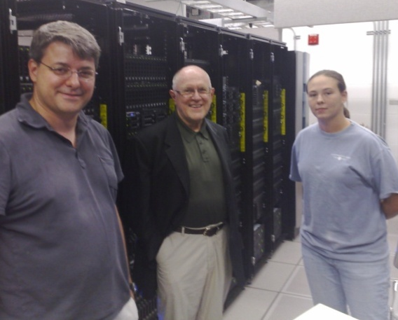
Petascale Data Intensive Computing for eScience
Alex Szalay, Maria Nieto-Santisteban,
Ani Thakar, Jan Vandenberg,
Alainna Wonders, Gordon Bell, Dan Fay, Tony Hey, Catherine Van Ingen, Jim Heasley

Slide 2
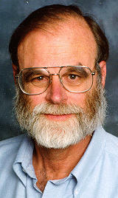
Gray’s Laws of Data Engineering
Jim Gray:
Scientific computing is increasingly revolving around data
Need scale-out solution for analysis
Take the analysis to the data!
Start with “20 queries”
Go from “working to working”
DISSC: Data Intensive Scalable Scientific Computing

Slide 3
Amdahl’s Laws
Gene Amdahl (1965): Laws for a balanced system
Parallelism: max speedup is S/(S+P)
One bit of IO/sec per instruction/sec (BW)
One byte of memory per one instr/sec (MEM)
One IO per 50,000 instructions (IO)
Modern multi-core systems move farther away
from Amdahl’s Laws (Bell, Gray and Szalay 2006)
For a Blue Gene the BW=0.001, MEM=0.12.
For the JHU GrayWulf cluster BW=0.5, MEM=1.04

Slide 4
Typical Amdahl Numbers

Slide 5
Commonalities of DISSC
Huge amounts of data, aggregates needed
  Also we must keep raw data
  Need for parallelism
Requests benefit from indexing
Very few predefined query patterns
  Everything goes…. search for the unknown!!
  Rapidly extract small subsets of large data sets
  Geospatial everywhere
Limited by sequential IO
Fits DB quite well, but no need for transactions
Simulations generate even more data

Slide 6
Total GrayWulf Hardware
46 servers with 416 cores
1PB+ disk space
1.1TB total memory
Cost <$700K

Slide 7
Data Layout
7.6TB database partitioned 4-ways
  4 data files (D1..D4), 4 log files (L1..L4)
Replicated twice to each server (2x12)
  IB copy at 400MB/s over 4 threads
Files interleaved across controllers
Only one data file per volume
All servers linked to head node
Distributed Partitioned Views
 |  | GW01
ctrl | vol | 82P | 82Q
1 | E | D1 | L4
1 | F | D2 | L3
1 | G | L1 | D4
1 | I | L2 | D3
2 | J | D4 | L1
2 | K | D3 | L2
2 | L | L3 | D2
2 | M | L4 | D1

Slide 8
Software Used
Windows Server 2008 Enterprise Edition
SQL Server 2008 Enterprise RTM
SQLIO test suite
PerfMon + SQL Performance Counters
Built in Monitoring Data Warehouse
SQL batch scripts for testing
DPV for looking at results

Slide 9
Performance Tests
Low level SQLIO
  Measure the “speed of light”
  Aggregate and per volume tests (R, some W)
Simple queries
  How does SQL Server perform on large scans
Porting a real-life astronomy problem
  Finding time series of quasars
  Complex workflow with billions of objects
  Well suited for parallelism

Slide 10
SQLIO Aggregate (12 nodes)

Slide 11
Aggregate IO Per Volume

Slide 12
IO Per Disk (Node/Volume)
2 ctrl volume
Test file on inner tracks,
plus 4K block format

Slide 13
Astronomy Application Data
SDSS Stripe82 (time-domain) x 24
  300 square degrees, multiple scans (~100)
  (7.6TB data volume) x 24 = 182.4TB
  (851M object detections)x24 = 20.4B objects
  70 tables with additional info
Very little existing indexing
Precursor to similar, but much bigger data from Pan-STARRS (2009) & LSST(2014)

Slide 14
Simple SQL Query
Harmonic Arithmetic
12,109 MB/s 12,081

Slide 15
Finding QSO Time-Series
Goal: Find QSO candidates in the SDSS Stripe82 data and study their temporal behavior
Unprecedented sample size (1.14M time series)!
Find matching detections (100+) from positions
Build table of detections collected /sorted by the common coadd object for fast analyses
Extract/add timing information from Field table
Original script written by Brian Yanny (FNAL)
and Gordon Richards (Drexel)
Ran in 13 days in the SDSS database at FNAL

Slide 16
CrossMatch Workflow
PhotoObjAll
Field
coadd
10 min
filter
filter
zone1
zone2
join
xmatch
2 min
1 min
neighbors
Match

Slide 17
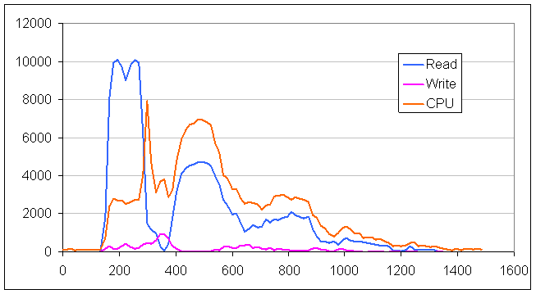
Xmatch Perf Counters

Slide 18
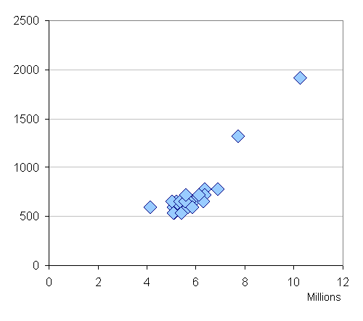
Crossmatch Results
Partition the queries spatially
  Each server gets part of sky
Runs in ~13 minutes!
Nice scaling behavior
Resulting data indexed
Very fast posterior analysis
  Aggregates in
  seconds over
  0.5B detections
Time [s]
Objects [M]

Slide 19
Conclusions
Demonstrated large scale computations involving ~200TB of DB data
DB speeds close to “speed of light” (72%)
Scale-out over SQL Server cluster
Aggregate I/O over 12 nodes
  17GB/s for raw IO, 12.5GB/s with SQL
Very cost efficient: $10K/(GB/s)
Excellent Amdahl number >0.5

Slide 20
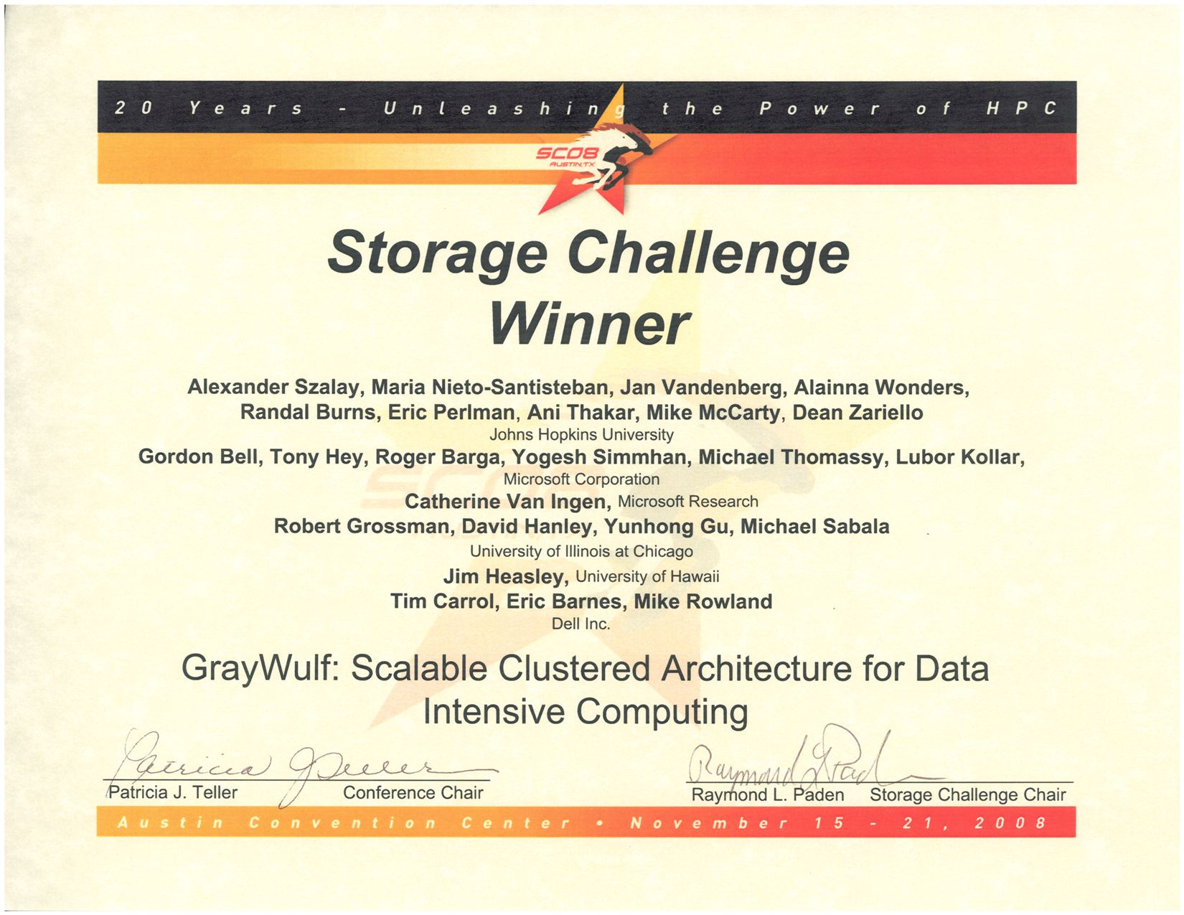

Slide 21




Slide 22
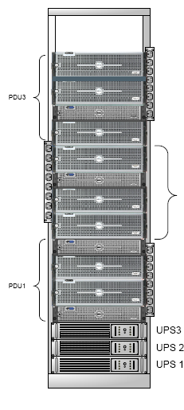
Test Hardware Layout
Dell 2950 servers
  8 cores, 16GB memory
  2xPERC/6 disk controller
  2x(MD1000 + 15x750GB SATA)
  SilverStorm IB controller (20Gbits/s)
12 units= (4 per rack)x3
1xDell R900 (head-node)
QLogic SilverStorm 9240
  (288 port IB switch)

