Slide 1
eScience
Supporting Data-Intensive Research with Client + Cloud
Tony Hey
Corporate Vice President
Microsoft Research

Slide 2
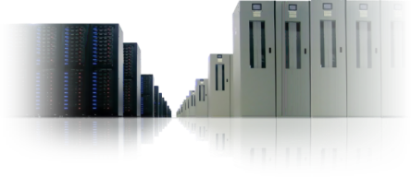
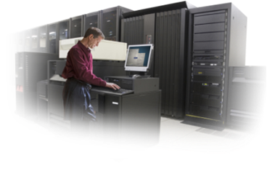


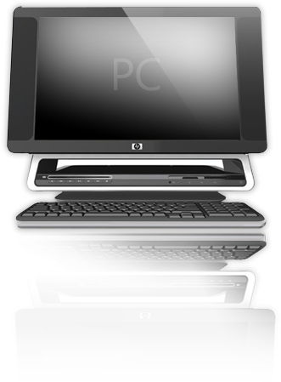
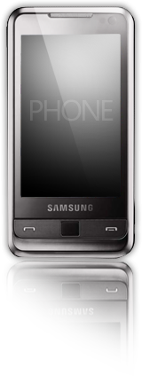
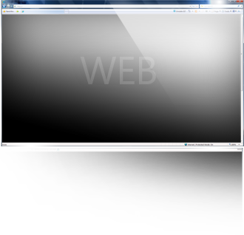
Vision
Create seamless experiences
that combine the magic of software
with the power of the Internet
across a world of devices

Slide 3
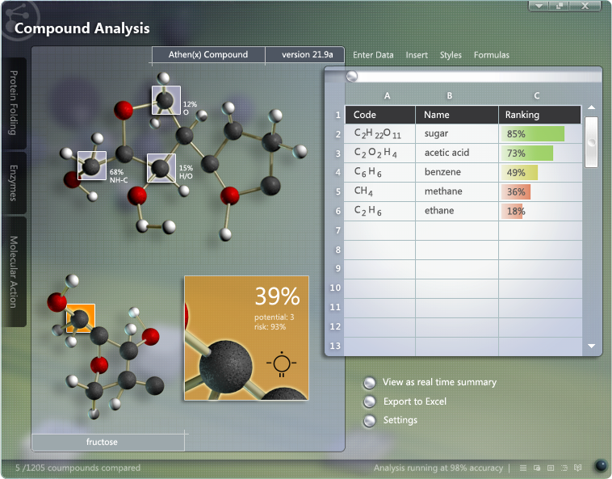
Big eScience Challenges
Limits to Moore’s Law
Massive data sets
Complex systems
Collaboration
Notes:
Tony hey- HPC and Office, Robotics – escience- Robotics
F#425-299-8092
Algorythms -

Slide 4

A Sea Change in Computing
Massive Data Sets
Federation, Integration, Collaboration
There will be more scientific
data generated in the next
five years than in the history of
humankind
Evolution of Many-core and
Multicore
Parallelism everywhere
What will you do with
100 times more
computing power?
The power of the
Client + Cloud
Access Anywhere, Any Time
Distributed, loosely-coupled,
applications at scale
across all devices
will be the norm
Notes:
THE DATA DELUGE. There will be more scientific data collected in the next five years than there has been in the history of human kind.
Data aggregation, filtering, analysis, visualization, etc. is empowering science. Multidisciplinary approaches to science, with computing as a core enabler, is imperative.
SOCIAL COMPUTING FOR SCIENTIFIC DISCOVERY. Collaboration and integration of data sets has never been more important.
All disciplines are amassing huge data sets. We need to move form data to knowledge. In order to do so, infrastructures and computing tools that allow researchers to collaborate and explore common data is crucial.
Advances in science and computing occurs through communities working as a team with massive aggregated data; not as individuals with a narrow view of their own data. It is as much about sociology as is it technological.
CONCRRENCY, COMPLEXITY, COMPOSIBILITY. There is a fundamental need to change the way we program computers. Many core / multi-core computing requires exploration of “Concurrency, Complexity, and Composibility”
Concurrency and complexity are the challenge; ‘composibility’ can be the solution.
Formal composition is required for components to plug together.
CLOUD + CLIENT. As computing chip power advances for both the servers and the client, applications need to take advantage of the integrated, balance of the capabilities. What will you do with 100 times more computing power? What are the new class of applications that will take advantage of the capabilities of Cloud + Client?
Developing for distributed, concurrent systems is the norm. The power is in Cloud + Client.
Highly distributed computing at any scale across all devices

Slide 5
The Fourth Paradigm:
Data-Intensive Science

Slide 6
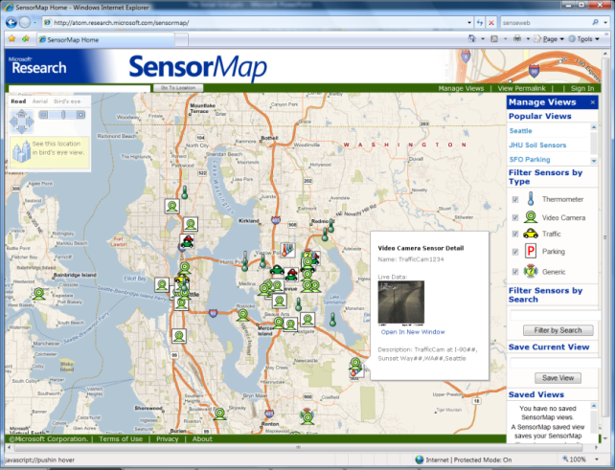
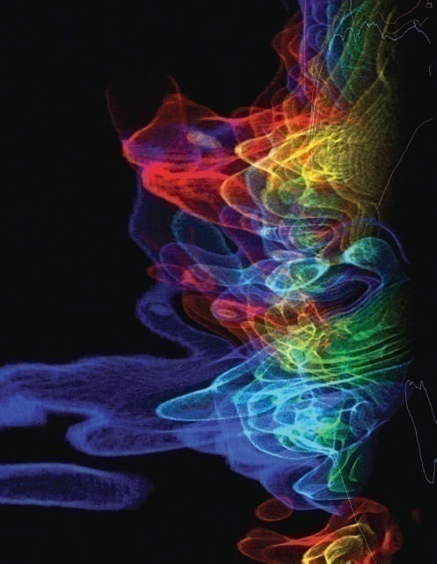
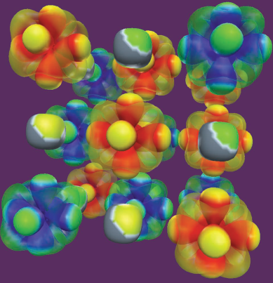
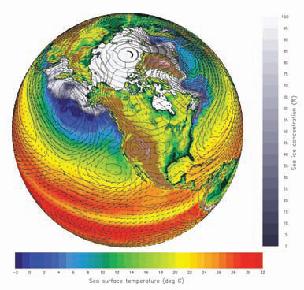
A Digital Data Deluge in Research
Data collection
  Sensor networks, satellite surveys, high throughput laboratory instruments, observation devices, supercomputers, LHC …
Data processing, analysis, visualization
  Legacy codes, workflows, data mining, indexing, searching, graphics …
Archiving
  Digital repositories, libraries, preservation, …
SensorMap
  Functionality: Map navigation
  Data: sensor-generated temperature, video camera feed, traffic feeds, etc.
Scientific visualizations
  NSF Cyberinfrastructure report, March 2007

Slide 7
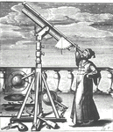
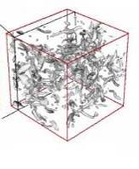
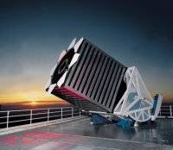

Emergence of a Fourth Research Paradigm
Thousand years ago – Experimental Science
  Description of natural phenomena
Last few hundred years – Theoretical Science
  Newton’s Laws, Maxwell’s Equations…
Last few decades – Computational Science
  Simulation of complex phenomena
Today – Data-Intensive Science
  Scientists overwhelmed with data sets
  from many different sources
    Data captured by instruments
    Data generated by simulations
    Data generated by sensor networks
  eScience is the set of tools and technologies
  to support data federation and collaboration
    For analysis and data mining
    For data visualization and exploration
    For scholarly communication and dissemination
(With thanks to Jim Gray)

Slide 8





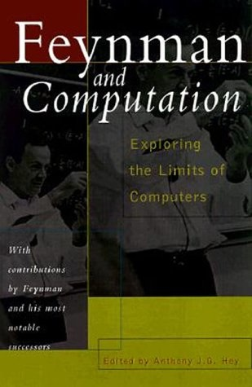

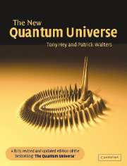
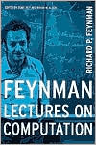




Tony Hey – My Background
Notes:
1970: D.Phil. in Theoretical Physics, Oxford, UK
Research at Caltech, CERN, MIT and IBM Research
1974 -1985: Professor in Physics at Southampton
1985 – 1999: Professor of Parallel Computing in Electronics and Computer Science at Southampton
1994 – 1999: Head of Electronics and Computer Science
1999 – 2001: Dean of Engineering
1996 – 2001: Director of Southampton Innovations Ltd.
2001 – 2005: Director of UK e-Science Program for the UK Office of Science and Technology
2005 – present: Corporate Vice President for Microsoft External Research

Slide 9
The Open Science Agenda
eScience 2.0

Slide 10
eScience 1.0
In 2001, distributed computing technologies for eScience were in transition
  Distributed authentication
  CORBA and Web Services
Over-emphasis on computation rather than data
  Computational Grids difficult to use and too complex
  Most communities do not want to install 100,000’s of lines of code before they can do anything
  Grid standards not supported by industry

Slide 11
Tim O’Reilly and Web 2.0 (2004)
Web 1.0 -> Web 2.0
DoubleClick-->Google AdSense
Ofoto-->Flickr
Akamai-->BitTorrent
mp3.com-->Napster
Britannica Online-->Wikipedia
personal websites-->blogging
evite-->upcoming.org and EVDB
domain name speculation-->search engine optimization
page views-->cost per click
screen scraping-->web services
publishing-->participation
content management systems-->wikis
directories (taxonomy)-->tagging ("folksonomy")
stickiness-->syndication

Slide 12
David De Roure’s “Research 2.0”
Decreasing cost of entry for digital research
It’s about Data – workflows, provenance, ontologies and e-Notebooks
Collaborative and participatory – blogs, wikis …
Network efforts and community intelligence
Open research – open systems and software tools
Researchers adopt tools that are better but not perfect
Tools that empower – bottom-up approach
Blurring of lines between digital and physical world

Slide 13
eScience 2.0
Use Web 2.0 and the Web as a Platform
  Simple protocols supported by industry
  Blogs, Wikis, RSS feeds, Tagging, Mash-ups …
Challenge for Computer Science community and the IT industry to deliver powerful and easy-to-use tools and technologies to support Data-Intensive research
  Interoperability and open standards
  Collaborative and multidisciplinary
  Parallelism and Multicore
  Client + Cloud: Software + Services

Slide 14


Open Science
Open access
Open source
Open data
“In order to help catalyze and facilitate
the growth of advanced CI, a critical
component is the adoption of open access
policy for data, publications and software.”
NSF Advisory Committee on
Cyberinfrastructure (ACCI)
Microsoft Interoperability Principles
  Open Connections to Microsoft Products
  Support for Standards
  Data Portability
  Open Engagement
http://www.microsoft.com/interop/

Slide 15

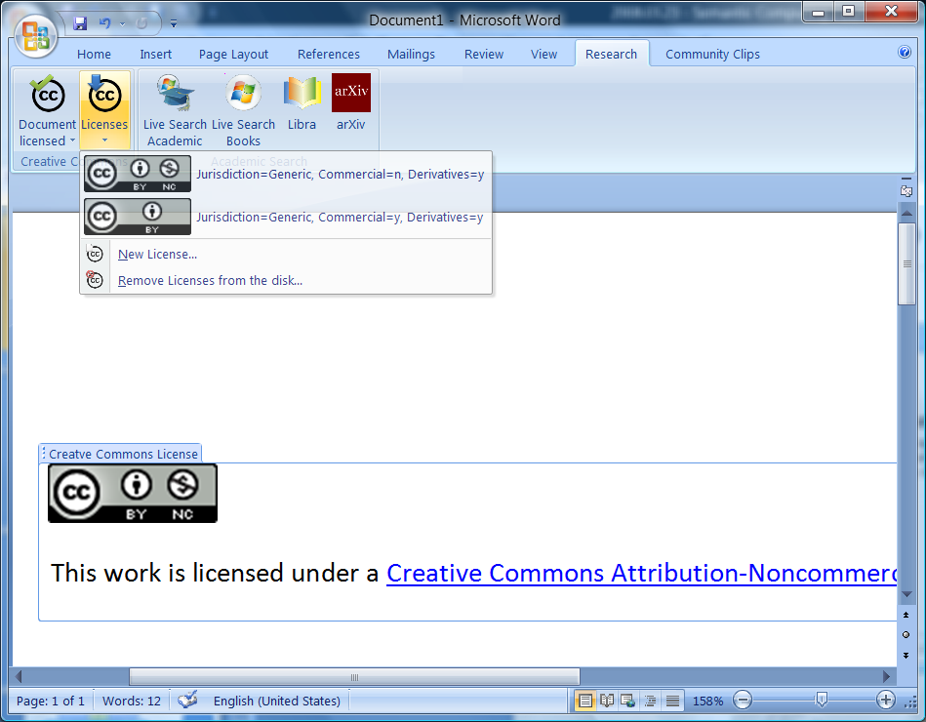
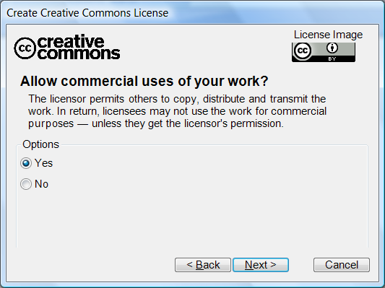
Creative Commons Add-in for Office 2007
Integration with the Creative Commons Web API so that new licenses can be created
Insert Creative Commons licenses from any Office 2007 application
Incorporate license information in the OOXML so that the license can be read even without Office installed

Slide 16
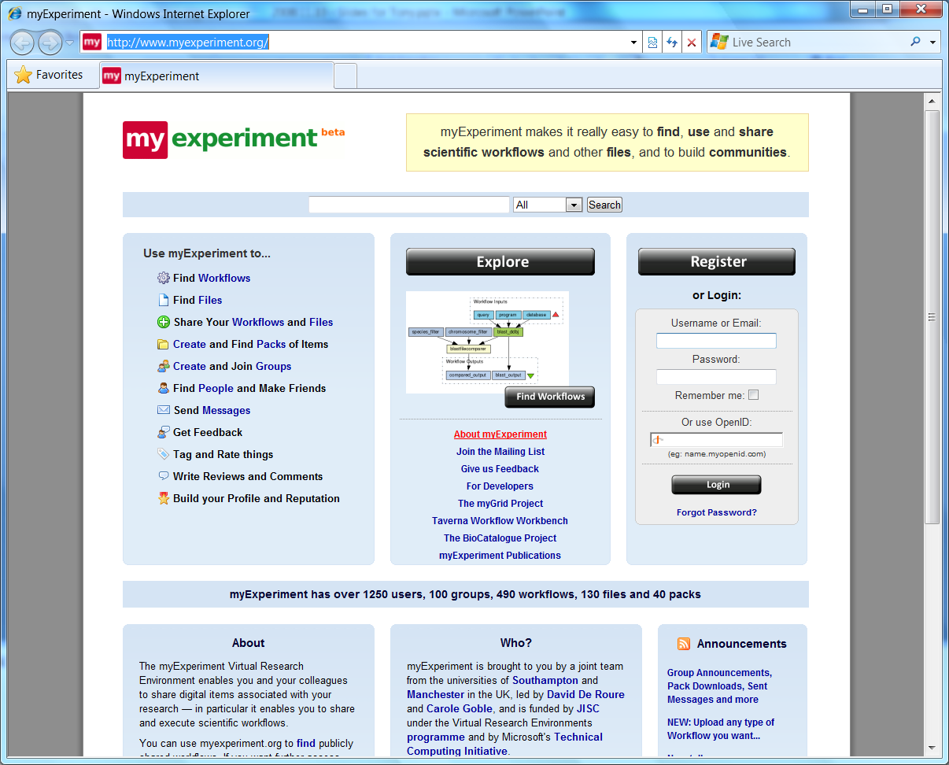
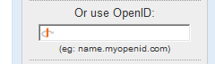
Live ID as an OpenID Provider
What does this mean?
You go to a great web site
It supports OpenID
No need to create/manage yet another account
You can now use Live ID to authenticate

Slide 17
Supporting researchers worldwide
The Research Lifecycle

Slide 18

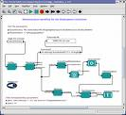
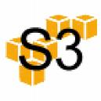








Research Pipeline
Data Acquisition and Modeling
Collaboration and Visualization
Analysis and Data Mining
Disseminate and Share
Archiving and Preservation
Data Acquisition and Modeling
  Data capture from source, cleaning, storage, etc.
  SQL Server, SSIS, Windows WF
Support Collaboration
  Allow researchers to work together, share context, facilitate interactions
  SharePoint Server, One Note 2007 (shared)
Data Analysis, Modeling, and Visualization
  Mining techniques (OLAP, cubes) and visual analytics
  SQL Analysis Services, BI, Excel, Optima, SILK (MSR-A)
Disseminate and Share Research Outputs
  Publish, Present, Blog, Review and Rate
  Word, PowerPoint
Archiving
  Published literature, reference data, curated data, etc.
  SQL Server
Microsoft has technologies that can offer end-to-end support

Slide 19
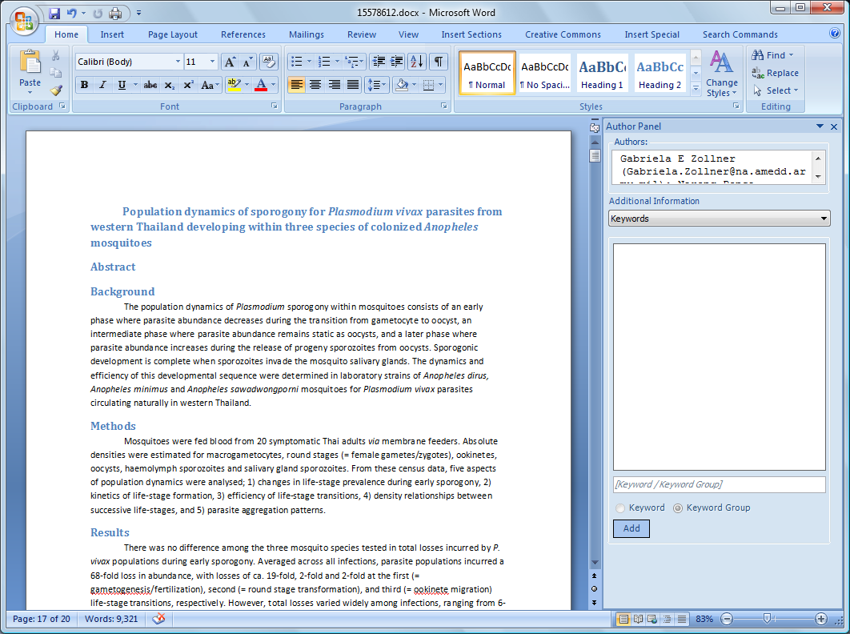
Data Acquisition & Modeling
Collaboration and Visualization
Analysis and Data Mining
Disseminate & Share
Archiving and Preservation
Article Authoring Add-in for Word 2007

Slide 20
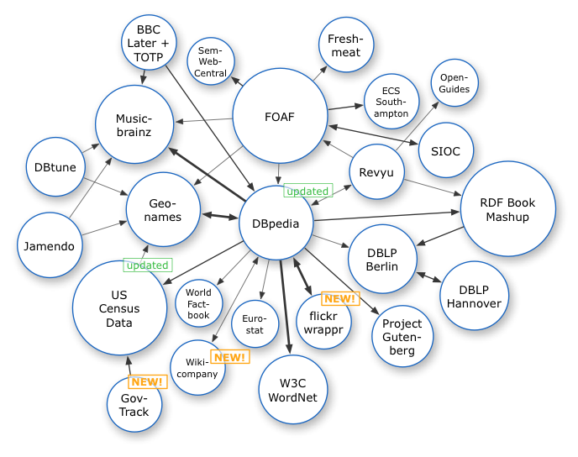
Data Acquisition and Modeling
Collaboration and Visualization
Analysis and Data Mining
Disseminate and Share
Archiving and Preservation
Semantic Annotations in Word
Phil Bourne and Lynn Fink, UCSD
Goals
Semantic mark-up using ontologies and controlled vocabularies
Facilitate/automate referencing to PDB (and other resources) from manuscript
Conversion of manuscript to NLM DTD for direct submission to publisher
Scenario
Authors do not need to be aware of the use of semantic technologies
A domain-specific ontology is downloaded and made available from within Microsoft Word 2007
Authors can record their intention, the meaning of the terms they use based on their community’s agreed vocabulary
Attribution: Richard Cyganiak

Slide 21
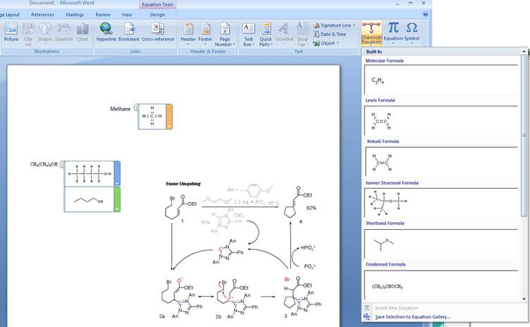
Data Acquisition and Modeling
Collaboration and Visualization
Analysis and Data Mining
Disseminate and Share
Archiving and Preservation
Chemistry Drawing for Office
Peter Murray Rust, Univ. of Cambridge
Murray Sargent, Office
Geraldine Wade, Advanced Reading Technologies
Goals
Support students/researchers in simple chemistry structure authoring/editing
Enable ecosystem of tools around lifecycle of chemistry-related scholarly works
Support the Chemistry Markup Language
Proof of concept plug-in
Execution
MSR Developer to work on the proof of concept
Post-doc in Cambridge to use plug-in and give feedback and move their chemistry tools to .NET and Office
Advanced Reading Technologies to create necessary glyphs

Slide 22


Data Acquisition & Modeling
Collaboration and Visualization
Analysis and Data Mining
Disseminate & Share
Archiving and Preservation
“GenePattern for Word 2007”
Reproducible Research with
Broad Institute @ MIT
Goals
Integrate data and images from GenePattern workflows into research papers. Allow for research reproducibility by combining data with the text
Demonstrate OpenXML and Office 2007 technologies and break new research ground with the integration of data & workflows with research papers
Project Status
Currently in final phase of testing; moving into production in 2008
Testing/linkage to other labs – will move beyond initial installation at Broad/MIT
Code to be made available on http://www.codeplex.com

Slide 23
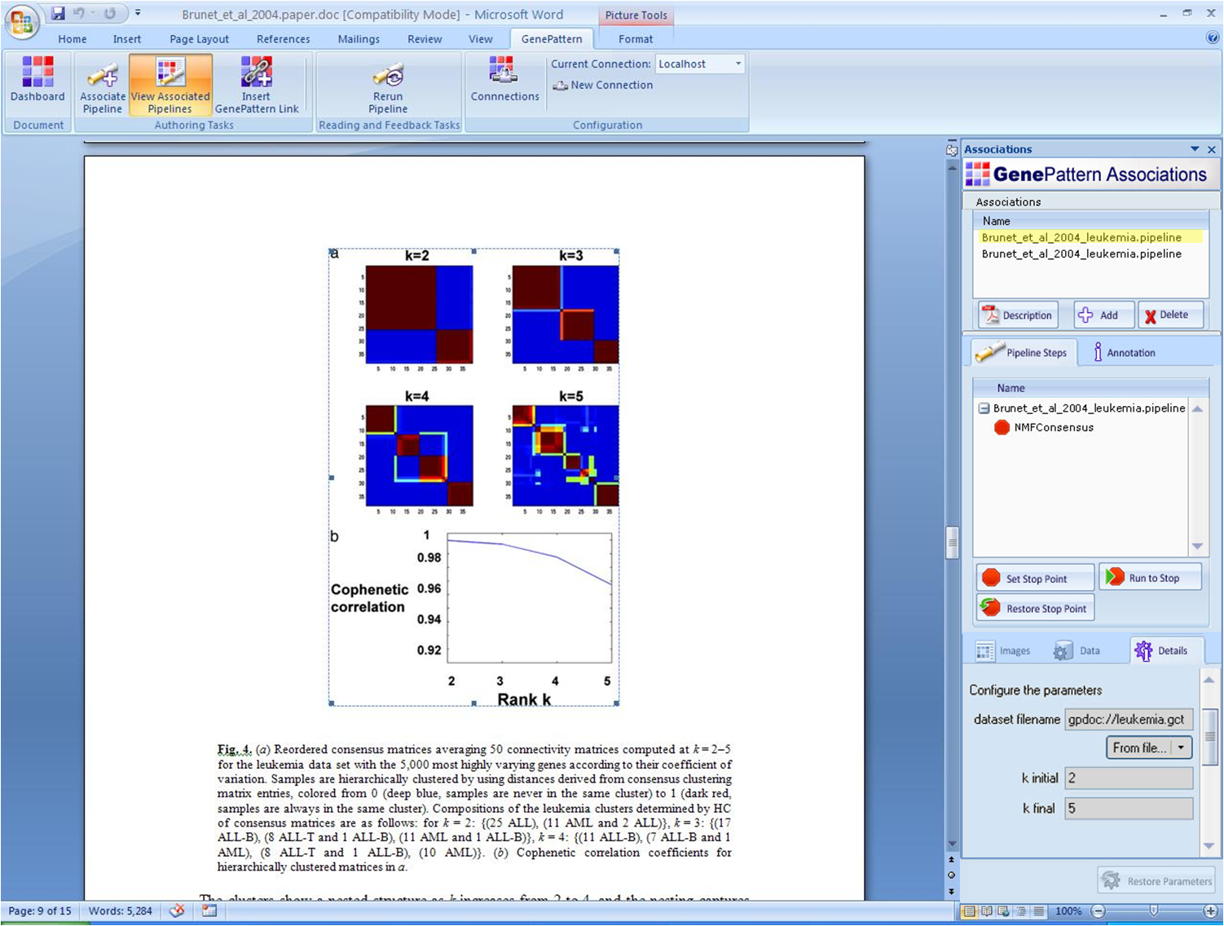

Slide 24













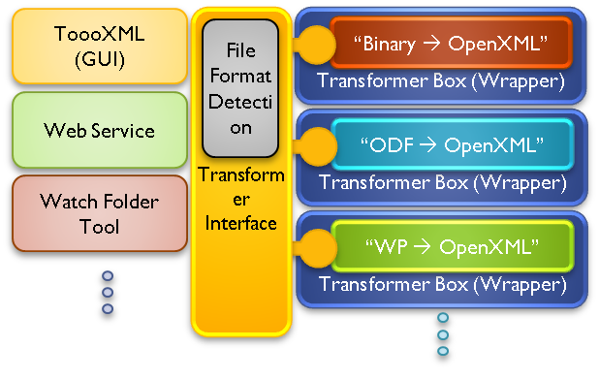
Data Acquisition and Modeling
Collaboration and Visualization
Analysis and Data Mining
Disseminate and Share
Archiving and Preservation
PLANETS
Tools and methods for sustainable long-term preservation of digital objects
Organization
High-profile EU Commission Project, €14M for 4 years
Consortium of 5 national libraries, 4 national archives, 4 universities and 4 industry partners
Goals
Preservation of Office Documents based on OpenXML
Deliver converters for MS Office binary formats
Funded open source project for ODF to/from OpenXML converter
Deliver Preservation Toolkit

Slide 25

Cloud Computing

Slide 26
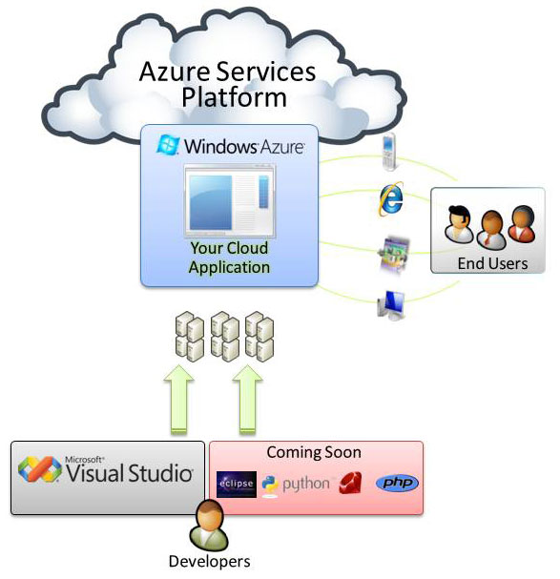
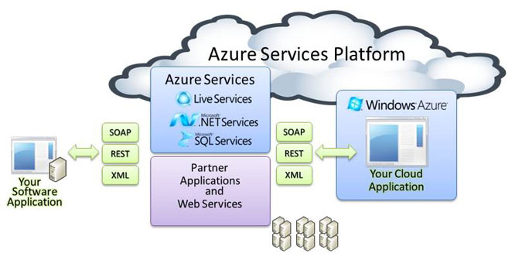
Windows Azure
An Operating System for the Cloud
Application services in the cloud
  Build apps in the design environment, scale it out on the cloud
Web Services using familiar tools:
  SOAP
  XML
  REST
SQL Services
  Hierarchical data model that doesn’t require a pre-defined schema
  Data item stored in this service is kept as a property with its own name, type, and value.
  Query using LINQ or REST
Live Services
  Embed social building blocks
  Connect across digital devices
Notes:
What are the Azure application services in the cloud?
Azure is a Web-based platform that offers application computing services to boost existing systems or power new Internet-based services and applications.
The Azure Services Platform provides student developers with the ability to extend existing applications to the cloud and build new solutions with Internet scale and reach.
Example:
The Azure™ Services Platform
Windows Azure™—a cloud services operating system that serves as the development, service hosting, and service management environment for the Azure Services Platform.
Microsoft .NET Services—a suite of Web services for customers with integration and business-to-business collaboration requirements including workflow, access control, and service bus connectivity.
Microsoft SQL Services—a suite of cloud-based SQL Server capabilities. The first of these capabilities is SQL Data Services, which offers Internet-facing database and advanced query processing services.
Live Services—a comprehensive set of Web services that represent the core functionality of Windows Live (which includes Windows Live Messenger, Live Search, and many more services).

Slide 27
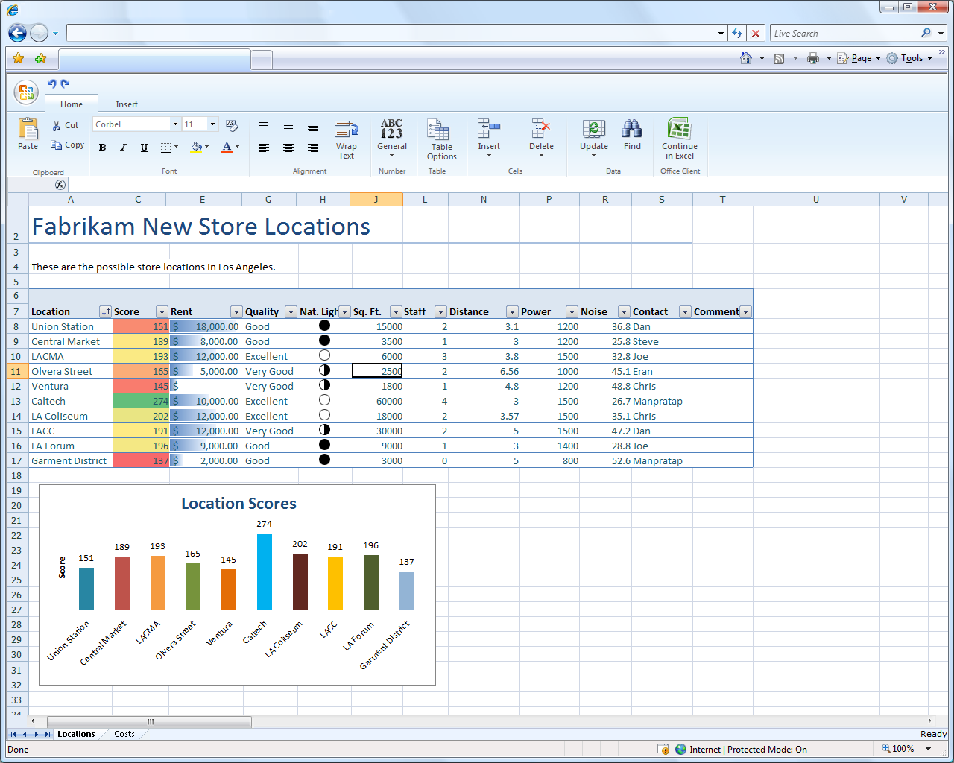
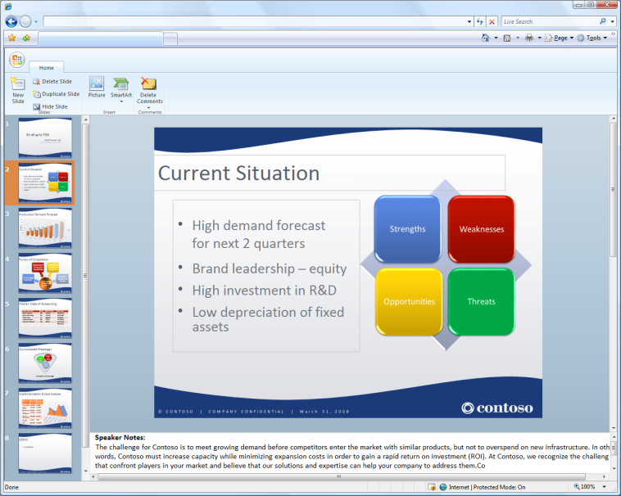
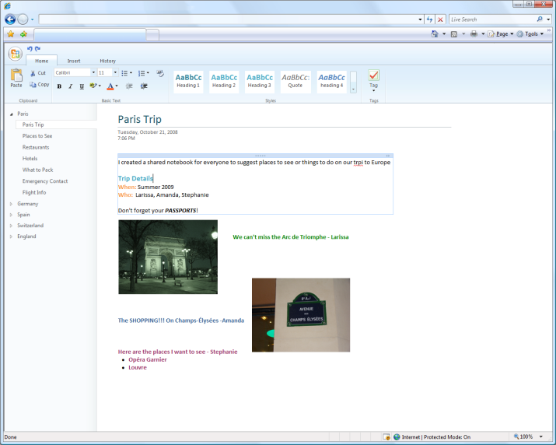
Office Web Applications
Documents in the browser (Internet Explorer, Firefox, Safari)
Synchronization (live updates) between desktop and browser (great collaboration experience
Full fidelity maintained
Integration with Office Live Workspaces
Office 14 timeframe

Slide 28
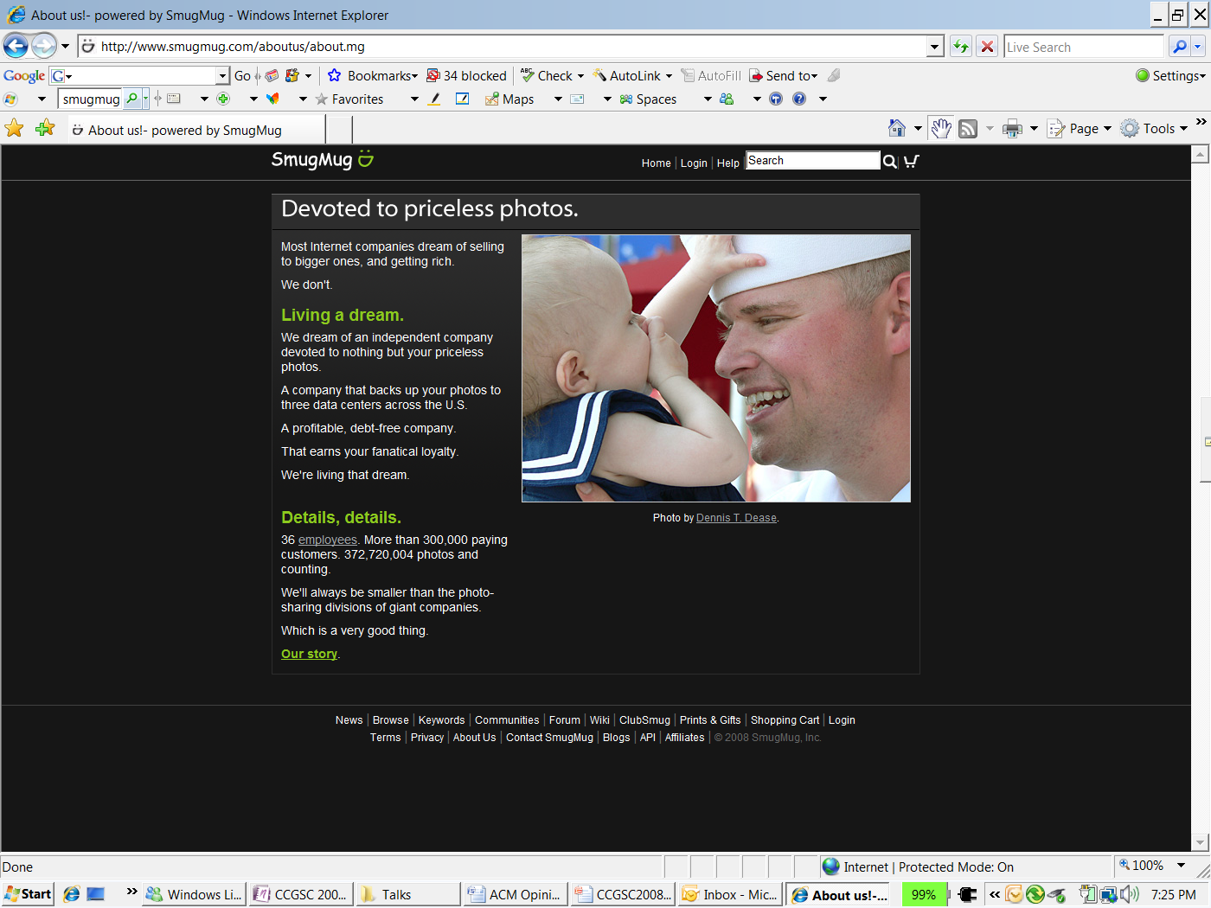
www.smugmug.com

Slide 29
Client + Cloud Computing for Science

Slide 30
Four Examples
Virtual Research Environments
Oceanography Work Bench
Private Clouds for Personal Health
Robotic Receptionist

Slide 31
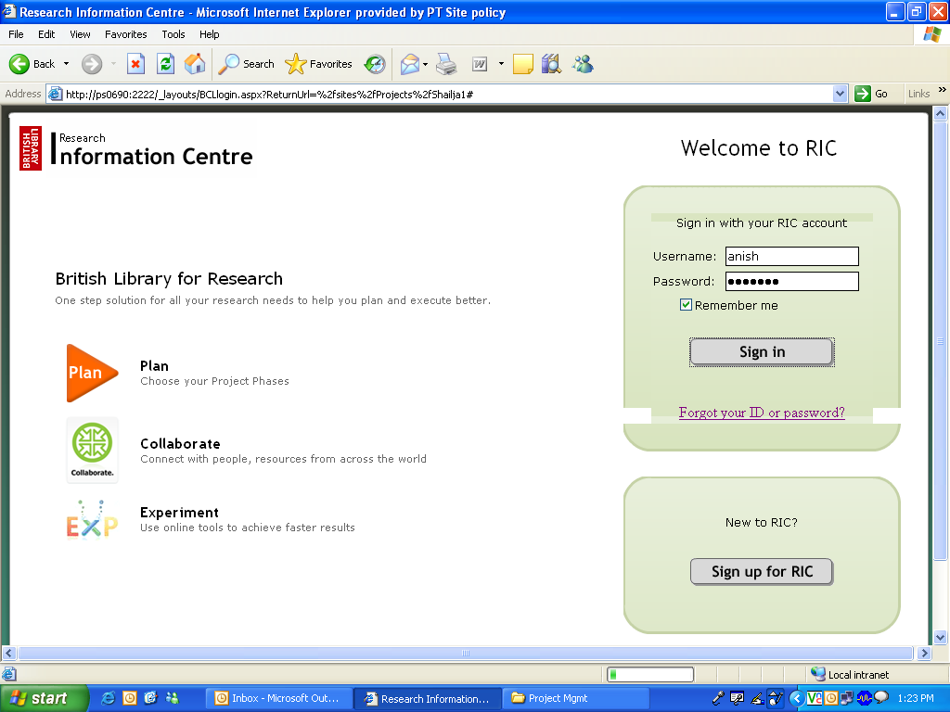
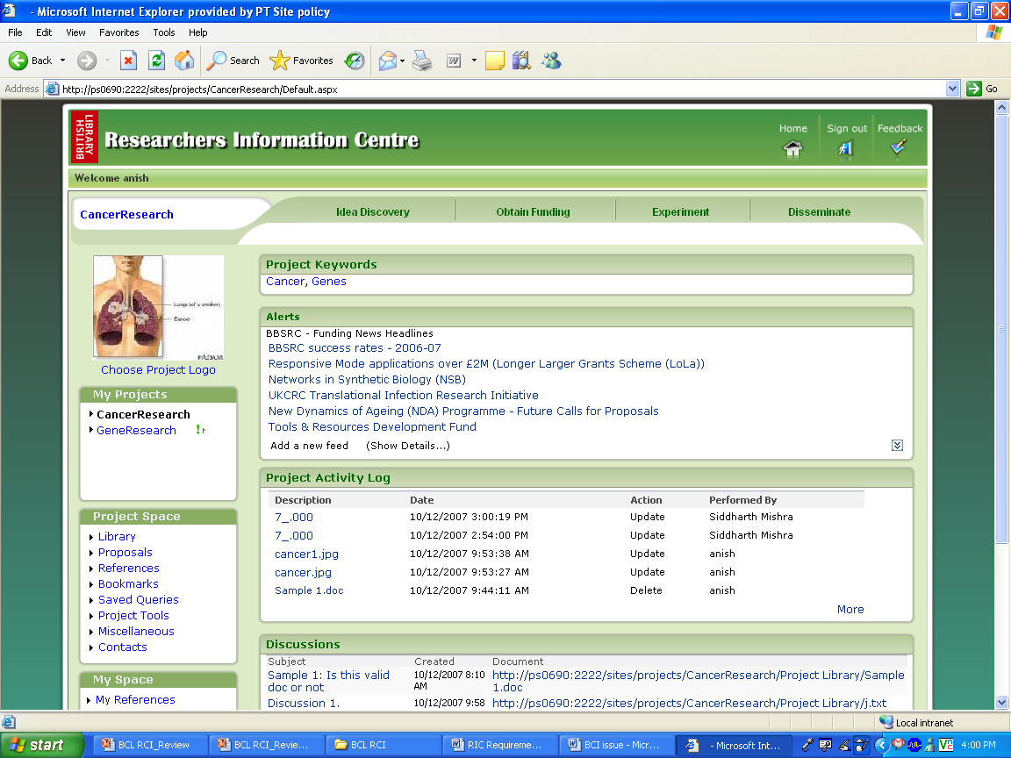


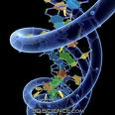

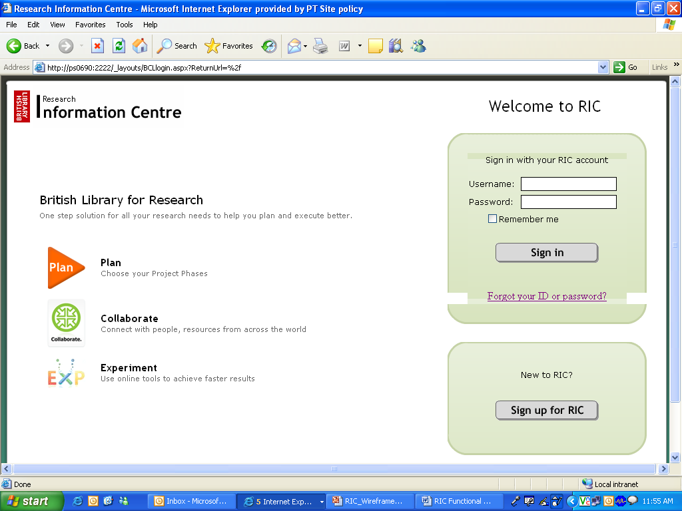

British Library for Research
A one stop solution for carrying out research studies in planned & phased manner and networking with fellow community members
Existing RIC Members
Username:
Plan The Research
Search for study ideas, plan the study, and apply for funding.
Password:
Remember Me
Network
Connect with fellow researchers for sharing ideas, resources etc.
Login
Forgot your ID or Password?
Experiment
Use online tools to achieve faster results.
New to RIC?
Sign Up
Publish
Disseminate the study results for the public.
Currently in beta evaluation, directed by The British Library.
Notes:
After roughly 10 months of development, resulting in 135K LOC and 56 UI screens.
Today we have a stable prototype currently in beta evaluation here in the UK, managed by the BL.
In my presentation here today I would like to share
Overview of our project and the specific technology focus
How we selected features in RIC – what did researchers & the literature tell us
Early feedback from the ongoing evaluation study
Finally, a few comments on the value of network effects for VREs
Which I hope will inform other VRE projects

Slide 32

Microsoft Online Services
Exchange, Sharepoint, Live Meeting, Dynamics CRM, etc.
No need to build your own infrastructure or maintain/manage servers
Moving forward, even science-related services could move to the Cloud (e.g. RIC with British Library)
http://www.microsoft.com/online/

Slide 33
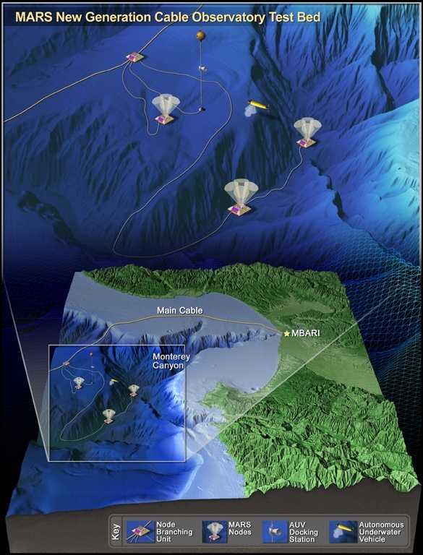




Data Acquisition and Modeling
Collaboration and Visualization
Analysis and Data Mining
Disseminate and Share
Archiving and Preservation
Trident Scientific Workflow Workbench
Univ. of Washington and Monterey Bay Aquarium Research Institute
Scientific workflow workbench to automate the data
processing pipelines of the world’s first plate-scale
undersea observatory
Goals
From raw data to useable data products
Focusing on cleaning, analysis, re-gridding, interpolation
Support real time, on-demand visualizations
Custom activities and workflow libraries for authoring
Visual programming accessible via a browser
Trial Cloud Services for science
Proof Points
A scientific workflow workbench for a number of science projects, reusable workflows, automatic provenance capture.
Demonstrate scientific use of Windows WF, HPCS, SQL Server and Cloud Service SSDS

Slide 34
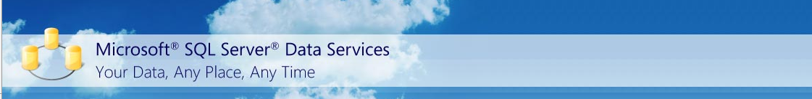
Microsoft SQL Services
“Hosted” SQL Server functionality
Structured data, structured queries
On-demand scalability
Service-Level Agreements
  High availability, performance, fault-tolerance
Programmability
  An easy-to-use programming API (SOAP and REST)
http://www.microsoft.com/sql/dataservices/

Slide 35

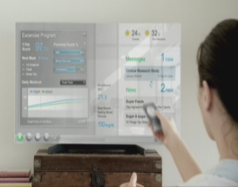

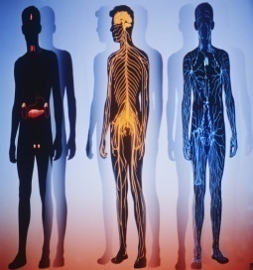
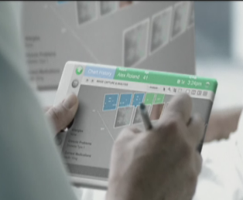
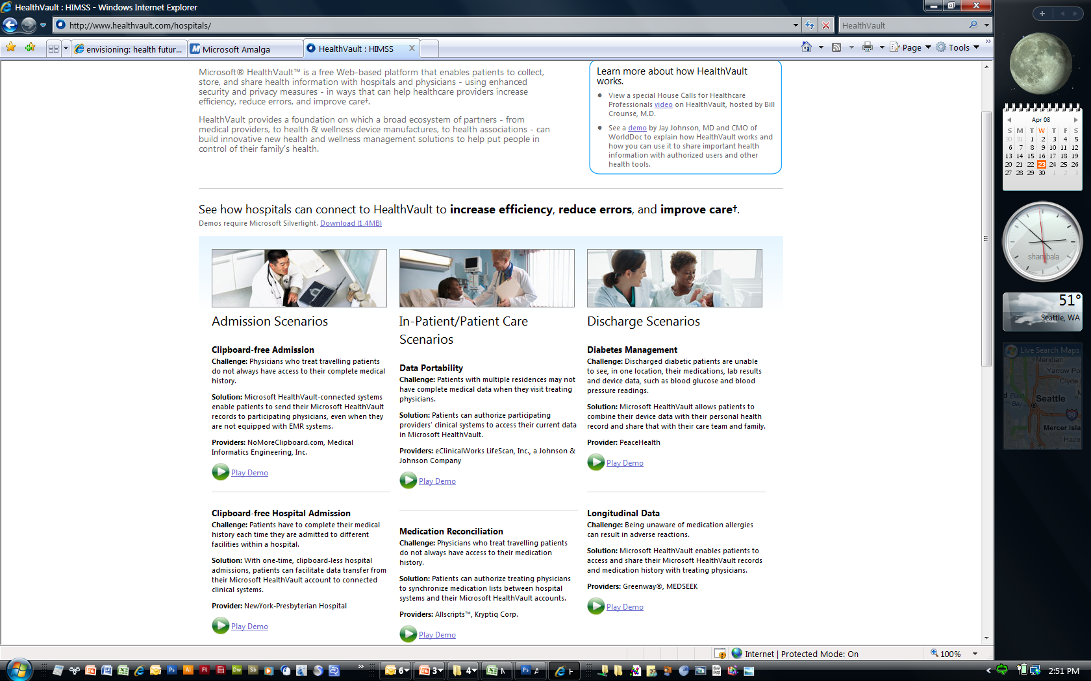
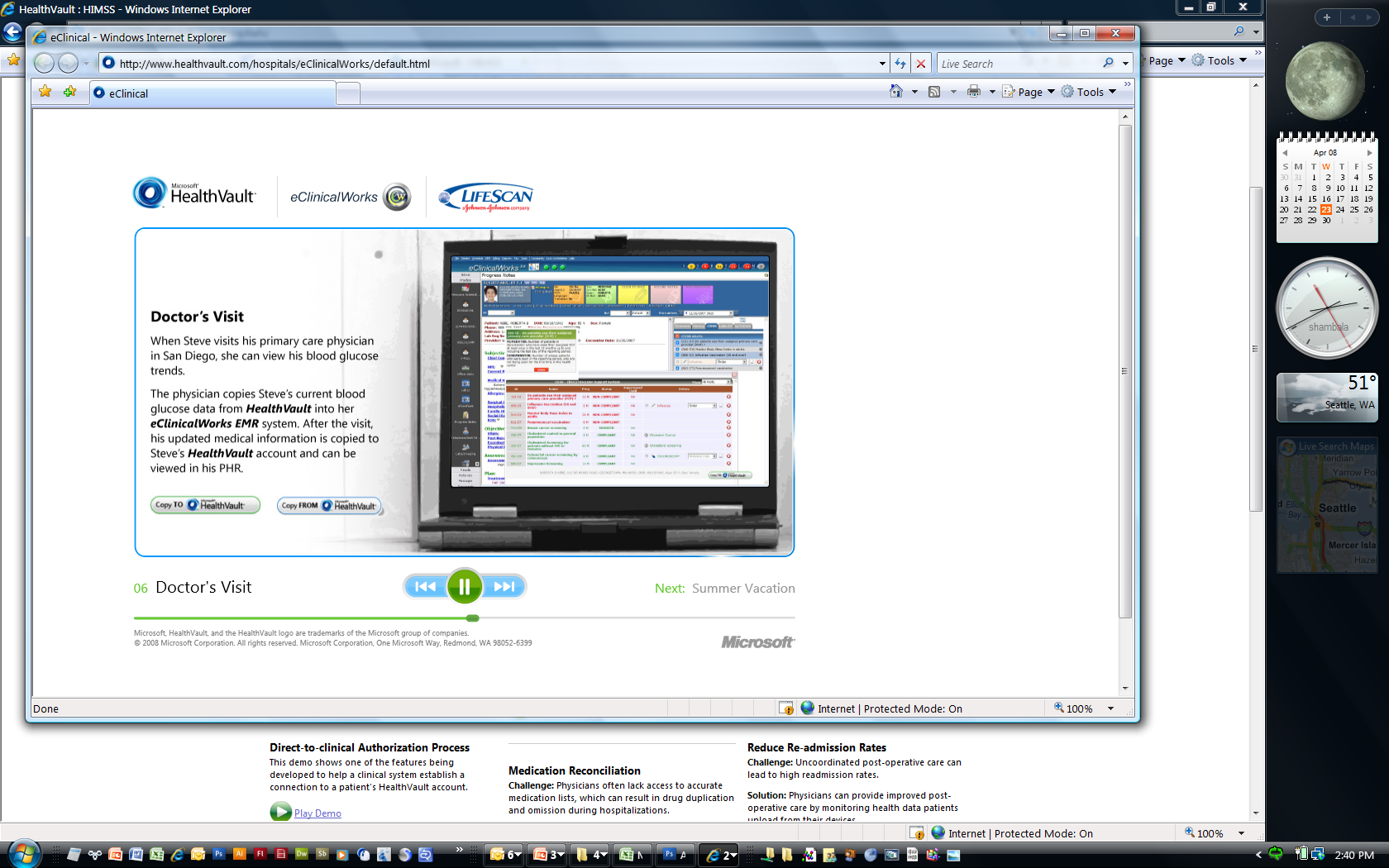
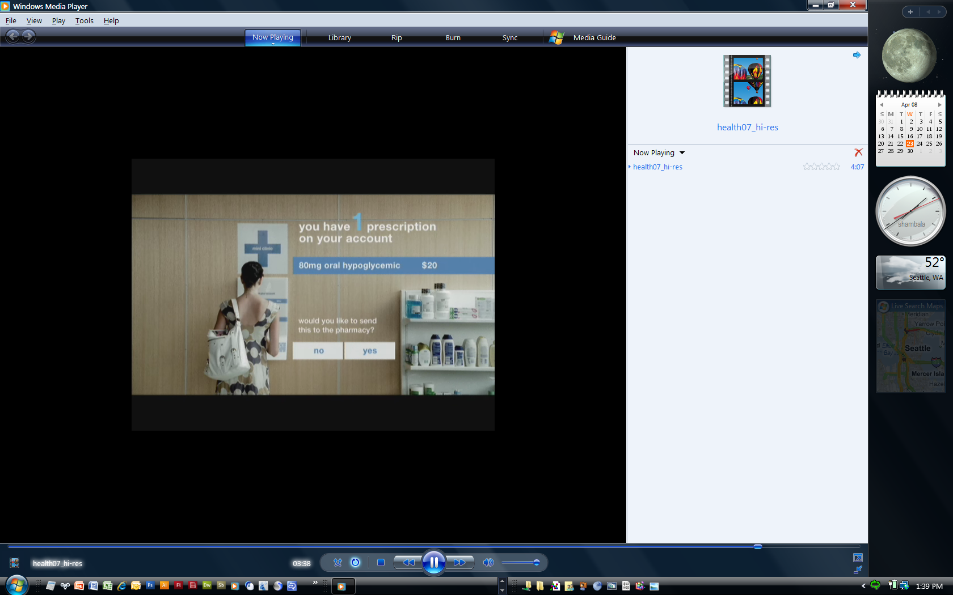



Future of Health
Data Driven Medicine
Personal Monitoring
Anticipatory Medicine
Advanced Analytics
Connected
Data & Care
Smart Medication
Personal Health Management

Slide 36
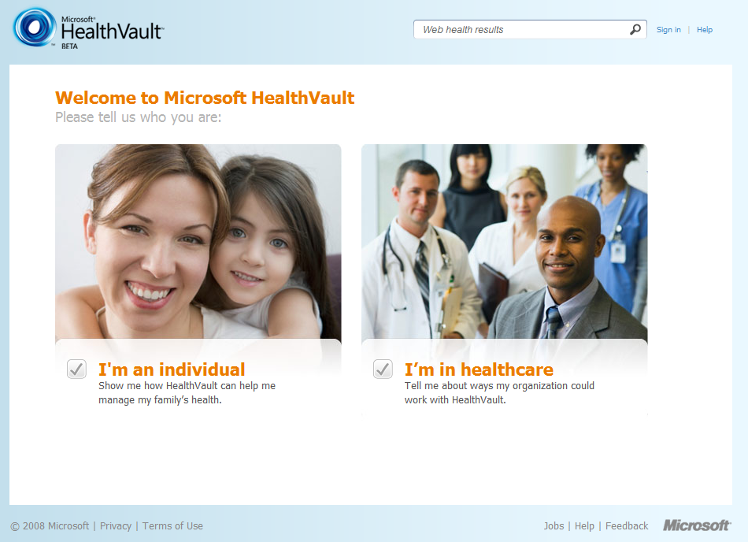
‘Smart’ Private Clouds
Semantic context. The ‘private cloud’ contains context about the user to automatically tailor information that is most likely to be relevant to that user
Example: HealthVault
  a set of platform services, and a catalyst for creating an application ecosystem to collect, store, and share health information online
  the user controls their health information and decides who can share it, and what they can share
  integrated with Live Search
  intuitively organizes the most relevant online health content, allowing people to refine searches faster and with more accuracy, and eventually connect them with HealthVault-compatible solutions

Slide 37
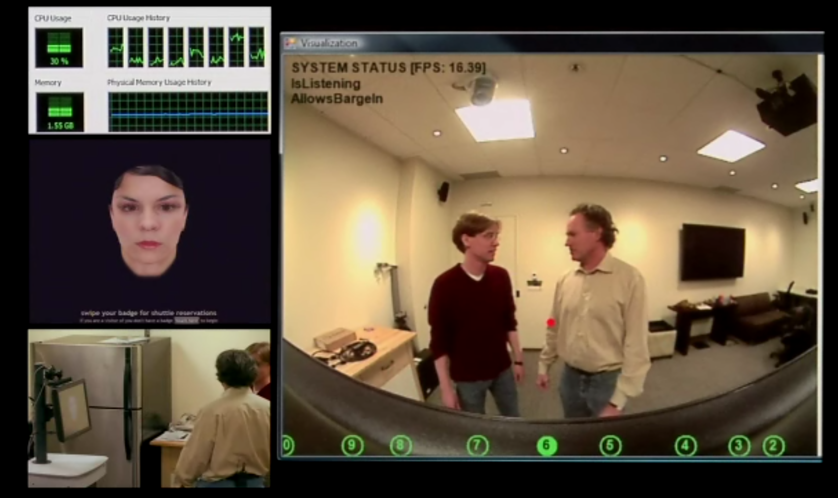

“The Receptionist” – Integrating Technologies
Multicore – Upper left part of screen; CPU monitor of 8 cores
Avatar HCI interaction – middle left of screen
Natural interaction – lower left of screen, what the user sees
Computer visualization and audio technologies – main screen
The small red dot is the computer vision focus. The focus shifts depending on what is happening in the room – mimics human sight
The circles at the bottom of the screen are the audio array – mimics spatial human hearing
Context sensitive – the next person entering is dressed more formally, system assumes him as a visitor and interacts differently
Mimics awareness – when the users attention strays, the computer brings them back into the conversation
Multiple applications running in parallel
Loosely coupled
Needs power of Multi/ManyCore
Will not run in the Cloud
Requires local resources

Slide 38
Video Demo

Slide 39
A world where all data is linked…
Data/information is inter-connected through machine-interpretable information (e.g. paper X is about star Y)
Social networks are a special case of ‘data meshes’
Important/key considerations
  Formats or “well-known” representations of data/information
  Pervasive access protocols are key (e.g. HTTP)
  Data/information is uniquely identified (e.g. URIs)
  Links/associations between data/information
Attribution: Richard Cyganiak

Slide 40





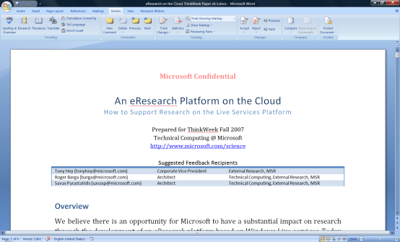

…and stored/processed/analyzed in the cloud
visualization and analysis services
Vision of Future Research
Environment with both
Software + Services
scholarly communications
domain-specific services
search
books
citations
blogs &
social networking
Reference management
instant messaging
Project management
identity
mail
notification
document store
storage/data services
The Microsoft Technical Computing mission to reduce time to scientific insights is exemplified by the June 13, 2007 release of a set of four free software tools designed to advance AIDS vaccine research. The code for the tools is available now via CodePlex, an online portal created by Microsoft in 2006 to foster collaborative software development projects and host shared source code. Microsoft researchers hope that the tools will help the worldwide scientific community take new strides toward an AIDS vaccine. See more.
knowledge management
compute
services
virtualization
knowledge discovery

Slide 41
Resources
Microsoft Research
  http://research.microsoft.com
  Microsoft Research downloads: http://research.microsoft.com/research/downloads
Science at Microsoft
  http://www.microsoft.com/science
Scholarly Communications
  http://www.microsoft.com/scholarlycomm
CodePlex
  http://www.codeplex.com
The Faculty Connection
  http://www.microsoft.com/education/facultyconnection
MSDN Academic Alliance
  http://msdn.microsoft.com/en-us/academic

Slide 42


