Slide 1
Turning Biologists into Bioinformaticists – A Practical Approach
Charlie Whittaker
Bioinformatics and Computing Core Facility
David H. Koch Institute for Integrative Cancer Research at MIT

Slide 2
About the Koch Institute
Multi-disciplinary operation consisting of MIT molecular geneticists and cell biologists and engineers.
Research Force
  24 Biology and Engineering Faculty
  170 Postdoctoral Fellows and Associate Scientists
  175 Graduate Students
  70 Undergraduates
  70 Technical Staff
The Swanson Biotechnology Center supports KI research
  15 core facilities from glassware to flow cytometry.
  One facility is our Bioinformatics and Computing Core (BCC).
  The roles of the BCC include assistance, collaboration and training.
  The three BCC members can’t keep up with demand.

Slide 3
Biology Research and Computing
Biology is an increasingly quantitative field requiring sophisticated computational methods.
  Genomics
    Genome-wide annotation analyses
    Microarrays
  Massively Parallel Applications
    NextGen Sequencing
    High-Throughput Screening
    Automated Imaging
Many biologists are underprepared to meet the computational demands of their research.
Some have systematically avoided computing throughout their careers.

Slide 4
Assessment Activities
Survey was designed to identify barriers to learning…
  Intimidation: “Every time I see a blinking cursor I freak out.”
  Lack of awareness: “Why do I need to know about this, it is why I have a Mac.”
  Dependency: “I have a Grace.”
and to assess users computing skills…
  Participants were observed while executing four bioinformatics tasks (file management, text summary, numerical analysis, text processing).
  Graded on a,b or c scale
    a – struggled
    b – completed task but not easily
    c – completed task easily

Slide 5
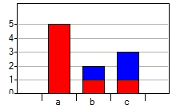
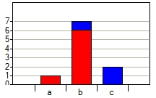
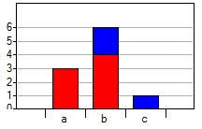
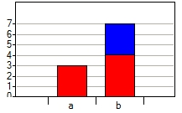
Assessment results
File Management
Text Summary
Numerical Analysis
Text Manipulation
3/10 had computer books of some kind at their desks (blue bars).
7/10 of participants want an easily accessible reference resource.
4/10 expressed frustration or intimidation with command line computing.
3/10 felt they knew all they needed to know about computers.

Slide 6
The Problem
GA Tech Students
Mark Guzdial – MS Faculty Summit 2008
  Computing should be taught to everyone.
  Context leads to time-on-task leads to effective learning.
Computer Science
Computer Scientist
Biologists
Relational Databases
Statistics
Data Management
Programming
Bioinformaticists

Slide 7
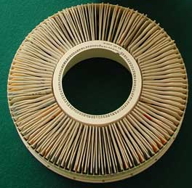
The PowerPoint Phenomena
Incredibly useful tools encourage the investment of time and rapidly become commonplace!
Late ’90s – PowerPoint presentations went from rare to ubiquitous in less than a year.

Slide 8
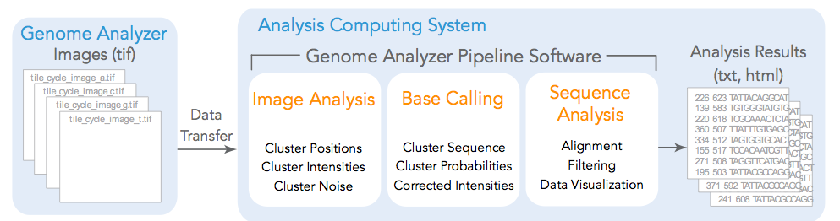

The Illumina Phenomena?
128000 Images (880Gb) per Experiment (8*100*4*40)
~5 million 40-letter sequences
<50% KI capacity for 1 year sequenced the mouse genome 3X
Gene Expression Analysis
Genomic Composition Analysis
Genomic Variation Analysis
Mixture Characterization
Examining these data with point-and-click tools is nearly impossible.
Command-line tools are simple and effective (Unix utilities, Perl, MySQL, R)

Slide 9
“Nuggets” of Computation Information
The material should be contextually relevant.
Nuggets should be useful for both initial instruction and subsequent reference.
An example… during the survey this command was demonstrated:
  awk ‘$3 >= 8’ numbers.txt|wc –l
A week later…
  awk '($16 == 1) && ($23 != $16) && ($30 == $16)' dpnRun_stock.txt | wc -l

Slide 10
Presenting the Nuggets
Formal training sessions
  26,28,30 January 2009
Small group sessions
Training during collaboration
Walkabouts
Website development
  Online lessons
  Video tutorials

Slide 11
Challenges
What are the ideal training strategies?
What is the optimal way to archive the nuggets?
  Web-based hierarchies or wizards
  Wiki – capture users contributions
How can we monitor our training progress?

