Slide 1
Welcome!
Ken Hinckley
Papers Co-Chair, MobileHCI 2015
Principal Researcher, Microsoft Research

Slide 2
MobileHCI 2015 Review Results Summary (Redmond)

Slide 3
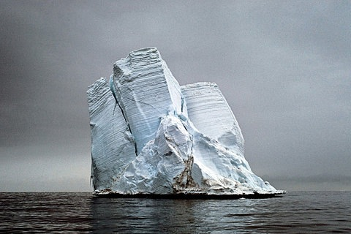
Remember: 90% of papers are always below 4.0 ...

Slide 4
The fate of 116 papers at a glance…

Slide 5
The fate of 116 papers at a glance…

Slide 6
The fate of 116 papers at a glance…

Slide 7
The fate of 116 papers at a glance…

Slide 8
The fate of 116 papers at a glance…

Slide 9
The fate of 116 papers at a glance…

Slide 14
ATTITUDE

Slide 15
…
This is a journey of discovery.

Slide 16
…
This is a journey of discovery.
There will be surprises along the way.

Slide 17
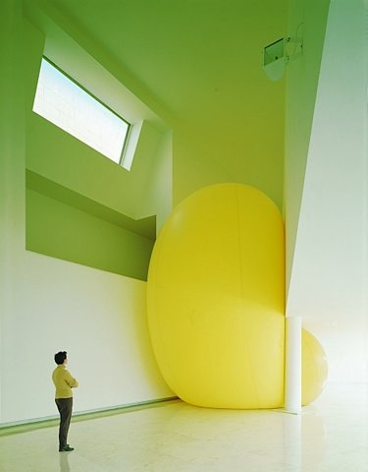
Contributions come in many flavors.
Try to stay open-minded.
Some will not be to your taste.

Slide 18
At other times the stream of uninspiring papers will seem to go on and on.

Slide 19
Look for the light in the darkness.

Slide 20
Be a paper champion.
Find reasons to like papers. Fight for the papers in your stack. Be open to a change of heart about a paper.
Our role is to accept papers.

Slide 21
Remember our mantra for papers on the fence:
When in doubt, let the literature sort it out.

Slide 22
PROCESS

Slide 23
Ground Rules
Have an opinion
… but always be respectful of authors, other PC members.
We will not make decisions based on extra last-second reviews
Provide input, ask questions, but 1AC / 2AC / 3AC own decision
We don’t need 100% agreement
If a PC member makes good argument(s) for a paper, we can Accept.
Nothing is final until the end of the meeting
Do not tweet / email paper results to colleagues during the meeting!!!

Slide 24
Possibly Valid but Oft-Squirrely Reasons to Reject
Too short / too long
We are not picky about page count. Measure contribution, not concise writing.
Incremental, Borderline, Seems relatively obvious …
Either it makes a contribution or it doesn’t
One man’s increment is another man’s insight. And vice versa.
Results often seem obvious… but only in retrospect.
“Shallow Evaluation” esp. if contrib is more systems-oriented
Weigh merits of the paper the authors wrote, not the paper you wished they wrote.

Slide 25
Reminder:
You can flag any paper
to resurrect or discuss (for any reason)
before the close of the meeting.
(Send email to Ken or pass sticky note with paper #)

Slide 26
Revise & Resubmit: new option for 2015
All papers are Conditionally Accepted pending final revisions.
But, R&R is stronger than “conditional accept”
Give clear guidance on what is needed…
Reject if they don’t deliver.
Similar to “shepherding” but with option to take more risks on papers that seem worth the effort.
We should use this sparingly, but it’s a tool at our disposal.

Slide 27
Best Paper Nominations
Be on the lookout for papers to nominate!
Anyone on PC may nominate a paper
Best Papers subcommittee (TBA) will choose Top 5% and Top 1% from all nominated papers.
It’s not a best average score contest
Reward innovative, ambitious, inspiring papers
Nominate on review form
Or by passing yellow sticky with the paper # and “Nomination”

Slide 28
After the meeting…
Decisions will go to out to authors on Weds, 15 April
Finalize your 1AC / 2AC / 3AC reviews ASAP:
Update based on PC discussion: give authors a sense of what happened to their paper and why. (Jot notes as we go!)
Include detailed & specific instructions for revision (A / R&R).
You must approve final versions of all accepted papers
May 22 author’s revision due
May 29 1AC approval due

Slide 29
Remember our mantra for papers on the fence:
When in doubt, let the literature sort it out.

Slide 30
Remember our mantra for papers on the fence:
When in doubt, let the literature sort it out.

Slide 31
Let’s put together a great program!
Questions?
Comments?

Slide 32
Let’s put together a great program!
Questions?
Comments?

