Slide 1
2017 Microsoft Indoor Localization Competition
Organizers
CMU Volunteers
Dimitrios Lymberopoulos (Microsoft Research)
Jie Liu (Microsoft Research)
Vitor Sequeira (European Commission – Joint Research Center)
Maurizio Bocca (Bosch)
Ying Zhang (Google)
Xue Yang (Intel)
Niki Trigoni (University of Oxford)
Anthony Rowe (CMU)
Oliver Shih
Yujie Wei
Diana Zhang
Craig Hesling

Slide 2
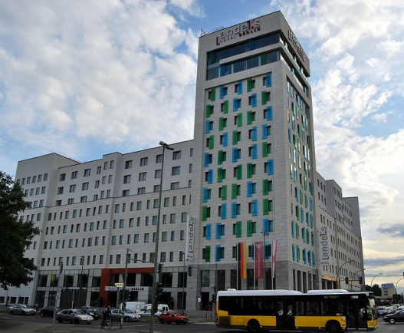
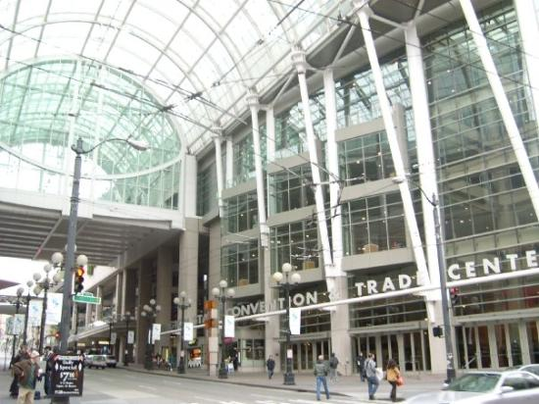
Competition Goals
Evaluate and compare technologies from academia and industry in the same, unfamiliar space.
Bring teams working in this area together in a more effective way.
2014: Berlin
2015: Seattle
2016: Vienna

Slide 3
2017: Pittsburgh
30 teams submitted abstracts
19 teams officially registered - ~60 people registered
18 teams showed up in Pittsburgh
16 teams were evaluated

Slide 4
Two Categories
2D Category
Report (X,Y) locations
Do not require the deployment of any infrastructure (WiFi and/or IMU based)
3D Category
Report (X,Y,Z) locations
Require custom hardware deployment (UWB, Ultrasound etc.)
Each team can deploy up to 8 anchor devices in the evaluation space

Slide 5
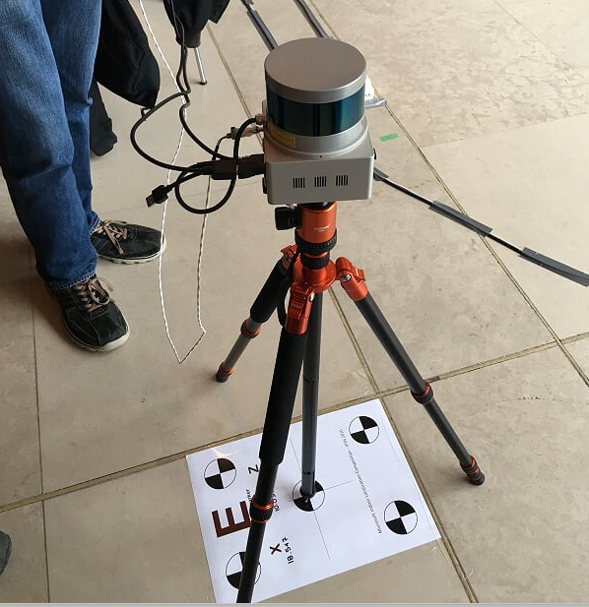
Evaluation Process
Day 1: Tuesday
Teams were given 7 hours to setup and calibrate their systems
Day 2: Wednesday
Each team was asked to provide the coordinates of 20 previously measured test points
Evaluation Metric
Average localization error across the 20 test points
The lower the error the better

Slide 6
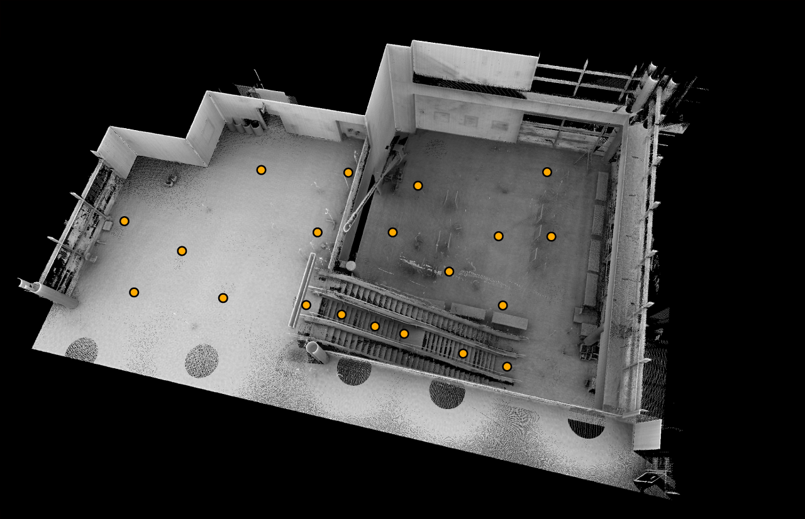
600m² Evaluation Area - Two Floors

Slide 7
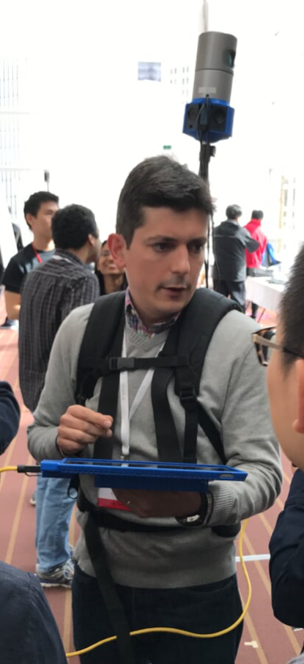
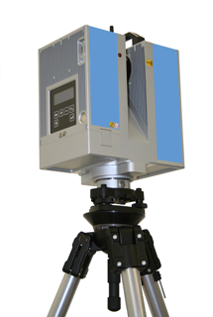
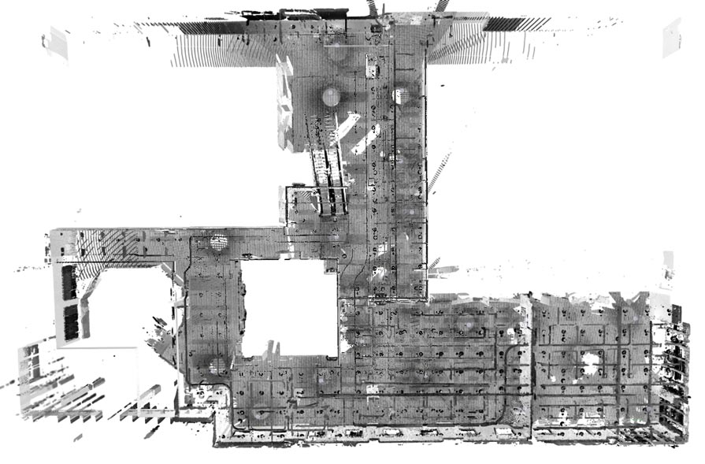
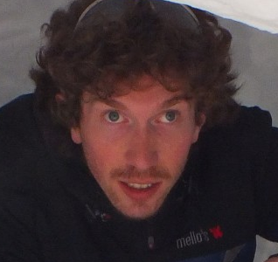
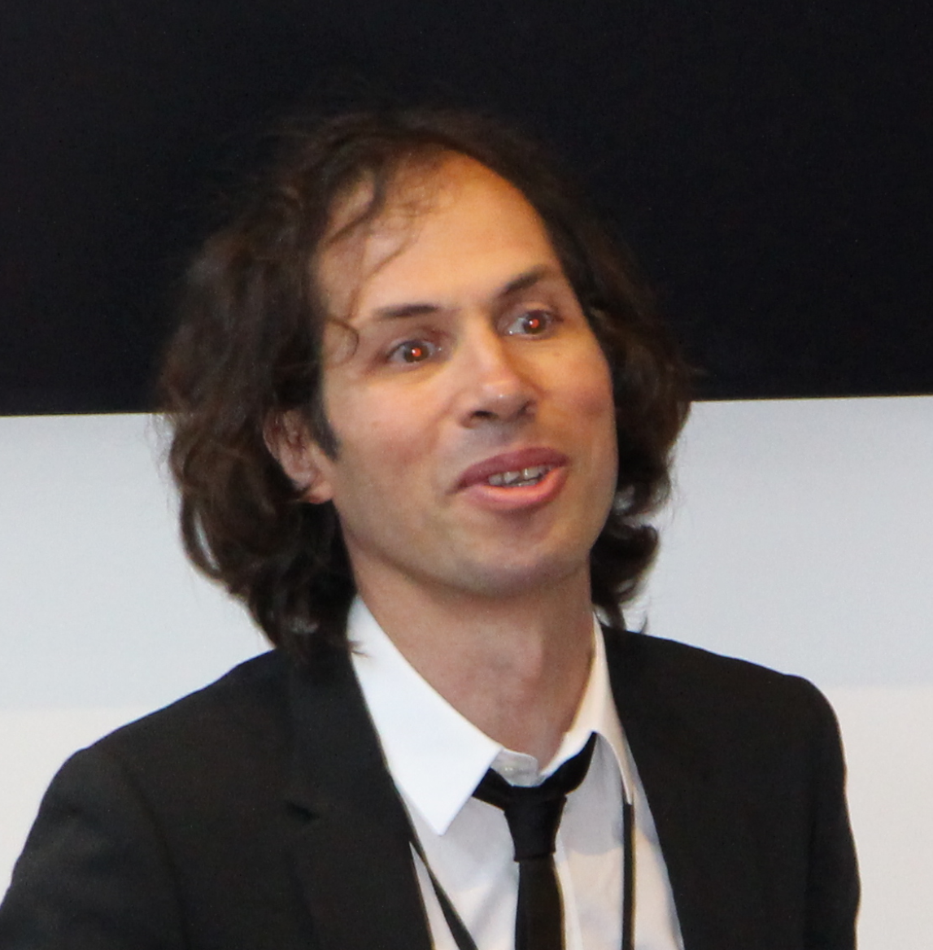
Ground Truth Measurements
High Resolution 3D Acquisition and Registration
Simone Ceriani
Carlos Sanchez
Vitor Sequeira
JRC (https://ec.europa.eu/jrc), the winner of the 2015 competition, volunteered to provide its expertise for ground truth measurements.
JRC has been deploying 3D laser scanning technology to verify design information within nuclear facilities for more than 10 years.
The ground truth environment and the test points were acquired using multiple high definition 3D scans using a tripod mounted laser scanner (e.g. ZF 5006) and proprietary software

Slide 8
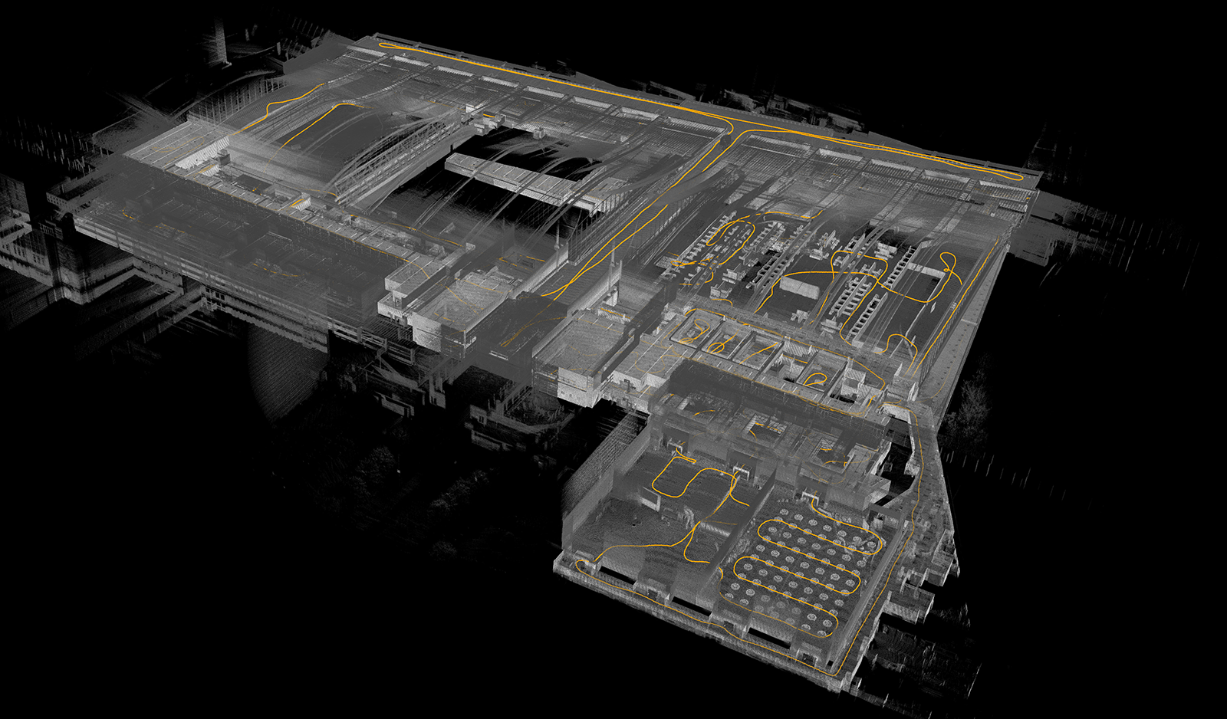

Slide 9
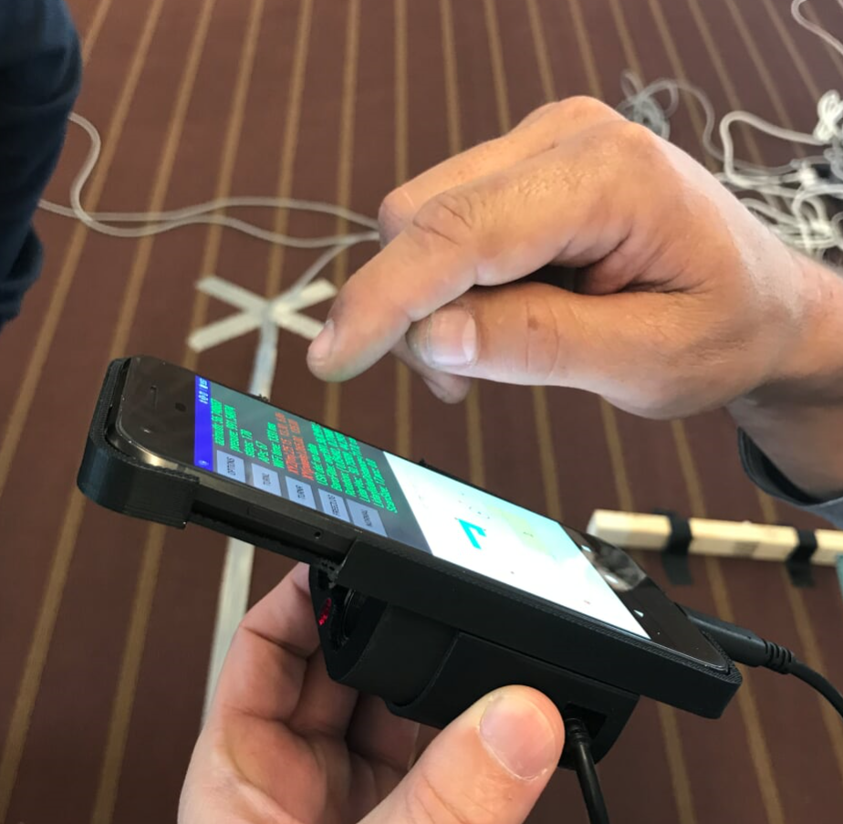
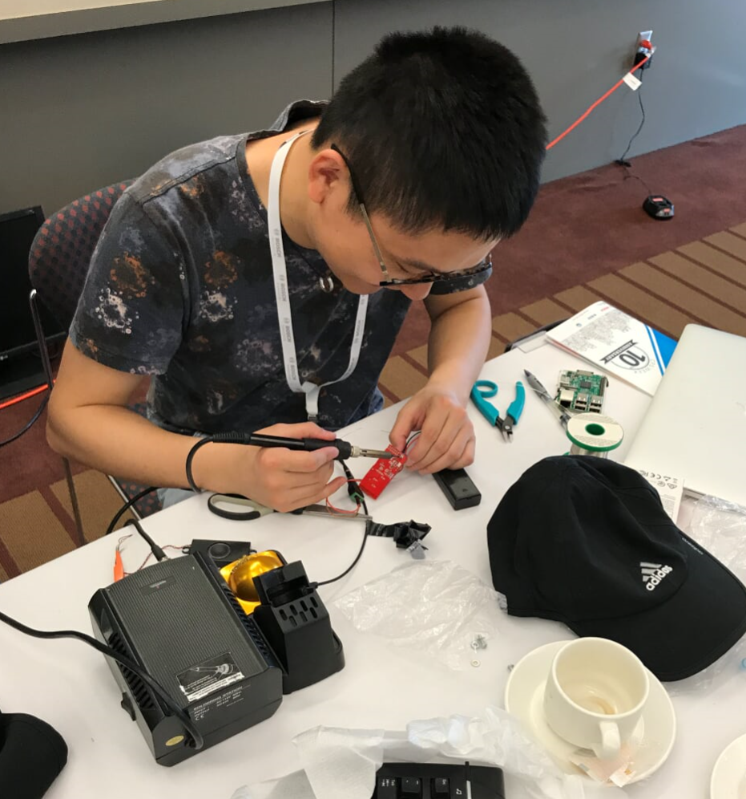
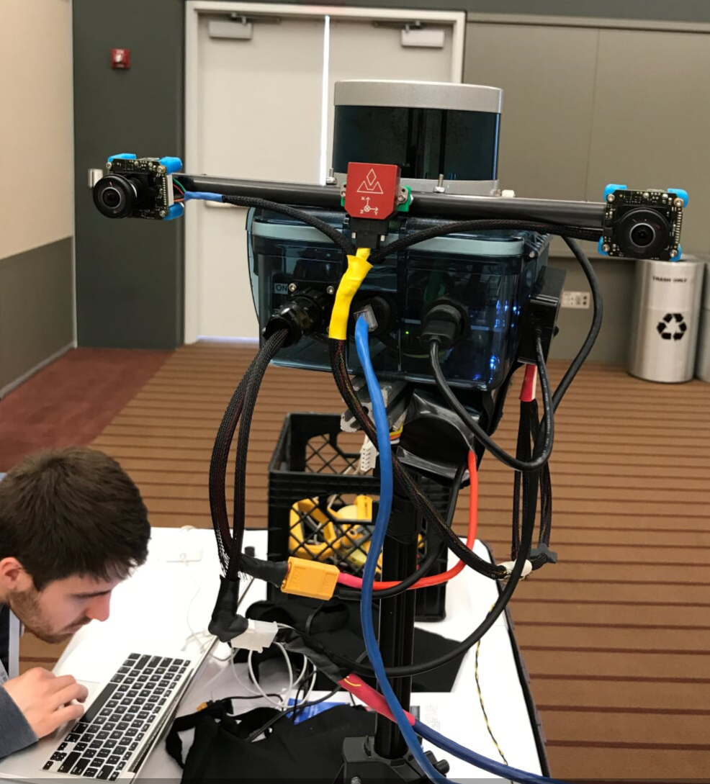
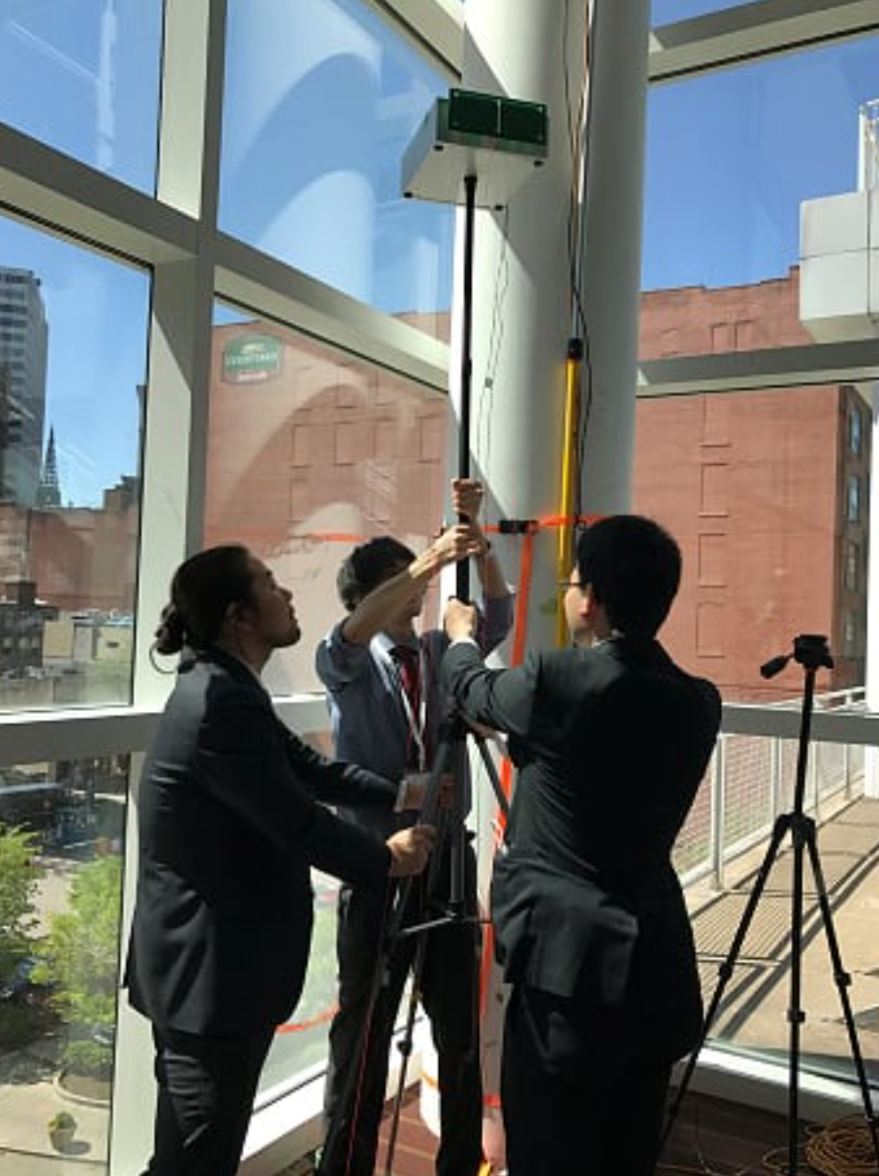
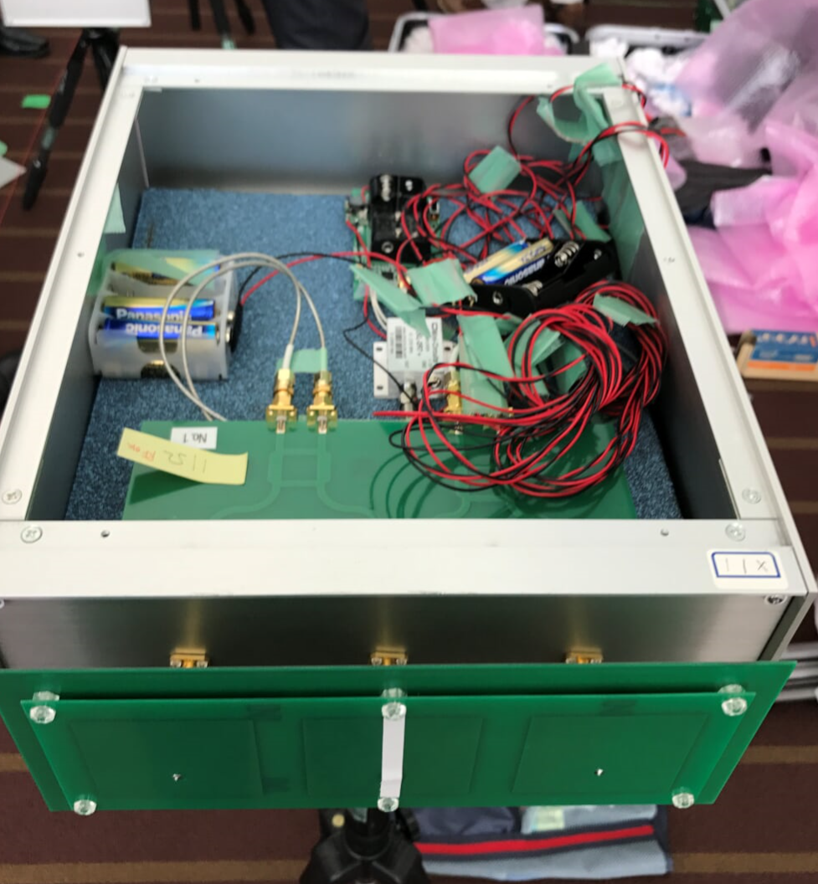
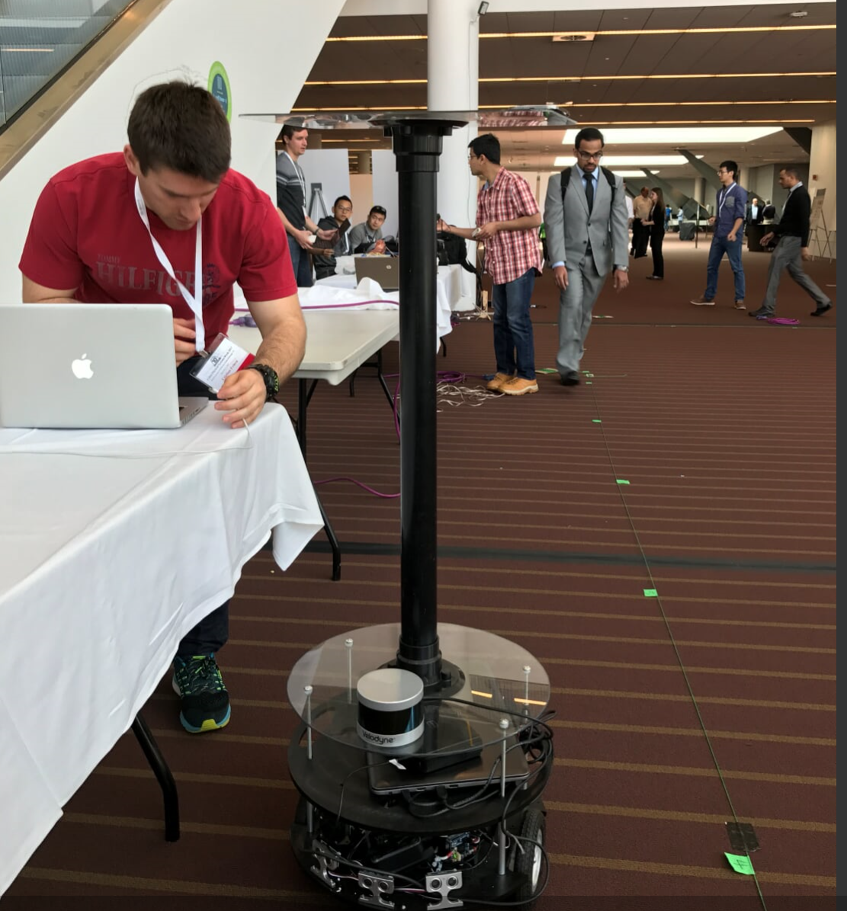
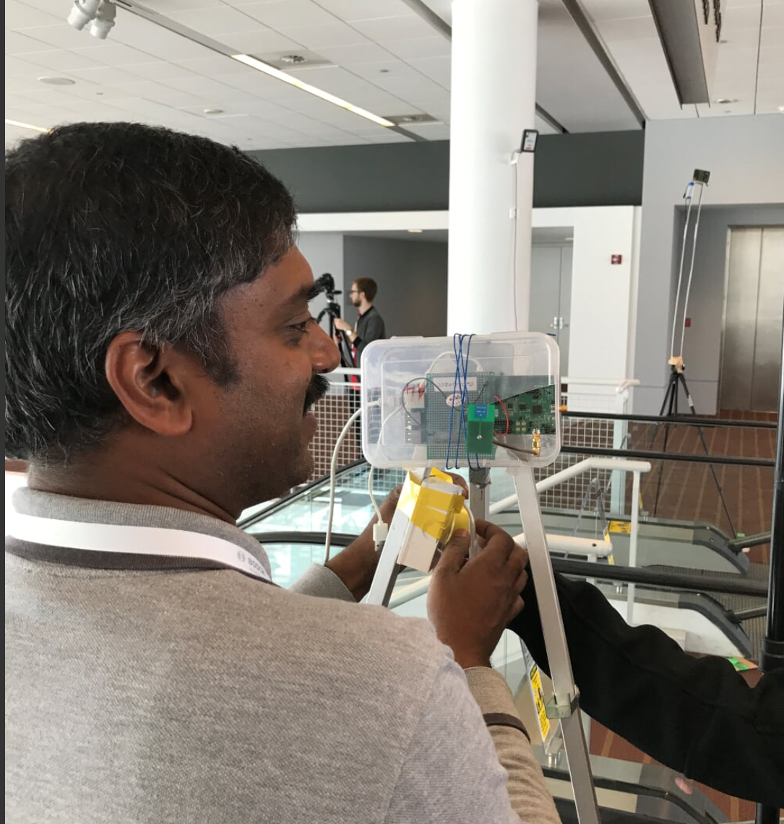
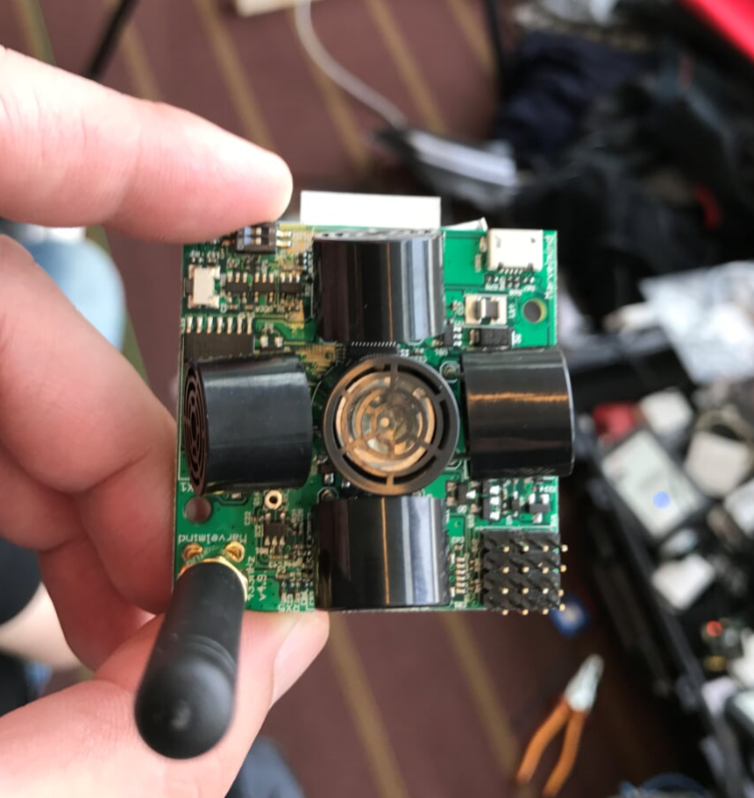
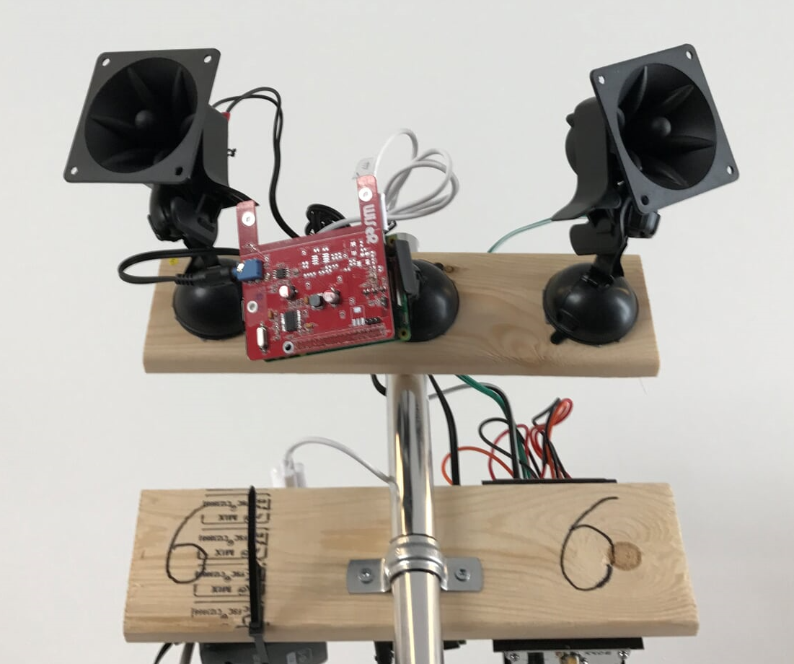
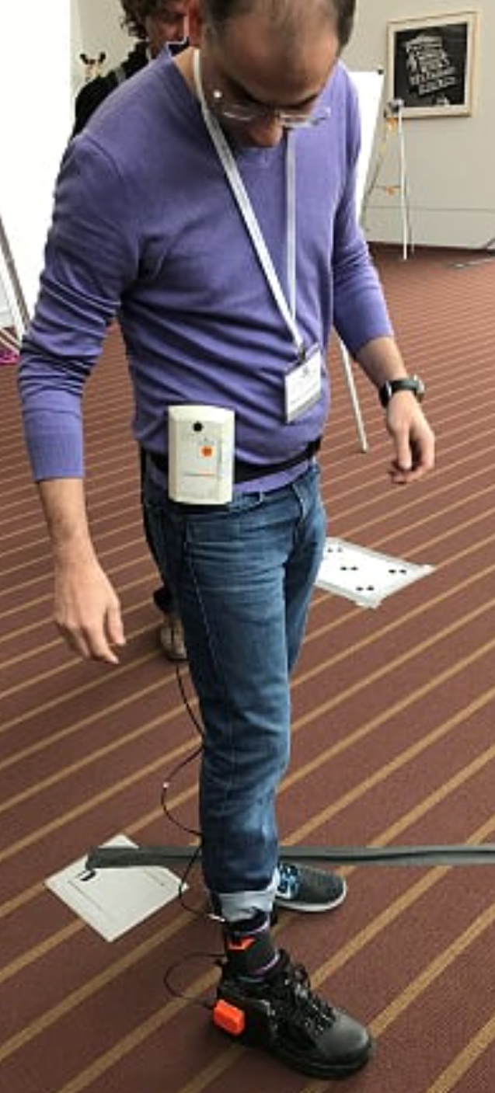
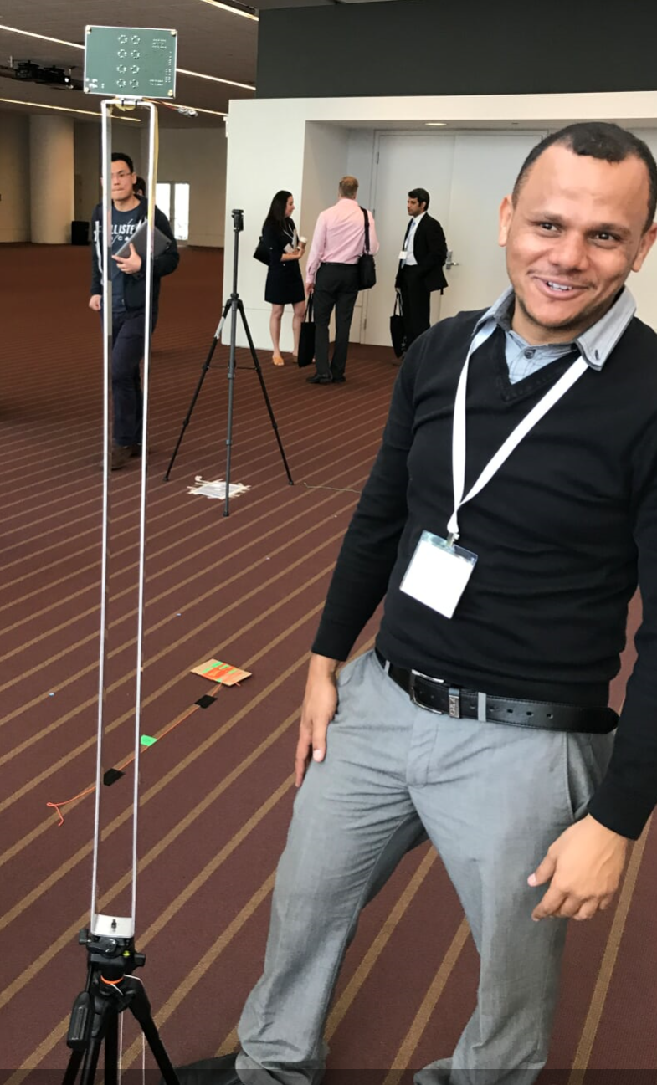
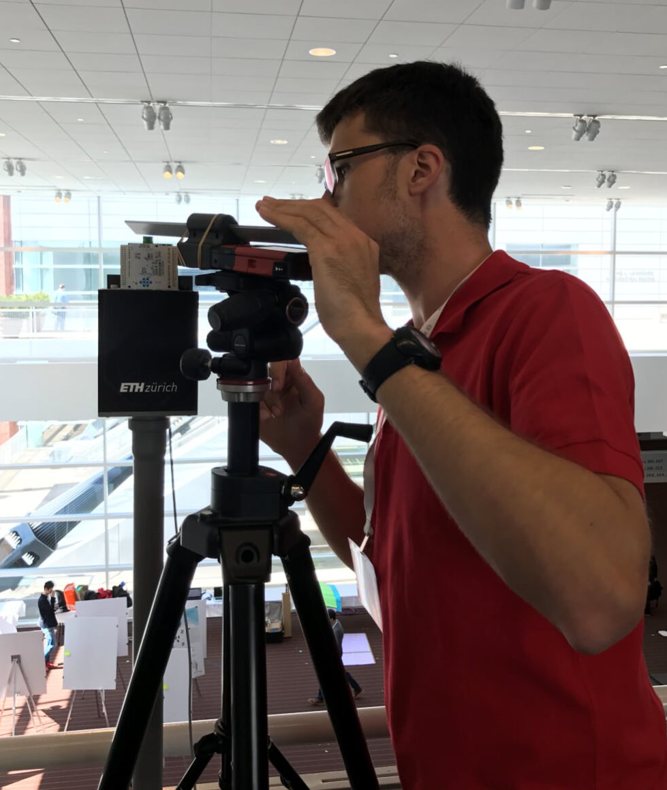
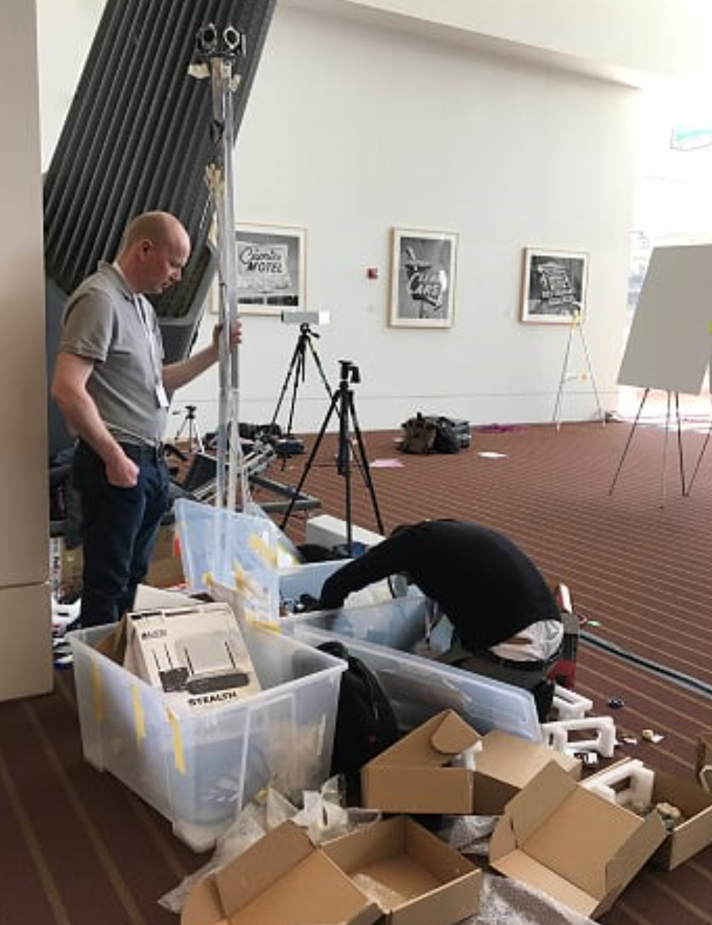
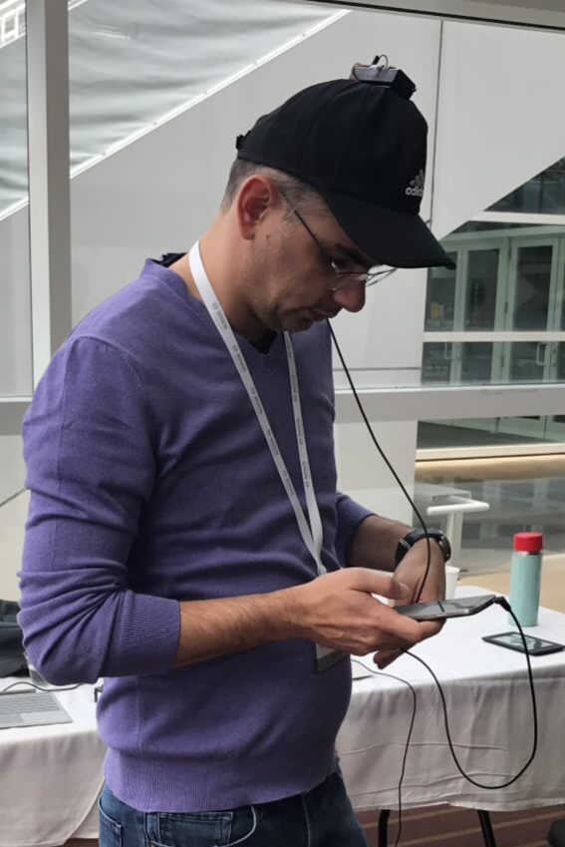

Slide 10
Fingerprinting
PDR
DoD Beacons
2D
UWB
Lidar
Sound
Ultrasound
3D

Slide 11
2D Category
3D Category
1st
PDR-based Indoor Localization
Li et al.
(McMaster University)
Real-time Localization without Reliance on Infrastructure
Zhang et al.
(Kaarta)
$1000
2.2m error
0.03m error
2nd
PDR System Considering Actual Condition of the Foot-mounted IMU
Ju et al.
(Seoul National University)
Intranav
Gunes et al.
(Quantitec)
$600
2.4m error
0.17m error
3rd
DoD-based Indoor Localization using BLE Beacons
Kikuchi et al.
(Iwate University)
UWB Indoor Localization
Beuchat et al.
(ETH Zurich)
$400
4m error
0.6m error

