Slide 1


Flexible Immutability with Frozen Objects
K. Rustan M. Leino Microsoft Research
Peter Müller ETH Zurich
Angela Wallenburg Chalmers University

Slide 2
Executive summary
Context
Verification system for object-oriented programs
Contribution
Specification and structuring technique for objects that no longer undergo change

Slide 3
Object Invariants
class C { int x, y, z; invariant x < 0 ∨ y ≤ z; }
Boogie methodology (used in Spec#)
Spec# demo: shows/ads
Notes:
//-- 0 -------------------------------------------------
public class RockBand
{
int shows;
int ads;
invariant shows <= ads;
public void Play()
{
ads++;
shows++;
}
}
//-- 1 -------------------------------------------------
public class RockBand
{
int shows;
int ads;
invariant shows <= ads;
public void Play()
{
shows++;
ads++;
}
}
//-- 2 -------------------------------------------------
public class RockBand
{
int shows;
int ads;
invariant shows <= ads;
public void Play()
{
expose (this) {
shows++;
ads++;
}
}
}
//-- 3 -------------------------------------------------
public class RockBand
{
int shows;
int ads;
invariant shows <= ads;
public void Play()
{
expose (this) {
shows++;
Play();
ads++;
}
}
}
//---------------------------------------------------
//---------------------------------------------------
//---------------------------------------------------
// Personnel.ssc
//---------------------------------------------------
using System;
using Microsoft.Contracts;
public enum GT { Gibson_LesPaul, FlyingV, Fender_Stratocaster, Ovation_12string }
public class Guitar : Personnel
{
public int Level;
public Guitar(string name, int level)
ensures Name == name && Level == level;
{
Level = level;
base(name);
}
public void Strum()
ensures Name == old(Name) && Level == old(Level);
{
/*...*/
}
public void Strum(int guitarId)
ensures Name == old(Name) && Level == old(Level);
{
/*...*/
}
}
public class Personnel {
public string Name;
public Personnel(string name)
ensures Name == name;
{
Name = name;
base();
}
public Personnel()
{
this("Alfred");
}
}
//---------------------------------------------------
//---------------------------------------------------
// Roadie.ssc
//---------------------------------------------------
using Microsoft.Contracts;
[Immutable]
public class Roadie
{
public int Strength;
Muscles m = new Muscles();
public Roadie(int strength)
ensures Strength == strength;
{
Strength = strength;
}
[Pure]
public int GetGuitarID(GT guitarType) {
int id = (int)guitarType; /*...*/ return id;
}
public void SchlepInstruments()
modifies m.*; // to trigger the final error in the demo
ensures Strength==old(Strength);
{ /*...*/ }
public void PrepareStage()
modifies m.*;
ensures Strength==old(Strength);
{ /*...*/ }
}
public class Muscles {
/*...*/
}

Slide 4
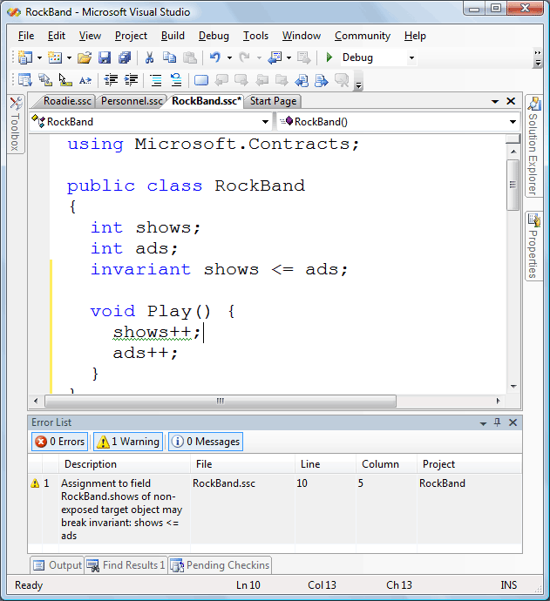

Slide 5
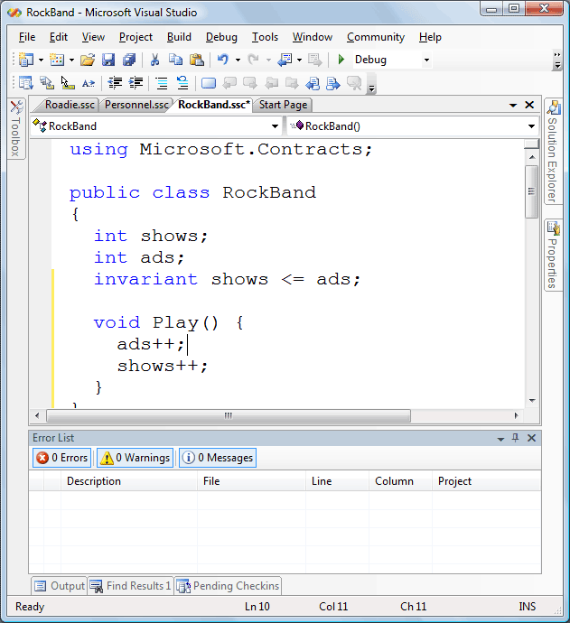

Slide 6
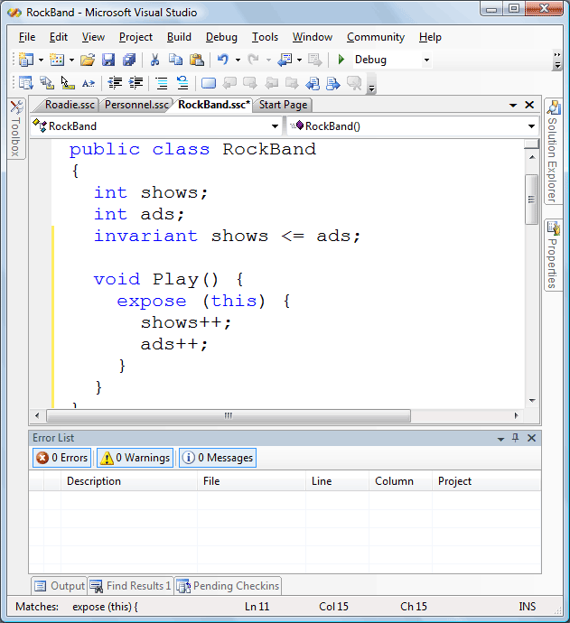

Slide 7
Invariants over multiple objects
class C { T t; invariant t.x = 10; }
class D { T s; invariant s.x = 23; }
Spec# demo: guitar/level
:C
:D
t
s
:T

Slide 8
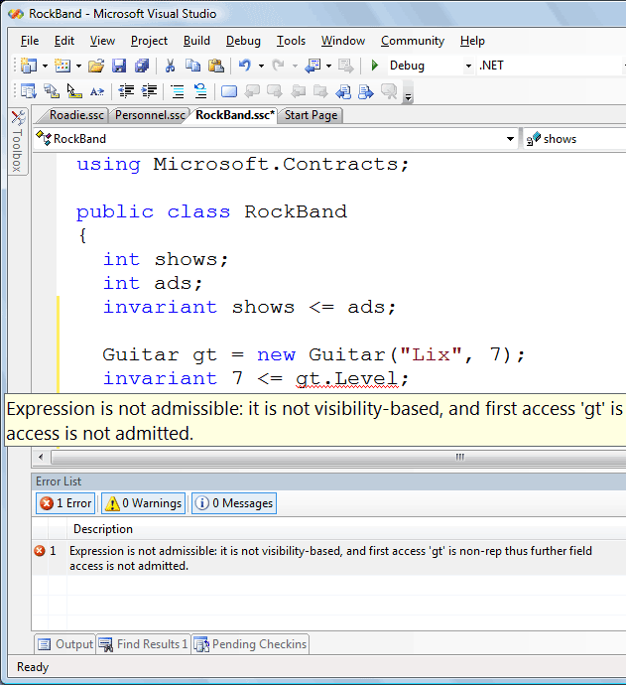

Slide 9
Ownership
class C { rep T t; invariant t.x = 10; }
class D { rep T s; invariant s.x = 23; }
Spec# demo: rep
:C
:D
t
owner
s
:T
owner
:T

Slide 10
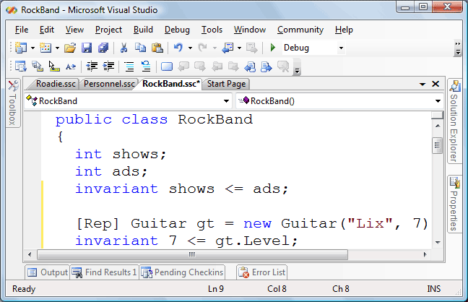

Slide 11
Object states
An object is valid if it is not exposed
(∀o • o.owner.valid ⇒ o.valid)
An object is consistent if it is valid and its owner is not valid
Spec# demo: strum
:RockBand
:Guitar
:GtString
:GtString

Slide 12
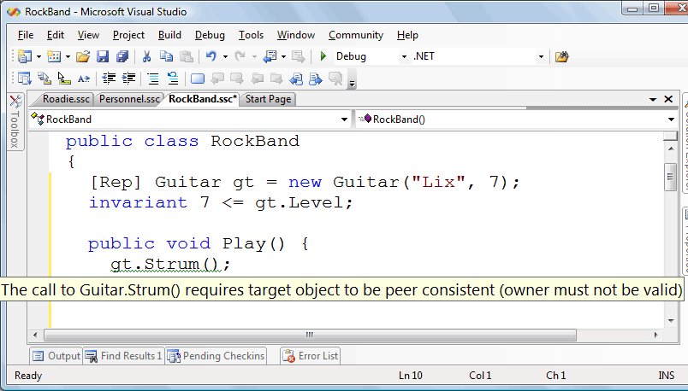

Slide 13
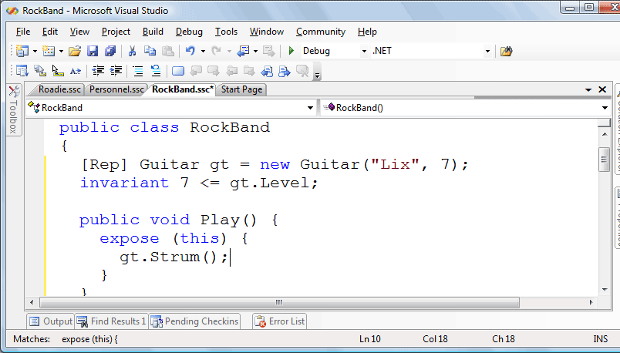

Slide 14
Classes of immutable objects
Spec# demo: roadie/immutable
Notes:
using Microsoft.Contracts;
public class RockBand
{
int shows;
int ads;
invariant shows <= ads;
[Rep] Guitar gt = new Guitar("Lix", 7);
invariant 7 <= gt.Level;
public Roadie rd;
public RockBand() {
Roadie r = new Roadie();
r.SchlepInstruments();
r.PrepareStage();
rd = r;
}
public void Play() {
expose (this) {
gt.Strum(rd.GetGuitarID(GT.FlyingV));
}
}
}

Slide 15
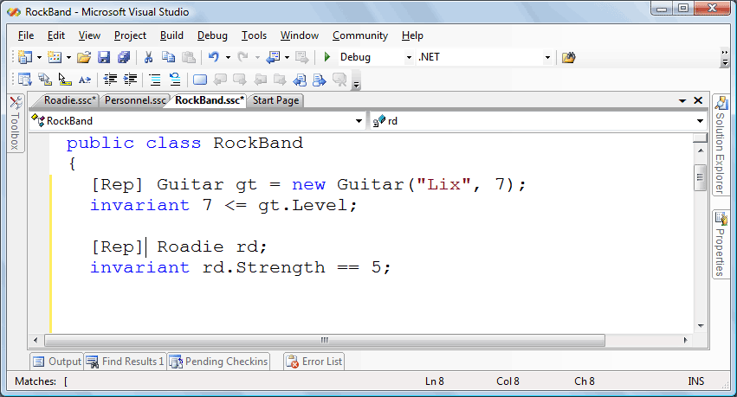

Slide 16
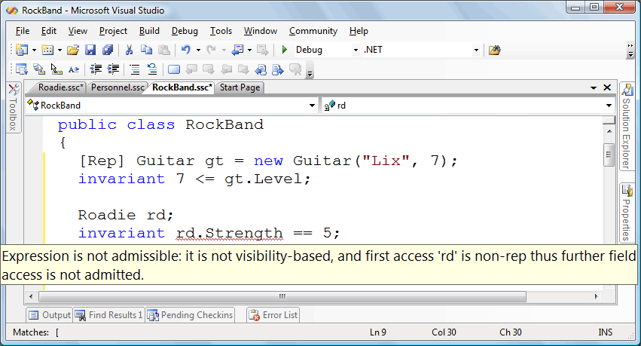

Slide 17
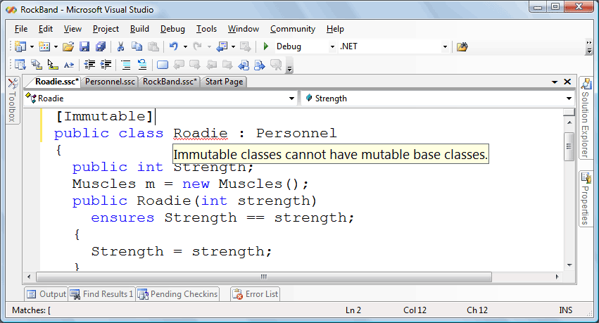

Slide 18
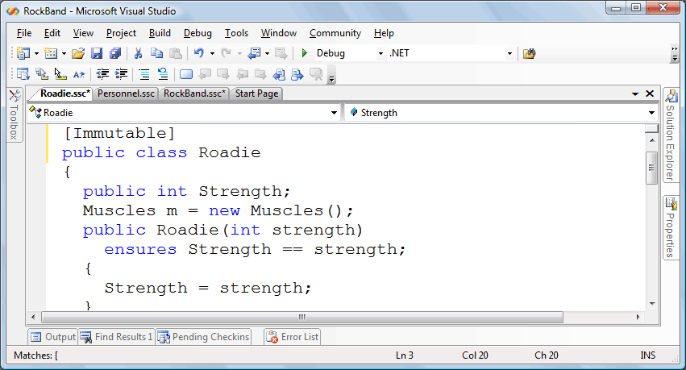

Slide 19
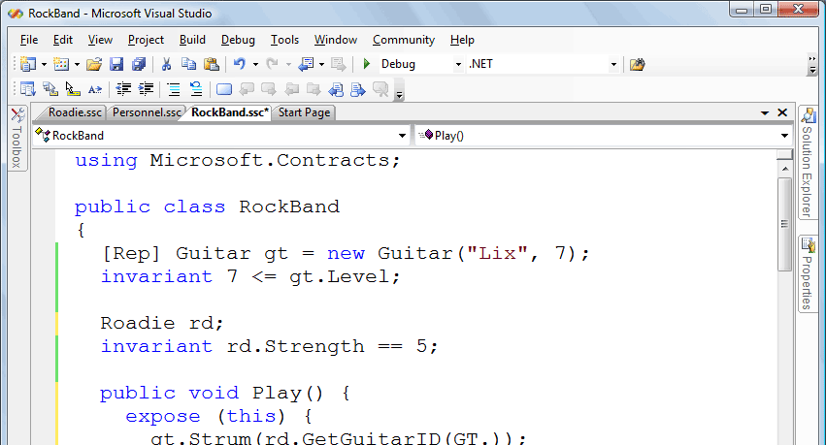

Slide 20
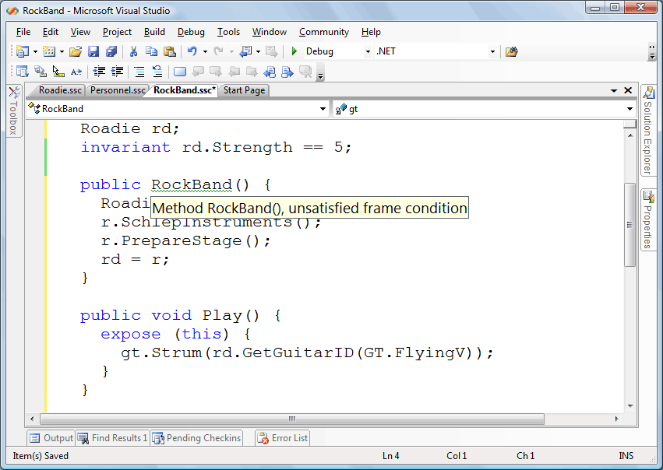

Slide 21
Classes of immutable objects
Spec# demo: roadie/immutable
Example summary:
Cannot share a rep object
Base class of immutable class cannot be mutable
Cannot apply mutable methods on an immutable object
Notes:
using Microsoft.Contracts;
public class RockBand
{
int shows;
int ads;
invariant shows <= ads;
[Rep] Guitar gt = new Guitar("Lix", 7);
invariant 7 <= gt.Level;
public Roadie rd;
public RockBand() {
Roadie r = new Roadie();
r.SchlepInstruments();
r.PrepareStage();
rd = r;
}
public void Play() {
expose (this) {
gt.Strum(rd.GetGuitarID(GT.FlyingV));
}
}
}

Slide 22
Frozen objects
Indicate which instances, not just whole classes, are immutable
Indicate when an object becomes immutable
Frozen objects can be mentioned in invariants
freeze operation transfers ownership to an fictitious freezer object

Slide 23
Using frozen in RockBand
class RockBand { frozen Roadie rd; invariant rd.Strength = 5; RockBand() { Roadie r = new Roadie(5); r.SchlepInstruments(); r.PrepareStage(); freeze r; rd = r; } … }

Slide 24
RockBand picture
freezer
:RockBand
rd
gt
owner
owner
:Guitar
:Roadie

Slide 25
Immutable classes revisited
Special case of frozen objects
Frozen objects give good encoding of immutable classes

Slide 26
Alternative design
Partial ownership
Chalice demo: RockBand

Slide 27
Chalice demo: RockBand
class RockBand {
var r: Roadie
invariant rd(r) && r != null
invariant acc(r.strength) && r.strength == 5
method Main() {
var arnold := new Roadie
arnold.strength := 5
var abba := new RockBand
abba.r := arnold
share abba
var noDoubt := new RockBand
noDoubt.r := arnold
share noDoubt
}
}
class Roadie {
var strength: int
}
Monitor invariant might not hold. Insufficient fraction at 4.13 for Roadie.strength.

Slide 28
Conclusion
Frozen objects are flexible. A program can:
decide which instances are frozen
decide when each instance becomes frozen
Frozen objects can fit into any system with ownership and ownership transfer
Frozen objects can encode immutable types
Invariants can be written over frozen objects
Future: implement in Spec#
http://research.microsoft.com/specsharp

