Slide 1
Proving Programs Robust
Swarat Chaudhuri^{1,3} Sumit Gulwani² Roberto Lublinerman¹ Sara Navidpour¹
¹Pennsylvania State University
²Microsoft Research
³Rice University

Slide 2
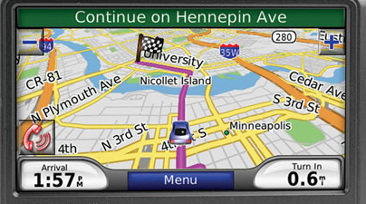
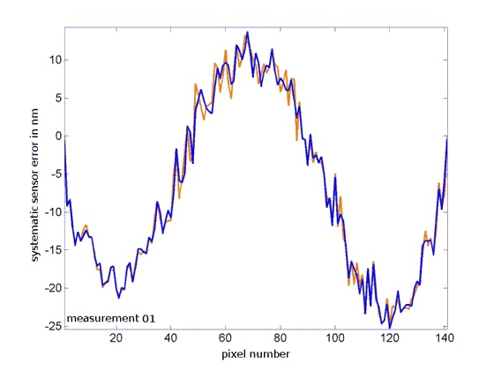
Uncertainty
Uncertainty: stale satellite data, erroneous sensor measurements, …
Does your program handle uncertainty robustly?
Notes:
Thank you, it’s a pleasure to be here. I am here today to tell you about a program analysis to determine whether a program represents a robust function. An application of the analysis is in reasoning about uncertain computation. We live in an era where computations often operate on uncertain data, in uncertain environments. Applications are running in your phones, in your cars, in your tvs and in your GPSs. These applications receive data from sensors and as a consequence the data can have small errors. In which case, how do we verify that programs handle this uncertainty correctly?
One key correctness property here is robustness.

Slide 3
Robustness
∞
Correctness in settings without uncertainty does not imply correctness in uncertain environments.
Notes:
Correctness in settings without uncertainty does not imply correctness in uncertain environments. Say robustness is correctness in uncertain environments, how are we going to define robustness? Is it a qualitative term or a quantitative one. I propose that robustness is a quantitative term, but then how are we going to measure robustness.

Slide 4
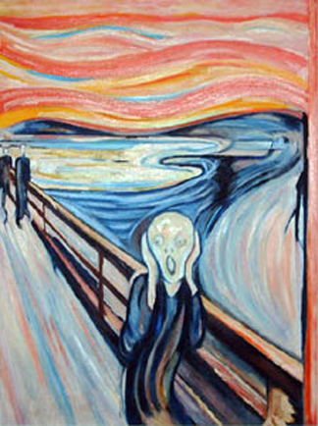
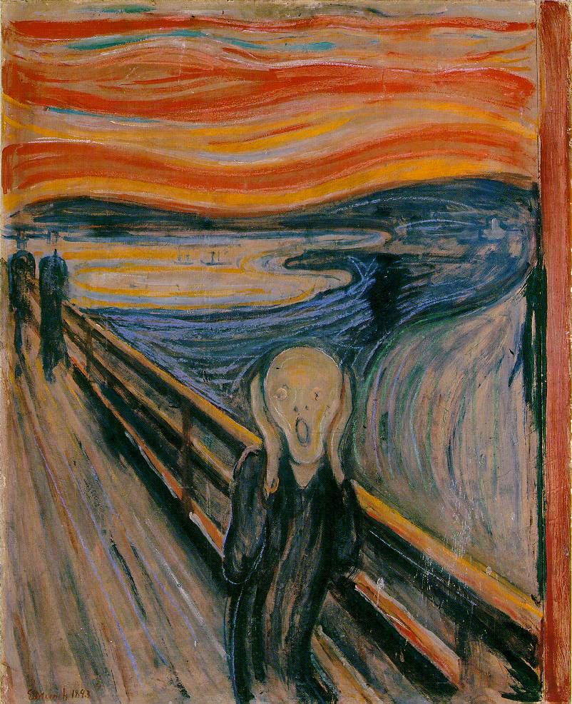
Before we “measure” robustness
3.14159
Notes:
before we can talk about errors, we need to define distance on values

Slide 5
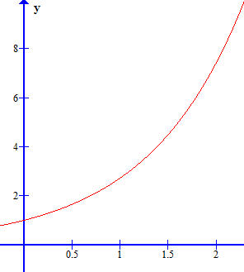
How would we “measure” robustness?
P
f(x) = e^{x}
No “jumps” due to loops and branches
Analytical continuity
Chaudhuri, Gulwani, Lublinerman. Continuity Analysis of Programs. POPL 2010.
Notes:
Now if you think of it, continuity is actually a robustness property…
of course, it is a rather weak robustness property for two reasons. First, it talks about arbitrarily small changes. Second, it assumes infinite-precision reals
I would argue that it is still an important property. first, a dominant source of nonrobustness is branches… As for infinite precision reals. The reason is that this is the abstraction using which algorithm designers think—so if you are trying to find logical or algorithmic errors in your system, this is the right level of abstraction to think in.

Slide 6
Quantitative robustness properties
k-robustness:
Change in output is bounded by K times the change in inputs.
P
Notes:
It is possible to give stronger definitions of robustness…
K might depend on the size of the input
-----------------------------
When can something be not robust.

Slide 7
Distance on arrays
4 | 2 | 5 | 1 | 6
-
5 | 1 | 5 | 4 | 5
=
max
= 3
1 | 1 | 0 | 3 | 1

Slide 8
Distance on graphs
2
2 | 2 | 1 | 3 | 1
1
-
1
2
2
4
1
1
1 | 4 | 2 | 5 | 1
3
5
=
max
= 2
1 | 2 | 1 | 2 | 0

Slide 9
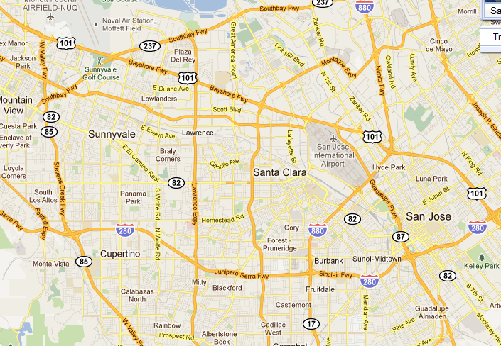
Robustness of shortest path
∞
You are here

Slide 10
Robustness of shortest path
∞
2.00
3.00
∞
∞
∞
4.10
∞
2.00
1.00
4.00
∞
3.00
1.00
∞
2.00
1.00
1.00
∞
∞
You are here

Slide 11
Robustness of shortest path
∞
2.00
3.00
∞
∞
∞
4.10
∞
2.00
1.00
4.00
∞
3.00
1.00
∞
2.00
1.00
1.00
2
1
You are here

Slide 12
Robustness of shortest path
∞
2.00
3.00
∞
∞
∞
4.10
2
2.00
1.00
4.00
2
3.00
1.00
∞
2.00
1.00
1.00
2
1
You are here

Slide 13
Robustness of shortest path
∞
2.00
3.00
6.10
∞
∞
4.10
2
2.00
1.00
4.00
2
3.00
1.00
∞
2.00
1.00
1.00
2
1
You are here

Slide 14
Robustness of shortest path
∞
2.00
3.00
6
∞
∞
4.10
2
2.00
1.00
4.00
2
3.00
1.00
5
2.00
1.00
1.00
2
1
You are here

Slide 15
Robustness of shortest path
∞
2.00
3.00
6
7
∞
4.10
2
2.00
1.00
4.00
2
3.00
1.00
5
2.00
1.00
1.00
2
1
You are here

Slide 16
Robustness of shortest path
∞
2.00
3.00
6
7
9
4.10
2
2.00
1.00
4.00
2
3.00
1.00
5
2.00
1.00
1.00
2
1
You are here

Slide 17
Robustness of shortest path
∞
2.00
3.00
6
7
9
4.10
2
2.00
1.00
4.00
2
3.00
1.00
5
0.95
2.00
1.00
1.00
2.10
2
1
You are here

Slide 18
Robustness of shortest path
∞
2.00
3.00
6.05
7.10
9.05
4.10
1.95
2.00
1.00
4.00
1.95
3.00
1.00
5.10
2.10
0.95
1.00
2.10
0.95
You are here

Slide 19
k-robustness and classical problems
Problem | Input | Output | k-robustness
Max of an array | elements in the array | maximum element of the array | 1-robust
Minimum spanning tree | graph | cost | N-robust
Sorting | elements in the array | sorted array | 1-robust
Notes:
Show arrays with pictorial example.

Slide 20
Robustness matrices
$$\begin{matrix}y & x\end{matrix}$$
$$\begin{matrix}y \\ x\end{matrix}$$
$$\left[\begin{matrix}1 & k \\ 0 & 1\end{matrix}\right]$$
R[y,x] = k
δ-variation in initial value of x
produces at most a kδ-variation in final value of y
Notes:
Say that is similar to the analytical concept of Jacobian matrix for derivatives

Slide 21
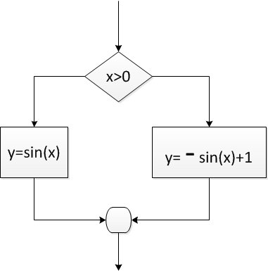
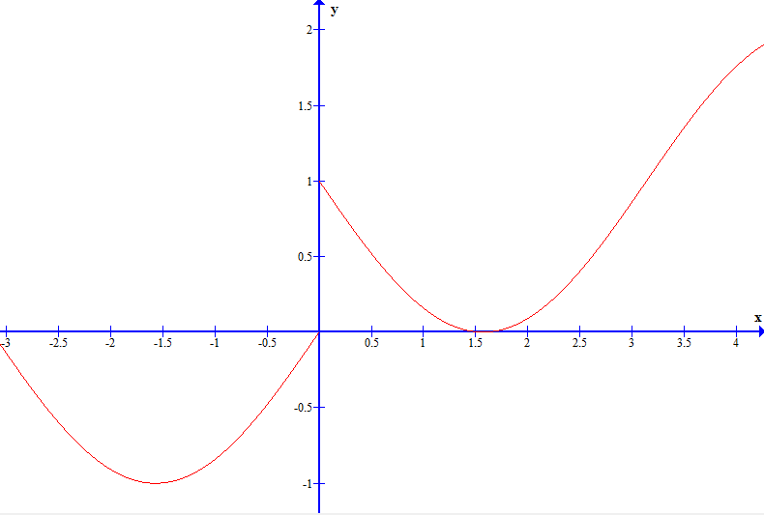
How do we prove k-robustness

Slide 22
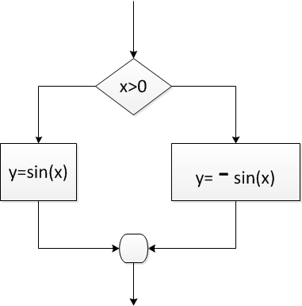
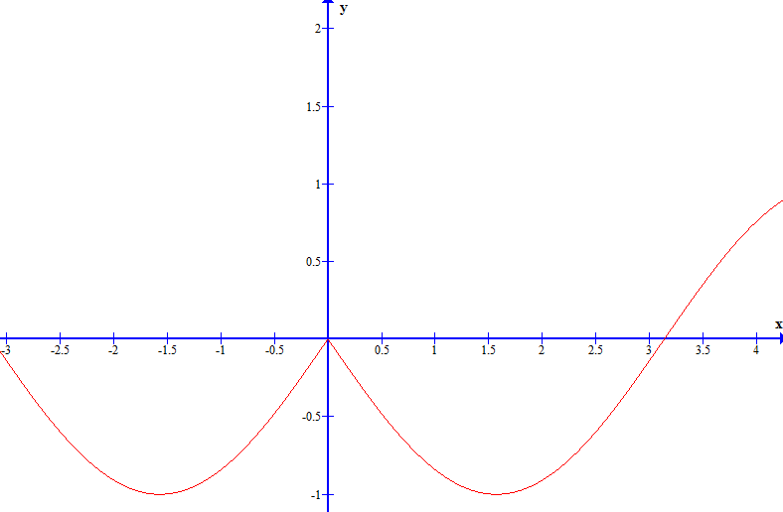
How do we prove k-robustness

Slide 23
Proving k-robustness
P
if B
1. P₁ has robustness matrix R₁
P₂ has robustness matrix R₂
P is continuous ^{*1}
P has robustness matrix
max(R₁, R₂)
T
F
P₁
P₂
^{*1} Chaudhuri, Gulwani, Lublinerman. Continuity Analysis of Programs. POPL 2010.

Slide 24
Proving k-robustness
P
1. P₁ has robustness matrix R₁
P₂ has robustness matrix R₂
P has robustness matrix R₂ R₁
P₁
P₂
Analogous to the “chain rule”

Slide 25
Proving piecewise k-robustness
1. Q has robustness matrix R
N is the bound on loop iterations
P is continuous *¹
P has robustness matrix R^{N}
P
while B
Q
^{*1} Chaudhuri, Gulwani, Lublinerman. Continuity Analysis of Programs. POPL 2010.
Notes:
For for loops is easy, for all of our examples. for more complex loops can use more sofisticated.

Slide 26
Example: Dijsktra’s shortest path algorithm
procedure Dijkstra(G: graph, src: node):
for each node v in G: d[v] = ∞
d[src] = 0; W := edges of G
while W is not empty
remove G[w,v] from W s.t. d[w] is minimal
z = d[w] + G[w,v]
if z < d[v]
d[v] = z; prev[v] = w

Slide 27
Example: Dijsktra’s shortest path algorithm
procedure Dijkstra(G: graph, src: node):
for each node v in G: d[v] = ∞
d[src] = 0; W := edges of G
while W is not empty
remove G[w,v] from W s.t. d[w] is minimal
z = d[w] + G[w,v]
if z < d[v]
d[v] = z; prev[v] = w
$$\begin{matrix}d & G\end{matrix}$$
$$\begin{matrix}d \\ G\end{matrix}$$
$$\left[\begin{matrix}1 & 0 \\ 0 & 1\end{matrix}\right]$$
d[0] =∞
$$\begin{matrix}d & G\end{matrix}$$
d[src] = 0
$$\begin{matrix}d \\ G\end{matrix}$$
$$\left[\begin{matrix}1 & 0 \\ 0 & 1\end{matrix}\right]$$
$$\begin{matrix}d & G\end{matrix}$$
$$\begin{matrix}d \\ G\end{matrix}$$
$$\left[\begin{matrix}1 & 0 \\ 0 & 1\end{matrix}\right]$$

Slide 28
Example: Dijsktra’s shortest path algorithm
procedure Dijkstra(G: graph, src: node):
for each node v in G: d[v] = ∞
d[src] = 0; W := edges of G
while W is not empty
remove G[w,v] from W s.t. d[w] is minimal
z = d[w] + G[w,v]
if z < d[v]
d[v] = z; prev[v] = w
$$\begin{matrix}d & G\end{matrix}$$
if d[v] > d[w] + G[w,v]
$$\begin{matrix}d & G\end{matrix}$$
$$\begin{matrix}d \\ G\end{matrix}$$
$$\left[\begin{matrix}1 & 1 \\ 0 & 1\end{matrix}\right]$$
$$\begin{matrix}d \\ G\end{matrix}$$
$$\left[\begin{matrix}1 & 0 \\ 0 & 1\end{matrix}\right]$$
F
T
d[v]=d[w] + G[w,v]
$$\begin{matrix}d & G\end{matrix}$$
$$\begin{matrix}d \\ G\end{matrix}$$
$$\left[\begin{matrix}1 & 1 \\ 0 & 1\end{matrix}\right]$$

Slide 29
Example: Dijsktra’s shortest path algorithm
procedure Dijkstra(G: graph, src: node):
for each node v in G: d[v] = ∞
d[src] = 0; W := edges of G
while W is not empty
remove G[w,v] from W s.t. d[w] is minimal
z = d[w] + G[w,v]
if z < d[v]
d[v] = z; prev[v] = w
while W not empty
Q
d is N-robust in G
$$\begin{matrix}d & G\end{matrix}$$
$$\begin{matrix}d \\ G\end{matrix}$$
$$\left[\begin{matrix}1 & 1 \\ 0 & 1\end{matrix}\right]$$
$$\begin{matrix}d & G\end{matrix}$$
$$\begin{matrix}d \\ G\end{matrix}$$
$$\left[\begin{matrix}1 & N \\ 0 & 1\end{matrix}\right]$$
Notes:
how do we compute the iterated produce. For for loops blah lbah

Slide 30
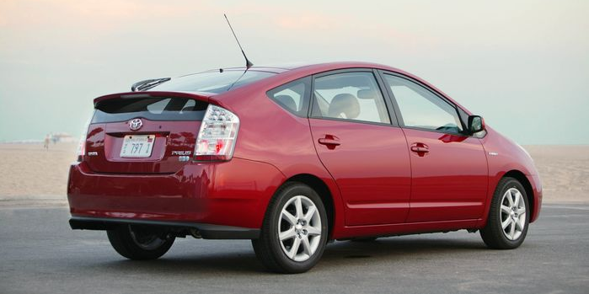
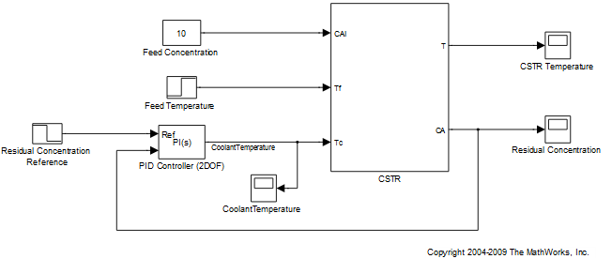
Applications: Robustness Proofs for Embedded Systems
Notes:
Motivating application.

Slide 31
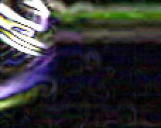
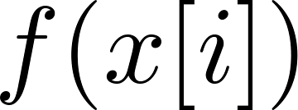
Approximate Computation: Trade accuracy for reduced cost
for i:= ….
P’
Notes:
Give a scenario: complex loop iterating over image. Want to trade off runtime for accuracy. Observation: most typical images, pixels are close by. You can reduce by half if f is robust.
Here is an analysis that can guide this sort of approximation, tell us when it ok to do it and when it is not.

Slide 32
Applications: Approximate Computation
Approximate loop rewriting:
Our static analysis can guide this sort of approximation
Accuracy vs. Performance trade-off of loop perforation [Sidiroglou, Misailovic, Hoffman, Rinard FSE11]
for i := 1 to n by 1
z = f(x[i])
sum = sum + z
sum = sum + z
2
Notes:
Do loop perforations.

Slide 33
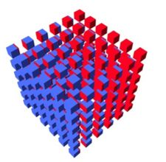
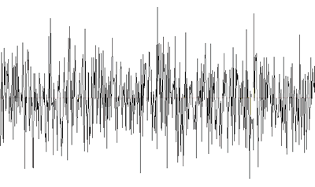
Applications: Privacy in Statistical Databases
Differential privacy [Dwork]
Notes:
Why is it useful, curator for a database..

Slide 34
Results
Implemented the analysis in a tool.
use Z3 to discharge continuity judgments.
Proved robustness for many classical algorithms
Bubble sort | Dijkstra | Knapsack
Insertion sort | Bellman-ford | Small controller
Selection sort | Kruskall
Merge sort | Prim

Slide 35
Related Work
Work on interval polyhedra [Chen et al 2009] [Chen et al 2010]
Continuity analysis of programs [Chaudhuri et al 2010]
Testing for robustness [Majmudar et al 2010]
Calculus for differential privacy [Reed and Pierce 2010]
Notes:
Look at the references on interval polyhedra.

Slide 36
Conclusion
Robustness is an important correctness property for programs operating under uncertainty.
We provide a automated program analysis for robustness.
k-robustness can be proved mechanically for many interesting programs.
Applications in different domains.

Slide 37
Sorting 1-robust?
4 | 2 | 5 | 1 | 6
4 | 7 | 5 | 1 | 6
1 | 2 | 4 | 5 | 6
1 | 4 | 5 | 6 | 7

