Slide 1
Using and Building an Automatic Program Verifier
K. Rustan M. Leino
Research in Software Engineering (RiSE)
Microsoft Research, Redmond
Lecture 0
Marktoberdorf Summer School 2011
Bayrischzell, BY, Germany
4 August 2011

Slide 2
Reasoning about programs
Central to any programming task
From safety critical applications to scripting
From initial development to maintenance to debugging
Minimizes faults, security problems, time/cost to market
Thinking skill

Slide 3
Program verifier
A verification tool can be used
to establish the correctness of a program
as a vehicle for learning to reason about programs

Slide 4
Program verification
Dafny and others
traditional mechanical program verification
hand proofs (or hand waving)
functional correctness
assurance level
extended static checking
limited checking
human effort
technology:
automatic decision procedures
(SMT solvers)
interactive proof assistants
no
machine assistance

Slide 5
Dafny
Object-based language
generic classes, no subclassing
object references, dynamic allocation
sequential control
Built-in specifications
pre- and postconditions
framing
loop invariants, inline assertions
termination
Specification support
Sets, sequences, inductive datatypes, …
User-defined recursive functions
Ghost variables

Slide 6
Basics (assert, ensures, BVD, assume, requires, call, testing specs, debugging specs)
demo
Swap (parameters, globals, fields)
Notes:
class Cell {
var data: int;
}
method Swap2(c: Cell, d: Cell)
requires c != null && d != null && c != d;
modifies c, d;
ensures c.data == old(d.data) && d.data == old(c.data);
{
c.data := c.data + d.data;
d.data := c.data - d.data;
c.data := c.data - d.data;
}
var a: int;
var b: int;
method Swap1()
modifies this;
ensures a == old(b) && b == old(a);
{
a := a + b;
b := a - b;
a := a - b;
}
method Swap0(a: int, b: int) returns (x: int, y: int)
ensures x == b && y == a;
{
x := b;
y := a;
}
method Main()
{
var k, m := 5, 7;
k, m := Swap0(k, m);
assert k + m == 12;
var c, d := new Cell, new Cell;
c.data := 5; d.data := 7;
Swap2(c, d);
assert d.data == 5;
assert c.data == 7;
}

Slide 7
When do tools kick in?
Run time
Compile time
Design time
→ closer to the time of program construction

Slide 8
Reasoning about loops
A loop invariant
holds at the top of every iteration
is the only thing the verifier remembers from one iteration to another (about the variables being modified)
while (B) { S; }
Loop invariant holds here

Slide 9
Loops
demo
Iterative Fibonacci, Binary Search
Notes:
function Fib(n: nat): nat
{
if n < 2 then n else Fib(n-2) + Fib(n-1)
}
method ComputeFib(n: nat) returns (x: nat)
ensures x == Fib(n);
{
x := 0;
var y := 1;
var i := 0;
while (i < n)
invariant 0 <= i <= n;
invariant x == Fib(i) && y == Fib(i+1);
{
x, y := y, x+y;
i := i + 1;
}
}
// ----------------------------------------------------------------------------------------
method BinarySearch(a: array<int>, key: int) returns (result: int)
requires a != null;
requires forall i,j :: 0 <= i <= j < a.Length ==> a[i] <= a[j];
ensures 0 <= result ==> result < a.Length && a[result] == key;
ensures result < 0 ==> forall i :: 0 <= i < a.Length ==> a[i] != key;
{
var lo, hi := 0, a.Length;
while (lo < hi)
invariant 0 <= lo <= hi <= a.Length;
invariant forall i :: 0 <= i < lo ==> a[i] != key;
invariant forall i :: hi <= i < a.Length ==> a[i] != key;
{
var mid := (lo + hi) / 2;
var midVal := a[mid];
if (midVal == key) {
result := mid; return;
} else if (midVal < key) {
lo := mid + 1;
} else {
hi := mid;
}
}
result := -1;
}

Slide 10
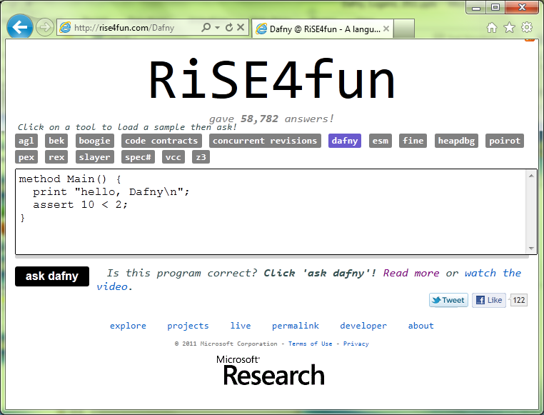
Using Dafny on the web

Slide 11
Exercises
Cubes
http://rise4fun.com/Dafny/Qch
Cubes, recursive
http://rise4fun.com/Dafny/6xO

Slide 12

Links
Dafny
research.microsoft.com/dafny
rise4fun
rise4fun.com
Verification Corner
research.microsoft.com/verificationcorner

