Slide 1
Specification and Verification of Object-Oriented Software
K. Rustan M. Leino
Research in Software Engineering (RiSE) Microsoft Research, Redmond, WA
part 0
International Summer School Marktoberdorf
Marktoberdorf, Germany
6 August 2008

Slide 2
Contents
Theory and techniques for building a basic program verifier for a language with references to dynamically allocated objects
A specification style and encoding thereof

Slide 3
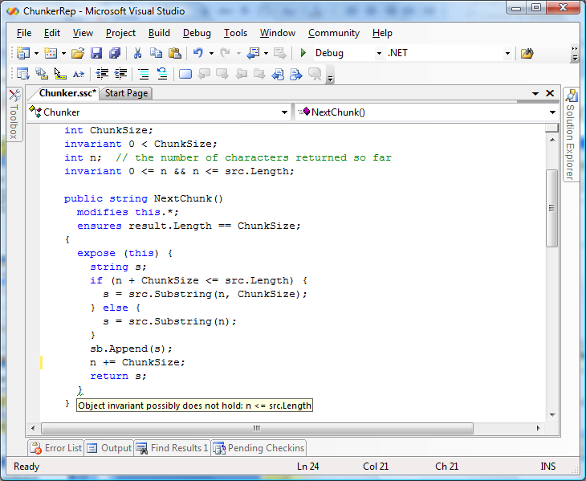
Motivation: Spec# demo

Slide 4
Basic verifier architecture
Source language
Intermediate verification language
Verification condition (logical formula)

Slide 5
Verification architecture
Spec#
C
Dafny
C
Spec# compiler
Dafny verifier
vcc
HAVOC
MSIL
Bytecode translator
Boogie
Inference engine
Static program verifier (Boogie)
V.C. generator
verification condition
SMT solver (Z3)
“correct” or list of errors

Slide 6
Modeling execution traces
terminates
…
diverges
goes wrong

Slide 7
States and execution traces
State
Cartesian product of variables
Execution trace
Nonempty finite sequence of states
Infinite sequence of states
Nonempty finite sequence of states followed by special error state
(x: int, y: int, z: bool)
…

Slide 8
Commands
A command describes a set of execution traces
A command is deterministic if it describes at most one trace from every initial state
Spec#, sequential Java, ML, Haskell
otherwise, it is nondeterministic
C, Modula-3, Erlang, Occam
A command is total if it describes at least one trace from every initial state
Dijkstra’s Law of the Excluded Miracle
otherwise, it is partial
Juno-2, LIM, Boogie
Note, example languages do not necessarily fall squarely into the shown category.

Slide 9
Command language
x := E
x := x + 1
x := 10
havoc x
P
assert P
assume P
¬P
P
Solid lines indicate traces whose length is 1
Dotted lines indicate traces whose length may be greater than 1

Slide 10
Command language
x := E
x := x + 1
x := 10
havoc x
S ; T
P
assert P
assume P
¬P
P
…
…
Solid lines indicate traces whose length is 1
Dotted lines indicate traces whose length may be greater than 1

Slide 11
Command language
x := E
x := x + 1
x := 10
havoc x
S ; T
P
assert P
assume P
S T
¬P
P
…
Solid lines indicate traces whose length is 1
Dotted lines indicate traces whose length may be greater than 1

