Slide 1
Specification and Verification of Programs with Pointers
K. Rustan M. Leino
Research in Software Engineering (RiSE) Microsoft Research, Redmond, WA
part 0
Summer School on Logic and Theorem-Proving in Programming Languages
Eugene, OR
28 July 2008

Slide 2
Contents
Theory and techniques for building a basic program verifier for an object-based language
Specification style and encoding thereof

Slide 3
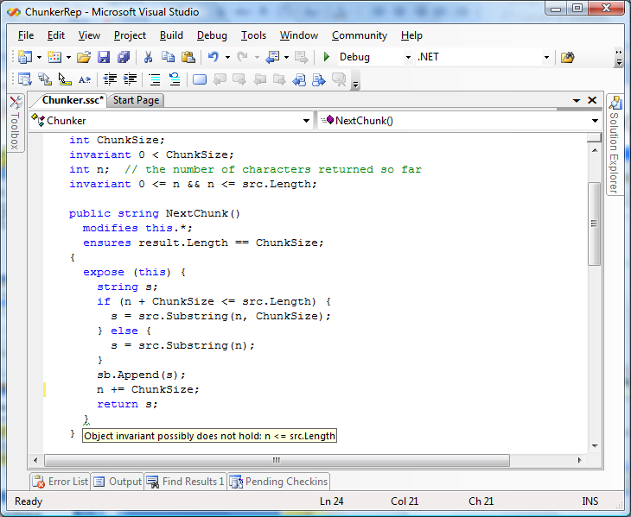
Spec# demo

Slide 4
Basic verifier architecture
Source language
Intermediate verification language
Verification condition (logical formula)

Slide 5
Verification architecture
Spec#
C
Dafny
C
Spec# compiler
Dafny verifier
vcc
HAVOC
MSIL
Bytecode translator
Boogie
Inference engine
Static program verifier (Boogie)
V.C. generator
verification condition
SMT solver (Z3)
“correct” or list of errors

Slide 6
Modeling execution traces
terminates
…
diverges
goes wrong

Slide 7
States and execution traces
State
Cartesian product of variables
Execution trace
Nonempty finite sequence of states
Infinite sequence of states
Nonempty finite sequence of states followed by special error state
(x: int, y: int, z: bool)
…

Slide 8
Commands
A command describes a set of execution traces
A command is deterministic if it describes at most one trace from every initial state
Java, ML, Haskell
otherwise, it is nondeterministic
C, Modula-3, Erlang, Occam
A command is total if it describes at least one trace from every initial state
Dijkstra’s Law of the Excluded Miracle
otherwise, it is partial
Juno-2, LIM

Slide 9
Command language
x := E
x := x + 1
x := 10
havoc x
P
assert P
assume P
¬P
P

Slide 10
Command language
x := E
x := x + 1
x := 10
havoc x
S ; T
P
assert P
assume P
¬P
P
…
…

Slide 11
Command language
x := E
x := x + 1
x := 10
havoc x
S ; T
P
assert P
assume P
S T
¬P
P
…

Slide 12
Arrays
An array is a map from indices to values
array update is map update:
a[ j ] := E means a := a[ j → E ]
Apply/select/get and update/store/set follow the familiar properties:
(∀a,j,k,x • j = k ⇒ a[ j → x ][ k ] = x )
(∀a,j,k,x • j ≠ k ⇒ a[ j → x ][ k ] = a[ k ] )

Slide 13
Reasoning about execution traces
Hoare triple { P } S { Q } says that
every terminating execution trace of S that starts in a state satisfying P
does not go wrong, and
terminates in a state satisfying Q
Given P and Q, what is the largest S’ satisfying {P} S’ {Q} ?
to check {P} S {Q}, check S ⊆ S’

Slide 14
Reasoning about execution traces
Hoare triple { P } S { Q } says that
every terminating execution trace of S that starts in a state satisfying P
does not go wrong, and
terminates in a state satisfying Q
Given S and Q, what is the weakest P’ satisfying {P’} S {Q} ?
P' is called the weakest precondition of S with respect to Q, written wp(S, Q)
to check {P} S {Q}, check P ⇒ P’

Slide 15
Reasoning about execution traces
Hoare triple { P } S { Q } says that
every terminating execution trace of S that starts in a state satisfying P
does not go wrong, and
terminates in a state satisfying Q
Given P and S, what is the strongest Q’ satisfying {P} S {Q’} ?
to check {P} S {Q}, check Q' ⇒ Q


Slide 16
Weakest preconditions
wp( x := E, Q ) =
wp( havoc x, Q ) =
wp( assert P, Q ) =
wp( assume P, Q ) =
wp( S ; T, Q ) =
wp( S T, Q ) =
Q[ E / x ]
(∀x • Q )
P ∧ Q
P ⇒ Q
wp( S, wp( T, Q ))
wp( S, Q ) ∧ wp( T, Q )

Slide 17
Structured if statement
if E then S else T end =
assume E; S
assume ¬E; T

Slide 18
Dijkstra's guarded command
if E → S | F → T fi =
assert E ∨ F;
(
assume E; S
assume F; T
)

Slide 19
Picking any good value
assign x such that P =
havoc x; assume P
assign x such that x*x = y
P
;
=
¬P

Slide 20
Procedures
A procedure is a user-defined command
procedure M(x, y, z) returns (r, s, t) requires P modifies g, h ensures Q

Slide 21
Procedure example
procedure Inc(n) returns (b) requires 0 ≤ n modifies g ensures g = old(g) + n ∧ b = (g even)

Slide 22
Procedures
A procedure is a user-defined command
procedure M(x, y, z) returns (r, s, t) requires P modifies g, h ensures Q
call a, b, c := M(E, F, G) = x’ := E; y’ := F; z’ := G; assert P’; g0 := g; h0 := h; havoc g, h, r’, s’, t’; assume Q’; a := r’; b := s’; c := t’
where
x’, y’, z’, r’, s’, t’, g0, h0 are fresh names
P’ is P with x’,y’,z’ for x,y,z
Q’ is Q with x’,y’,z’,r’,s’,t’,g0,h0 for x,y,z,r,s,t, old(g), old(h)

Slide 23
Procedure implementations
procedure M(x, y, z) returns (r, s, t) requires P modifies g, h ensures Q
implementation M(x, y, z) returns (r, s, t) is S
= assume P; g0 := g; h0 := h;
S; assert Q’
where
g0, h0 are fresh names
Q’ is Q with g0,h0 for old(g), old(h)
syntactically check that S assigns only to g,h

Slide 24
While loop with loop invariant
while E invariant J do S end
= ?
Homework

Slide 25
Summary
Spec# is a programming language/system with specifications and a static program verifier http://research.microsoft.com/specsharp
To engineer a program verifier or define the semantics of a source language, use an intermediate verification language
An intermediate language can be very small
The semantics of the intermediate language can be defined using weakest preconditions
Tomorrow: Application to programs with objects and references

