Slide 1
Deep Learning: Speech & Information Processing
New-Generation Models & Methodology for Advancing Speech Technology and Information Processing
Li Deng
Microsoft Research, Redmond, USA
CCF, Beijing, July 8, 2013
(including joint work with colleagues at MSR, U of Toronto, etc.)

Slide 2
PART I: Basics of Deep Learning (DL)
--- including impact and recent history of DL (Deep Neural Net, DNN) in speech recognition
PART II: Deeper Substance of DL
--- including connections to other ML paradigms, examples of incorporating speech knowledge in DL architecture, and recent experiments in speech recognition
Outline

Slide 3
Deep Learning (DL) Basics
Deep Learning (aka Deep Structured Learning, Hierarchical Learning): a class of machine learning techniques, where many layers of information processing stages in hierarchical architectures are exploited for unsupervised feature learning and for pattern analysis/classification.
Deep belief nets (DBN): probabilistic generative models composed of multiple layers of stochastic, hidden variables. The top two layers have undirected, symmetric connections between them. The lower layers receive top-down, directed connections from the layer above. (key: stacked RBMs; Hinton: Science, 2006)
Boltzmann machine (BM): a network of symmetrically connected, neuron-like units that make stochastic decisions about whether to be on or off.
Restricted Boltzmann machine (RBM): a special BM consisting of a layer of visible units and a layer of hidden units with no visible-visible or hidden-hidden connections. (Key: contrastive divergence learning)
Deep neural nets (DNN, or “DBN” before Nov 2012): multilayer perceptrons with many hidden layers, whose weights are often initialized (pre-trained) using stacked RBMs or DBN (DBN-DNN) or discriminative pre-training.
Deep auto-encoder: a DNN whose output is the data input itself, often pre-trained with DBN (Deng/Hinton, interspeech 2010; Hinton, Science 2006)
Distributed representation: a representation of the observed data in such a way that they are modeled as being generated by the interactions of many hidden factors. A particular factor learned from configurations of other factors can often generalize well. Distributed representations form the basis of deep learning.

Slide 4
More on “Deep Learning”
Definition 1: A class of machine learning techniques that exploit many layers of non-linear information processing for supervised or unsupervised feature extraction and transformation, and for pattern analysis and classification.
Definition 2: “A sub-field within machine learning that is based on algorithms for learning multiple levels of representation in order to model complex relationships among data. Higher-level features and concepts are thus defined in terms of lower-level ones, and such a hierarchy of features is called a deep architecture. Most of these models are based on unsupervised learning of representations.” (Wikipedia on “Deep Learning” around March 2012.)
Definition 3: “A sub-field of machine learning that is based on learning several levels of representations, corresponding to a hierarchy of features or factors or concepts, where higher-level concepts are defined from lower-level ones, and the same lower-level concepts can help to define many higher-level concepts. Deep learning is part of a broader family of machine learning methods based on learning representations. An observation (e.g., an image) can be represented in many ways (e.g., a vector of pixels), but some representations make it easier to learn tasks of interest (e.g., is this the image of a human face?) from examples, and research in this area attempts to define what makes better representations and how to learn them.” see Wikipedia on “Deep Learning” as of this writing in February 2013; see http://en.wikipedia.org/wiki/Deep_learning.
Definition 4: “Deep Learning is a new area of Machine Learning research, which has been introduced with the objective of moving Machine Learning closer to one of its original goals: Artificial Intelligence. Deep Learning is about learning multiple levels of representation and abstraction that help to make sense of data such as images, sound, and text.” See https://github.com/lisa-lab/DeepLearningTutorials

Slide 5
Data Science 101 (June 2013)
Deep Learning – A Term To Know
Deep Learning is a new term that is starting to appear in the data science/machine learning news.
  •Communications of the ACM just published a story on the topic, Deep Learning Comes of Age.
  •Deep Learning was named as one of the Top 10 Breakthrough Technologies of 2013 by MIT Technology Review.
  •Jeremy Howard, Chief Scientist at Kaggle declared Deep Learning – The Biggest Data Science Breakthrough of the Decade.
  •The New York Times published Scientists See Promise in Deep-Learning Programs
What is Deep Learning?
According to DeepLearning.net, the definition goes like this:
“Deep Learning is a new area of Machine Learning research, which has been introduced with the objective of moving Machine Learning closer to one of its original goals: Artificial Intelligence.”
Wikipedia provides the following definition:
“Deep learning is set of algorithms in machine learning that attempt to learn layered models of inputs, commonly neural networks. The layers in such models correspond to distinct levels of concepts, where higher-level concepts are defined from lower-level ones, and the same lower-level concepts can help to define many higher-level concepts.”
Deep Learning is sometimes referred to as deep neural networks since much of deep learning focuses on artificial neural networks. Artificial neural networks are a technique in computer science modelled after the connections (synapses) of neurons in the brain. Artificial neural networks, sometimes just called neural nets, have been around for about 50 years, but advances in computer processing power and storage are finally allowing neural nets to improve solutions for complex problems such as speech recognition, computer vision, and Natural Language Processing (NLP).

Slide 6
Useful Sites on Deep Learning
http://www.cs.toronto.edu/~hinton/
http://ufldl.stanford.edu/wiki/index.php/UFLDL_Recommended_Readings
http://ufldl.stanford.edu/wiki/index.php/UFLDL_Tutorial (Andrew Ng’s group)
http://deeplearning.net/reading-list/ (Bengio’s group)
http://deeplearning.net/tutorial/
http://deeplearning.net/deep-learning-research-groups-and-labs/
Google+ Deep Learning community
Notes:
Contextual dynamics; massive parameters vs parsimonious params; constraints in RNN.

Slide 7
http://deeplearning.net/deep-learning-research-groups-and-labs/
Deep Learning Research Groups
Some labs and research groups that are actively working on deep learning:
University of Toronto - Machine Learning Group (Geoff Hinton, Rich Zemel, Ruslan Salakhutdinov, Brendan Frey, Radford Neal)
Université de Montréal - Lisa Lab (Yoshua Bengio, Pascal Vincent, Aaron Courville, Roland Memisevic)
New York University – Yann Lecun‘s and Rob Fergus‘ group
Stanford University – Andrew Ng‘s group
UBC – Nando de Freitas‘s group
Google Research – Jeff Dean, Samy Bengio, Jason Weston, Marc’Aurelio Ranzato, Dumitru Erhan, Quoc Le et al
Microsoft Research – Li Deng et al
SUPSI – IDSIA (Schmidhuber’s group)
UC Berkeley – Bruno Olshausen‘s group
University of Washington – Pedro Domingos‘ group
IDIAP Research Institute - Ronan Collobert‘s group
University of California Merced – Miguel A. Carreira-Perpinan‘s group
University of Helsinki - Aapo Hyvärinen‘s Neuroinformatics group
Université de Sherbrooke – Hugo Larochelle‘s group
University of Guelph – Graham Taylor‘s group
University of Michigan – Honglak Lee‘s group
Technical University of Berlin – Klaus-Robert Muller‘s group
Baidu – Kai Yu‘s group
Aalto University – Juha Karhunen‘s group
U. Amsterdam – Max Welling‘s group
U. California Irvine – Pierre Baldi‘s group
Ghent University – Benjamin Shrauwen‘s group
University of Tennessee – Itamar Arel‘s group
IBM Research – Brian Kingsbury et al
University of Bonn – Sven Behnke’s group
Gatsby Unit @ University College London – Maneesh Sahani, Yee-Whye Teh, Peter Dayan
Last modified on April 10, 2013, at 1:27 pm by Caglar Gulcehre

Slide 8
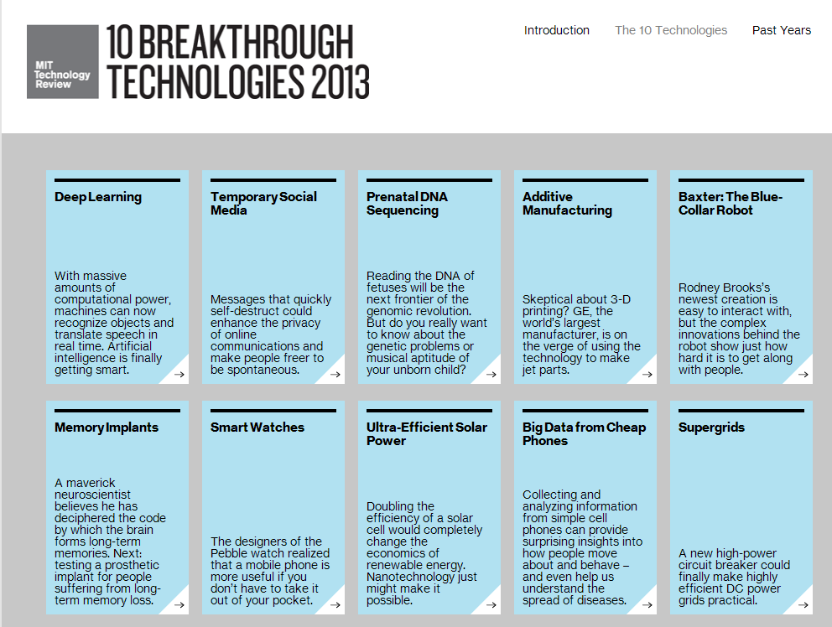

Slide 9




Plenary Keynote (9:50-10:40am, May 28)
Recent Developments in
Deep Neural Networks
Geoffrey E. Hinton
Host: Li Deng

Slide 10
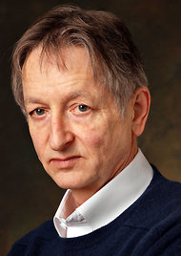

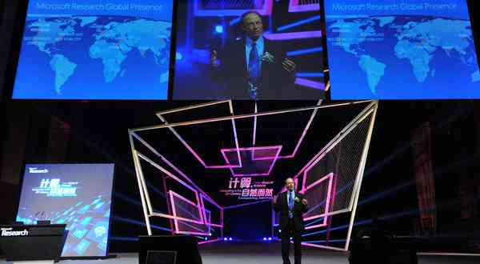
Scientists See Promise in Deep-Learning Programs
John Markoff
November 23, 2012
Rich Rashid in Tianjin, October, 25, 2012
Geoff Hinton
Notes:
I am going to make my introduction short to our keynote speaker today, Prof. Geoff Hinton.
Skipping his life-long remarkable achievements, I just want to say that Geoff designs machine learning algorithms
and has been extremely active and playing the pioneering and leadership roles in research of the topic area in this keynote
--- deep learning, which he established in 2006 as briefly described in this recent NYT article in case you have read it.
The NYT reporter John Markoff interviewed Geoff and me, among others, last fall,
and wrote Geoff’s recent research achievements very concisely,
which you will hear firsthand from him today, plus more recent advances since the article was written.
As a personal note, in Decembers of 2009 and 2010 when NNs were still “in the cold winter”,
my company and I were very fortunate to be able to attract Geoff to come to MSR (working side-by-side in my office),
and we started industry-scale speech applications.
I learned tremendously from him during those “cold winters” in Seattle.
Now, as witnessed by the very large number of DNN papers in our ICASSP,
Geoff has brought the “spring” season of NN to the world again (last time in 1986), this time with a “deep” flavor and with truly useful applications.
You will heard all this from his keynote talk now.
So here we have, Prof. Geoff Hinton.
====================
You may have heard of this real-time speech-to-speech translation demo that was presented in Beijing by Rick Rashid. This demo is only possible because of some remarkable advances in speech processing: we’ve tried it over the previous two years, and it didn’t work.

Slide 11
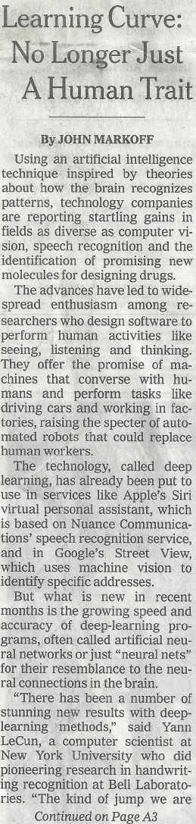
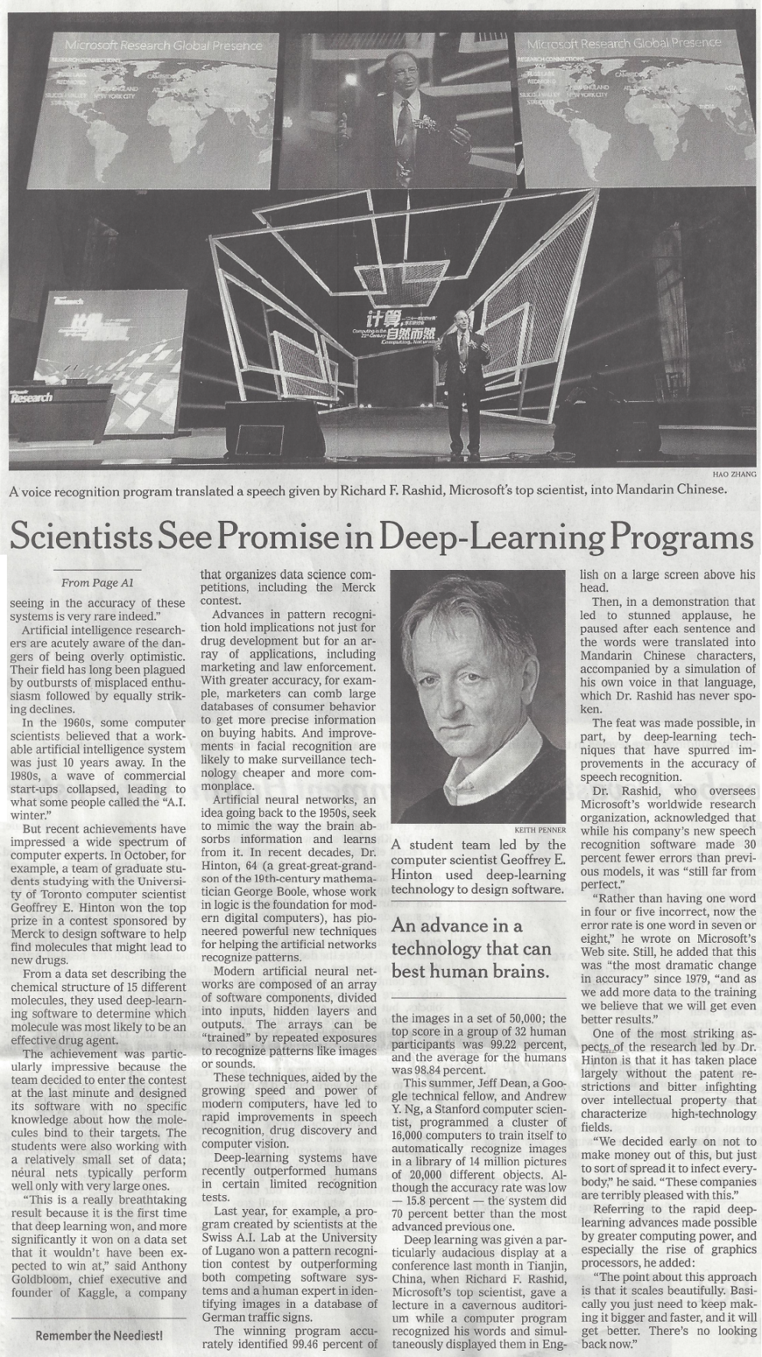


Slide 12
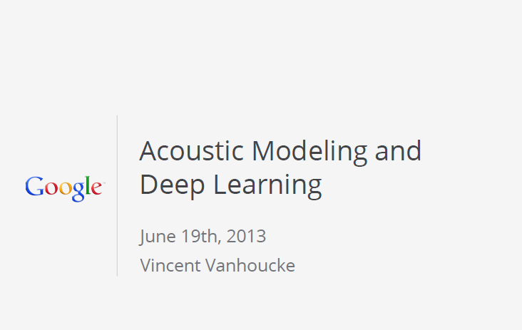


Thanks to Vincent for the permission of using his slides & discussions/corrections
of information in some slides

Slide 13
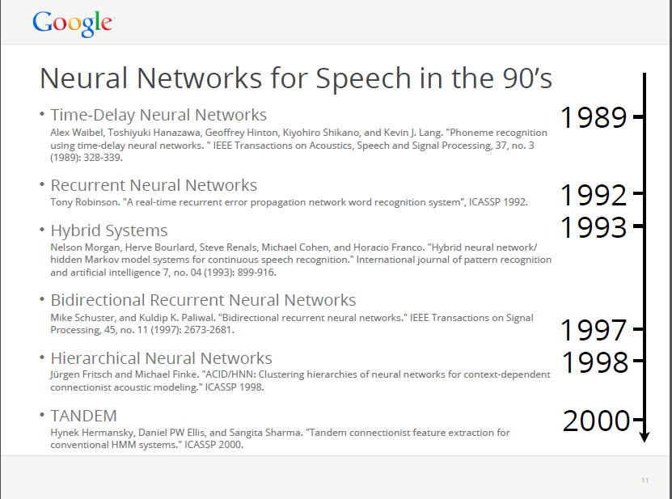

Slide 14
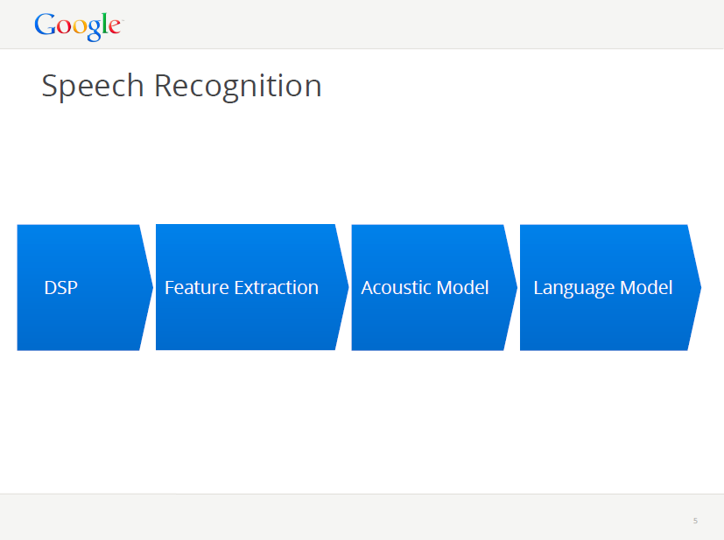

Slide 15
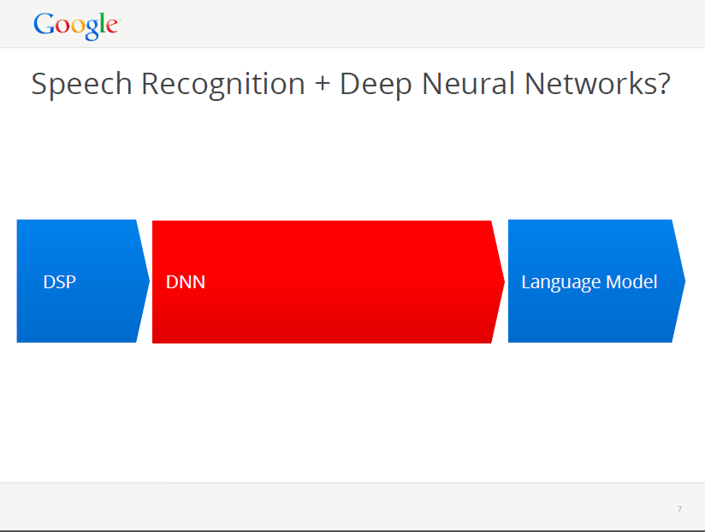

Slide 16
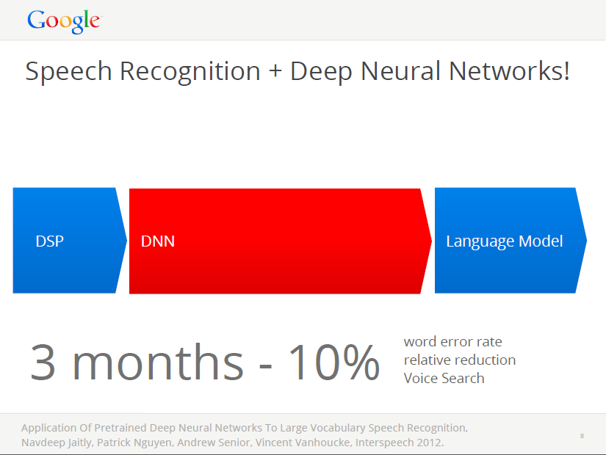

Slide 17
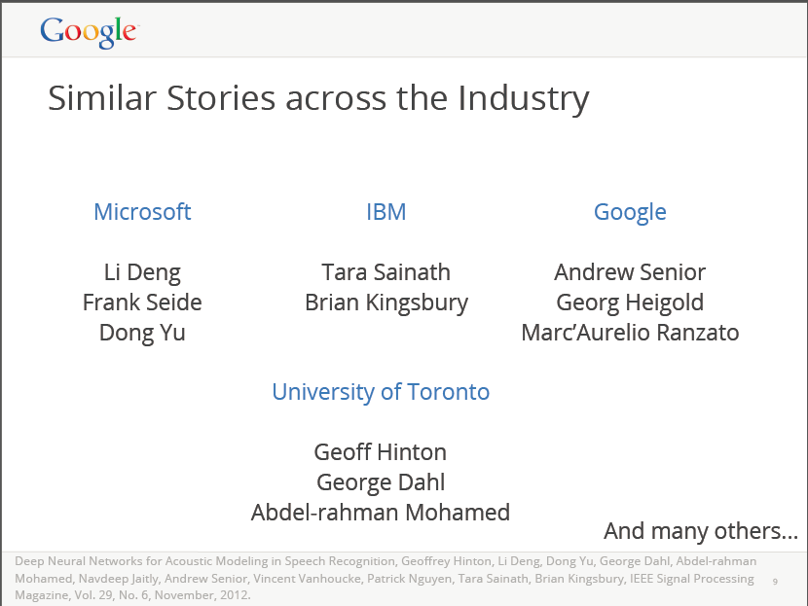

Slide 18
Some of Microsoft’s Stories…,
Since 2009…

Slide 19
DL Took off in Speech Recognition from MSR
Speech recognition: the first big (and real-world) success of deep learning
From MSR (initial collaboration with Hinton et al., 2009-2010) and then to the entire speech industry
Got out of “local optimum” of GMM-HMM stayed for many years
Now used by Microsoft, Google, Apple/Nuance/IBM, Baidu, IFlyTech, etc. doing voice search in the cloud for smart phones (plus many other applications.)

Slide 20

Renaissance of Neural Network
--- “Deep Learning,” 2006
  -Geoff Hinton invented Deep Belief Networks (DBN) to make neural net learning fast and effective; Science, 2006
  Pre-train each layer from bottom up
  Each pair of layers is an Restricted Boltzmann Machine (RBM)
  Jointly fine-tune all layers using back-propagation

Slide 21

Industry Scale Deep Learning
Started at MSR, 2009
  -2008 NIPS: Geoff Hinton & Li Deng reconnected
  -Earlier 2009: Initial exploration of DBN/DNN at MSR (image and speech)
  -Later 2009: Proof of concept by Mohamed et al.; MSR & Hinton collaborated on applying DBN-DNN to speech feature coding (on spectrogram) and speech recognition
  -Dec 2009: NIPS workshop
  (organizers: Deng, Yu, & Hinton)

Slide 22
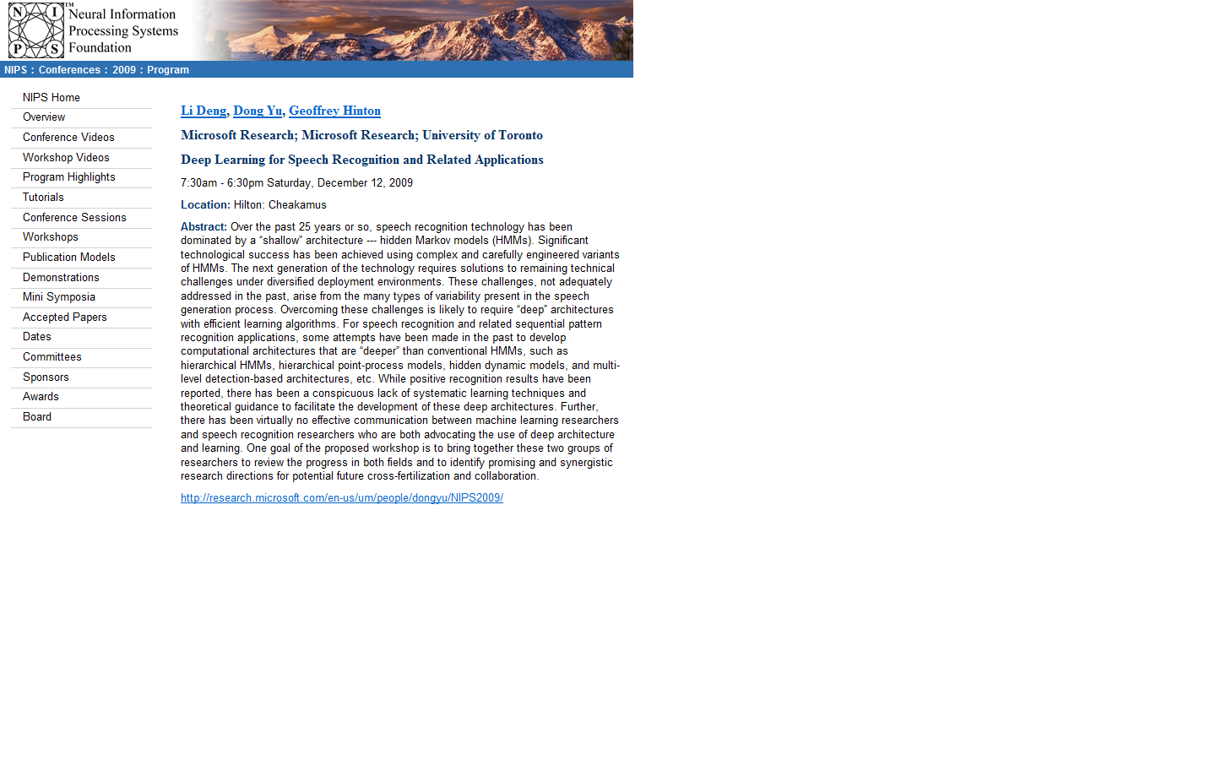

Slide 23
Industry Scale Deep Learning
Continued at MSR, 2010, 2011…
  -2010: slowly more people in MSR-speech joined DBN-DNN research
  -July 2010: success of bottleneck feature coding using speech spectrogram; Interspeech-2010 paper Deng/Hinton et al.
  -August 2010: success of DNN in large-vocabulary speech recognition (voice search); paper in ICASSP-2011 (Dahl/Yu/Deng)
  -Oct 2010: MSR/MSRA collaboration started on Switchboard task
  -March 2011: Success in the Switchboard task by MSR/MSRA; Interspeech-2011: Seide/Yu, et al. Success of deep stacking net: Deng/Yu/Platt.

Slide 24
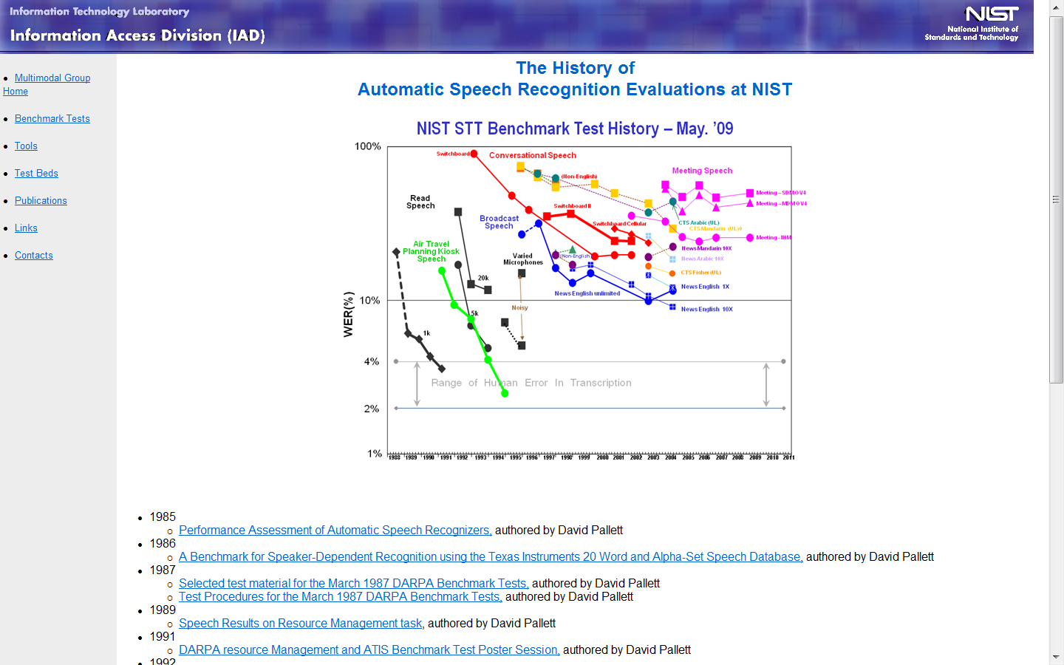
1989
1999
2011

Slide 25
1989
2011

Slide 26
PART I: Basics of Deep Learning (DL)
(including impact and recent history of DL (Deep Neural Net, DNN) in speech recognition)
PART II: Deeper Substance of DL
(including connections to other ML paradigms, example of incorporating speech knowledge in DL architecture, and recent experiments in speech recognition)
Outline

Slide 27
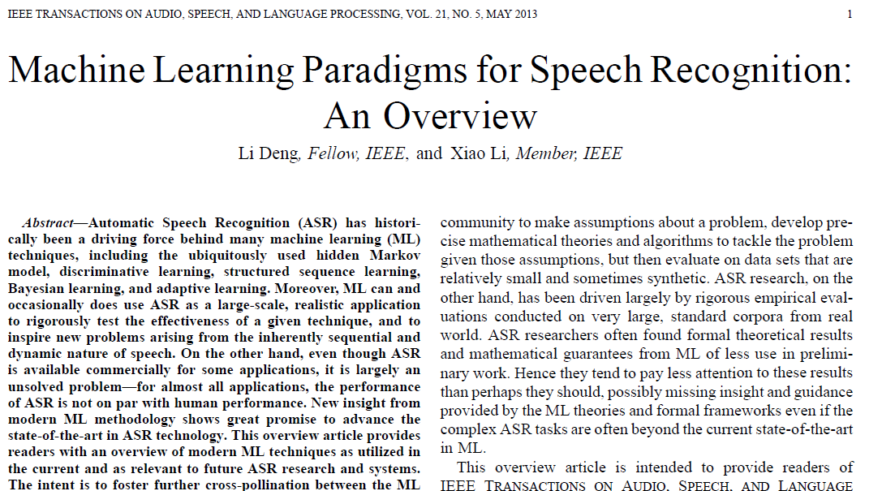
pp. 1060-1089

Slide 28
SHALLOW
DEEP
Modified from
Boosting
Neural Net
RNN
Perceptron
AE
D-AE
Conv. Net
SVM
RBM
DBN
DBM
Sparse Coding
GMM
BayesNP
ΣΠ
Bayes Nets
DecisionTree

Slide 29
SHALLOW
DEEP
Modified from
Boosting
Neural Networks
Deep Neural Net
RNN
Perceptron
AE
D-AE
Conv. Net
SVM
RBM
DBN
DBM
Sparse Coding
GMM
BayesNP
ΣΠ
Bayes Nets
Probabilistic Models
DecisionTree

Slide 30
SHALLOW
DEEP
Modified from
Boosting
Neural Networks
Deep Neural Net
RNN
Perceptron
AE
D-AE
Conv. Net
SVM
RBM
DBN
DBM
Sparse Coding
?GMM
BayesNP
ΣΠ
?Bayes Nets
Probabilistic Models
DecisionTree
Unsupervised
Supervised
Supervised

Slide 31
SHALLOW
DEEP
Modified from
Boosting
Deep Neural Net
RNN
Perceptron
AE
D-AE
Conv. Net
SVM
RBM
DBN
DBM
Sparse Coding
GMM
BayesNP
ΣΠ
Bayes Nets
DecisionTree

Slide 32
PART I: Basics of Deep Learning (DL)
(including impact and recent history of DL (Deep Neural Net, DNN) in speech recognition)
PART II: Deeper Substance of DL
---Technical introduction: RBM, DBN, DNN, CNN, RNN
---Advanced: 2 examples of incorporating domain knowledge (speech) into DL architectures
---Novel DL architectures and recent experiments
Outline

Slide 33
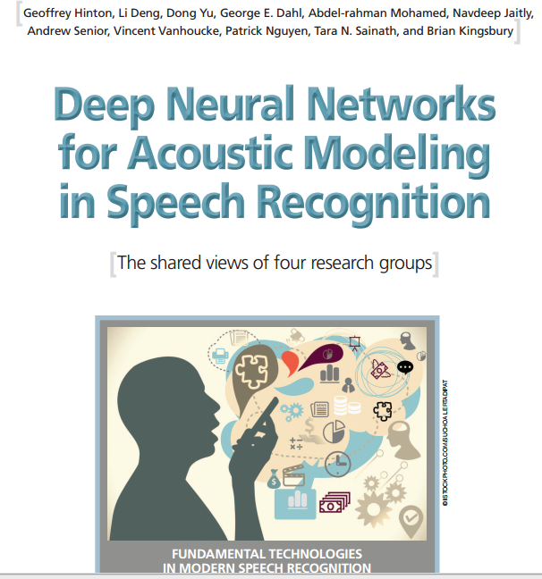
IEEE Signal Proc. Magazine
November, 2012

Slide 34
Restricted Boltzmann Machines (RBM)
We restrict the connectivity to make learning easier.
  Only one layer of hidden units.
  No connections between hidden units.
In an RBM, the hidden units are conditionally independent given the visible states.
So we can quickly get an unbiased sample from the posterior distribution when given a data-vector.
hidden
j
i
visible

Slide 35
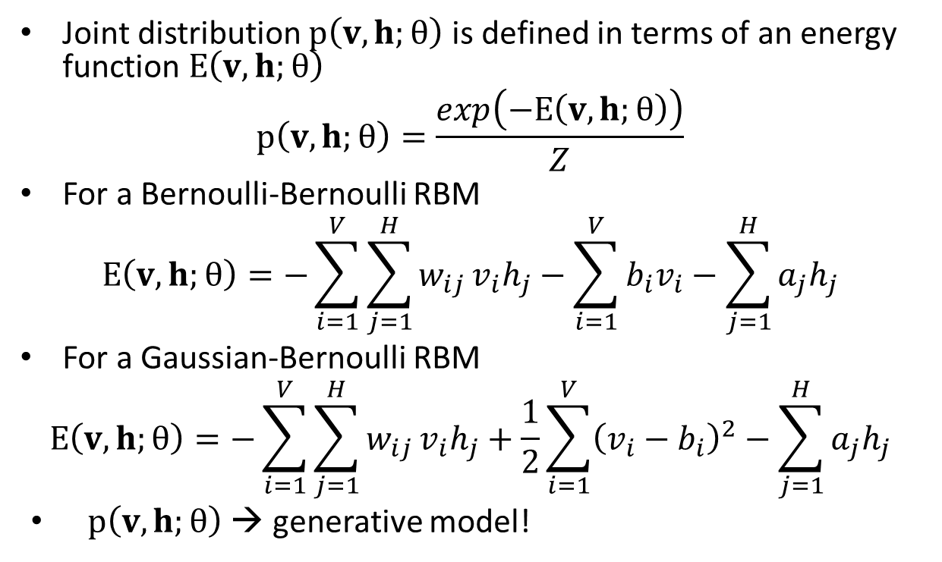
RBM: Weights → Energies → Probabilities
Joint distribution $p\left(v,h;θ\right)$ is defined in terms of an energy function $E\left(v,h;θ\right)$
$$p\left(v,h;θ\right)=\frac{exp\left(−E\left(v,h;θ\right)\right)}{Z}$$
For a Bernoulli-Bernoulli RBM
$$E\left(v,h;θ\right)=−\sum_{i=1}^{V}{\sum_{j=1}^{H}{w_{ij}}v_{i}h_{j}}−\sum_{i=1}^{V}{b_{i}v_{i}}−\sum_{j=1}^{H}{a_{j}h_{j}}$$
For a Gaussian-Bernoulli RBM
$$E\left(v,h;θ\right)=−\sum_{i=1}^{V}{\sum_{j=1}^{H}{w_{ij}}v_{i}h_{j}}+\frac{1}{2}\sum_{i=1}^{V}{{\left(v_{i}−b_{i}\right)}^{2}}−\sum_{j=1}^{H}{a_{j}h_{j}}$$
$p\left(v,h;θ\right)$ → generative model!

Slide 36
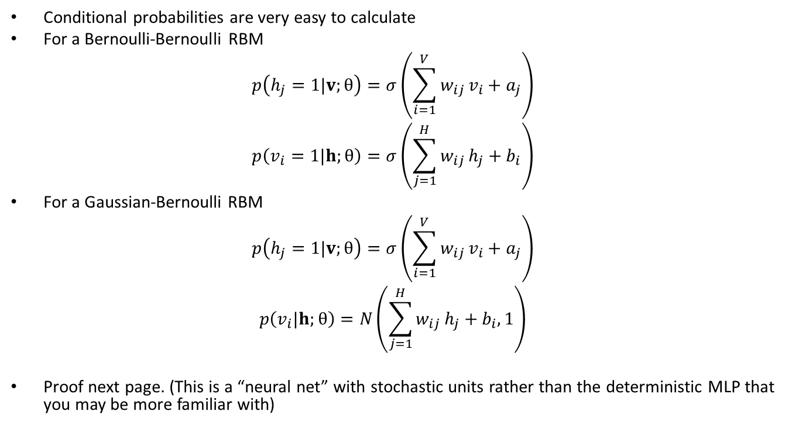
Restricted Boltzmann Machine (RBM)
Conditional probabilities are very easy to calculate
For a Bernoulli-Bernoulli RBM
$$p\left(h_{j}=1|v;θ\right)=σ\left(\sum_{i=1}^{V}{w_{ij}}v_{i}+a_{j}\right)$$
$$p\left(v_{i}=1|h;θ\right)=σ\left(\sum_{j=1}^{H}{w_{ij}}h_{j}+b_{i}\right)$$
For a Gaussian-Bernoulli RBM
$$p\left(h_{j}=1|v;θ\right)=σ\left(\sum_{i=1}^{V}{w_{ij}}v_{i}+a_{j}\right)$$
$$p\left(v_{i}|h;θ\right)=N\left(\sum_{j=1}^{H}{w_{ij}}h_{j}+b_{i}, 1\right)$$
Proof next page. (This is a “neural net” with stochastic units rather than the deterministic MLP that you may be more familiar with)
Inference
synthesis
Inference

Slide 37
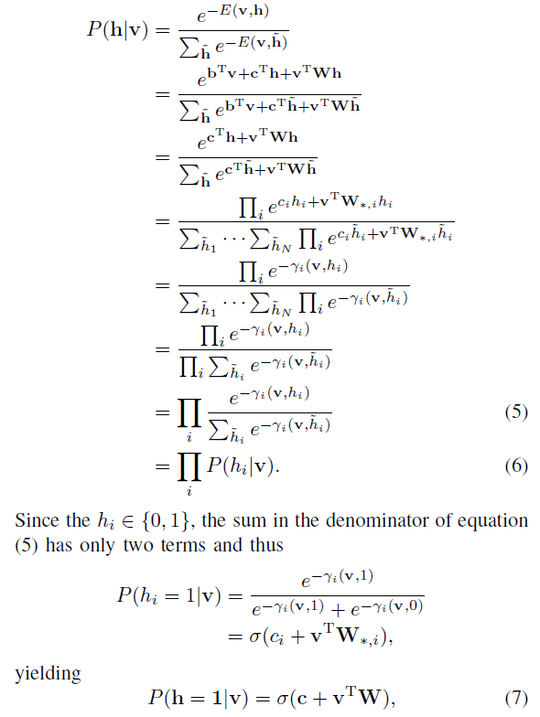
IEEE Trans. Audio, Speech,
Lang. Proc., Jan 2012

Slide 38
Maximum likelihood learning for RBM
j
j
j
j
a fantasy
i
i
i
i
t = 0 t = 1 t = 2 t = infinity
Start with a training vector on the visible units.
Then alternate between updating all the hidden units in parallel and updating all the visible units in parallel.

Slide 39
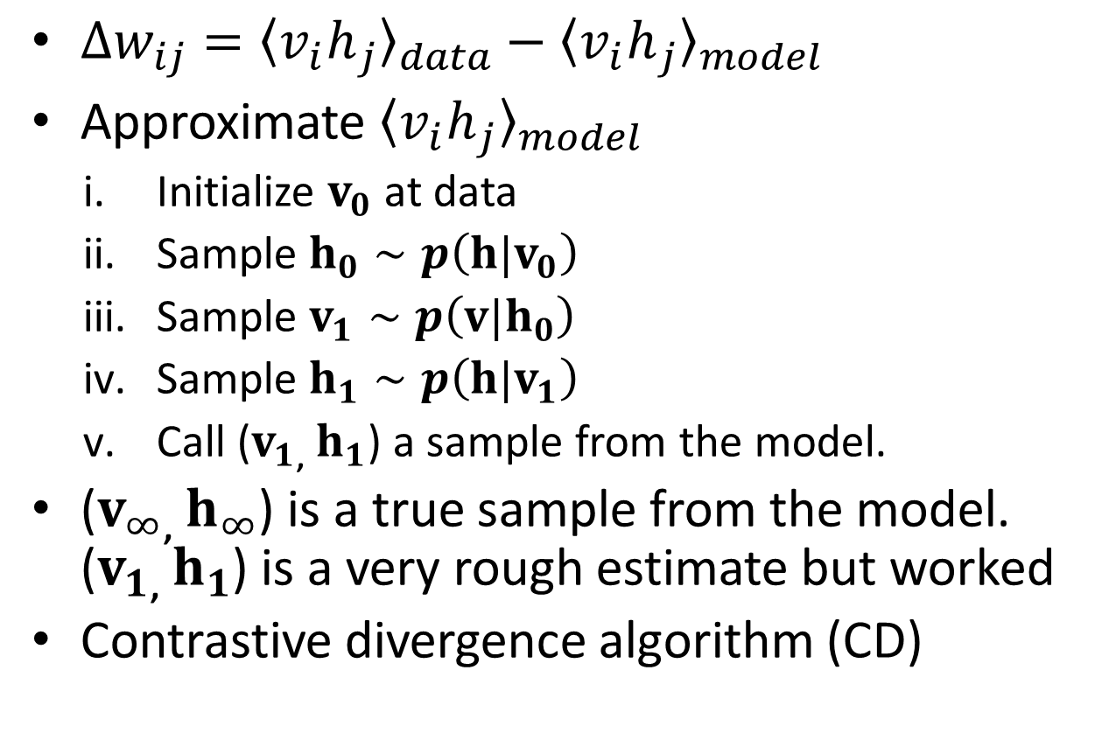
Training RBMs
$∆w_{ij}={〈{v_{i}h}_{j}〉}_{data}−{〈{v_{i}h}_{j}〉}_{model}$
Approximate ${〈{v_{i}h}_{j}〉}_{model}$
  Initialize $v_{0}$ at data
  Sample $h_{0}∼p\left(h|v_{0}\right)$
  Sample $v_{1}∼p\left(v|h_{0}\right)$
  Sample $h_{1}∼p\left(h|v_{1}\right)$
  Call ($v_{1}$, $h_{1}$) a sample from the model.
($v_{∞}$, $h_{∞}$) is a true sample from the model. ($v_{1}$, $h_{1}$) is a very rough estimate but worked
Contrastive divergence algorithm (CD)

Slide 40
Building a Deep Network
This is the main reason why RBM’s are interesting (as a building block)
First train a layer of hidden units that receive input directly from the data (image, speech, coded text, etc).
Then treat the activations of hidden units (the trained “features”) as if they were “data” and learn features of features in a second hidden layer.
It can be proved that each time we add another layer of features we improve a variational lower bound on the log probability of the training data.
  The proof is complicated (Hinton et al, 2006)
  Based on an equivalence between an RBM and a deep directed model

Slide 41
































Deep Belief Net (DBN) & Deep Neural Net (DNN)
DBN: Undirected at top two layers which is an RBM; directed Bayes net (top-down) at lower layers (good for synthesis and recognition)
DNN: Multi-layer perceptron (bottom up) + unsupervised pre-training w. RBM weights (good for recognition only)
$$l_{1}$$
$$l_{2}$$
$$⋯$$
$$l_{j}$$
$$⋯$$
$$l_{J}$$
Labels
MANY Hidden Layers
MANY Hidden Layers
$$h_{1}$$
$$h_{2}$$
$$⋯$$
$$h_{i}$$
$$⋯$$
$$h_{I}$$
$$1$$
MANY Hidden Layers
$$h_{1}$$
$$h_{2}$$
$$⋯$$
$$h_{j}$$
$$⋯$$
$$h_{J}$$
$$1$$
$$h_{1}$$
$$h_{2}$$
$$⋯$$
$$h_{i}$$
$$⋯$$
$$h_{I}$$
$$1$$
$$h_{1}$$
$$h_{2}$$
$$⋯$$
$$h_{j}$$
$$⋯$$
$$h_{J}$$
$$1$$
$$h_{1}$$
$$h_{2}$$
$$⋯$$
$$h_{i}$$
$$⋯$$
$$h_{I}$$
$$1$$
$$h_{1}$$
$$h_{2}$$
$$⋯$$
$$h_{j}$$
$$⋯$$
$$h_{J}$$
$$1$$
Visible Layer
$$v_{1}$$
$$v_{2}$$
$$⋯$$
$$v_{i}$$
$$⋯$$
$$v_{I}$$
$$1$$

Slide 42
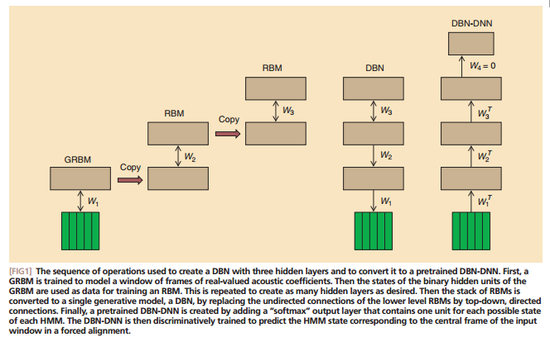
Hinton, Deng, Yu, Mohamed, Dahl… etc. IEEE Sig. Proc. Mag. (Nov 2012)
First train a stack of three models each of which has one hidden layer. Each model in the stack treats the hidden variables of the previous model as data.
Then add outputs and train the DNN with backprop.
Then compose them into a single Deep Belief Network.

Slide 43
Quiz Questions
DBN & DNN: which one is generative? Which one is discriminative?
How can a generative model be used for recognition? (Bayes rule as for HMM speech recognition)
How does DBN do synthesis?
How does DBN do recognition?
How does DNN do recognition?
For recognition, is RBN or DNN better?
What is the difference between DBN and Dynamic Bayes Net (a.k.a. “DBN”)?

Slide 44
The Answer to Quiz Question 3:
To generate data:
  Get an equilibrium sample from the top-level RBM by performing alternating Gibbs sampling for a long time.
  Perform a top-down pass to get states for all the other layers.
  So the lower level bottom-up connections are not part of the generative model. They are just used for inference.
h3
h2
h1
data

Slide 45
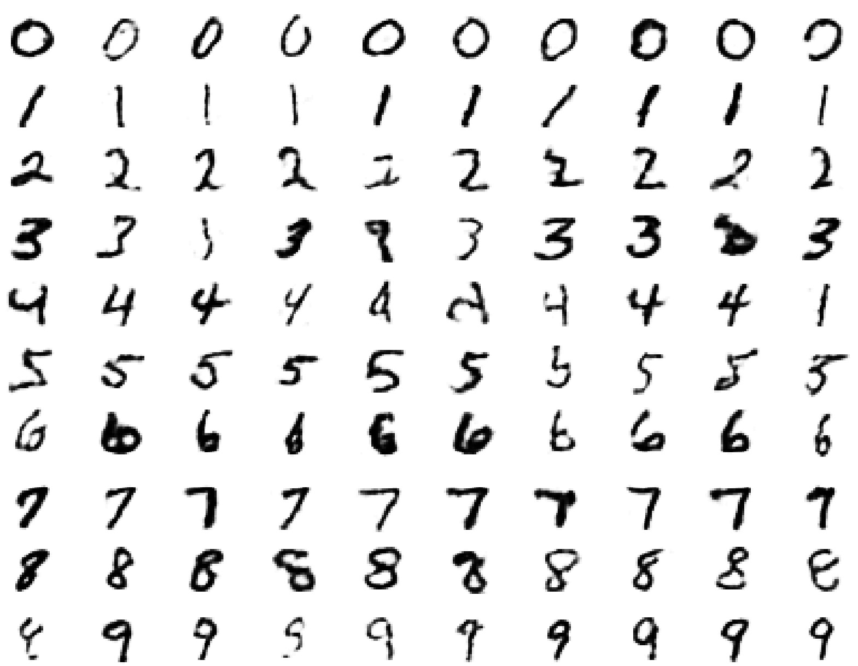
Samples generated by letting the associative memory run with one label clamped. There are 1000 iterations of alternating Gibbs sampling between samples (example from Hinton) .

Slide 46
Answer to Quiz Question 4: Example of digit/image recognition by DBN
The top two layers form an associative memory whose energy landscape models the low dimensional manifolds of the digits
The energy valleys have names
2000 top-level neurons
10 label neurons
500 neurons
The model learns to generate combinations of labels and images.
To perform recognition we start with a neutral state of the label units and do an up-pass from the image followed by a few iterations of the top-level associative memory ---> probability of that digit label; then repeat for all digit labels; then compare.
(slide modified from Hinton)
500 neurons
28 x 28 pixel image

Slide 47
DBN & DNN: Fine-tuning for discrimination
First learn one layer at a time greedily.
Then treat this as “pre-training” that finds a good initial set of weights which can be fine-tuned by a local search procedure.
For DBN: Contrastive wake-sleep (see Hinton’s)
For DNN: Back-propagation
  This overcomes many of the limitations of standard backpropagation (if you do not have large labeled training data).

Slide 48










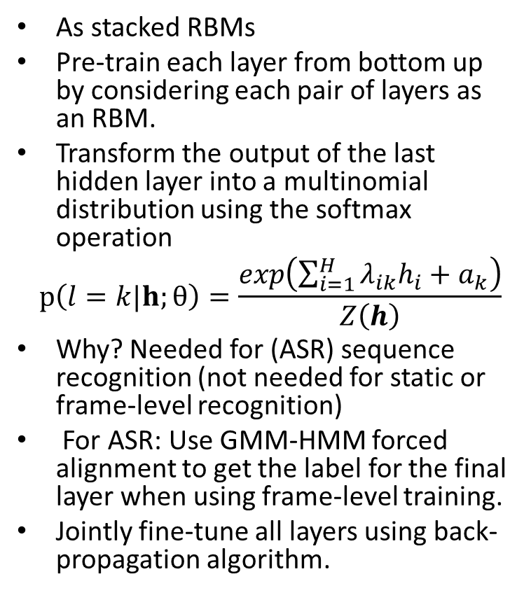


















DNN with class posteriors (not DBN)
As stacked RBMs
Pre-train each layer from bottom up by considering each pair of layers as an RBM.
Transform the output of the last hidden layer into a multinomial distribution using the softmax operation
$$p\left(l=k|h;θ\right)=\frac{exp\left(\sum_{i=1}^{H}{λ_{ik}h_{i}}+a_{k}\right)}{Z\left(h\right)}$$
Why? Needed for (ASR) sequence recognition (not needed for static or frame-level recognition)
For ASR: Use GMM-HMM forced alignment to get the label for the final layer when using frame-level training.
Jointly fine-tune all layers using back-propagation algorithm.
$$l_{1}$$
$$l_{2}$$
$$⋯$$
$$l_{j}$$
$$⋯$$
$$l_{J}$$
$$v_{1}$$
$$v_{2}$$
$$⋯$$
$$v_{i}$$
$$⋯$$
$$v_{I}$$
$$1$$
$$h_{1}$$
$$h_{2}$$
$$⋯$$
$$h_{j}$$
$$⋯$$
$$h_{J}$$
$$1$$
$$v_{1}$$
$$v_{2}$$
$$⋯$$
$$v_{i}$$
$$⋯$$
$$v_{I}$$
$$1$$
$$h_{1}$$
$$h_{2}$$
$$⋯$$
$$h_{j}$$
$$⋯$$
$$h_{J}$$
$$1$$
$$v_{1}$$
$$v_{2}$$
$$⋯$$
$$v_{i}$$
$$⋯$$
$$v_{I}$$
$$1$$
$$h_{1}$$
$$h_{2}$$
$$⋯$$
$$h_{j}$$
$$⋯$$
$$h_{J}$$
$$1$$
$$v_{1}$$
$$v_{2}$$
$$⋯$$
$$v_{i}$$
$$⋯$$
$$v_{I}$$
$$1$$

Slide 49
The current wisdom on unsupervised pre-training
Pre-training achieves two things:
  It makes optimization easier.
  It reduces overfitting.
We now know more about how to initialize weights sensibly by hand.
  So unsupervised pre-training is not required to make the optimization work.
Unsupervised pre-training is still very effective at preventing over-fitting when labeled data is scarce.
  It is not needed when labeled data is abundant.
Hinton: ICASSP-2013

Slide 50
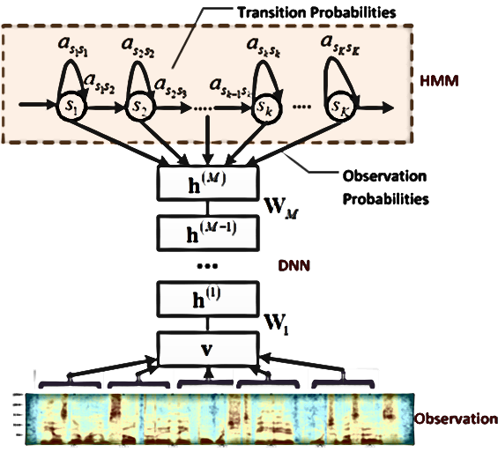
DNN-HMM
(replacing GMM only; longer MFCC/filter-back windows w. no transformation)
Model tied triphone states directly
Many layers of nonlinear feature transformation + SoftMax

Slide 51
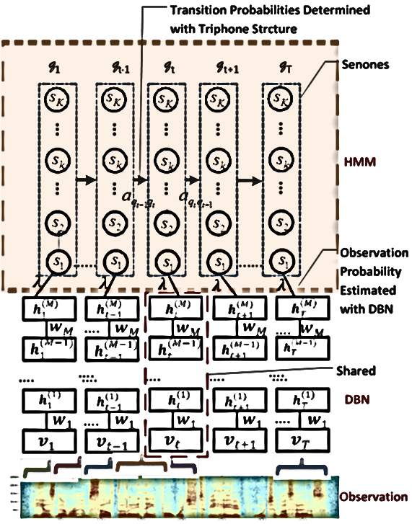
CD-DNN-HMM: Architecture

Slide 52
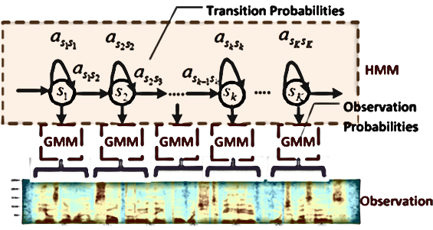
(Shallow) GMM-HMM
Model frames of acoustic data with two stochastic processes:
  A hidden Markov process to model state transition
  A Gaussian mixture model to generate observations
Train with maximum likelihood criterion using EM followed by discriminative training (e.g. MPE)

Slide 53
Voice Search with DNN-HMM
First attempt in using deep models for large vocabulary speech recognition (summer 2010)
Published in ICASSP-2011 & 2012 Special issue of T-ASLP:

Slide 54

MSR Key Innovations (2009-2013)
Scale the success to large industrial speech tasks
  Grew output neurons from context-independent phones (100-200) to context-dependent ones (9k-32k)
  Motivated initially by saving huge MSFT investment in huge speech decoder software infrastructure (e.g. Entropic acquisition)
  Extremely fast decoder
  Developed novel deep learning architectures & techniques: DCN/DSN, tensor-DSN, kernel-DCN, tensor-DNN, etc.
Engineering for large systems:
  Expertise in DNN and speech recognition
  Close collaboration among MSRR, MSRA, & speech product teams
  (Deng, Yu, Seide, Gang Li, Jinyu Li, Jui-Ting Huang, Yifan Gong, etc.)

Slide 55
Some Recent News by Reporters
DNN Research Improves Bing Voice Search (very fast decoder)
How technology can bridge language gaps: Speech-to-speech translation promises to help connect our world
Scientists See Promise in Deep-Learning Programs (NYT: speech to speech)
Microsoft Research shows a promising new breakthrough in speech translation technology
Bing Makes Voice Recognition on Windows Phone More Accurate and Twice as Fast
Microsoft revs speedier, smarter speech recognition for phones

Slide 56
PART I: Basics of Deep Learning (DL)
(including impact and recent history of DL (Deep Neural Net, DNN) in speech recognition)
PART II: Deeper Substance of DL
---Technical introduction: RBM, DBN, DNN,
DNN-HMM, CNN, RNN
---Examples of incorporating domain knowledge (about speech) into DL architectures
1. Hidden/articulatory Speech dynamics into RNN
2. Speech invariance/class-discrim.into deep-CNN
---A few new, promising DL architectures
Outline

Slide 57
PART I: Basics of Deep Learning (DL)
(including impact and recent history of DL (Deep Neural Net, DNN) in speech recognition)
PART II: Deeper Substance of DL
---Example 1: incorporating domain knowledge:
Hidden/Deep Dynamics in Human Speech
Outline

Slide 58
Deep/Dynamic Models are Natural for Speech
Hierarchical structure in human speech generation
  Global concept/semantics formation
  Word sequence formation / prosodic planning
  Phonological encoding (phones, distinctive features)
  Phonetic encoding (motor commands, articulatory targets)
  Articulatory dynamics
  Acoustic dynamics (clean speech)
  Distorted speech
  Interactions between speakers and listener/machine
Hierarchical structure in human speech perception
  Cochlear nonlinear spectral analysis
  Attribute/phonological-feature detection at higher level(s)
  Phonemic and syllabic detection at still higher level(s)
  Word and sequence detection
  Syntactic analysis and semantic understanding at deeper auditory cortex

Slide 59
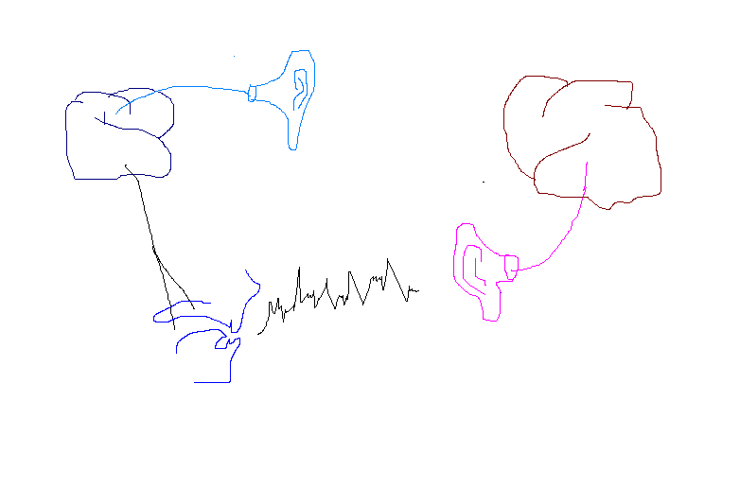
Production & Perception: Closed-Loop Chain
SPEAKER
LISTENER
decoded
message
Internal
model
message
ear/auditory reception
motor/articulators
  Speech Acoustics in
  closed-loop chain

Slide 60
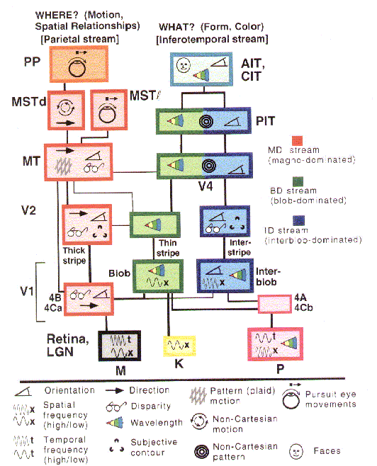
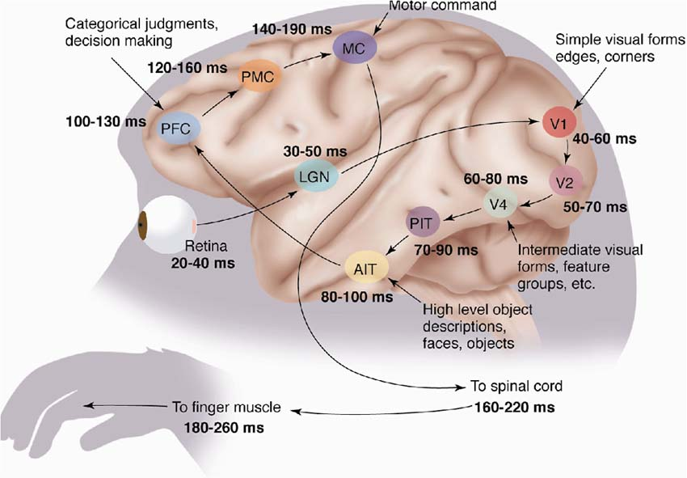
The Mammalian Visual Cortex is Hierarchical
The ventral (recognition) pathway in the visual cortex has multiple stages
Retina - LGN - V1 - V2 - V4 - PIT - AIT ....
Lots of intermediate representations
[picture from Simon Thorpe]
[Gallant & Van Essen]

Slide 61
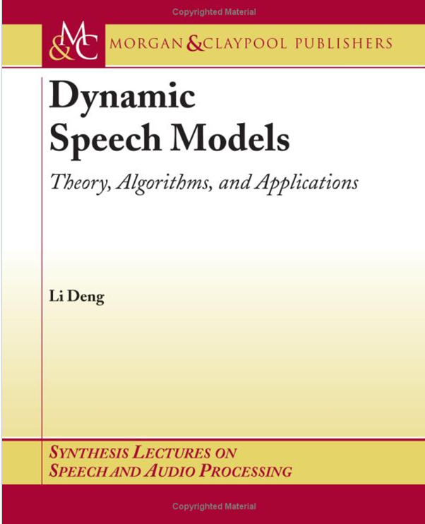
(Deep) Dynamic Bayesian Net
SPEAKER
targets
articulation
message
distortion-free acoustics
distorted acoustics
motor/articulators
  Speech Acoustics
distortion factors &
feedback to articulation

Slide 62
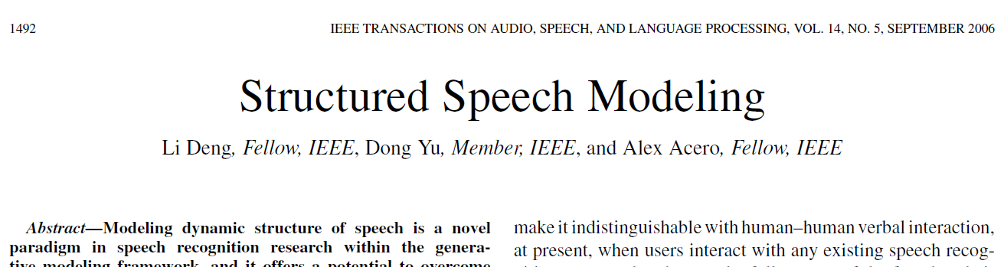
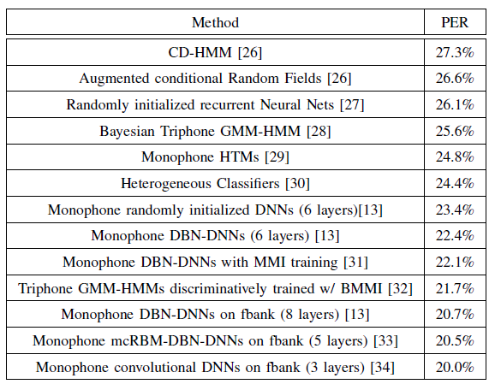
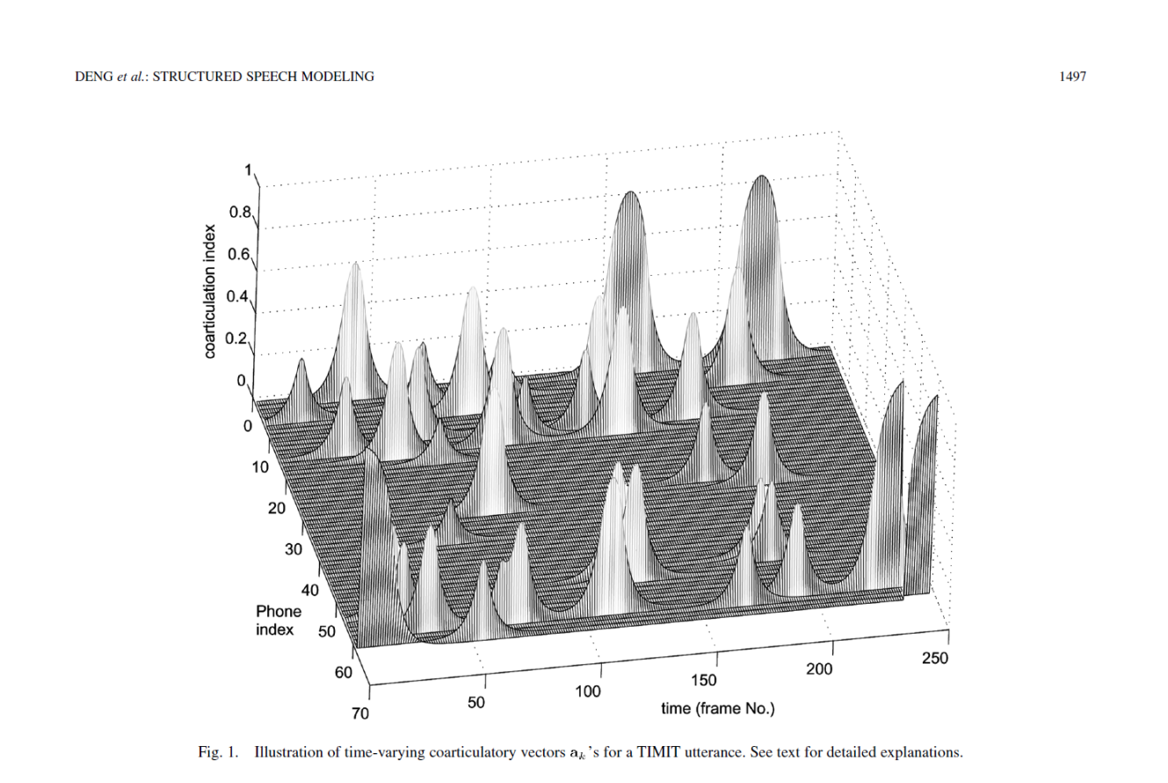

Slide 63
(Hidden) Dynamic Models
Many types of dynamic models since 90’s
Good survey article on earlier work (Ostendorf et al. 1996)
Hidden Dynamic Models (HDM/HTM) since late 90’s
This is “deep” generative model with >2 layers
More recent work: book 2006
Pros and cons of different models
All intended to create more realistic speech models “deeper” than HMM for speech recognition
But with different assumptions on speech dynamics
How to embed such dynamic properties into the DNN framework?

Slide 64
DBN (Deep) vs. DBN* (Dynamic)
DBN-DNN (2009-2012) vs. HDM/HTM (1990’s-2006)
Distributed vs. local representations
Massive vs. parsimonious parameters
Product of experts vs. mixture of experts
Generative-discriminative hybrid vs. generative models
Longer windows vs. shorter windows
A neat way of “pre-training” RNN by HDM and then “fine-tuning” RNN by backprop (non-trivial gradient derivation and computation)

Slide 65
Building Dynamics into Deep Recurrent Models
(Deep) recurrent neural networks for ASR: both acoustic and language modeling
  generic temporal dependency
  lack of constraints provided by hidden speech dynamics
  Information redundancy & inconsistency: long windows for each “frame” introducing undesirable “noise”
  Need to go beyond unconstrained temporal dependence and ESN (while easier to learn)
An active and exciting research area to work on

Slide 66
PART I: Basics of Deep Learning (DL)
(including impact and recent history of DL (Deep Neural Net, DNN) in speech recognition)
PART II: Deeper Substance of DL
---Example 2: incorporating domain knowledge:
Speech invariance/variability vs. phonetic discrimination in Conv. NN
Outline

Slide 67
A Deep Convolutional Neural Net Using Heterogeneous Pooling to Tradeoff Acoustic Invariance w. Phonetic Distinction
Li Deng, Ossama Abdel-Hamid, and Dong Yu
Microsoft Research, Redmond
York University, Toronto
ICASSP, May 28, 2013

Slide 68
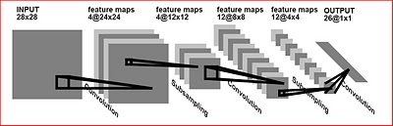
Background: Convolutional Nets (CNN)
LeCun et al. 90’s
Convolution layer (w. tying weights): a.k.s. “time/spatial”-invariant FIR filter
Gives maps of replicated features; neural activities “equivariant” to translation
Pooling layer (max of neighboring units in conv layer): Data reduction & some degree of invariance.
2D deep-CNN: State of the art in object recognition (Krizhevsky et al., 2012; LeCun et al.; Ciresan et al.)

Slide 69
Background: Convolutional Nets (CNN)
Difficulties of CNN:
  2D Images: Information lost about the precise positions of parts → object confusion
  2D Speech spectrogram: spectral-temporal information lost about phonetic distinction
  E.g. 1-D CNN along freq axis (Abdel-Hamid et al., 2012): (TDNN & TF-trajectory CNN)
  local weight sharing + max pooling over a range→ invariance to freq shift
  (VTL normalization)
  But if freq range too small → not enough VTL normalization (acoustic invariance)
  too large → formant patterns of a sound shift → phone confusion
  Solutions for image recognition: (tried some for speech, no clear success)
  Transforming autoencoder (Hinton et al., 2011)
  Tiled CNN (Le et al., 2012)
  Deconvolutional nets (Zeiler et al., 2011)
A good solution for speech recognition is surprisingly simple

Slide 70
Main Ideas of This Paper
Bring “confusion” into designing CNN intended for “invariance”
Exploit the knowledge of how increasing the degree of invariance (to shift along frequency-axis) may reduce phonetic discrimination
(Kai Yu this morning: Spatial Pyramid Matching for vision)
Examine/predict how the pooling size (i.e. range of freq-shift invariance) affects phonetic classification errors
  Theoretic guidance possible; e.g.
  Phonetic reduction (in casual, conversation speech) shrinks formant space →tradeoff towards “distinction” from “invariance”→ smaller pooling size
Use of many feature maps (afforded by CNN weight tying)
Different pooling sizes (heterogeneous pooling) for different feature maps
  Design and use a distribution of pooling sizes and randomly sample it.
  Special case: use a fixed pooling size, optimized by validation or predicted by acoustic-phonetic “theory” (consistent for TIMIT; not as good as HP)

Slide 71
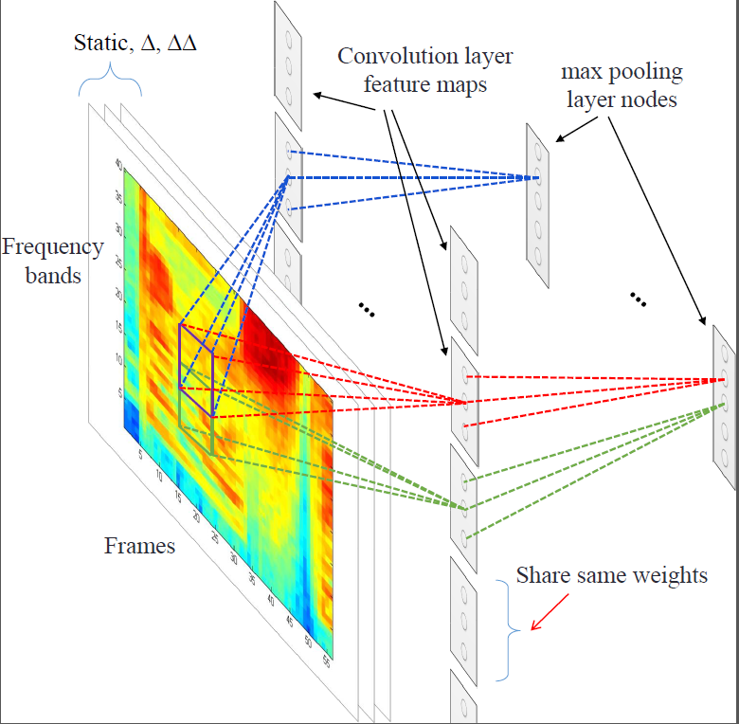
CNN with a Fixed Pooling Size
(a special case of HP-CNN w. P=3)
P=3
P=3
(limited weight sharing)

Slide 72
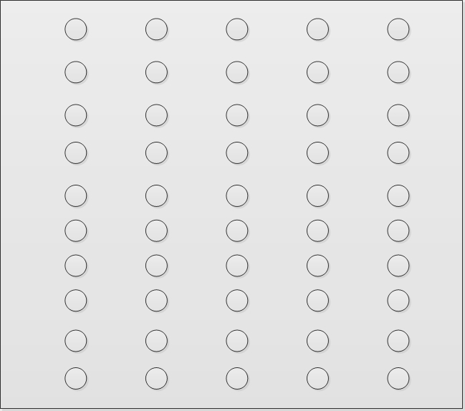

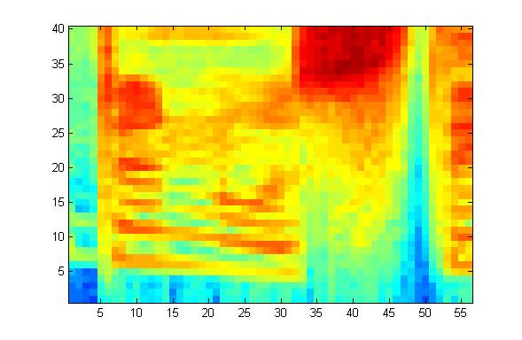
HP-CNN [P_{1,} N₁ P_{2,} N_{2 … ,} P_{m,} N_{m}]
P1=2; P2=3
…………
…N1…
Pooling size P1
P1=2
…N1…
Pooling size P2
…N2…
…N2…
P2=3
…………
…………

Slide 73
Regularizing HP-CNN with “Dropout”
A variant of the Dropout method for DNN (Hinton et al., 2012)
Dropout in both conv and pooling layers of CNN is helpful, in addition to fully-connected DNN layers
Dropout in the input layer (filterbanks) is not helpful
In TIMIT, for CNN w. N=100 feature maps, and DNN hid=2000, the best dropout rate=0.2
With dropout rate=0.5 & DNN hid=5000, error rate increases

Slide 74
Standard TIMIT Task: Core Testset Results
Table 2: DNN performance on wideband and narrowband test sets (a multitask-learning setup) using mixed-bandwidth training data.
Systems | Phone Error Rate
DNN (fully-connected 5 layers) | 22.3%
CNN-DNN; P=1 (2 CNN & 3 DNN layers) | 21.8%
CNN-DNN; P=12 | 20.8%
CNN-DNN; P=6 (fixed P, optimal) | 20.4%
CNN-DNN; P=6 (add dropout) | 19.9%
CNN-DNN; P=1:m (HP, m=12) | 19.3%
CNN-DNN; above (add dropout) | 18.7%
CNN-DNN; P=1 → equivariance: 21.8% > 20.4% (invariance w. fixed, optimal pooling size=6)
CNN-DNN; P=1:12 → Heterogeneous pooling: 19.3% < 20.4%
Dropout is always helpful (thanks Geoff!): 18.7% < 19.3% ; 19.9% < 20.4%
18.7% WAS the record low error rate on this standard task (until this morning by LSTM-RNN)

Slide 75
PART I: Basics of Deep Learning (DL)
(including impact and recent history of DL (Deep Neural Net, DNN) in speech recognition)
PART II: Deeper Substance of DL
---Technical introduction: RBM, DBN, DNN,
DNN-HMM, CNN, RNN
---Examples of incorporating domain knowledge (about speech) into DL architectures
1. Hidden/articulatory Speech dynamics into RNN
2. Speech invariance/class-discrim.into deep-CNN
--- A few new, promising DL architectures
Outline

Slide 76
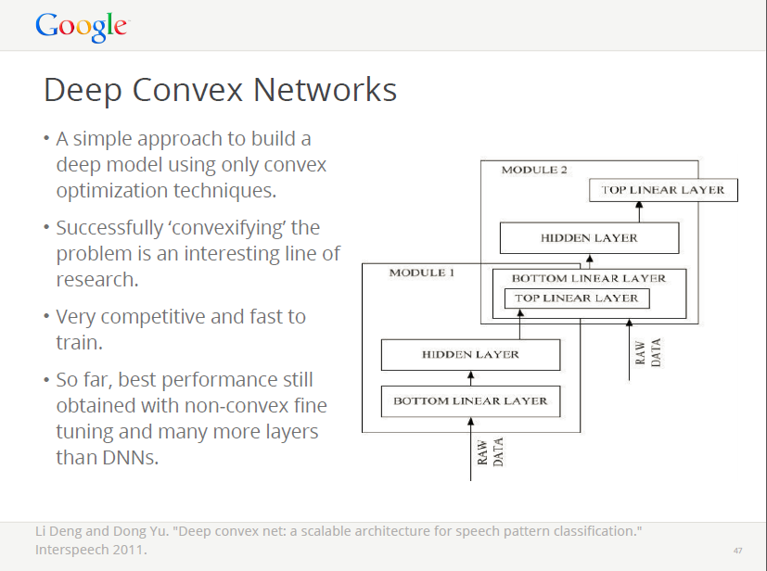

Slide 77
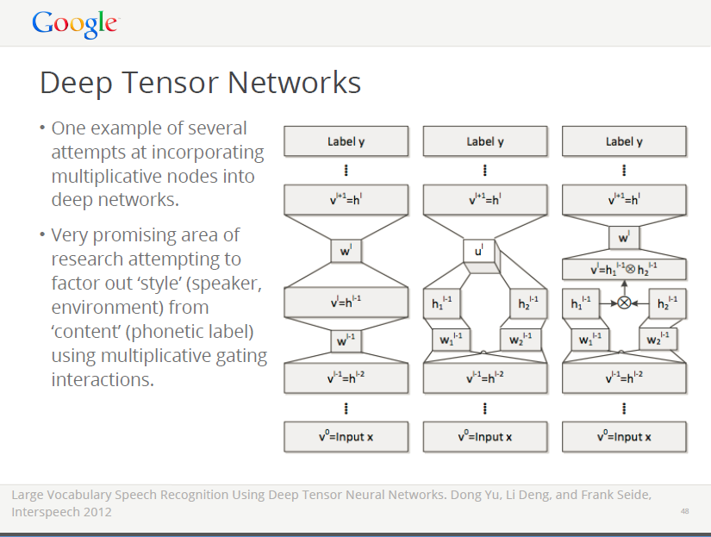

Slide 78
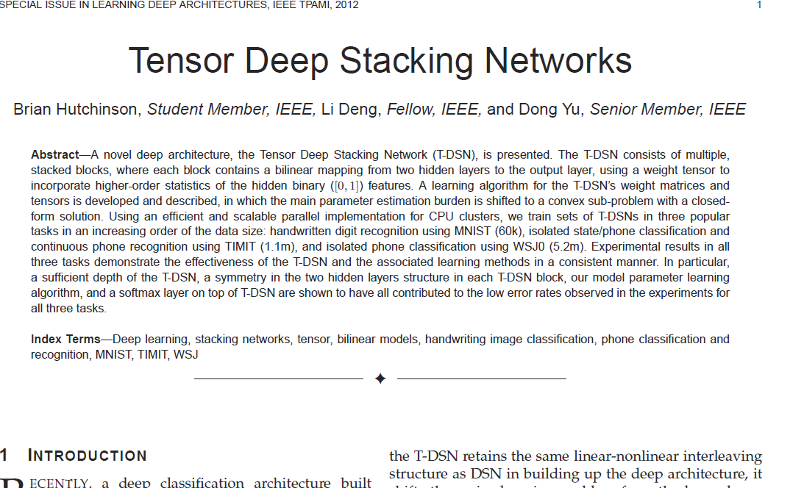
in print, August, 2013

Slide 79
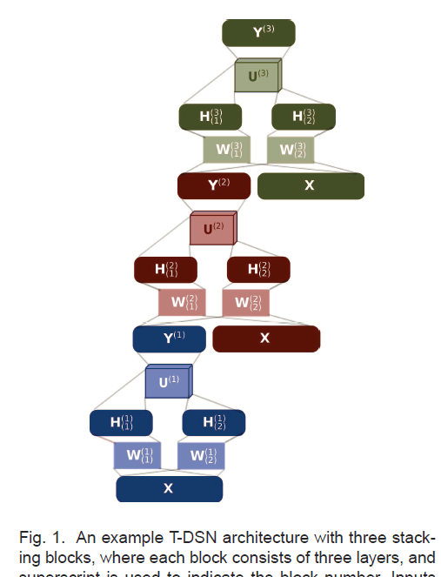
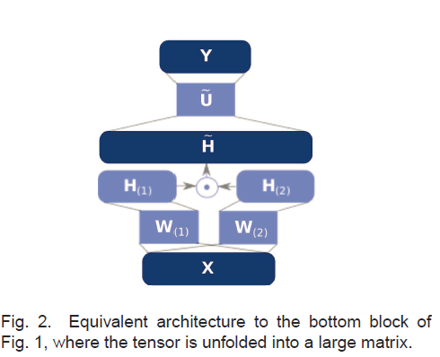

Slide 80
Deep Stacking Networks for
Information Retrieval
Li Deng, Xiaodong He, and Jianfeng Gao
Microsoft Research, Redmond
ICASSP, May 30, 2013

Slide 81
Outline
Motivation: deep learning for Information Retrieval (IR)
  Learning to rank
  Semantic feature extraction for ranking
Deep Stacking Net (DSN)
  Basic modular architectures
  Novel discriminative learning algorithm
Applying DSN for IR --- learning to rank
  Formulating IR as a classification problem
  Special role of regularization
Experiments
  IR task, data sets, and features
  Relationship between NDCG score & classification error rate
  NDCG results on an IR task (Ads selection)

Slide 82
Background of IR
Goal of IR: ranking text documents (D) for a query (Q)
Common methods:
  Lexical matching: suffers from text discrepancy btwn Q and D (e.g. vocabulary, word usage, expression style, etc.)
    E.g., TF-IDF weighted vector space model
  Semantic matching: to bridge lexical gaps btw Q and D
    E.g., Latent Semantic Analysis (LSA), PLSA, LDA, etc.
  Learning Q-D matching using clickthrough data
    E.g., translation models, bilingual topic models etc.
  These linear models suffer from restricted expressive power

Slide 83
Deep Learning for IR
Multilayers of nonlinearities
  Greater expressive power
  Better able to capture semantic contents in Q and D
    E.g., semantic hashing (Hinton et al, 2007)
  More effective use of supervised clickthrough data
Use of (labeled) clickthrough data for IR ranking
  Shallow linear models: Gao et al., 2010;2011
  Shallow nonlinear models: Burges et al., 2005;2006

Slide 84


Deep Stacking Net (DSN)
Table 2: DNN performance on wideband and narrowband test sets (a multitask-learning setup) using mixed-bandwidth training data.
.
.
.
Deep Stacking Nets (Deng & Yu, Interspeech’10; Deng, Yu, Platt, ICASSP’12)
Interleave linear/nonlinear layers
Exploit closed-form constraints among network’s weights
Much easier to learn than DNN
Naturally amenable to parallel training
(Largely) convex optimization
Extended to tensor version (Hutchinson et al, ICASSP’12, TPAMI-2013)
Extended to kernel version (Deng et al, SLT’12)
Works very well for MNIST, TIMIT, WSJ, SLU
This paper: a more recent application to IR ranking
Y3
H3
Y2
X
H2
Y1
X
H1
X

Slide 85
Learning DSN Weights --- Main Ideas
Learn weight matrices U and W in individual modules separately.
Given W and linear output layer, U can be expressed as explicit nonlinear function of W.
This nonlinear function is used as the constraint in solving nonlinear least square for learning W.
Initializing W with RBM (bottom layer)
For higher layers, part of W is initialized with the optimized W from the immediately lower layer and part of it with random numbers

Slide 86
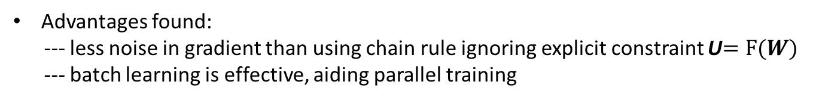
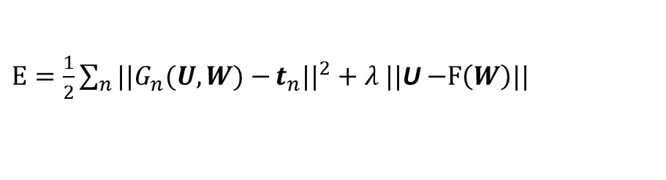
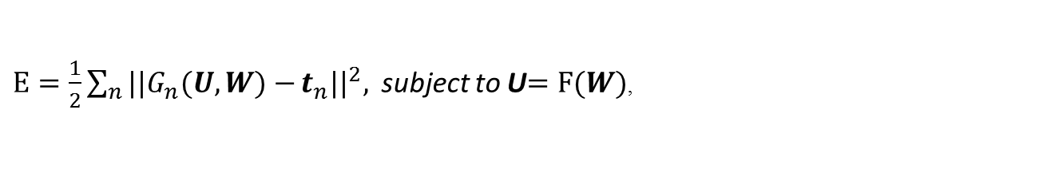
Learning DSN Weights --- Single Module
$$E=\frac{1}{2}\sum_{n}{{||y}_{n}−}t_{n}{||}^{2}, where{ y}_{n}=U^{T}h_{n}=U^{T}σ\left(W^{T}x_{n}\right)=G_{n}(U, W)$$
$\frac{∂E}{∂U}=2H{\left(U^{T}H−T\right)}^{T}$ → $U={\left({HH}^{T}\right)}^{−1}HT^{T}=F(W)$, where $h_{n}=σ\left(W^{T}x_{n}\right)$
$E=\frac{1}{2}\sum_{n}{||G_{n}(U, W)−}t_{n}{||}^{2},$subject to U$=F(W)$,
Y
U
Use of Lagrange multiplier method:
H
$E=\frac{1}{2}\sum_{n}{||G_{n}(U, W)−}t_{n}{||}^{2}+λ ||$U$−F\left(W\right)||$
W
to learn W and then U → no longer backpropagation
X
Advantages found:
--- less noise in gradient than using chain rule ignoring explicit constraint U$=F(W)$
--- batch learning is effective, aiding parallel training

Slide 87
Experimental Evaluation
IR task
  Sponsored Search: retrieve and rank relevant ads given a query
Data sets
  Training: 189K query–ads pairs
  Testing: 58K query–ads pairs
Features to DSN
  A total of 160 features in two categories
    Text features: TF-IDF, word overlap, length, etc.
    User click features: clickthrough, clicked queries, etc.
State-of-the-art baseline system (Burges et al. 2006)
  LambdaRank, a single-hidden-layer neural network
  Trained to maximize (a smoothed approximation of) NDCG via heuristic lambda-function

Slide 88
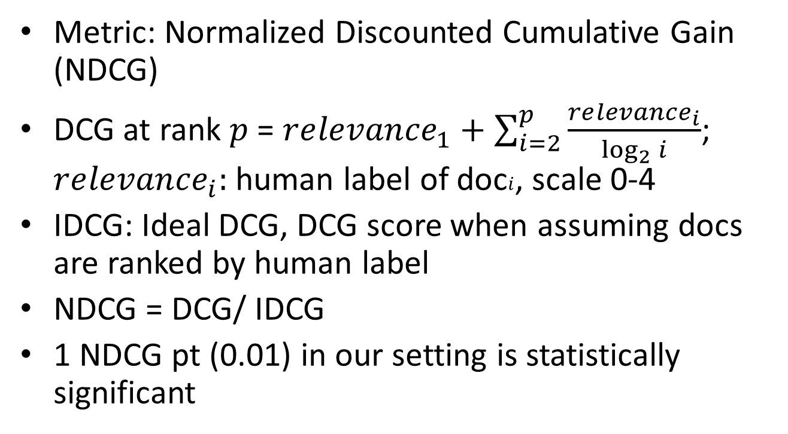
Evaluation Metric
Metric: Normalized Discounted Cumulative Gain (NDCG)
DCG at rank $p$ = $re{levance}_{1}+\sum_{i=2}^{p}{\frac{re{levance}_{i}}{\log_{2}{i}}}$; $re{levance}_{i}:$ human label of doc$i$, scale 0-4
IDCG: Ideal DCG, DCG score when assuming docs are ranked by human label
NDCG = DCG/ IDCG
1 NDCG pt (0.01) in our setting is statistically significant

Slide 89
NDCG Results
IR Quality measures (NDCG) for the DSN System vs. Baseline
IR Systems | NDCG@1 | NDCG@3 | NDCG@10
LambdaRank | 0.331 | 0.347 | 0.382
DSN system | 0.359 | 0.366 | 0.402

Slide 90
Analysis
Relationship between classification error rates and NDCG@1 measure)
Observations:
Correlation is clearly evidenced for NDCG1 < 0.35
Weaker correlation in the high IR-quality region, i.e., NDCG1 > 0.35
Implication:
Due to the inconsistency between the training objective and the IR-quality measure
It is desirable to train the model to optimize the end-to-end IR quality directly

Slide 91
Learning Curves

Slide 92
Conclusions (of this ICASSP-2013 paper)
First study on the use of deep learning techniques for learning-to-rank in IR problems
Significantly better than shallow neural network
Model trained by MSE
  Generally correlated well with the NDCG as the IR quality measure
  But weaker correlation in the region of high IR quality
Deep learning using end-to-end IR-relevant metric is a key future direction

Slide 93
PART I: Basics of Deep Learning (DL)
(including impact and recent history of DL (Deep Neural Net, DNN) in speech recognition)
PART II: Deeper Substance of DL
---Technical introduction: RBM, DBN, DNN,
DNN-HMM, CNN, RNN
---Examples of incorporating domain knowledge (about speech) into DL architectures
1. Hidden/articulatory Speech dynamics into RNN
2. Speech invariance/class-discrim.into deep-CNN
-A few new, promising DL architectures (CONTINUED)
Outline

Slide 94

New Types of Deep Neural Network & Learning for
Speech Recognition+
An Overview
Li Deng, Geoffrey Hinton, Brian Kingsbury
MSR, U. Toronto/Google, IBM
ICASSP Special Session, May 28, 2013

Slide 95

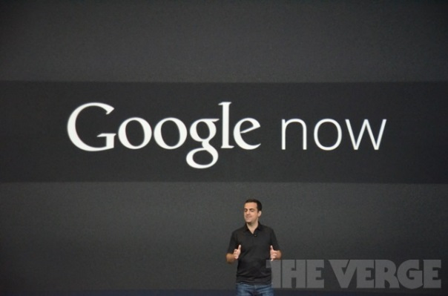

Special Session Motivations
Huge impact of deep neural nets (DNN) in speech (and vision, language, etc.)

Slide 96
Special Session Motivations
Review article (2011-2012) IEEE Sig. Proc. Mag, Nov 2012
Key factors:
  Deeper network
  Faster hardware
  Larger network output layer
  (& hidden, input layers)
  Better network initialization
  (not essential with big data)
Rather standard MLP
architecture
Also standard backprop
learning (1980’s)

Slide 97
Take-Away from This Special Session
New models and new learning methods
Key capabilities of DNNs in knowledge transfer, learning representations, etc.
Advances in DNNs since the SPM overview paper

Slide 98
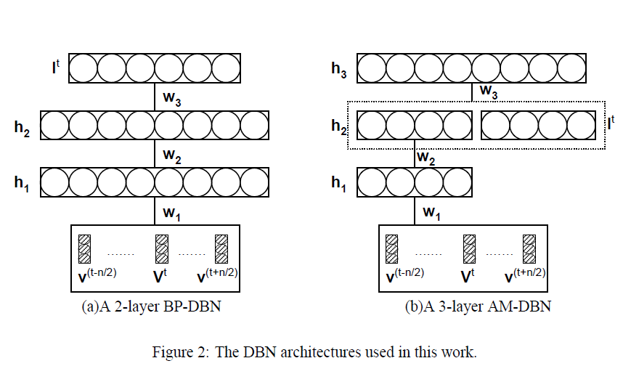
Recent History of “Deep” Models in Speech
U Toronto’s DBN-DNN (2006-2009)
MSR’s (deep) Dyn. Bayes Net (2004-2007)
Phones/words
targets
articulation
message
distortion-free acoustics
distorted acoustics
motor/articulators
distortion factors &
feedback to articulation
Mohamed, Dahl, Hinton, NIPS-WS, 2009
(a simple “recipe”)

Slide 99
Hinton’s 2009“Recipe”

Slide 100

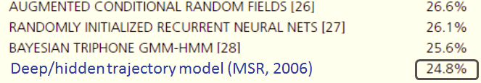
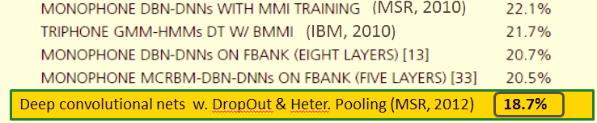
Deep Learning for Phone Recognition
(a stunning discovery at MSR, 2009)
Error pattern A
Error pattern B

Slide 101
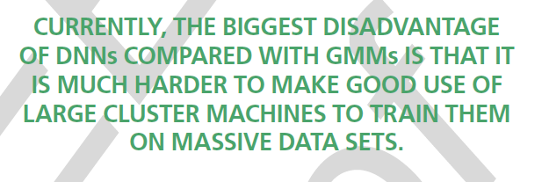
Deep Learning for Large-Vocabulary Speech Recognition

Slide 102
New Discoveries about the DNN
“Recipe” since 2009
Pre-training not needed when a lot of labeled data are available (2010)
The recipe works well for LVCSR when DNN output units correspond to CD HMM states (2010)
Decoding alg. & infrastructure largely unchanged, enabling industry-scale speech recognition (2010-2013)
Filterbank features (closer to waveform) better than MFCCs for DNNs (opposite to GMM systems) (2011-2013)
DNN works surprisingly well for noisy speech (2012)
Fully-connected DNN can be modified to include “convolutional” layers to handle speech variability (2012-2013)
DNN highly effective for multi-task/transfer learning
(e.g. multilingual ASR, 2012-2013)
DNN effective for applications beyond ASR.

Slide 103

Five Technical Papers in Our Special Session
RECENT ADVANCES IN DEEP LEARNING FOR SPEECH
RESEARCH AT MICROSOFT
IMPROVING DEEP NEURAL NETWORKS FOR LVCSR
USING RECTIFIED LINEAR UNITS AND DROPOUT
DEEP CONVOLUTIONAL NEURAL NETWORKS
FOR LVCSR
MULTILINGUAL ACOUSTIC MODELS USING DISTRIBUTED
DEEP NEURAL NETWORKS
ADVANCES IN OPTIMIZING RECURRENT NETWORKS

Slide 104
Themes in the Session

Slide 105
Themes: Better Inputs

Slide 106
Themes: Nonlinearities

Slide 107

Themes: Architectures

Slide 108

Themes: Optimization

Slide 109

Themes: Regularization

Slide 110

Themes: Hyperparameters

Slide 111

Themes: Multi-task Learning

Slide 112

Recent Advances in Deep Learning for Speech
Research at Microsoft
Li Deng, Jinyu Li, Jui-Ting Huang, Kaisheng Yao, Dong Yu, Frank Seide, Mike Seltzer, Geoff Zweig, Xiaodong He, Jason Williams, Yifan Gong, Alex Acero
ICASSP Special Session, May 28, 2013

Slide 113
Outline
Advances in deep learning for features/ representations
Advances in deep learning for models/ architectures
Systems and applications in acoustic modeling, language modeling, dialogue, (and information retrieval/search)

Slide 114
Learning Features/Representations
Advances in deep learning for features/ representations
Advances in deep learning for models/ architectures
Systems and applications in acoustic modeling, language modeling, dialogue, (and information retrieval/search)

Slide 115
Scientists See Promise in Deep-Learning Programs
John Markoff
November 23, 2012
Notes:
You may have seen this front page article in the NY Times last month, on the subject of “deep learning”, also referred to as “deep neural networks” or simply “deep networks”. It featured an interview with Rick Rashid and this photo of a demonstration Rick gave in China in October.
[start the video]
This was a real-time speech-to-speech translation demo, with Rick speaking freely in English and then a computer rendering his speech into Mandarin, and doing so in Rick’s own voice. This demo is something that we’ve tried to set up for a couple of years but frankly was never robust enough for a live showing. But this year that all changed, because of some remarkable advances in speech processing.
Just to make this more vivid, I’d like to ask Rick to say a few words. [start live demo now]

Slide 116
Back to Primitive Spectral Features
Philosophy of deep learning:
  Learning representations automatically instead of manually engineering/design them (e.g., MFCC, PLP)
DNN capability in representing correlated feature dimensions
→ eliminate cosine transform in MFCC in favor of filterbanks in spectral domain

Slide 117
Back to Primitive Spectral Features
Philosophy of deep learning:
  Learning representations automatically instead of manually engineering/design them (e.g., MFCC, PLP)
DNN capability in representing correlated feature dimensions
→ eliminate cosine transform in MFCC in favor of filterbanks and spectrograms in the spectral domain

Slide 118
In early 2010, we discovered:
For deep autoencoding of speech features:
Both spectrogram/filterbank features are better than MFCCs
Better to use spectrogram features than filterbanks
“Better” in terms of coding efficiency (i.e., errors/energy)

Slide 119
LVCSR Using Spectral Features
LVCSR Systems | Word error rate
Best GMM-HMM (MFCCs; fMPE+BMMI) | 34.7%
DNN (MFCCs) | 31.6%
DNN (Spectrogram --- 256 log FFT bins) | 32.3%
DNN (29 log filter-banks) | 30.1%
DNN (40 log filter-banks) | 29.9%
Filterbanks > MFCC > Spectrograms
Not quite consistent with deep autoencoder results
Further research: regularization, online feature normalization at sentence level, etc.

Slide 120


Learning Multi-Task Features
Mixed-Band DNN architecture:
Multilingual DNN architecture:

Slide 121

Shared Hidden Layers with
Language-Specific Output Layers

Slide 122

Learning Multi-Task Features
English words, with some errors
or French words
or Chinese words
with fewer errors
8KHz waveforms
16KHz waveforms
Training
Runtime
English training data
French training data
Chinese training data
8Khz or 16KHz
English
speech input
or French
or Chinese
Notes:
Another important characteristic of DNNs is that they preserve some key features of our best machine learning algorithms. For example, DNNs show excellent performance in multiple tasks. If you take a DNN that has been trained on English, and then train it on French and Chinese, amazingly the performance of the DNN on English actually improves! Similarly, the same DNN then trained on 8KHz waveforms (in addition to 16KHz waveforms) shows better performance on both 8Khz and 16Khz waveforms.

Slide 123
Multilingual ASR Summary Results
Table 2: DNN performance on wideband and narrowband test sets (a multitask-learning setup) using mixed-bandwidth training data.
Speech Recognizers | WER on ENU
DNN trained with only ENU data | 30.9%
+FRA, retrain all layers with ENU | 30.6%
or +FRA, retrain the top layer with ENU | 27.3%
or +FRA+ DEU+ ESP+ITA, retrain top layer | 25.3%

Slide 124
Dialogue State Tracking Example (Jason Williams)
  Prob [ CorrectUserGoals_t | DialogueHistory_{1,2,…,t-1}, UserInfo_{1,2,…,t-1} ]
Tracker inputs
Tracker output
SLU output
+ confidence
Dialog
state hyps
Distribution over dialog state hyps
System output
User speech
Per-hypothesis features
General features
Hello, which bus route?
sixty one c
61B 0.4
61B
Observed-count: 1
Latest-conf-score: 0.4
Confirmed: no
…
QuestionType: Ask
Times-asked: 1
Times-confirmed: 0
Hyp-count: 3
61B
61D 0.3
61D
Observed-count: 1
Latest-conf-score: 0.4
Confirmed: no
…
61D
61C 0.1
61C
Observed-count: 1
Latest-confidence: 0.1
Confirmed: no
61C
Rest
Sorry, which bus route?
sixty one c
63 0.5
63
Observed-count: 1
Latest-conf-score: 0.4
Confirmed: no
…
QuestionType: Ask
Times-asked: 2
Times-confirmed: 0
Hyp-count: 5
61B
53 0.4
53
Observed-count: 1
Latest-conf-score: 0.4
Confirmed: no
…
61D
61C 0.2
61B
Observed-count: 1
Latest-conf-score: 0.4
Confirmed: no
…
61C
61D
Observed-count: 1
Latest-conf-score: 0.4
Confirmed: no
…
63
61C
Observed-count: 2
Latest-confidence: 0.2
Confirmed: no
53
At a given turn, there are G dialog state hypotheses to score. At this turn, G=5.
Rest
Sixty one c, is that right?
yes
YES 0.9
63
Observed-count: 1
Latest-conf-score: 0.4
Confirmed: no
…
QuestionType: Confirm
Times-asked: 2
Times-confirmed: 1
Hyp-count: 5
61B
53
Observed-count: 1
Latest-conf-score: 0.4
Confirmed: no
…
61D
61B
Observed-count: 1
Latest-conf-score: 0.4
Confirmed: no
…
61C
Each hypothesis is described by M features in each turn. In this example, M=3.
61D
Observed-count: 1
Latest-conf-score: 0.4
Confirmed: no
…
63
61C
Observed-count: 2
Latest-confidence: 0.2
Confirmed: yes
Each turn also has K features that describe general dialog context. In this example, K=4.
53
Rest

Slide 125
DSN Results for Dialogue State Tracking
Table 2: DNN performance on wideband and narrowband test sets (a multitask-learning setup) using mixed-bandwidth training data.
Task: Dialog state tracking (defined in Spoken Dialogue Challenge 2010)
Strong interactions among features → strength of deep networks
Can be framed as a multiple binary classification problem
Baseline: carefully tuned, highly optimized Max Entropy classifier (J. Williams)
Deep Stacking Nets (slightly tuned) achieve similar accuracy% for all 5 slots:
 | State of the Art baseline | Deep Stacking Networks
Bus route | 58.0% | 58.1%
Origin location | 56.4% | 57.1%
Destination location | 66.5% | 65.4%
Date | 83.9% | 84.6%
Time | 63.1% | 62.5%

Slide 126
PART I: Basics of Deep Learning (DL)
--- including impact and recent history of DL (Deep Neural Net, DNN) in speech recognition
PART II: Deeper Substance of DL
--- including connections to other ML paradigms
--- two examples of incorporating speech knowledge in DL architectures,
---recent experiments in speech recognition with new DL architectures beyond DNN
Summary

Slide 127
Perspective: What Types of Problems Fit (not fit)
Deep Learning (some conjectures)
“Perceptual” AI
“Data matching”
e.g.: Image/video recognition
Speech recognition
Speech/text understanding
Sequential data with temporal
structure (stock market prediction?)
e.g.: Malware detection(ICASSP-2013)
movie recommender, speaker/language detection?
Non-obvious data representations
Easy data representation
e.g., histogram of events,
user-watched movies, etc.
Deep learning already shows
tremendous benefits
Deep learning may not win over
standard machine learning
Notes:
Deep networks are not a panacea, however. We know that they work well on visual object recognition and speech recognition. There is early evidence that they will work well on document understanding. In all of these kind of problems, it’s very difficult for an engineer to specify or build a representation for the data (that isn’t just the lowest-level building blocks, such as pixels or words). Deep networks should be state-of-the-art in those kind of problems.
Many machine learning applications inside and outside of Microsoft are not difficult AI problems: they fall under ‘data mining’. An example of such a problem is movie recommendation. In movie recommendation, the problem of how to represent data is very easy. For example, you just represent the movies that a user watches in a big sparse matrix. Perhaps you add the demographics of the user. Then, simply apply an existing ML algorithm. We expect deep networks will have no benefit in this (or similar) cases.

Slide 128

Deep Learning: A Theoretician's Nightmare?
Deep Learning involves non-convex loss functions
  With non-convex losses, all bets are off
  Then again, every speech recognition system ever deployed has used non-convex optimization (GMMs are non convex).
But to some of us all “interesting” learning is non convex
  Convex learning is invariant to the order in which sample are presented (only depends on asymptotic sample frequencies).
  Human learning isn't like that: we learn simple concepts before complex ones. The order in which we learn things matter.

Slide 129
Deep Learning: A Theoretician's Nightmare?
No generalization bounds?
  Actually, the usual VC bounds apply: most deep learning systems have a finite VC dimension
  We don't have tighter bounds than that.
  But then again, how many bounds are tight enough to be useful for model selection?
It's hard to prove anything about deep learning systems
  Then again, if we only study models for which we can prove things, we wouldn't have speech, handwriting, and visual object recognition systems today.

Slide 130
Deep Learning: A Theoretician's Paradise?
Deep Learning is about representing high-dimensional data
  There has to be interesting theoretical questions there
  What is the geometry of natural signals?
  Is there an equivalent of statistical learning theory for unsupervised learning?
  What are good criteria on which to base unsupervised learning?
Deep Learning Systems are a form of latent variable factor graph
  Internal representations can be viewed as latent variables to be inferred, and deep belief networks are a particular type of latent variable models.
  The most interesting deep belief nets have intractable loss functions: how do we get around that problem?
Lots of theory at the 2012 IPAM summer school on deep learning
  Wright's parallel SGD methods, Mallat's “scattering transform”, Osher's “split Bregman” methods for sparse modeling, Morton's “algebraic geometry of DBN”,....

Slide 131
Deep Learning and Feature Learning Today
Deep Learning has been the hottest topic in speech recognition in the last 2 years
  A few long-standing performance records were broken with deep learning methods
  Microsoft and Google have both deployed DL-based speech recognition system in their products
  Microsoft, Google, IBM, Nuance, AT&T, and all the major academic and industrial players in speech recognition have projects on deep learning
Deep Learning is the hottest topic in Computer Vision
  Feature engineering is the bread-and-butter of a large portion of the CV community, which creates some resistance to feature learning
  But the record holders on ImageNet and Semantic Segmentation are convolutional nets
Deep Learning is becoming hot in Natural Language Processing
Deep Learning/Feature Learning in Applied Mathematics
  The connection with Applied Math is through sparse coding, non-convex optimization, stochastic gradient algorithms, etc...

Slide 132
In Many Fields, Feature Learning Has Caused a Revolution
(methods used in commercially deployed systems)
Speech Recognition I (late 1980s)
  Trained mid-level features with Gaussian mixtures (2-layer classifier)
Handwriting Recognition and OCR (late 1980s to mid 1990s)
  Supervised convolutional nets operating on pixels
Face & People Detection (early 1990s to mid 2000s)
  Supervised convolutional nets operating on pixels (YLC 1994, 2004, Garcia 2004)
  Haar features generation/selection (Viola-Jones 2001)
Object Recognition I (mid-to-late 2000s: Ponce, Schmid, Yu, YLC....)
  Trainable mid-level features (K-means or sparse coding)
Low-Res Object Recognition: road signs, house numbers (early 2010's)
  Supervised convolutional net operating on pixels
Speech Recognition II (circa 2011)
  Deep neural nets for acoustic modeling
Object Recognition III, Semantic Labeling (2012, Hinton, YLC,...)
  Supervised convolutional nets operating on pixels

Slide 133
Selected References (updated, 2013)
Abdel-Hamid, O., Mohamed, A., Jiang, H., and G. Penn, “Applying convolutional neural networks concepts to hybrid NN-HMM model for speech recognition,” Proc. ICASSP, 2012.
Arel, I., Rose, C., and Karnowski, T. “Deep Machine Learning - A New Frontier in Artificial Intelligence,” IEEE Computational Intelligence Mag., Nov., 2010.
Baker, J., Deng, L., Glass, J., Khudanpur, S., Lee, C.-H., Morgan, N., and O’Shaughnessy, D. “Research developments and directions in speech recognition and understanding,” IEEE Sig. Proc. Mag., vol. 26, no. 3, May 2009, pp. 75-80.
Baker, J., Deng, L., Glass, J., Khudanpur, S., Lee, C.-H., Morgan, N., and O’Shaughnessy, D. “Updated MINS report on speech recognition and understanding,” IEEE Sig. Proc. Mag., vol. 26, no. 4, July 2009a.
Bengio, Y., Boulanger, N., and Pascanu. R. “Advances in optimizing recurrent networks,” Proc. ICASSP, 2013.
Bengio, Y., Courville, A., and Vincent, P. “Representation learning: A review and new perspectives,” IEEE Trans. PAMI, 2013a.
Bengio, Y. “Learning deep architectures for AI,” in Foundations and Trends in Machine Learning, Vol. 2, No. 1, 2009, pp. 1-127.
Bengio, Y., Ducharme, R., Vincent, P. and Jauvin, C. “A neural probabilistic language model,” Proc. NIPS, 2000, pp. 933-938.
Bengio, Y., De Mori, R., Flammia, G. and Kompe, F. “Global optimization of a neural network—Hidden Markov model hybrid,” in Proc. Eurospeech, 1991.
Bergstra, J. and Bengio, Y. “Random search for hyper-parameter optimization,” J. Machine Learning Research,” Vol. 3, pp. 281-305, 2012.
Bottou, L. and LeCun. Y. “Large scale online learning,” Proc. NIPS, 2004.
Bilmes, J. “Dynamic graphical models,” IEEE Signal Processing Mag., vol. 33, pp. 29–42, 2010.
Bilmes, J. and Bartels, C. “Graphical model architectures for speech recognition,” IEEE Signal Processing Mag., vol. 22, pp. 89–100, 2005.
Bourlard, H. and Morgan, N., Connectionist Speech Recognition: A Hybrid Approach, Norwell, MA: Kluwer, 1993.
Bouvrie, J. “Hierarchical Learning: Theory with Applications in Speech and Vision,” Ph.D. thesis, MIT, 2009.
Bridle, J., L. Deng, J. Picone, H. Richards, J. Ma, T. Kamm, M. Schuster, S. Pike, and R. Reagan, “An investigation of segmental hidden dynamic models of speech coarticulation for automatic speech recognition,” Final Report for 1998 Workshop on Language Engineering, CLSP, Johns Hopkins, 1998.
Caruana, R. “Multitask Learning,” Machine Learning, Vol. 28, pp. 41-75, Kluwer Academic Publishers, 1997.
Cho, Y. and Saul L. “Kernel methods for deep learning,” Proc. NIPS, pp. 342–350, 2009.
Ciresan, D., Giusti, A., Gambardella, L., and Schmidhuber, J. “Deep neural networks segment neuronal membranes in electron microscopy images,” Proc. NIPS, 2012.
Cohen, W. and R. V. de Carvalho. “Stacked sequential learning,” Proc. IJCAI, pp. 671–676, 2005.
Collobert, R. “Deep learning for efficient discriminative parsing,” Proc. NIPS Workshop on Deep Learning and Unsupervised Feature Learning, 2010.
Collobert, R. and Weston J. “A unified architecture for natural language processing: Deep neural networks with multitask learning,” Proc. ICML, 2008.
Collobert, R., Weston, J., Bottou, L., Karlen, M., Kavukcuoglu, K., and Kuksa, P. “Natural language processing (almost) from scratch,” J. Machine Learning Research, Vo. 12, pp. 2493-2537, 2011.

Slide 134
Selected References
Dahl, G., Yu, D., Deng, L., and Acero, A. “Context-dependent DBN-HMMs in large vocabulary continuous speech recognition,” Proc. ICASSP, 2011.
Dahl, G., Yu, D., Deng, L., and Acero, A. “Context-dependent, pre-trained deep neural networks for large vocabulary speech recognition,” IEEE Trans. Audio, Speech, & Language Proc., Vol. 20 (1), pp. 30-42, January 2012.
Dahl, G., Ranzato, M., Mohamed, A. and Hinton, G. “Phone recognition with the mean-covariance restricted Boltzmann machine,” Proc. NIPS, vol. 23, 2010, 469-477.
Dean, J., Corrado, G., R. Monga, K. Chen, M. Devin, Q. Le, M. Mao, M. Ranzato, A. Senior, P. Tucker, Yang, K., and Ng, A. “Large Scale Distributed Deep Networks,” Proc. NIPS, 2012.
Deng, L. and Li, X. “Machine learning paradigms in speech recognition: An overview,” IEEE Trans. Audio, Speech, & Language, May 2013.
Deng, L., Abdel-Hamid, O., and Yu, D. “A deep convolutional neural network using heterogeneous pooling for trading acoustic invariance with phonetic confusion,” Proc. ICASSP, 2013.
Deng, L., Li, J., Huang, K., Yao, D. Yu, F. Seide, M. Seltzer, G. Zweig, X. He, J. Williams, Y. Gong, and A. Acero. “Recent advances in deep learning for speech research at Microsoft,” Proc. ICASSP, 2013a.
Deng, L., Hinton, G., and Kingsbury, B. “New types of deep neural network leaning for speech recognition and related applications: An overview,” Proc. ICASSP, 2013b.
Deng, L., He, X., and J. Gao, J. “Deep stacking networks for information retrieval,” Proc. ICASSP, 2013c.
Deng, L., Tur, G, He, X, and Hakkani-Tur, D. “Use of kernel deep convex networks and end-to-end learning for spoken language understanding,” Proc. IEEE Workshop on Spoken Language Technologies, December 2012.
Deng, L., Yu, D., and Platt, J. “Scalable stacking and learning for building deep architectures,” Proc. ICASSP, 2012a.
Deng, L., Hutchinson, B., and Yu, D. “Parallel training of deep stacking networks,” Proc. Interspeech, 2012b.
Deng, L. “An Overview of Deep-Structured Learning for Information Processing,” Proceedings of Asian-Pacific Signal & Information Processing Annual Summit and Conference (APSIPA-ASC), October 2011.
Deng, L. and Yu, D. “Deep Convex Network: A scalable architecture for speech pattern classification,” Proc. Interspeech, 2011.
Deng, L., Seltzer, M., Yu, D., Acero, A., Mohamed, A., and Hinton, G. “Binary coding of speech spectrograms using a deep auto-encoder,” Proc. Interspeech, 2010.
Deng, L., Yu, D., and Hinton, G. “Deep Learning for Speech Recognition and Related Applications” NIPS Workshop, 2009.
Deng, L. and Yu, D. “Use of differential cepstra as acoustic features in hidden trajectory modeling for phonetic recognition,” Proc. ICASSP, 2007.
Deng, L. DYNAMIC SPEECH MODELS – Theory, Algorithm, and Application, Morgan & Claypool, December 2006.
Deng, L., Yu, D. and Acero, A. “Structured speech modeling,” IEEE Trans. on Audio, Speech and Language Processing, vol. 14, no. 5, pp. 1492-1504, September 2006
Deng, L., Yu, D. and Acero, A. “A bidirectional target filtering model of speech coarticulation: Two-stage implementation for phonetic recognition,” IEEE Transactions on Audio and Speech Processing, vol. 14, no. 1, pp. 256-265, January 2006a.

Slide 135
Deng, L., Wu, J., Droppo, J., and Acero, A. “Dynamic Compensation of HMM Variances Using the Feature Enhancement Uncertainty Computed From a Parametric Model of Speech Distortion,” IEEE Transactions on Speech and Audio Processing, vol. 13, no. 3, pp. 412–421, 2005.
Deng, L. and O'Shaughnessy, D. SPEECH PROCESSING – A Dynamic and Optimization-Oriented Approach, Marcel Dekker, 2003.
Deng, L. “Switching dynamic system models for speech articulation and acoustics,” in Mathematical Foundations of Speech and Language Processing, pp. 115–134. Springer-Verlag, New York, 2003.
Deng, L. “Computational Models for Speech Production,” in Computational Models of Speech Pattern Processing, pp. 199-213, Springer Verlag, 1999.
Deng, L., Ramsay, G., and Sun, D. “Production models as a structural basis for automatic speech recognition,” Speech Communication, vol. 33, no. 2-3, pp. 93–111, Aug 1997.
Deng, L. and Sameti, H. “Transitional speech units and their representation by regressive Markov states: Applications to speech recognition,” IEEE Transactions on speech and audio processing, vol. 4, no. 4, pp. 301–306, July 1996.
Deng, L., Aksmanovic, M., Sun, D., and Wu, J. “Speech recognition using hidden Markov models with polynomial regression functions as nonstationary states,” IEEE Transactions on Speech and Audio Processing, vol. 2, no. 4, pp. 507-520, 1994.
Deng L. and Sun, D. “A statistical approach to automatic speech recognition using the atomic speech units constructed from overlapping articulatory features,” Journal of the Acoustical Society of America, vol. 85, no. 5, pp. 2702-2719, 1994.
Deng, L. “A stochastic model of speech incorporating hierarchical nonstationarity,” IEEE Transactions on Speech and Audio Processing, vol. 1, no. 4, pp. 471-475, 1993.
Deng, L. “A generalized hidden Markov model with state-conditioned trend functions of time for the speech signal,” Signal Processing, vol. 27, no. 1, pp. 65–78, 1992.
Deselaers, T., Hasan, S., Bender, O. and Ney, H. “A deep learning approach to machine transliteration,” Proc. 4th Workshop on Statistical Machine Translation , pp. 233–241, Athens, Greece, March 2009.
Erhan, D., Bengio, Y., Courvelle, A., Manzagol, P., Vencent, P., and Bengio, S. “Why does unsupervised pre-training help deep learning?” J. Machine Learning Research, pp. 201-208, 2010.
Fine, S., Singer, Y. and Tishby, N. “The hierarchical hidden Markov model: Analysis and applications,” Machine Learning, vol. 32, p. 41-62, 1998.
Gens, R. and Domingo, P. “Discriminative learning of sum-product networks,” NIPS, 2012.
George, D. “How the Brain Might Work: A Hierarchical and Temporal Model for Learning and Recognition,” Ph.D. thesis, Stanford University, 2008.
Gibson, M. and Hain, T. “Error approximation and minimum phone error acoustic model estimation,” IEEE Trans. Audio, Speech, and Language Proc., vol. 18, no. 6, August 2010, pp. 1269-1279.
Glorot, X., Bordes, A., and Bengio, Y. “Deep sparse rectifier neural networks,” Proc. AISTAT, April 2011.
Glorot, X. and Bengio, Y. “Understanding the difficulty of training deep feed-forward neural networks” Proc. AISTAT, 2010.

Slide 136
Graves, A., Fernandez, S., Gomez, F., and Schmidhuber, J. “Connectionist temporal classification: Labeling unsegmented sequence data with recurrent neural networks,” Proc. ICML, 2006.
Graves, A. “Sequence Transduction with Recurrent Neural Networks,” Representation Learning Worksop, ICML 2012.
Graves, A., Mahamed, A., and Hinton, G. “Speech recognition with deep recurrent neural networks,” Proc. ICASSP, 2013.
Hawkins, J. and Blakeslee, S. On Intelligence: How a New Understanding of the Brain will lead to the Creation of Truly Intelligent Machines, Times Books, New York, 2004.
Hawkins, G., Ahmad, S. and Dubinsky, D. “Hierarchical Temporal Memory Including HTM Cortical Learning Algorithms,” Numenta Tech. Report, December 10, 2010.
He, X., Deng, L., Chou, W. “Discriminative learning in sequential pattern recognition – A unifying review for optimization-oriented speech recognition,” IEEE Sig. Proc. Mag., vol. 25, 2008, pp. 14-36.
He, X. and Deng, L. “Speech recognition, machine translation, and speech translation – A unifying discriminative framework,” IEEE Sig. Proc. Magazine, Vol. 28, November, 2011.
He, X. and Deng, L. “Optimization in speech-centric information processing: Criteria and techniques,” Proc. ICASSP, 2012.
He, X. and Deng, L. “Speech-centric information processing: An optimization-oriented approach,” Proc. of the IEEE, 2013.
Heigold, G., Vanhoucke, V., Senior, A. Nguyen, P., Ranzato, M., Devin, M., and Dean, J. “Multilingual acoustic models using distributed deep neural networks,” Proc. ICASSP, 2013.
Heigold, G., Ney, H., Lehnen, P., Gass, T., Schluter, R. “Equivalence of generative and log-liner models,” IEEE Trans. Audio, Speech, and Language Proc., vol. 19, no. 5, February 2011, pp. 1138-1148.
Heintz, I., Fosler-Lussier, E., and Brew, C. “Discriminative input stream combination for conditional random field phone recognition,” IEEE Trans. Audio, Speech, and Language Proc., vol. 17, no. 8, Nov. 2009, pp. 1533-1546.
Hifny, Y. and Renals, S. “Speech recognition using augmented conditional random fields,” IEEE Trans. Audio, Speech, and Language Proc., vol. 17, no. 2, February 2009, pp. 354-365.
Hinton, G. and Salakhutdinov, R. “Discovering binary codes for documents by learning deep generative models,” Topics in Cognitive Science, pp. 1-18, 2010.
Hinton, G., Srivastava, N., Krizhevsky, A., Sutskever, I., and Salakhutdinov, R. “Improving neural networks by preventing co-adaptation of feature detectors,” arXiv: 1207.0580v1, 2012.
Hinton, G., Deng, L., Yu, D., Dahl, G., Mohamed, A., Jaitly, N., Senior, A., Vanhoucke, V., Nguyen, P., Sainath, T., and Kingsbury, B., “Deep Neural Networks for Acoustic Modeling in Speech Recognition,” IEEE Signal Processing Magazine, vol. 29, no. 6, pp. 82-97, November 2012.

Slide 137
Hinton, G., Krizhevsky, A., and Wang, S. “Transforming auto-encoders,” Proc. Intern. Conf. Artificial Neural Networks, 2011.
Hinton, G. “A practical guide to training restricted Boltzmann machines,” UTML Tech Report 2010-003, Univ. Toronto, August 2010.
Hinton, G., Osindero, S., and Teh, Y. “A fast learning algorithm for deep belief nets,” Neural Computation, vol. 18, pp. 1527-1554, 2006.
Hinton, G. and Salakhutdinov, R. “Reducing the dimensionality of data with neural networks,” Science, vol. 313. no. 5786, pp. 504 - 507, July 2006.
Hinton, G. “A better way to learn features,” Communications of the ACM,” Vol. 54, No. 10, October, 2011, pp. 94.
Huang, J., Li, J., Deng, L., and Yu, D. “Cross-language knowledge transfer using multilingual deep neural networks with shared hidden layers,” Proc. ICASSP, 2013.
Huang, S. and Renals, S. “Hierarchical Bayesian language models for conversational speech recognition,” IEEE Trans. Audio, Speech, and Language Proc., vol. 18, no. 8, November 2010, pp. 1941-1954.
Huang, E., Socher, R., Manning, C, and Ng, A. “Improving Word Representations via Global Context and Multiple Word Prototypes,” Proc. ACL, 2012.
Hutchinson, B., Deng, L., and Yu, D. “A deep architecture with bilinear modeling of hidden representations: Applications to phonetic recognition,” Proc. ICASSP, 2012.
Hutchinson, B., Deng, L., and Yu, D. “Tensor deep stacking networks,” IEEE Trans. Pattern Analysis and Machine Intelligence, 2013.
Jaitly, N. and Hinton, G. “Learning a better representation of speech sound waves using restricted Boltzmann machines,” Proc. ICASSP, 2011.
Jaitly, N., Nguyen, P., and Vanhoucke, V. “Application of pre-trained deep neural networks to large vocabulary speech recognition,” Proc. Interspeech, 2012.
Jarrett, K., Kavukcuoglu, K. and LeCun, Y. “What is the best multistage architecture for object recognition?” Proc. Intl. Conf. Computer Vision, pp. 2146–2153, 2009.
Jiang, H. and Li, X. “Parameter estimation of statistical models using convex optimization: An advanced method of discriminative training for speech and language processing,” IEEE Signal Processing Magazine, vol. 27, no. 3, pp. 115–127, 2010.
Juang, B.-H., Chou, W., and Lee, C.-H. “Minimum classification error rate methods for speech recognition,” IEEE Trans. On Speech and Audio Processing, vol. 5, pp. 257–265, 1997.
Kavukcuoglu, K., Sermanet, P., Boureau, Y., Gregor, K., Mathieu M., and LeCun, Y. “Learning Convolutional Feature Hierarchies for Visual Recognition,” Proc. NIPS, 2010.
Ketabdar, H. and Bourlard, H. “Enhanced phone posteriors for improving speech recognition systems,” IEEE Trans. Audio, Speech, and Language Proc., vol. 18, no. 6, August 2010, pp. 1094-1106.

Slide 138
Kingsbury, B. “Lattice-based optimization of sequence classification criteria for neural-network acoustic modeling,” Proc. ICASSP, 2009.
Kingsbury, B., Sainath, T., and Soltau, H. “Scalable minimum Bayes risk training of deep neural network acoustic models using distributed Hessian-free optimization,” Proc. Interspeech, 2012.
Krizhevsky, A., Sutskever, I. and Hinton, G. “ImageNet classification with deep convolutional neural Networks,” Proc. NIPS 2012.
Kubo, Y., Hori, T., and Nakamura, A. “Integrating deep neural networks into structural classification approach based on weighted finite-state transducers,” Proc. Interspeech, 2012.
Kurzweil R. How to Create a Mind. Viking Books, Dec., 2012.
Lang, K., Waibel, A., and Hinton, G. “A time-delay neural network architecture for isolated word recognition,” Neural Networks, Vol. 3(1), pp. 23-43, 1990.
Larochelle, H. and Bengio, Y. “Classification using discriminative restricted Boltzmann machines,” Proc. ICML, 2008.
Le, H., Allauzen, A., Wisniewski, G., and Yvon, F. “Training continuous space language models: Some practical issues,” in Proc. of EMNLP, 2010, pp. 778–788.
Le, H., Oparin, I., Allauzen, A., Gauvain, J., and Yvon, F. “Structured output layer neural network language model,” Proc. ICASSP, 2011.
Le, Q., Ngiam, J., Coates, A., Lahiri, A., Prochnow, B., and Ng, A. “On optimization methods for deep learning,” Proc. ICML, 2011.
Le, Q., Ranzato, M., Monga, R., Devin, M., Corrado, G., Chen, K., Dean, J., Ng, A. “Building High-Level Features Using Large Scale Unsupervised Learning,” Proc. ICML 2012.
LeCun, Y., Bottou, L., Bengio, Y., and Haffner, P. “Gradient-based learning applied to document recognition,” Proceedings of the IEEE, Vol. 86, pp. 2278-2324, 1998.
LeCun, Y. and Bengio, Y. “Convolutional networks for images, speech, and time series," in The Handbook of Brain Theory and Neural Networks (M. Arbib, ed.), pp. 255- 258, Cambridge, Massachusetts: MIT Press, 1995.
LeCun, Y., Chopra S., Ranzato, M., and Huang, F. “Energy-based models in document recognition and computer vision,” Proc. Intern. Conf. Document Analysis and Recognition (ICDAR), 2007.
Lee, C.-H. “From knowledge-ignorant to knowledge-rich modeling: A new speech research paradigm for next-generation automatic speech recognition,” Proc. ICSLP, 2004, p. 109-111.

Slide 139
Lee, H., Grosse, R., Ranganath, R., and Ng, A. “Unsupervised learning of hierarchical representations with convolutional deep belief networks,” Communications of the ACM,” Vol. 54, No. 10, October, 2011, pp. 95-103.
Lee, H., Grosse, R., Ranganath, R., and Ng, A. “Convolutional Deep Belief Networks for Scalable Unsupervised Learning of Hierarchical Representations,” Proc. ICML, 2009.
Lee, H., Largman, Y., Pham, P., Ng, A. “Unsupervised feature learning for audio classification using convolutional deep belief networks,” Proc. NIPS, 2010.
Lena, P., Nagata, K., and Baldi, P. “Deep spatiotemporal architectures and learning for protein structure prediction,” Proc. NIPS, 2012.
Li, J., Yu, D., Huang, J., and Gong, Y. “Improving wideband speech recognition using mixed-bandwidth training data in CD-DNN-HMM,” Proc. IEEE SLT 2012.
Lin, H., Deng, L., Yu, D., Gong, Y., Acero, A., and C-H Lee, “A study on multilingual acoustic modeling for large vocabulary ASR.” Proc. ICASSP, 2009.
Ling, Z., Richmond, K., and Yamagishi, J. “Articulatory control of HMM-based parametric speech synthesis using feature-space-switched multiple regression,” IEEE Trans. Audio, Speech, and Language Proc., Vol. 21, Jan, 2013.
Markoff, J. “Scientists See Promise in Deep-Learning Programs,” New York Times, Nov 24, 2012.
Martens, J. “Deep learning with Hessian-free optimization,” Proc. ICML, 2010.
Martens, J. and Sutskever, I. “Learning recurrent neural networks with Hessian-free optimization,” Proc. ICML, 2011.
Mikolov, T. “Statistical Language Models based on Neural Networks,” PhD thesis, Brno University of Technology, 2012.
Mikolov, T., Deoras, A., Povey, D., Burget, L., and Cernocky, J. “Strategies for training large scale neural network language models,” Proc. IEEE ASRU, 2011.
Mikolov, T., Karafiat, M., Burget, L., Cernocky, J., and Khudanpur, S. “Recurrent neural network based language model,” Proc. ICASSP, 2010, 1045–1048.
Minami, Y., McDermott, E. Nakamura, A. and Katagiri, S. “A recognition method with parametric trajectory synthesized using direct relations between static and dynamic feature vector time series,” Proc. ICASSP, pp. 957-960, 2002.
Mnih, A. and Hinton G. “Three new graphical models for statistical language modeling,” Proc. ICML, 2007, pp. 641-648.
Mnih, A. and Hinton G. “A scalable hierarchical distributed language model” Proc. NIPS, 2008, pp. 1081-1088.
Mohamed, A., Dahl, G. and Hinton, G. “Acoustic Modeling Using Deep Belief Networks”, IEEE Trans. Audio, Speech, & Language Proc. Vol. 20 (1), January 2012.

Slide 140
Mohamed, A., Hinton, G., and Penn, G., “Understanding how deep belief networks perform acoustic modelling,” Proc. ICASSP, 2012a.
Mohamed, A., Yu, D., and Deng, L. “Investigation of full-sequence training of deep belief networks for speech recognition,” Proc. Interspeech, Sept. 2010.
Mohamed, A., Dahl, G., and Hinton, G. “Deep belief networks for phone recognition,” in Proc. NIPS Workshop Deep Learning for Speech Recognition and Related Applications, 2009.
Morgan, N. “Deep and Wide: Multiple Layers in Automatic Speech Recognition,” IEEE Trans. Audio, Speech, & Language Proc. Vol. 20 (1), January 2012.
Morgan, N., Q. Zhu, A. Stolcke, K. Sonmez, S. Sivadas, T. Shinozaki, M. Ostendorf, P. Jain, H. Hermansky, D. Ellis, G. Doddington, B. Chen, O. Cretin, H. Bourlard, , and M. Athineos, “Pushing the envelope - aside [speech recognition],” IEEE Signal Processing Magazine, vol. 22, no. 5, pp. 81–88, Sep 2005.
Murphy, K. Machine Learning – A Probabilistic Perspective, The MIT Press, 2012.
Nair, V. and Hinton, G. “3-d object recognition with deep belief nets,” Proc. NIPS, 2009.
Ney, H. “Speech translation: Coupling of recognition and translation,” Proc. ICASSP, 1999.
Ngiam, J., Khosla, A., Kim, M., Nam, J., Lee, H., and Ng, A. “Multimodal deep learning,” Proc. ICML, 2011.
Ngiam, J., Chen, Z., Koh, P., and Ng, A. “Learning deep energy models,” Proc. ICML, 2011.
Oliver, N., Garg, A., and Horvitz, E. “Layered Representations for Learning and Inferring Office Activity from Multiple Sensory Channels,” Computer Vision and Image Understanding,” vol. 96, pp. 163-180, 2004.
Olshausen, B. “Can ‘Deep Learning’ offer deep insights about Visual Representation?” NIPS Workshop on Deep Learning and Unsupervised Feature Learning, 2012.
Ostendorf, V. Digalakis, and O. Kimball, “From HMM’s to segment models: A unified view of stochastic modeling for speech recognition,” IEEE Trans. Speech and Audio Proc., vol. 4, no. 5, September 1996.
Papandreou, G., Katsamanis, A., Pitsikalis, V., and Maragos, P. “Adaptive multimodal fusion by uncertainty compensation with application to audiovisual speech recognition,” IEEE Trans. Audio, Speech, and Lang. Processing, Vol.17(3), pp. 423-435, 2009.
Peng, J., Bo, L., and Xu, J. “Conditional neural fields,” Proc. NIPS, 2009.
Picone, P., S. Pike, R. Regan, T. Kamm, J. bridle, L. Deng, Z. Ma, H. Richards, and M. Schuster, “Initial evaluation of hidden dynamic models on conversational speech,” Proc. ICASSP, 1999.
Pinto, J., Garimella, S., Magimai-Doss, M., Hermansky, H., and Bourlard, H. “Analysis of MLP-based hierarchical phone posterior probability estimators,” IEEE Trans. Audio, Speech, and Language Proc., vol. 19, no. 2, Feb. 2011.

Slide 141
Poggio. T. “How the Brain Might Work: The Role of Information and Learning in Understanding and Replicating Intelligence,” In: Information: Science and Technology for the New Century, Editors: G. Jacovitt, A. Pettorossi, R. Consolo and V. Senni, Lateran University Press, pp. 45-61, 2007.
Poon, H. and Domingos, P. “Sum-product networks: A new deep architecture,” Proc. Twenty-Seventh Conference on Uncertainty in Artificial Intelligence, 2011. Barcelona, Spain.
Povey, D. and Woodland, P. “Minimum phone error and I-smoothing for improved discriminative training,” Proc. ICASSP, 2002, pp. 105–108.
Prabhavalkar, R. and Fosler-Lussier, E. “Backpropagation training for multilayer conditional random field based phone recognition”, Proc. ICASSP 2010, pp. 5534-5537.
Ranzato, M., Chopra, S. and LeCun, Y., and Huang, F.-J. “Energy-based models in document recognition and computer vision,” Proc. International Conference on Document Analysis and Recognition (ICDAR), 2007.
Ranzato, M., Boureau, Y., and LeCun, Y. “Sparse Feature Learning for Deep Belief Networks,” Proc. NIPS, 2007.
Ranzato, M., Susskind, J., Mnih, V., and Hinton, G. “On deep generative models with applications to recognition,” Proc. CVPR, 2011.
Rennie, S., Hershey, H., and Olsen, P. “Single-channel multi-talker speech recognition — Graphical modeling approaches,” IEEE Signal Processing Mag., vol. 33, pp. 66–80, 2010.
Rifai, S., Vincent, P., X. Muller, X. Glorot, and Y. Bengio, “Contractive autoencoders: Explicit invariance during feature extraction,” Proc. ICML, 2011, pp. 833-840.
Robinson, A. “An application of recurrent nets to phone probability estimation,” IEEE Trans. Neural Networks, Vol. 5, pp. 298-305, 1994.
Sainath, T., Ramabhadran, B., Picheny, M., Nahamoo, D., and Kanevsky, D., “Exemplar-Based Sparse Representation Features: From TIMIT to LVCSR,” IEEE Transactions on Speech and Audio Processing, November 2011.
Sainath, T., Kingbury, B., Ramabhadran, B., Novak, P., and Mohamed, A. “Making deep belief networks effective for large vocabulary continuous speech recognition,” Proc. IEEE ASRU, 2011.
Sainath, T., Mohamed, A., Kingsbury, B., and Ramabhadran, B. “Convolutional neural networks for LVCSR,” Proc. ICASSP, 2013.
Salakhutdinov R. and Hinton, G. “Semantic hashing,” Proc. SIGIR Workshop on Information Retrieval and Applications of Graphical Models, 2007.
Salakhutdinov R. and Hinton, G. “Deep Boltzmann machines,” Proc. AISTATS, 2009.
Salakhutdinov R. and Hinton, G. “A better way to pretrain deep Boltzmann machines,” Proc. NIPS, 2012.

Slide 142
Sarikaya, R., Hinton, G., Ramabhadran, B. “Deep belief nets for natural language call-routing,” Proc. ICASSP, pp. 5680-5683, 2011.
Seide, F., Li, G., Chen, X., and Yu, D. “Feature engineering in context-dependent deep neural networks for conversational speech transcription,” Proc. ASRU 2011, pp. 24-29.
Seide, F., Li, G., and Yu, D. “Conversational Speech Transcription Using Context-Dependent Deep Neural Networks,” Interspeech 2011, pp. 437-440.
Shannon, M., Zen, H., and Byrne W. “Autoregressive models for statistical parametric speech synthesis,” IEEE Trans. Audio, Speech, Language Proc., Vol. 21, No. 3, 2013, pp. 587-597.
Sheikhzadeh, H. and Deng, L. “Waveform-based speech recognition using hidden filter models: Parameter selection and sensitivity to power normalization,” IEEE Trans. on Speech and Audio Processing, Vol. 2, pp. 80-91, 1994.
Siniscalchi, M., Yu, D., Deng, L., and Lee, C.-H. “Exploiting deep neural networks for detection-based speech recognition,” Neurocomputing, 2013.
Siniscalchi, M., Svendsen, T., and Lee, C.-H. “A bottom-up modular search approach to large vocabulary continuous speech recognition,” IEEE Trans. Audio, Speech, Language Proc., Vol. 21, 2013a.
Sivaram G. and Hermansky, H. “Sparse multilayer perceptron for phoneme recognition,” IEEE Trans. Audio, Speech, & Language Proc. Vol. 20 (1), January 2012.
Snoek, J., Larochelle, H., and Adams, R. “Practical Bayesian Optimization of Machine Learning Algorithms,” Proc. NIPS, 2012.
Socher, R. “New Directions in Deep Learning: Structured Models, Tasks, and Datasets,” NIPS Workshop on Deep Learning and Unsupervised Feature Learning, 2012.
Socher, R., Lin, C., Ng, A., and Manning, C. “Learning continuous phrase representations and syntactic parsing with recursive neural networks,” Proc. ICML, 2011.
Socher, R., Pennington, J., Huang, E., Ng, A., and Manning, C. “Semi-Supervised Recursive Autoencoders for Predicting Sentiment Distributions,” Proc. EMNLP, 2011a.
Socher, R., Pennington, J., Huang, E., Ng, A., and Manning, C. “Dynamic Pooling and Unfolding Recursive Autoencoders for Paraphrase Detection, Proc. NIPS 2011b.
Socher, R., Bengio, Y., and Manning, C. “Deep learning for NLP,” Tutorial at ACL, 2012, http://www.socher.org/index.php/DeepLearningTutorial/DeepLearningTutorial.
Stoyanov, V., Ropson, A. and Eisner, J. “Empirical Risk Minimization of Graphical Model Parameters Given Approximate Inference, Decoding, and Model Structure,” Proc. AISTAT, 2011.
Srivastava, N. and Salakhutdinov R. “Multimodal learning with deep Boltzmann machines,” Proc. NIPS, 2012.
Sutskever. I. “Training Recurrent Neural Networks,” Ph.D. Thesis, University of Toronto, 2013.

Slide 143
Sutskever, I., Martens J., and Hinton, G. “Generating text with recurrent neural networks,” Proc. ICML, 2011.
Taylor, G., Hinton, G. E., and Roweis, S. “Modeling human motion using binary latent variables.” Proc. NIPS, 2007.
Tang, Y. and Eliasmith, C. “Deep networks for robust visual recognition,” Proc. ICML, 2010.
Taralba, A, Fergus R, and Weiss, Y. “Small codes and large image databases for recognition,” Proc. CVPR, 2008.
Tur, G., Deng, L., Hakkani-Tür, D., and X. He. “Towards deep understanding: Deep convex networks for semantic utterance classification,” Proc. ICASSP, 2012.
Vincent, P. “A connection between score matching and denoising autoencoder”, Neural Computation, Vol. 23, No. 7, pp. 1661-1674, 2011.
Vincent, P., Larochelle, H., Lajoie, I., Bengio, Y., and Manzagol, P. “Stacked denoising autoencoders: Leaning useful representations in a deep network with a local denoising criterion,” J. Machine Learning Research, Vol. 11, 2010, pp. 3371-3408.
Vinyals, O., & Povey, D. “Krylov Subspace Descent for Deep Learning,” Proc. AISTAT, 2012.
Vinyals, O., Jia, Y., Deng, L., and Darrell, T. “Learning with recursive perceptual representations,” Proc. NIPS, 2012.
Vinyals O., and Ravuri, S. “Comparing multilayer perceptron to deep belief network tandem features for robust ASR,” Proc. ICASSP, 2011.
Welling, M., Rosen-Zvi, M., and Hinton, G. “Exponential family harmoniums with an application to information retrieval,” Proc. NIPS, Vol. 20, 2005.
Wohlmayr, M., Stark, M., Pernkopf, F. “A probabilistic interaction model for multi-pitch tracking with factorial hidden Markov model,” IEEE Trans. Audio, Speech, and Language Proc., vol. 19, no. 4, May. 2011.
Wolpert, D. “Stacked generalization,” Neural Networks, 5(2), pp. 241-259, 1992.
Xiao, L. and Deng, L. “A geometric perspective of large-margin training of Gaussian models,” IEEE Signal Processing Magazine, vol. 27, no. 6, pp. 118-123, IEEE, November 2010.
Yamin, S., Deng, L., Wang, Y., and Acero, A. “An integrative and discriminative technique for spoken utterance classification,” IEEE Trans. Audio, Speech, and Language Proc., 2008.
Yang, D., Furui, S. “Combining a two-step CRF model and a joint source channel model for machine transliteration,” Proc. ACL, Uppsala, Sweden, 2010, pp. 275-280.
Yu, D., Deng, L., and Seide, F. “The deep tensor neural network with applications to large vocabulary speech recognition,” IEEE Trans. Audio, Speech, Lang. Proc., 2013.
Yu, D. and Deng, L. “Efficient and effective algorithms for training single-hidden-layer neural networks,” Pattern Recognition Letters, 2012.

Slide 144
Yu, D., Seide, F., Li, G., Deng, L. “Exploiting sparseness in deep neural networks for large vocabulary speech recognition,” Proc. ICASSP 2012.
Yu, D., Siniscalchi, S., Deng, L., and Lee, C. “Boosting attribute and phone estimation accuracies with deep neural networks for detection-based speech recognition”, Proc. ICASSP 2012.
Yu, D., Chen, X., and Deng, L., “Factorized deep neural networks for adaptive speech recognition,” International Workshop on Statistical Machine Learning for Speech Processing, March 2012.
Yu, D. and Deng, L. “Deep learning and its applications to signal and information processing,” IEEE Signal Processing Magazine, January 2011, pp. 145-154.
Yu, D. and Deng, L. “Accelerated parallelizable neural networks learning algorithms for speech recognition,” Proc. Interspeech 2011.
Yu, D., Deng, L., Li, G., and F. Seide. “Discriminative pretraining of deep neural networks,” U.S. Patent Filing, Nov. 2011.
Yu, D. and Deng, L. “Deep-structured hidden conditional random fields for phonetic recognition,” Proc. Interspeech, Sept. 2010.
Yu, D., Wang, S., Karam, Z., Deng, L. “Language recognition using deep-structured conditional random fields,” Proc. ICASSP, 2010, pp. 5030-5033.
Yu, D., Wang, S., Deng, L., “Sequential labeling using deep-structured conditional random fields”, J. of Selected Topics in Signal Processing, 2010a.
Yu, D., Li, J.-Y., and Deng, L. “Calibration of confidence measures in speech recognition,” IEEE Trans. Audio, Speech and Language, 2010b.
Yu, D., Deng, L., and Dahl, G.E., “Roles of Pre-Training and Fine-Tuning in Context-Dependent DBN-HMMs for Real-World Speech Recognition,” NIPS 2010 Workshop on Deep Learning and Unsupervised Feature Learning, Dec. 2010c.
Yu, D., Deng, D., Wang, S., “Learning in the Deep-Structured Conditional Random Fields,” NIPS 2009 Workshop on Deep Learning for Speech Recognition and Related Applications, 2009.
Yu, D, Deng, L., Gong, Y. and Acero, A. “A novel framework and training algorithm for variable-parameter hidden Markov models,” IEEE Transactions on Audio, Speech and Language Processing, vol. 17, no. 7, September 2009, pp. 1348-1360.
Yu, D., Deng, L., Liu, P., Wu, J., Gong, Y., and Acero, A. “Cross-lingual speech recognition under runtime resource constraints,” Proc. ICASSP, 2009.
Yu, D. and Deng, L. “Solving nonlinear estimation problems using Splines,” IEEE Signal Processing Magazine, vol. 26, no. 4, pp. 86-90, July 2009.
Zamora-Martínez, F., Castro-Bleda, M., España-Boquera, S. “Fast evaluation of connectionist language models,” Intern. Conf. Artificial Neural Networks, 2009, pp. 144-151.
Zen, H., Nankaku, Y., and Tokuda, K. “Continuous stochastic feature mapping based on trajectory HMMs,” IEEE Trans. Audio, Speech, and Language Proc., vol. 19, no. 2, Feb. 2011, pp. 417-430.
Zen, H. Gales, M. J. F. Nankaku, Y. Tokuda, K. “Product of experts for statistical parametric speech synthesis,” IEEE Trans. Audio, Speech, and Language Proc., vol. 20, no. 3, March, 2012, pp. 794-805.
Zweig, G. and Nguyen, P. “A segmental CRF approach to large vocabulary continuous speech recognition,” Proc. ASRU, 2009.

Slide 145
Grégoire Mesnil, Xiaodong He, Li Deng, and Yoshua Bengio, Investigation of Recurrent-Neural-Network Architectures and Learning Methods for Spoken Language Understanding, in Interspeech 2013, August 2013
Ossama Abdel-Hamid, Li Deng, and Dong Yu, Exploring convolutional neural network structures and optimization techniques for speech recognition, in Proc. Interspeech, Lyon, France, August 2013
Ossama Abdel-Hamid, Li Deng, Dong Yu, and Hui Jiang, Deep segmental neural networks for speech recognition, in Proc. Interspeech, Lyon, France, August 2013
George Dahl, Jack W. Stokes, Li Deng, and Dong Yu, Large-Scale Malware Classification Using Random Projections and Neural Networks, in Proceedings IEEE Conference on Acoustics, Speech, and Signal Processing, IEEE SPS, 26 May 2013
Li Deng, Geoffrey Hinton, and Brian Kingsbury, New types of deep neural network learning for speech recognition and related applications: An overview, in IEEE International Conference on Acoustics, Speech, and Signal Processing (ICASSP), May 2013, May 2013
Po-Sen Huang, Li Deng, Mark Hasegawa-Johnson, and Xiaodong He, Random Features for Kernel Deep Convex Network, IEEE International Conference on Acoustics, Speech, and Signal Processing (ICASSP), May 2013
Li Deng, Jinyu Li, Jui-Ting Huang, Kaisheng Yao, Dong Yu, Frank Seide, Michael Seltzer, Geoff Zweig, Xiaodong He, Jason Williams, Yifan Gong, and Alex Acero, Recent Advances in Deep Learning for Speech Research at Microsoft, IEEE International Conference on Acoustics, Speech, and Signal Processing (ICASSP), May 2013
Xiaodong He, Li Deng, Dilek Hakkani-Tur, and Gokhan Tur, Multi-Style Adaptive Training for Robust Cross-Lingual Spoken Language Understanding, IEEE International Conference on Acoustics, Speech, and Signal Processing (ICASSP), May 2013
Jennifer Gillenwater, Xiaodong He, Jianfeng Gao, and Li Deng, End-To-End Learning of Parsing Models for Information Retrieval, IEEE International Conference on Acoustics, Speech, and Signal Processing (ICASSP), May 2013
Jui-Ting Huang, Jinyu Li, Dong Yu, Li Deng, and Yifan Gong, CROSS-LANGUAGE KNOWLEDGE TRANSFER USING MULTILINGUAL DEEP NEURAL NETWORK WITH SHARED HIDDEN LAYERS, in IEEE International Conference on Acoustics, Speech, and Signal Processing (ICASSP), May 2013
Li Deng, Xiaodong He, and Jianfeng Gao, Deep Stacking Networks for Information Retrieval, IEEE International Conference on Acoustics, Speech, and Signal Processing (ICASSP), May 2013
Li Deng, Ossama Abdel-Hamid, and Dong Yu, A deep convolutional neural network using heterogeneous pooling for trading acoustic invariance with phonetic confusion, in IEEE International Conference on Acoustics, Speech, and Signal Processing (ICASSP), May 2013
Po-Sen Huang, Kshitiz Kumar, Chaojun Liu, Yifan Gong, and Li Deng, PREDICTING SPEECH RECOGNITION CONFIDENCE USING DEEP LEARNING WITH WORD IDENTITY AND SCORE FEATURES, in Proc. ICASSP, May 2013
Hamid Palangi, Rabab Ward, and Li Deng, Using deep stacking network to improve structured compressive sensing with multiple measurement vectors, in IEEE International Conference on Acoustics, Speech, and Signal Processing (ICASSP), May 2013
Zhen-Hua Ling, Li Deng, and Dong Yu, Modeling Spectral Envelopes Using Restricted Boltzmann Machines For Statistical Parametric Speech Synthesis, in ICASSP 2013, IEEE International Conference on Acoustics, Speech, and Signal Processing (ICASSP), 2013
Xiaodong He and Li Deng, Speech-Centric Information Processing: An Optimization-Oriented Approach, in Proceedings of the IEEE, vol. 31 May 2013.

Slide 146
Li Deng, DYNAMIC SPEECH MODELS --- Theory, Algorithm, and Application; (book review in IEEE Trans. Neural Networks, Vol. March 2009), Morgan & Claypool, December 2006.
TABLE OF CONTENTS
Chapter 1: Introduction
1.1 What Are Speech Dynamics?
1.2 What Are Dynamic Speech Models?
1.3 Why Modeling Speech Dynamics?
1.4 Outline of the Book
Chapter 2: A General Modeling And Computational Framework
2.1 Background and Literature Review
2.2 Model Design Philosophy and Overview
2.3 Model Components and the Computational Framework
2.4 Summary
Chapter 3: Modeling: From Acoustic Dynamics To Hidden Dynamics
3.1 Background and Introduction
3.2 Statistical Models for Acoustic Speech Dynamics
3.3 Statistical Models for Hidden Speech Dynamics
3.4 Summary
Chapter 4: Models With Discrete Valued Hidden Speech Dynamics
4.1 Basic Model with Discretized Hidden Dynamics
4.2 Extension of the Basic Model
4.3 Application to Automatic Tracking of Hidden Dynamics
Chapter 5: Models With Continuous Valued Hidden Speech Trajectories
5.1 Overview of the Hidden Trajectory Model
5.2 Understanding Model Behavior by Computer Simulation
5.3 Parameter Estimation
5.4 Application to Phonetic Recognition
5.5 Summary
References

Slide 147



Slide 148
“DBN vs DBN” (for fun)
From: Geoffrey Hinton [mailto:geoffrey.hinton@gmail.com]
Sent: Tuesday, January 17, 2012 9:33 AM
To: Li Deng
Subject: DBNs are beating DBNs
http://acronyms.thefreedictionary.com/DBNAcronym | Definition
DBN | 1, 5-Diazabicyclo(4.3.0)Non-5-Ene (chemical compound)
DBN | Doing Business - Not
DBN | Dialog Broadband Networks (Dialog Telekom PLC; Sri Lanka)
DBN | De Bonis Non (Legal: appointment of a personal representative to a vacancy)
DBN | Divisible by None (band)
DBN | Deep Belief Network (machine learning)
DBN | Dynamic Bayes Network
DBN | Data Bus Network
DBN | Dial-Back Number
DBN | Day Beacon
DBN | Domain-Border Node
DBN | Digital Billboard Network (Australia)
DBN | Drunk Before Noon
DBN | District Borough Number (New York City Department of Education school identifier)
DBN | Database Notification
DBN | Directed Bipartite Network
DBN | Décolletage de Basse Normandie (French: Turning of Lower Normandy)
DBN | Don Boule de Neige (French: Don Snowball)
DBN | Development Business Network (various locations)

