Slide 1
Being Deep & Being Dynamic New-Generation Models & Methodology for Advancing Speech Technology
Li Deng
Microsoft Research, Redmond, USA
Keynote at Odyssey Speaker/Language Recognition Workshop
Singapore, June. 26, 2012
(including joint work with colleagues at MSR, U of Toronto, etc.)

Slide 2
Outline
Part I: Deep Learning
A quick Tutorial (RBM, DBN, DNN-HMM, DCN)
A brief history on how speech industry started exploring deep learning with success stories (replacing GMM so far)
Part II: Dynamic Models and Learning
DBN*, HDM, HTM, segment models, etc.
A longer, separate history and a critical review
Part III: Connecting the Dots
Linguistic hierarchy in dynamic human speech
Exploiting hierarchical dynamics in deep learning framework (to replace HMM and MFCCs as well)
Notes:
Contextual dynamics; massive parameters vs parsimonious params; constraints in RNN.

Slide 3
Outline
Deep Learning
A quick Tutorial (RBM, DBN, DNN-HMM, DCN)
A brief history on how speech industry started exploring deep learning with success stories (replacing GMM so far)
Dynamic Models and Learning
DBN*, HDM, HTM, segment models, etc.
A longer history and a critical review
Connecting the Dots
Linguistic hierarchy in dynamic human speech
Exploiting hierarchical dynamics in deep learning framework
Notes:
Contextual dynamics; massive parameters vs parsimonious params; constraints in RNN.

Slide 4
Review of Deep Learning Basics
Deep Learning (Deep Structured Learning, Learning Deep Hierarchy): a class of machine learning techniques, where many layers of information processing stages in hierarchical architectures are exploited for unsupervised feature learning and for pattern analysis/classification.
Deep belief nets (DBN): probabilistic generative models composed of multiple layers of stochastic, hidden variables. The top two layers have undirected, symmetric connections between them. The lower layers receive top-down, directed connections from the layer above. (key: stacked RBMs; Hinton: Science, 2006)
Boltzmann machine (BM): a network of symmetrically connected, neuron-like units that make stochastic decisions about whether to be on or off.
Restricted Boltzmann machine (RBM): a special BM consisting of a layer of visible units and a layer of hidden units with no visible-visible or hidden-hidden connections. (Key: contrastive divergence learning)
Deep neural nets (DNN or “DBN”): multilayer perceptrons with many hidden layers, whose weights are often initialized (pre-trained) using stacked RBMs or DBN (DBN-DNN) or discriminative pre-training.
Deep auto-encoder: a DNN whose output is the data input itself, often pre-trained with DBN (Deng/Hinton, interspeech 2010; Hinton, Science 2006)
Deep Convex/Stacking networks (DCN/DSN), Tensor-DSN, etc.

Slide 5
A Hot Topic
2011 NIPS Workshop on Deep Learning and Unsupervised Feature Learning
2011 ICML Workshop on Learning Architectures, Representations, and Optimization for Speech and Visual Information Processing
2009 ICML Workshop on Learning Feature Hierarchies
2008 NIPS Deep Learning Workshop
2009 NIPS Workshop on Deep Learning for Speech Recognition and Related Applications,
→2012: special issue on Deep Learning for Speech and Language Processing in IEEE Transactions on Audio, Speech, and Language Processing (Jan. 2012)
2012 (December): special issue “learning deep architectures” IEEE Trans. Pattern Analysis & Machine Intelligence (PAMI)
DARPA deep learning program, since 2009
2012 NIPS Workshop (Representation Learning)
An overview paper to appear in IEEE Signal Processing Magazine (November 2012)
Many papers in Interspeech-2012 (full two sessions on “DNN for Speech Recognition”)

Slide 6
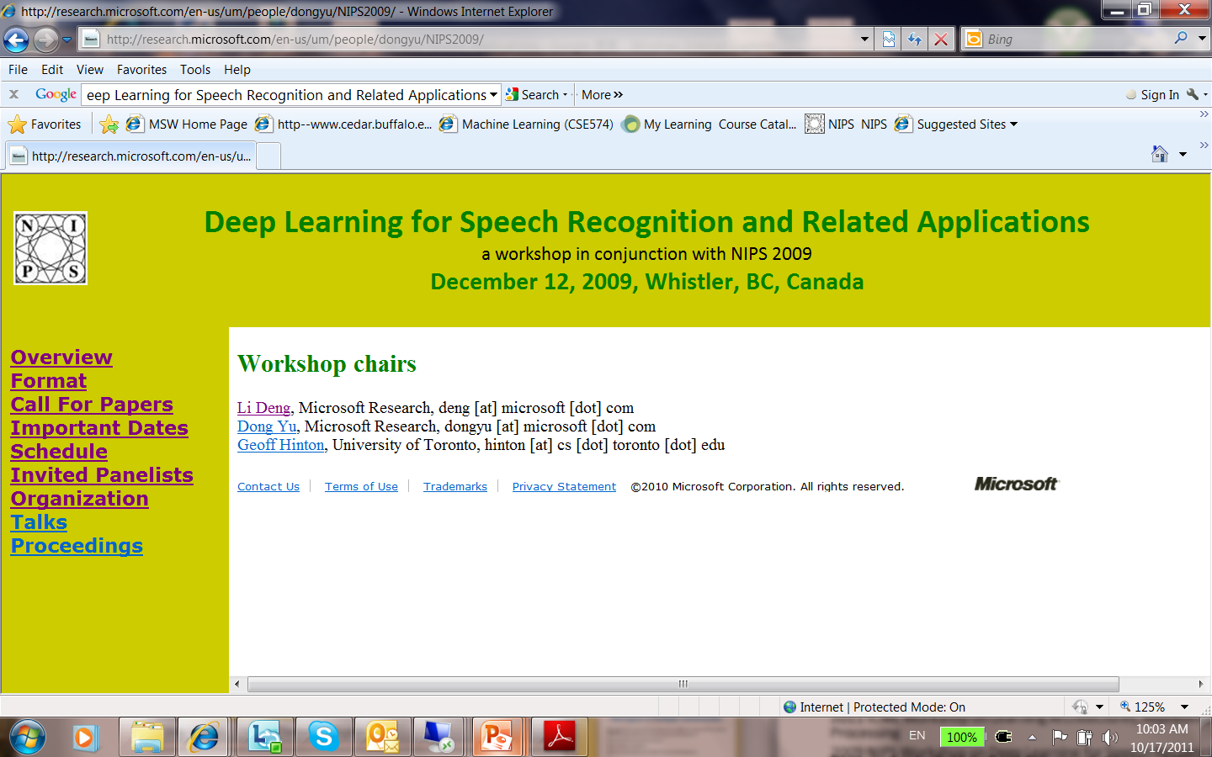
2011 ICML Workshop on Learning Architectures, Representations, and Optimization for Speech and Visual Information Processing
2009 NIPS Workshop on Deep Learning for Speech Recognition and Related Applications,
2009 ICML Workshop on Learning Feature Hierarchies
2008 NIPS Deep Learning Workshop
2009 NIPS Workshop on Deep Learning for Speech Recognition and Related Applications,
→2012: special issue on Deep Learning for Speech and Language Processing in IEEE Transactions on Audio, Speech, and Language Processing (Jan. 2012; intro in my EiC inaugural editorial)
2012: Joint special issue on “learning deep architectures” in IEEE Signal Processing Magazine (SPM) & IEEE Trans. Pattern Analysis and Machine Intelligence (PAMI) (under planning)
DARPA deep learning program, since 2009
Hot key words of “deep network” in 2011 Learning Workshop (Fort Lauderdale), NIPS 2010, ICASSP 2011 Trend Session (Speech/Language Proc.)
Tutorial on deep learning at ICASSP-2012, just accepted … …
First time deep learning shows promise in speech recognition! And activities
grew rapidly since then…

Slide 7
Deep Learning for Speech Recognition and Related Applications
Anecdote: Speechless summary presentation of the NIPS 2009 Workshop on Speech
Li Deng, Dong Yu (Microsoft Research)
Geoffrey Hinton (University of Toronto)

Slide 8
They met in year 2009…

Slide 9
I was told you are smart.

Slide 10
Because I am deeper.

Slide 11
Can you understand speech as I do?

Slide 12
You bet! I can recognize phonemes.

Slide 13
That’s a nice first step!

Slide 14
What else are you looking for?

Slide 15
Recognizing noisy sentences spoken by unknown people.

Slide 16
Maybe we can work together.

Slide 17
Deep speech recognizer is born.
Multi-objective
Competitive Learning
Hierarchical
Deep Belief Net
Conditional
Scalable
Recurrent

Slide 18
“DBN vs DBN” (for fun)
From: Geoffrey Hinton [mailto:geoffrey.hinton@gmail.com] Sent: Tuesday, January 17, 2012 9:33 AM To: Li Deng Subject: DBNs are beating DBNs
http://acronyms.thefreedictionary.com/DBNAcronym | Definition
DBN | 1, 5-Diazabicyclo(4.3.0)Non-5-Ene (chemical compound)
DBN | Doing Business - Not
DBN | Dialog Broadband Networks (Dialog Telekom PLC; Sri Lanka)
DBN | De Bonis Non (Legal: appointment of a personal representative to a vacancy)
DBN | Divisible by None (band)
DBN | Deep Belief Network (machine learning)
DBN | Dynamic Bayes Network
DBN | Data Bus Network
DBN | Dial-Back Number
DBN | Day Beacon
DBN | Domain-Border Node
DBN | Digital Billboard Network (Australia)
DBN | Drunk Before Noon
DBN | District Borough Number (New York City Department of Education school identifier)
DBN | Database Notification
DBN | Directed Bipartite Network
DBN | Décolletage de Basse Normandie (French: Turning of Lower Normandy)
DBN | Don Boule de Neige (French: Don Snowball)
DBN | Development Business Network (various locations)

Slide 19
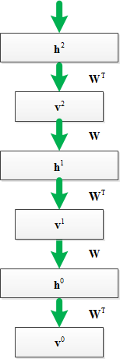
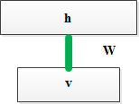
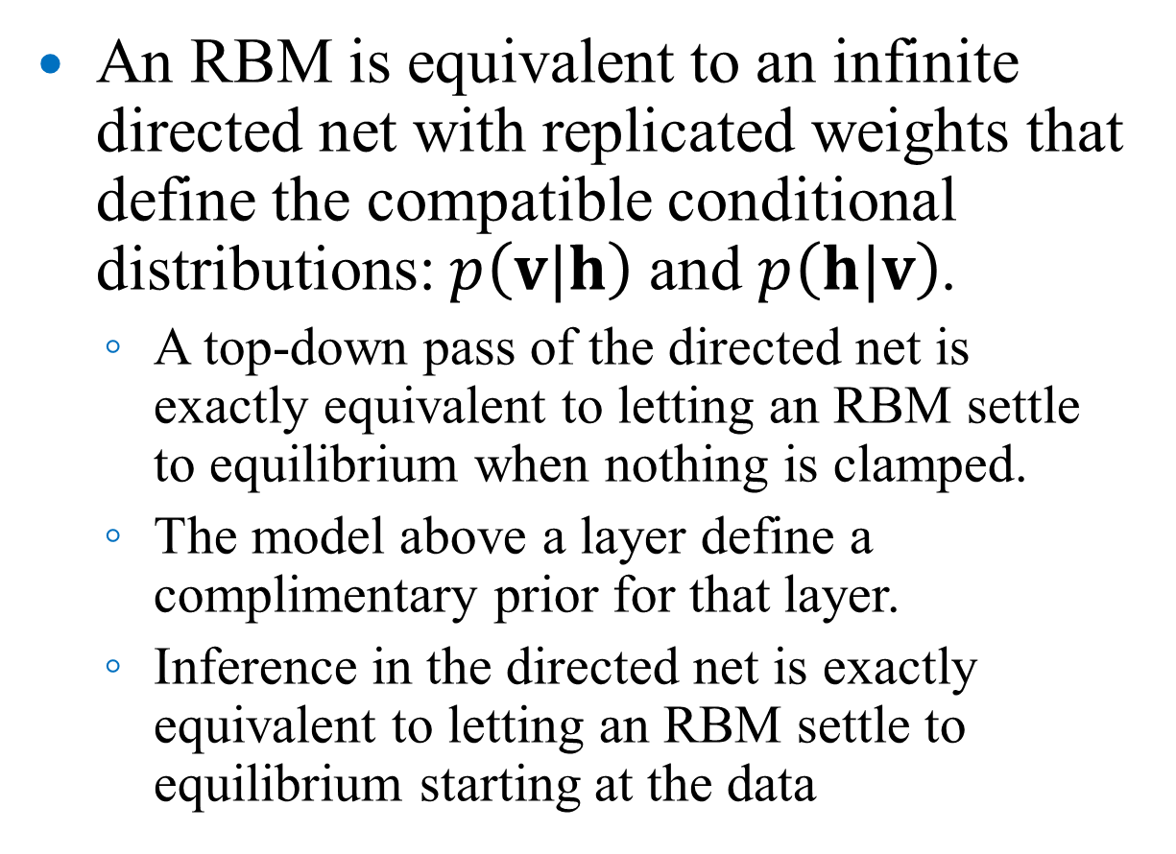
RBM and DBN
An RBM is equivalent to an infinite directed net with replicated weights that define the compatible conditional distributions: $p\left(v|h\right)$ and $p\left(h|v\right)$.
A top-down pass of the directed net is exactly equivalent to letting an RBM settle to equilibrium when nothing is clamped.
The model above a layer define a complimentary prior for that layer.
Inference in the directed net is exactly equivalent to letting an RBM settle to equilibrium starting at the data

Slide 20
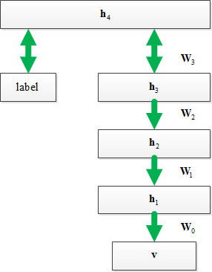
How to Use DBN: Generation
learns to generate combinations of labels and features
1. Run the top layer to thermal equilibrium with or without label clamped
2A. Sample from the distribution and then top-down till end
2B. Calculate p(v) and sample from it.

Slide 21
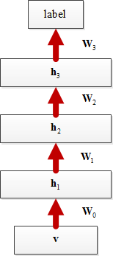
Deep Neural Network
Recognition using generative DBN is poor.
For recognition better use discriminative deep neural network, e.g., multi-layer perceptron with many layers
Training deep neural network is hard
Trick: Use DBN pretraining procedure to initialize the weights and then use backpropagation algorithm to fine tune the weights.
It can alleviate some of the problems associated with backpropagation esp. when training set is small
Empirically works well without theoretical guarantee.

Slide 22
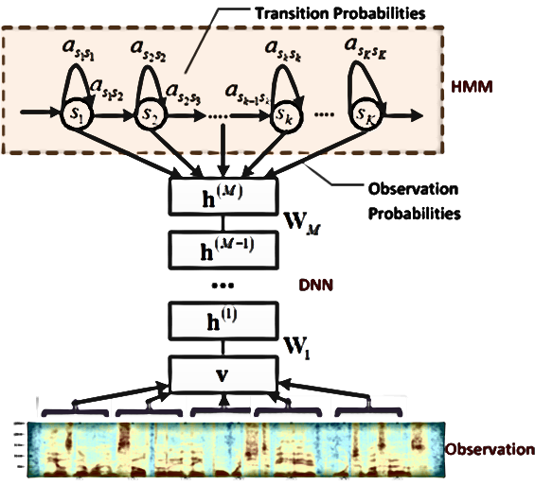
DNN-HMM (replacing GMM only; longer MFCC windows w. no transformation)
Model tied triphone states directly
Many layers of nonlinear feature transformation + SoftMax

Slide 23
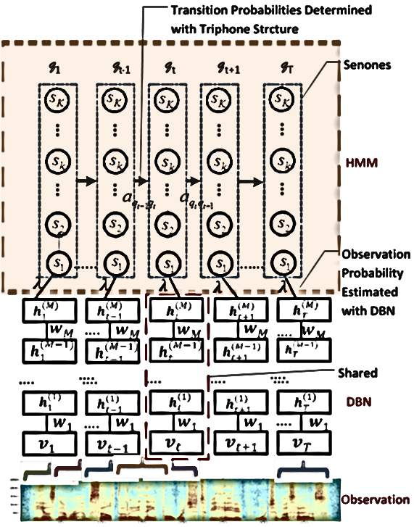
CD-DNN-HMM: Architecture

Slide 24
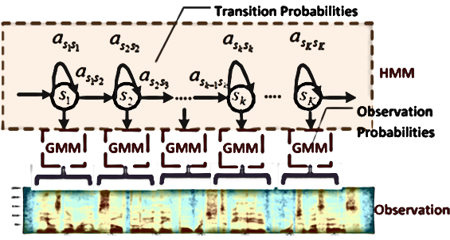
(Shallow) GMM-HMM
Model frames of acoustic data with two stochastic processes:
A hidden Markov process to model state transition
A Gaussian mixture model to generate observations
Train with maximum likelihood criterion using EM followed by discriminative training (e.g. MPE)

Slide 25
G. Hinton, L. Deng, D. Yu, G. Dahl, A.Mohamed, N. Jaitly, A. Senior, V. Vanhoucke, P. Nguyen, T. Sainath, and B. Kingsbury. “Deep Neural Networks for Acoustic Modeling in Speech Recognition.” IEEE Signal Processing Magazine, Vol. 29, No. 6, November, 2012 (to appear).

Slide 26
Voice Search with DNN-HMM
First attempt in using deep models for large vocabulary speech recognition (summer 2010)
Published in the 2012 Special issue of T-ASLP:

Slide 27
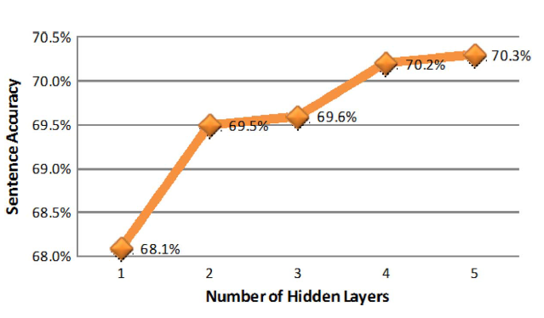
Effects of DNN Depth
Baseline GMM-HMM (trained with MPE): 65.5%
Same training recipe is then used for Switchboard task with more reliably-labeled training data

Slide 28
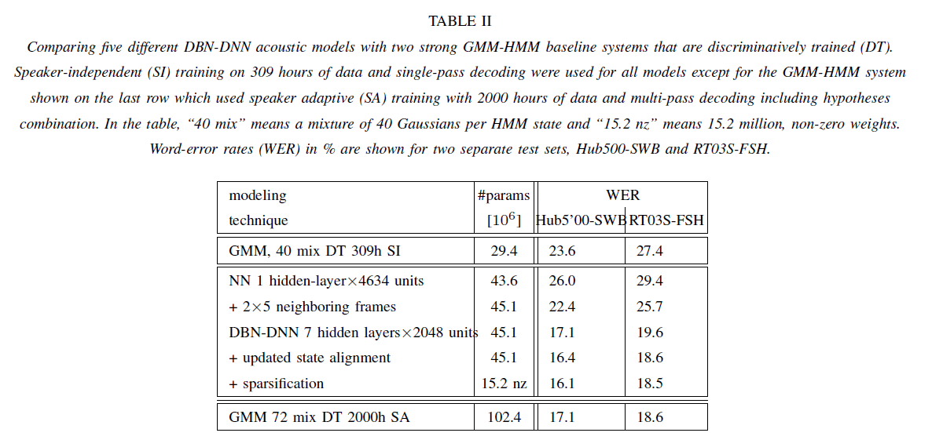
ICASSP-2012

Slide 29
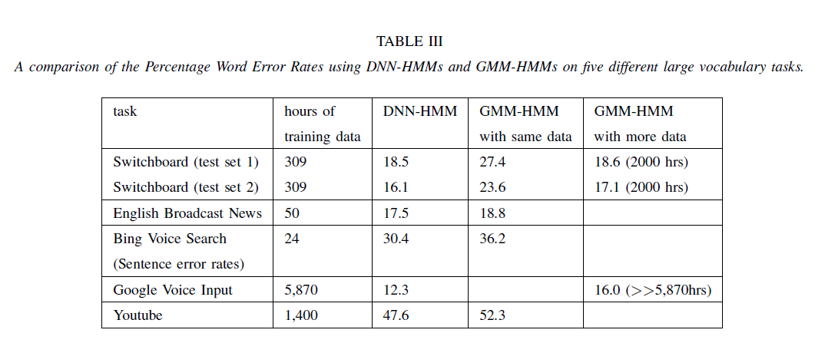
Notes:
IBM has much better results coming out in interspeech-2012

Slide 30
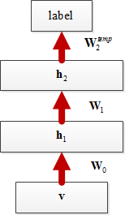
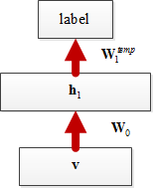
Discriminative Pre-training for DNN
Train weights with a single hidden layer using BackProp (stop early)
Insert a new hidden layer and train it using BackProp (stop early)
Continue to a fixed number of layers (stop early)
Finally, jointly fine-tune all layers till convergence (no DBN)
Yu, Deng, Seide: Discriminative pretraining of deep neural networks, patent filed Nov. 2011

Slide 31


Deep Convex Network (DCN/DSN)
.
.
.
Example: L=3
Deng & Yu (Interspeech 2011, ICASSP-2012)
Best L=26
Each image has 784 pixels
Ten classes as the output of each module (digits)
60,000 training samples
10,000 test samples
Parallel implementation (interspeech-2012; GPU free)
Works well for TIMIT, WSJ, and SLU (Deng, Yu, Platt: ICASSP-2012; Tur, Deng: ICASSP-2012)
10
3000
10
784
3000
10
784
3000
784

Slide 32
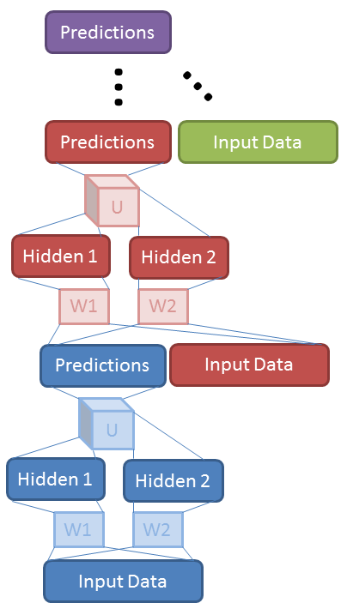
Tensor Version of DCN/DSN (Hutchinson, Deng, & Yu, ICASSP-2012)

Slide 33
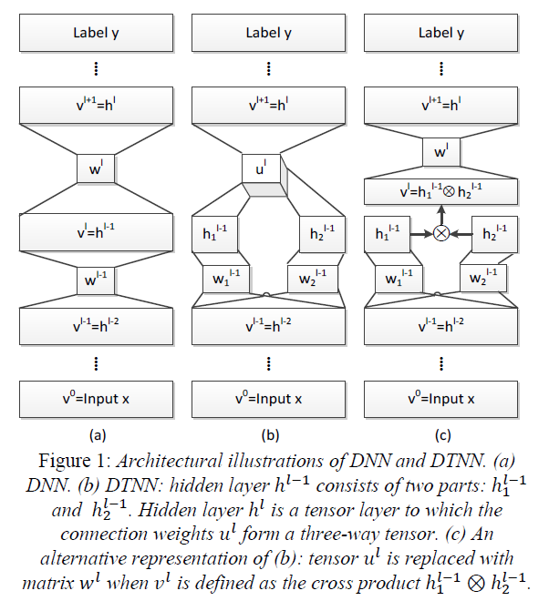
Tensor Version of DNN (Yu, Deng, Seide, Interspeech-2012)

Slide 34
Outline
Deep Learning
A quick Tutorial (RBM, DBN, DNN-HMM, DCN)
A brief history on how speech industry started exploring deep learning with success stories (replacing GMM so far)
Part II: Dynamic Generative Models and Learning
DBN*, HDM, HTM, segment models, etc.
A (longer) separate history and a critical review
Connecting the Dots
Linguistic hierarchy in dynamic human speech
Exploiting hierarchical dynamics in deep learning framework (to replace HMM and MFCCs as well)
Notes:
Contextual dynamics; massive parameters vs parsimonious params; constraints in RNN.

Slide 35
Deep/Dynamic Models are Natural for Speech
Hierarchical structure in human speech generation
Global concept/semantics formation (IS)
Word sequence formation / prosodic planning
Phonological encoding (phones, distinctive features)
Phonetic encoding (motor commands, articulatory targets)
Articulatory dynamics
Acoustic dynamics (clean speech)
Distorted speech
Interactions between speakers and listener/machine
Hierarchical structure in human speech perception
Cochlear nonlinear spectral analysis
Attribute/phonological-feature detection at higher level(s)
Phonemic and syllabic detection at still higher level(s)
Word and sequence detection
Syntactic analysis and semantic understanding at deeper auditory cortex

Slide 36
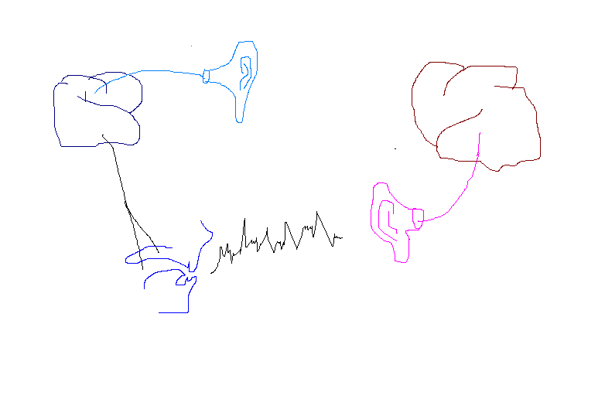
Production & Perception: Closed-Loop Chain
SPEAKER
LISTENER
decoded
message
Internal
model
message
ear/auditory reception
motor/articulators
Speech Acoustics in
closed-loop chain

Slide 37
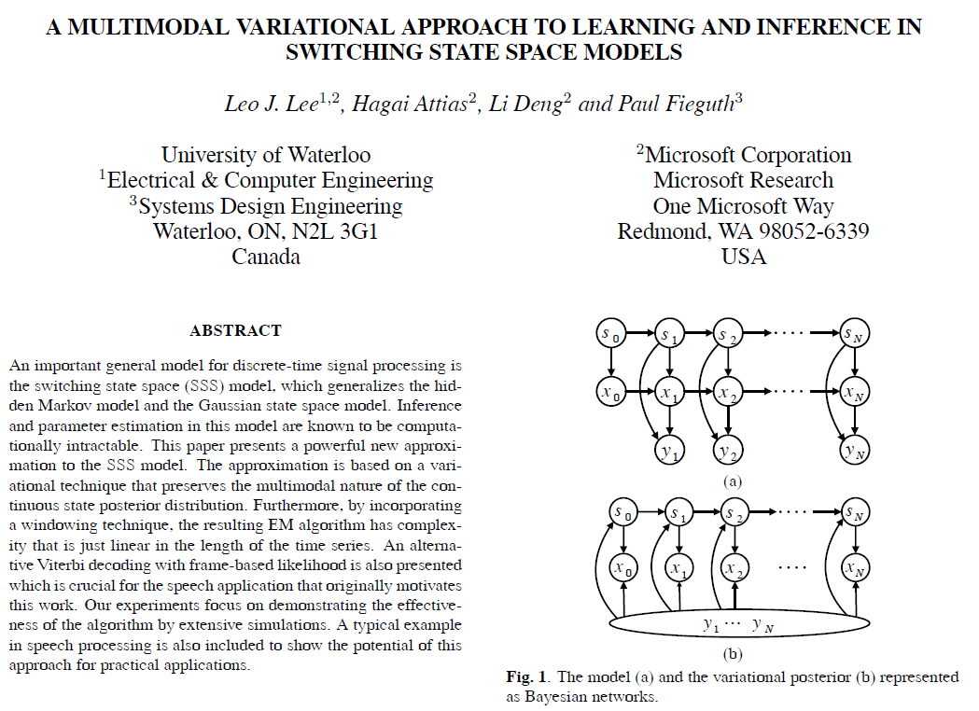
ICASSP-2004

Slide 39
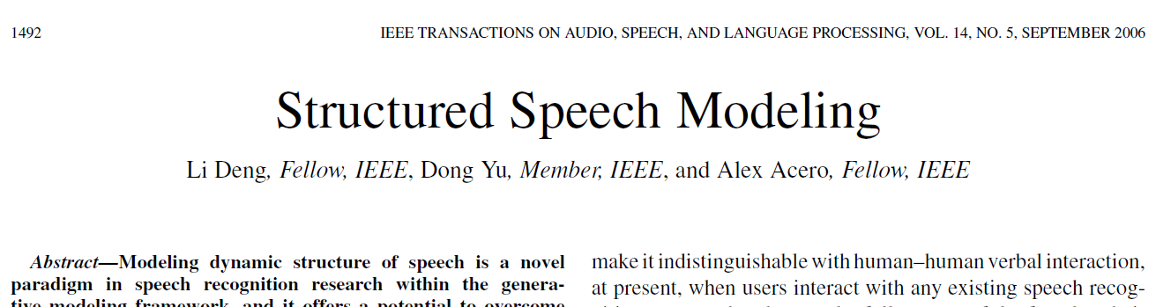
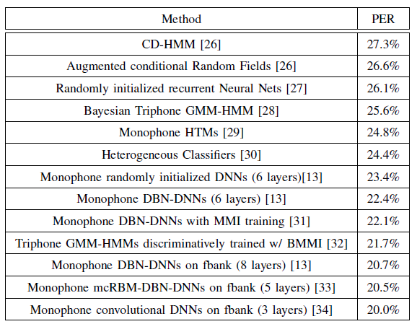
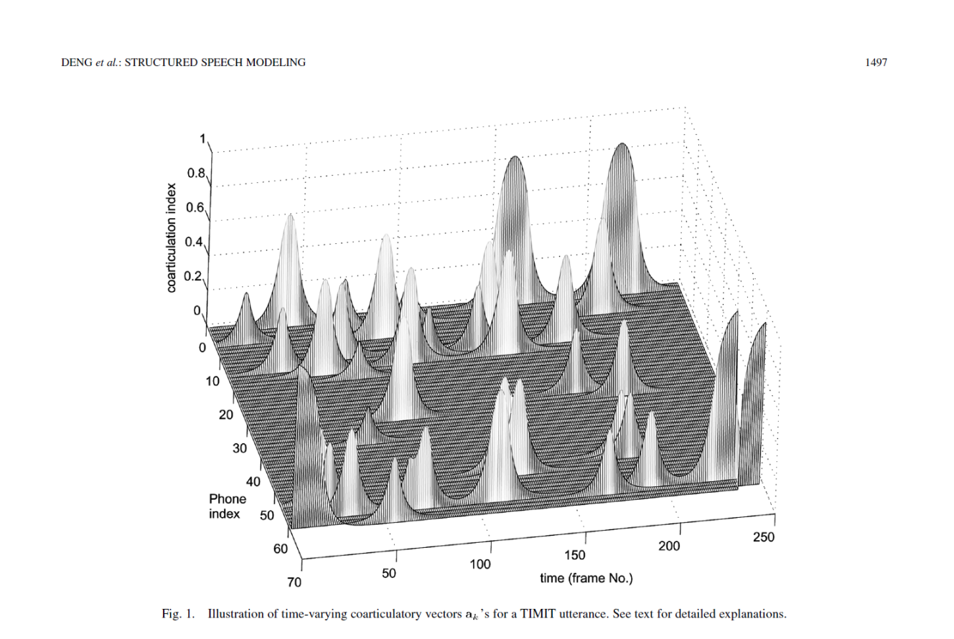

Slide 40
Encoder: Two-Stage Production Mechanisms
Phonology (higher level):
Symbolic encoding of linguistic message
Discrete representation by phonological features
Loosely-coupled multiple feature tiers
Overcome beads-on-a-string phone model
Theories of distinctive features, feature geometry
& articulatory phonology
Account for partial/full sound deletion/modification
in casual speech
SPEAKER
message
Phonetics (lower level):
Convert discrete linguistic features to
continuous acoustics
Mediated by motor control & articulatory dynamics
Mapping from articulatory variables to
VT area function to acoustics
Account for co-articulation and reduction (target undershoot), etc.
motor/articulators
Speech Acoustics

Slide 41
Encoder: Phonological Modeling
Computational phonology:
Represent pronunciation variations as
constrained factorial Markov chain
Constraint: from articulatory phonology
Language-universal representation
SPEAKER
ten themes
message
/ t ε n ө i: m z /
motor/articulators
Tongue
Tip
Tongue
Body
Mid / Front
High / Front
Speech Acoustics

Slide 42
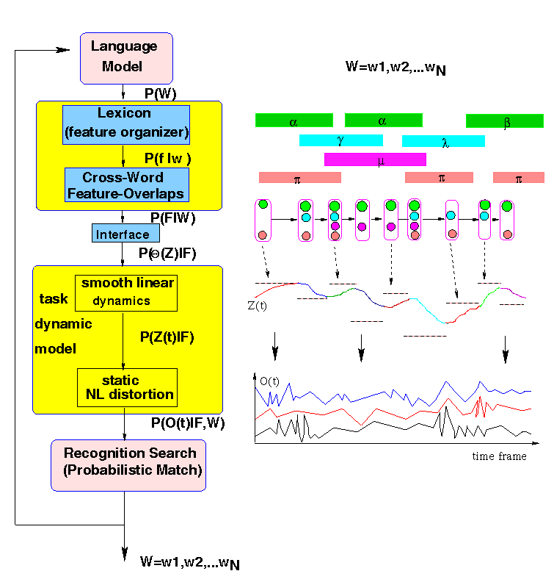
Deng: Speech Communication, 1998

Slide 43
Decoder I: Auditory Reception
Convert speech acoustic waves into
efficient & robust auditory representation
This processing is largely independent
of phonological units
Involves processing stages in cochlea
(ear), cochlear nucleus, SOC, IC,…, all
the way to A1 cortex
Principal roles:
1) combat environmental acoustic
distortion;
2) detect relevant speech features
3) provide temporal landmarks to aid
decoding
Key properties:
1) Critical-band freq scale, logarithmic compression,
2) adapt freq selectivity, cross-channel correlation,
3) sharp response to transient sounds
4) modulation in independent frequency bands,
5) binaural noise suppression, etc.
LISTENER
decoded
message
Internal
model
message
ear/auditory reception
motor/articulators

Slide 44
Decoder II: Cognitive Perception
Cognitive process: recovery of linguistic
message
Relies on
1) “Internal” model: structural knowledge of
the encoder (production system)
2) Robust auditory representation of features
3) Temporal landmarks
Child speech acquisition process is one that
gradually establishes the “internal” model
Strategy: analysis by synthesis
i.e., Probabilistic inference on (deeply)
hidden linguistic units using the internal
model
No motor theory: the above strategy
requires no articulatory recovery from
speech acoustics
LISTENER
decoded
message
Internal
model
message
ear/auditory reception
motor/articulators

Slide 45
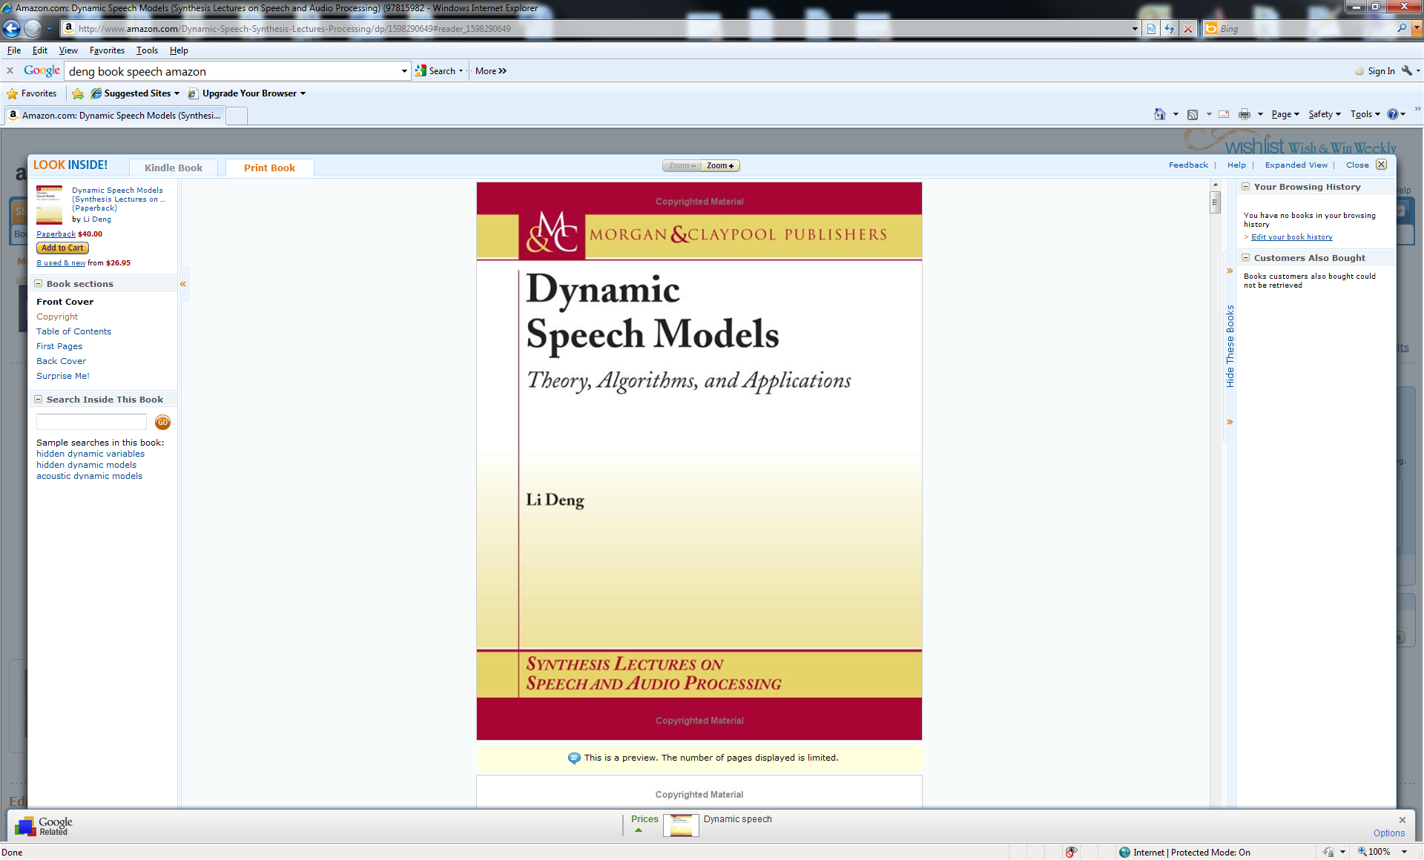
(Hidden) Dynamic Models
Many types of dynamic models since 90’s
Good survey article on earlier work (Ostendorf et al. 1996)
Hidden Dynamic Models (HDM/HTM) since late 90’s
This is “deep” generative model with >2 layers
More recent work: book 2006
Pros and cons of different models
All intended to create more realistic speech models “deeper” than HMM for speech recognition
But with different assumptions on speech dynamics
DBN (2009-2010) vs. HTM (2006)
Distributed vs. centralized representations
Massive vs. parsimonious parameters
Product of experts vs mixture of experts
No connections (so far) to deep nets

Slide 46
Quite Deep, But Did not Take Off
SPEAKER
targets
articulation
message
distortion-free acoustics
distorted acoustics
motor/articulators
Speech Acoustics
distortion factors &
feedback to articulation

Slide 47
Summary
Speech research motivates the use of deep architectures from human speech production/perception mechanisms
HMM is a shallow architecture with GMM to link linguistic units with observations
Hierarchical/deep statistical models for speech have been developed in the past
trajectory model, segmental model, switching dynamic system model, hidden dynamic model (articulatory/VTR), hidden trajectory, and hybrid ANN-HMM, tandem model, etc.
With less success than expected
We are now beginning to understand why based on the success of more recent successful use of Deep Belief Net (DBN) speech recognition
Importance of distributed representation, massive parameters, and products of experts
Outlook: Connecting dots between DBN (intended to replace GMM) and dynamic models of speech (intended to replace GMM-HMM)

Slide 48
Thank You

Slide 49
Selected References (updated, 2013)
Abdel-Hamid, O., Mohamed, A., Jiang, H., and G. Penn, “Applying convolutional neural networks concepts to hybrid NN-HMM model for speech recognition,” Proc. ICASSP, 2012.
Arel, I., Rose, C., and Karnowski, T. “Deep Machine Learning - A New Frontier in Artificial Intelligence,” IEEE Computational Intelligence Mag., Nov., 2010.
Baker, J., Deng, L., Glass, J., Khudanpur, S., Lee, C.-H., Morgan, N., and O’Shaughnessy, D. “Research developments and directions in speech recognition and understanding,” IEEE Sig. Proc. Mag., vol. 26, no. 3, May 2009, pp. 75-80.
Baker, J., Deng, L., Glass, J., Khudanpur, S., Lee, C.-H., Morgan, N., and O’Shaughnessy, D. “Updated MINS report on speech recognition and understanding,” IEEE Sig. Proc. Mag., vol. 26, no. 4, July 2009a.
Bengio, Y., Boulanger, N., and Pascanu. R. “Advances in optimizing recurrent networks,” Proc. ICASSP, 2013.
Bengio, Y., Courville, A., and Vincent, P. “Representation learning: A review and new perspectives,” IEEE Trans. PAMI, 2013a.
Bengio, Y. “Learning deep architectures for AI,” in Foundations and Trends in Machine Learning, Vol. 2, No. 1, 2009, pp. 1-127.
Bengio, Y., Ducharme, R., Vincent, P. and Jauvin, C. “A neural probabilistic language model,” Proc. NIPS, 2000, pp. 933-938.
Bengio, Y., De Mori, R., Flammia, G. and Kompe, F. “Global optimization of a neural network—Hidden Markov model hybrid,” in Proc. Eurospeech, 1991.
Bergstra, J. and Bengio, Y. “Random search for hyper-parameter optimization,” J. Machine Learning Research,” Vol. 3, pp. 281-305, 2012.
Bottou, L. and LeCun. Y. “Large scale online learning,” Proc. NIPS, 2004.
Bilmes, J. “Dynamic graphical models,” IEEE Signal Processing Mag., vol. 33, pp. 29–42, 2010.
Bilmes, J. and Bartels, C. “Graphical model architectures for speech recognition,” IEEE Signal Processing Mag., vol. 22, pp. 89–100, 2005.
Bourlard, H. and Morgan, N., Connectionist Speech Recognition: A Hybrid Approach, Norwell, MA: Kluwer, 1993.
Bouvrie, J. “Hierarchical Learning: Theory with Applications in Speech and Vision,” Ph.D. thesis, MIT, 2009.
Bridle, J., L. Deng, J. Picone, H. Richards, J. Ma, T. Kamm, M. Schuster, S. Pike, and R. Reagan, “An investigation of segmental hidden dynamic models of speech coarticulation for automatic speech recognition,” Final Report for 1998 Workshop on Language Engineering, CLSP, Johns Hopkins, 1998.
Caruana, R. “Multitask Learning,” Machine Learning, Vol. 28, pp. 41-75, Kluwer Academic Publishers, 1997.
Cho, Y. and Saul L. “Kernel methods for deep learning,” Proc. NIPS, pp. 342–350, 2009.
Ciresan, D., Giusti, A., Gambardella, L., and Schmidhuber, J. “Deep neural networks segment neuronal membranes in electron microscopy images,” Proc. NIPS, 2012.
Cohen, W. and R. V. de Carvalho. “Stacked sequential learning,” Proc. IJCAI, pp. 671–676, 2005.
Collobert, R. “Deep learning for efficient discriminative parsing,” Proc. NIPS Workshop on Deep Learning and Unsupervised Feature Learning, 2010.
Collobert, R. and Weston J. “A unified architecture for natural language processing: Deep neural networks with multitask learning,” Proc. ICML, 2008.
Collobert, R., Weston, J., Bottou, L., Karlen, M., Kavukcuoglu, K., and Kuksa, P. “Natural language processing (almost) from scratch,” J. Machine Learning Research, Vo. 12, pp. 2493-2537, 2011.
Dahl, G., Yu, D., Deng, L., and Acero, A. “Context-dependent DBN-HMMs in large vocabulary continuous speech recognition,” Proc. ICASSP, 2011.
Dahl, G., Yu, D., Deng, L., and Acero, A. “Context-dependent, pre-trained deep neural networks for large vocabulary speech recognition,” IEEE Trans. Audio, Speech, & Language Proc., Vol. 20 (1), pp. 30-42, January 2012.
Dahl, G., Ranzato, M., Mohamed, A. and Hinton, G. “Phone recognition with the mean-covariance restricted Boltzmann machine,” Proc. NIPS, vol. 23, 2010, 469-477.
Dean, J., Corrado, G., R. Monga, K. Chen, M. Devin, Q. Le, M. Mao, M. Ranzato, A. Senior, P. Tucker, Yang, K., and Ng, A. “Large Scale Distributed Deep Networks,” Proc. NIPS, 2012.
Deng, L. and Li, X. “Machine learning paradigms in speech recognition: An overview,” IEEE Trans. Audio, Speech, & Language, May 2013.
Deng, L., Abdel-Hamid, O., and Yu, D. “A deep convolutional neural network using heterogeneous pooling for trading acoustic invariance with phonetic confusion,” Proc. ICASSP, 2013.
Deng, L., Li, J., Huang, K., Yao, D. Yu, F. Seide, M. Seltzer, G. Zweig, X. He, J. Williams, Y. Gong, and A. Acero. “Recent advances in deep learning for speech research at Microsoft,” Proc. ICASSP, 2013a.
Deng, L., Hinton, G., and Kingsbury, B. “New types of deep neural network leaning for speech recognition and related applications: An overview,” Proc. ICASSP, 2013b.
Deng, L., He, X., and J. Gao, J. “Deep stacking networks for information retrieval,” Proc. ICASSP, 2013c.
Deng, L., Tur, G, He, X, and Hakkani-Tur, D. “Use of kernel deep convex networks and end-to-end learning for spoken language understanding,” Proc. IEEE Workshop on Spoken Language Technologies, December 2012.
Deng, L., Yu, D., and Platt, J. “Scalable stacking and learning for building deep architectures,” Proc. ICASSP, 2012a.
Deng, L., Hutchinson, B., and Yu, D. “Parallel training of deep stacking networks,” Proc. Interspeech, 2012b.
Deng, L. “An Overview of Deep-Structured Learning for Information Processing,” Proceedings of Asian-Pacific Signal & Information Processing Annual Summit and Conference (APSIPA-ASC), October 2011.
Deng, L. and Yu, D. “Deep Convex Network: A scalable architecture for speech pattern classification,” Proc. Interspeech, 2011.
Deng, L., Seltzer, M., Yu, D., Acero, A., Mohamed, A., and Hinton, G. “Binary coding of speech spectrograms using a deep auto-encoder,” Proc. Interspeech, 2010.
Deng, L., Yu, D., and Hinton, G. “Deep Learning for Speech Recognition and Related Applications” NIPS Workshop, 2009.
Deng, L. and Yu, D. “Use of differential cepstra as acoustic features in hidden trajectory modeling for phonetic recognition,” Proc. ICASSP, 2007.
Deng, L. DYNAMIC SPEECH MODELS – Theory, Algorithm, and Application, Morgan & Claypool, December 2006.
Deng, L., Yu, D. and Acero, A. “Structured speech modeling,” IEEE Trans. on Audio, Speech and Language Processing, vol. 14, no. 5, pp. 1492-1504, September 2006
Deng, L., Yu, D. and Acero, A. “A bidirectional target filtering model of speech coarticulation: Two-stage implementation for phonetic recognition,” IEEE Transactions on Audio and Speech Processing, vol. 14, no. 1, pp. 256-265, January 2006a.

Slide 50
Deng, L., Wu, J., Droppo, J., and Acero, A. “Dynamic Compensation of HMM Variances Using the Feature Enhancement Uncertainty Computed From a Parametric Model of Speech Distortion,” IEEE Transactions on Speech and Audio Processing, vol. 13, no. 3, pp. 412–421, 2005.
Deng, L. and O'Shaughnessy, D. SPEECH PROCESSING – A Dynamic and Optimization-Oriented Approach, Marcel Dekker, 2003.
Deng, L. “Switching dynamic system models for speech articulation and acoustics,” in Mathematical Foundations of Speech and Language Processing, pp. 115–134. Springer-Verlag, New York, 2003.
Deng, L. “Computational Models for Speech Production,” in Computational Models of Speech Pattern Processing, pp. 199-213, Springer Verlag, 1999.
Deng, L., Ramsay, G., and Sun, D. “Production models as a structural basis for automatic speech recognition,” Speech Communication, vol. 33, no. 2-3, pp. 93–111, Aug 1997.
Deng, L. and Sameti, H. “Transitional speech units and their representation by regressive Markov states: Applications to speech recognition,” IEEE Transactions on speech and audio processing, vol. 4, no. 4, pp. 301–306, July 1996.
Deng, L., Aksmanovic, M., Sun, D., and Wu, J. “Speech recognition using hidden Markov models with polynomial regression functions as nonstationary states,” IEEE Transactions on Speech and Audio Processing, vol. 2, no. 4, pp. 507-520, 1994.
Deng L. and Sun, D. “A statistical approach to automatic speech recognition using the atomic speech units constructed from overlapping articulatory features,” Journal of the Acoustical Society of America, vol. 85, no. 5, pp. 2702-2719, 1994.
Deng, L. “A stochastic model of speech incorporating hierarchical nonstationarity,” IEEE Transactions on Speech and Audio Processing, vol. 1, no. 4, pp. 471-475, 1993.
Deng, L. “A generalized hidden Markov model with state-conditioned trend functions of time for the speech signal,” Signal Processing, vol. 27, no. 1, pp. 65–78, 1992.
Deselaers, T., Hasan, S., Bender, O. and Ney, H. “A deep learning approach to machine transliteration,” Proc. 4th Workshop on Statistical Machine Translation , pp. 233–241, Athens, Greece, March 2009.
Erhan, D., Bengio, Y., Courvelle, A., Manzagol, P., Vencent, P., and Bengio, S. “Why does unsupervised pre-training help deep learning?” J. Machine Learning Research, pp. 201-208, 2010.
Fine, S., Singer, Y. and Tishby, N. “The hierarchical hidden Markov model: Analysis and applications,” Machine Learning, vol. 32, p. 41-62, 1998.
Gens, R. and Domingo, P. “Discriminative learning of sum-product networks,” NIPS, 2012.
George, D. “How the Brain Might Work: A Hierarchical and Temporal Model for Learning and Recognition,” Ph.D. thesis, Stanford University, 2008.
Gibson, M. and Hain, T. “Error approximation and minimum phone error acoustic model estimation,” IEEE Trans. Audio, Speech, and Language Proc., vol. 18, no. 6, August 2010, pp. 1269-1279.
Glorot, X., Bordes, A., and Bengio, Y. “Deep sparse rectifier neural networks,” Proc. AISTAT, April 2011.
Glorot, X. and Bengio, Y. “Understanding the difficulty of training deep feed-forward neural networks” Proc. AISTAT, 2010.

Slide 51
Graves, A., Fernandez, S., Gomez, F., and Schmidhuber, J. “Connectionist temporal classification: Labeling unsegmented sequence data with recurrent neural networks,” Proc. ICML, 2006.
Graves, A. “Sequence Transduction with Recurrent Neural Networks,” Representation Learning Worksop, ICML 2012.
Graves, A., Mahamed, A., and Hinton, G. “Speech recognition with deep recurrent neural networks,” Proc. ICASSP, 2013.
Hawkins, J. and Blakeslee, S. On Intelligence: How a New Understanding of the Brain will lead to the Creation of Truly Intelligent Machines, Times Books, New York, 2004.
Hawkins, G., Ahmad, S. and Dubinsky, D. “Hierarchical Temporal Memory Including HTM Cortical Learning Algorithms,” Numenta Tech. Report, December 10, 2010.
He, X., Deng, L., Chou, W. “Discriminative learning in sequential pattern recognition – A unifying review for optimization-oriented speech recognition,” IEEE Sig. Proc. Mag., vol. 25, 2008, pp. 14-36.
He, X. and Deng, L. “Speech recognition, machine translation, and speech translation – A unifying discriminative framework,” IEEE Sig. Proc. Magazine, Vol. 28, November, 2011.
He, X. and Deng, L. “Optimization in speech-centric information processing: Criteria and techniques,” Proc. ICASSP, 2012.
He, X. and Deng, L. “Speech-centric information processing: An optimization-oriented approach,” Proc. of the IEEE, 2013.
Heigold, G., Vanhoucke, V., Senior, A. Nguyen, P., Ranzato, M., Devin, M., and Dean, J. “Multilingual acoustic models using distributed deep neural networks,” Proc. ICASSP, 2013.
Heigold, G., Ney, H., Lehnen, P., Gass, T., Schluter, R. “Equivalence of generative and log-liner models,” IEEE Trans. Audio, Speech, and Language Proc., vol. 19, no. 5, February 2011, pp. 1138-1148.
Heintz, I., Fosler-Lussier, E., and Brew, C. “Discriminative input stream combination for conditional random field phone recognition,” IEEE Trans. Audio, Speech, and Language Proc., vol. 17, no. 8, Nov. 2009, pp. 1533-1546.
Hifny, Y. and Renals, S. “Speech recognition using augmented conditional random fields,” IEEE Trans. Audio, Speech, and Language Proc., vol. 17, no. 2, February 2009, pp. 354-365.
Hinton, G. and Salakhutdinov, R. “Discovering binary codes for documents by learning deep generative models,” Topics in Cognitive Science, pp. 1-18, 2010.
Hinton, G., Srivastava, N., Krizhevsky, A., Sutskever, I., and Salakhutdinov, R. “Improving neural networks by preventing co-adaptation of feature detectors,” arXiv: 1207.0580v1, 2012.
Hinton, G., Deng, L., Yu, D., Dahl, G., Mohamed, A., Jaitly, N., Senior, A., Vanhoucke, V., Nguyen, P., Sainath, T., and Kingsbury, B., “Deep Neural Networks for Acoustic Modeling in Speech Recognition,” IEEE Signal Processing Magazine, vol. 29, no. 6, pp. 82-97, November 2012.

Slide 52
Hinton, G., Krizhevsky, A., and Wang, S. “Transforming auto-encoders,” Proc. Intern. Conf. Artificial Neural Networks, 2011.
Hinton, G. “A practical guide to training restricted Boltzmann machines,” UTML Tech Report 2010-003, Univ. Toronto, August 2010.
Hinton, G., Osindero, S., and Teh, Y. “A fast learning algorithm for deep belief nets,” Neural Computation, vol. 18, pp. 1527-1554, 2006.
Hinton, G. and Salakhutdinov, R. “Reducing the dimensionality of data with neural networks,” Science, vol. 313. no. 5786, pp. 504 - 507, July 2006.
Hinton, G. “A better way to learn features,” Communications of the ACM,” Vol. 54, No. 10, October, 2011, pp. 94.
Huang, J., Li, J., Deng, L., and Yu, D. “Cross-language knowledge transfer using multilingual deep neural networks with shared hidden layers,” Proc. ICASSP, 2013.
Huang, S. and Renals, S. “Hierarchical Bayesian language models for conversational speech recognition,” IEEE Trans. Audio, Speech, and Language Proc., vol. 18, no. 8, November 2010, pp. 1941-1954.
Huang, E., Socher, R., Manning, C, and Ng, A. “Improving Word Representations via Global Context and Multiple Word Prototypes,” Proc. ACL, 2012.
Hutchinson, B., Deng, L., and Yu, D. “A deep architecture with bilinear modeling of hidden representations: Applications to phonetic recognition,” Proc. ICASSP, 2012.
Hutchinson, B., Deng, L., and Yu, D. “Tensor deep stacking networks,” IEEE Trans. Pattern Analysis and Machine Intelligence, 2013.
Jaitly, N. and Hinton, G. “Learning a better representation of speech sound waves using restricted Boltzmann machines,” Proc. ICASSP, 2011.
Jaitly, N., Nguyen, P., and Vanhoucke, V. “Application of pre-trained deep neural networks to large vocabulary speech recognition,” Proc. Interspeech, 2012.
Jarrett, K., Kavukcuoglu, K. and LeCun, Y. “What is the best multistage architecture for object recognition?” Proc. Intl. Conf. Computer Vision, pp. 2146–2153, 2009.
Jiang, H. and Li, X. “Parameter estimation of statistical models using convex optimization: An advanced method of discriminative training for speech and language processing,” IEEE Signal Processing Magazine, vol. 27, no. 3, pp. 115–127, 2010.
Juang, B.-H., Chou, W., and Lee, C.-H. “Minimum classification error rate methods for speech recognition,” IEEE Trans. On Speech and Audio Processing, vol. 5, pp. 257–265, 1997.
Kavukcuoglu, K., Sermanet, P., Boureau, Y., Gregor, K., Mathieu M., and LeCun, Y. “Learning Convolutional Feature Hierarchies for Visual Recognition,” Proc. NIPS, 2010.
Ketabdar, H. and Bourlard, H. “Enhanced phone posteriors for improving speech recognition systems,” IEEE Trans. Audio, Speech, and Language Proc., vol. 18, no. 6, August 2010, pp. 1094-1106.

Slide 53
Kingsbury, B. “Lattice-based optimization of sequence classification criteria for neural-network acoustic modeling,” Proc. ICASSP, 2009.
Kingsbury, B., Sainath, T., and Soltau, H. “Scalable minimum Bayes risk training of deep neural network acoustic models using distributed Hessian-free optimization,” Proc. Interspeech, 2012.
Krizhevsky, A., Sutskever, I. and Hinton, G. “ImageNet classification with deep convolutional neural Networks,” Proc. NIPS 2012.
Kubo, Y., Hori, T., and Nakamura, A. “Integrating deep neural networks into structural classification approach based on weighted finite-state transducers,” Proc. Interspeech, 2012.
Kurzweil R. How to Create a Mind. Viking Books, Dec., 2012.
Lang, K., Waibel, A., and Hinton, G. “A time-delay neural network architecture for isolated word recognition,” Neural Networks, Vol. 3(1), pp. 23-43, 1990.
Larochelle, H. and Bengio, Y. “Classification using discriminative restricted Boltzmann machines,” Proc. ICML, 2008.
Le, H., Allauzen, A., Wisniewski, G., and Yvon, F. “Training continuous space language models: Some practical issues,” in Proc. of EMNLP, 2010, pp. 778–788.
Le, H., Oparin, I., Allauzen, A., Gauvain, J., and Yvon, F. “Structured output layer neural network language model,” Proc. ICASSP, 2011.
Le, Q., Ngiam, J., Coates, A., Lahiri, A., Prochnow, B., and Ng, A. “On optimization methods for deep learning,” Proc. ICML, 2011.
Le, Q., Ranzato, M., Monga, R., Devin, M., Corrado, G., Chen, K., Dean, J., Ng, A. “Building High-Level Features Using Large Scale Unsupervised Learning,” Proc. ICML 2012.
LeCun, Y., Bottou, L., Bengio, Y., and Haffner, P. “Gradient-based learning applied to document recognition,” Proceedings of the IEEE, Vol. 86, pp. 2278-2324, 1998.
LeCun, Y. and Bengio, Y. “Convolutional networks for images, speech, and time series," in The Handbook of Brain Theory and Neural Networks (M. Arbib, ed.), pp. 255- 258, Cambridge, Massachusetts: MIT Press, 1995.
LeCun, Y., Chopra S., Ranzato, M., and Huang, F. “Energy-based models in document recognition and computer vision,” Proc. Intern. Conf. Document Analysis and Recognition (ICDAR), 2007.
Lee, C.-H. “From knowledge-ignorant to knowledge-rich modeling: A new speech research paradigm for next-generation automatic speech recognition,” Proc. ICSLP, 2004, p. 109-111.

Slide 54
Lee, H., Grosse, R., Ranganath, R., and Ng, A. “Unsupervised learning of hierarchical representations with convolutional deep belief networks,” Communications of the ACM,” Vol. 54, No. 10, October, 2011, pp. 95-103.
Lee, H., Grosse, R., Ranganath, R., and Ng, A. “Convolutional Deep Belief Networks for Scalable Unsupervised Learning of Hierarchical Representations,” Proc. ICML, 2009.
Lee, H., Largman, Y., Pham, P., Ng, A. “Unsupervised feature learning for audio classification using convolutional deep belief networks,” Proc. NIPS, 2010.
Lena, P., Nagata, K., and Baldi, P. “Deep spatiotemporal architectures and learning for protein structure prediction,” Proc. NIPS, 2012.
Li, J., Yu, D., Huang, J., and Gong, Y. “Improving wideband speech recognition using mixed-bandwidth training data in CD-DNN-HMM,” Proc. IEEE SLT 2012.
Lin, H., Deng, L., Yu, D., Gong, Y., Acero, A., and C-H Lee, “A study on multilingual acoustic modeling for large vocabulary ASR.” Proc. ICASSP, 2009.
Ling, Z., Richmond, K., and Yamagishi, J. “Articulatory control of HMM-based parametric speech synthesis using feature-space-switched multiple regression,” IEEE Trans. Audio, Speech, and Language Proc., Vol. 21, Jan, 2013.
Markoff, J. “Scientists See Promise in Deep-Learning Programs,” New York Times, Nov 24, 2012.
Martens, J. “Deep learning with Hessian-free optimization,” Proc. ICML, 2010.
Martens, J. and Sutskever, I. “Learning recurrent neural networks with Hessian-free optimization,” Proc. ICML, 2011.
Mikolov, T. “Statistical Language Models based on Neural Networks,” PhD thesis, Brno University of Technology, 2012.
Mikolov, T., Deoras, A., Povey, D., Burget, L., and Cernocky, J. “Strategies for training large scale neural network language models,” Proc. IEEE ASRU, 2011.
Mikolov, T., Karafiat, M., Burget, L., Cernocky, J., and Khudanpur, S. “Recurrent neural network based language model,” Proc. ICASSP, 2010, 1045–1048.
Minami, Y., McDermott, E. Nakamura, A. and Katagiri, S. “A recognition method with parametric trajectory synthesized using direct relations between static and dynamic feature vector time series,” Proc. ICASSP, pp. 957-960, 2002.
Mnih, A. and Hinton G. “Three new graphical models for statistical language modeling,” Proc. ICML, 2007, pp. 641-648.
Mnih, A. and Hinton G. “A scalable hierarchical distributed language model” Proc. NIPS, 2008, pp. 1081-1088.
Mohamed, A., Dahl, G. and Hinton, G. “Acoustic Modeling Using Deep Belief Networks”, IEEE Trans. Audio, Speech, & Language Proc. Vol. 20 (1), January 2012.

Slide 55
Mohamed, A., Hinton, G., and Penn, G., “Understanding how deep belief networks perform acoustic modelling,” Proc. ICASSP, 2012a.
Mohamed, A., Yu, D., and Deng, L. “Investigation of full-sequence training of deep belief networks for speech recognition,” Proc. Interspeech, Sept. 2010.
Mohamed, A., Dahl, G., and Hinton, G. “Deep belief networks for phone recognition,” in Proc. NIPS Workshop Deep Learning for Speech Recognition and Related Applications, 2009.
Morgan, N. “Deep and Wide: Multiple Layers in Automatic Speech Recognition,” IEEE Trans. Audio, Speech, & Language Proc. Vol. 20 (1), January 2012.
Morgan, N., Q. Zhu, A. Stolcke, K. Sonmez, S. Sivadas, T. Shinozaki, M. Ostendorf, P. Jain, H. Hermansky, D. Ellis, G. Doddington, B. Chen, O. Cretin, H. Bourlard, , and M. Athineos, “Pushing the envelope - aside [speech recognition],” IEEE Signal Processing Magazine, vol. 22, no. 5, pp. 81–88, Sep 2005.
Murphy, K. Machine Learning – A Probabilistic Perspective, The MIT Press, 2012.
Nair, V. and Hinton, G. “3-d object recognition with deep belief nets,” Proc. NIPS, 2009.
Ney, H. “Speech translation: Coupling of recognition and translation,” Proc. ICASSP, 1999.
Ngiam, J., Khosla, A., Kim, M., Nam, J., Lee, H., and Ng, A. “Multimodal deep learning,” Proc. ICML, 2011.
Ngiam, J., Chen, Z., Koh, P., and Ng, A. “Learning deep energy models,” Proc. ICML, 2011.
Oliver, N., Garg, A., and Horvitz, E. “Layered Representations for Learning and Inferring Office Activity from Multiple Sensory Channels,” Computer Vision and Image Understanding,” vol. 96, pp. 163-180, 2004.
Olshausen, B. “Can ‘Deep Learning’ offer deep insights about Visual Representation?” NIPS Workshop on Deep Learning and Unsupervised Feature Learning, 2012.
Ostendorf, V. Digalakis, and O. Kimball, “From HMM’s to segment models: A unified view of stochastic modeling for speech recognition,” IEEE Trans. Speech and Audio Proc., vol. 4, no. 5, September 1996.
Papandreou, G., Katsamanis, A., Pitsikalis, V., and Maragos, P. “Adaptive multimodal fusion by uncertainty compensation with application to audiovisual speech recognition,” IEEE Trans. Audio, Speech, and Lang. Processing, Vol.17(3), pp. 423-435, 2009.
Peng, J., Bo, L., and Xu, J. “Conditional neural fields,” Proc. NIPS, 2009.
Picone, P., S. Pike, R. Regan, T. Kamm, J. bridle, L. Deng, Z. Ma, H. Richards, and M. Schuster, “Initial evaluation of hidden dynamic models on conversational speech,” Proc. ICASSP, 1999.
Pinto, J., Garimella, S., Magimai-Doss, M., Hermansky, H., and Bourlard, H. “Analysis of MLP-based hierarchical phone posterior probability estimators,” IEEE Trans. Audio, Speech, and Language Proc., vol. 19, no. 2, Feb. 2011.

Slide 56
Poggio. T. “How the Brain Might Work: The Role of Information and Learning in Understanding and Replicating Intelligence,” In: Information: Science and Technology for the New Century, Editors: G. Jacovitt, A. Pettorossi, R. Consolo and V. Senni, Lateran University Press, pp. 45-61, 2007.
Poon, H. and Domingos, P. “Sum-product networks: A new deep architecture,” Proc. Twenty-Seventh Conference on Uncertainty in Artificial Intelligence, 2011. Barcelona, Spain.
Povey, D. and Woodland, P. “Minimum phone error and I-smoothing for improved discriminative training,” Proc. ICASSP, 2002, pp. 105–108.
Prabhavalkar, R. and Fosler-Lussier, E. “Backpropagation training for multilayer conditional random field based phone recognition”, Proc. ICASSP 2010, pp. 5534-5537.
Ranzato, M., Chopra, S. and LeCun, Y., and Huang, F.-J. “Energy-based models in document recognition and computer vision,” Proc. International Conference on Document Analysis and Recognition (ICDAR), 2007.
Ranzato, M., Boureau, Y., and LeCun, Y. “Sparse Feature Learning for Deep Belief Networks,” Proc. NIPS, 2007.
Ranzato, M., Susskind, J., Mnih, V., and Hinton, G. “On deep generative models with applications to recognition,” Proc. CVPR, 2011.
Rennie, S., Hershey, H., and Olsen, P. “Single-channel multi-talker speech recognition — Graphical modeling approaches,” IEEE Signal Processing Mag., vol. 33, pp. 66–80, 2010.
Rifai, S., Vincent, P., X. Muller, X. Glorot, and Y. Bengio, “Contractive autoencoders: Explicit invariance during feature extraction,” Proc. ICML, 2011, pp. 833-840.
Robinson, A. “An application of recurrent nets to phone probability estimation,” IEEE Trans. Neural Networks, Vol. 5, pp. 298-305, 1994.
Sainath, T., Ramabhadran, B., Picheny, M., Nahamoo, D., and Kanevsky, D., “Exemplar-Based Sparse Representation Features: From TIMIT to LVCSR,” IEEE Transactions on Speech and Audio Processing, November 2011.
Sainath, T., Kingbury, B., Ramabhadran, B., Novak, P., and Mohamed, A. “Making deep belief networks effective for large vocabulary continuous speech recognition,” Proc. IEEE ASRU, 2011.
Sainath, T., Mohamed, A., Kingsbury, B., and Ramabhadran, B. “Convolutional neural networks for LVCSR,” Proc. ICASSP, 2013.
Salakhutdinov R. and Hinton, G. “Semantic hashing,” Proc. SIGIR Workshop on Information Retrieval and Applications of Graphical Models, 2007.
Salakhutdinov R. and Hinton, G. “Deep Boltzmann machines,” Proc. AISTATS, 2009.
Salakhutdinov R. and Hinton, G. “A better way to pretrain deep Boltzmann machines,” Proc. NIPS, 2012.

Slide 57
Sarikaya, R., Hinton, G., Ramabhadran, B. “Deep belief nets for natural language call-routing,” Proc. ICASSP, pp. 5680-5683, 2011.
Seide, F., Li, G., Chen, X., and Yu, D. “Feature engineering in context-dependent deep neural networks for conversational speech transcription,” Proc. ASRU 2011, pp. 24-29.
Seide, F., Li, G., and Yu, D. “Conversational Speech Transcription Using Context-Dependent Deep Neural Networks,” Interspeech 2011, pp. 437-440.
Shannon, M., Zen, H., and Byrne W. “Autoregressive models for statistical parametric speech synthesis,” IEEE Trans. Audio, Speech, Language Proc., Vol. 21, No. 3, 2013, pp. 587-597.
Sheikhzadeh, H. and Deng, L. “Waveform-based speech recognition using hidden filter models: Parameter selection and sensitivity to power normalization,” IEEE Trans. on Speech and Audio Processing, Vol. 2, pp. 80-91, 1994.
Siniscalchi, M., Yu, D., Deng, L., and Lee, C.-H. “Exploiting deep neural networks for detection-based speech recognition,” Neurocomputing, 2013.
Siniscalchi, M., Svendsen, T., and Lee, C.-H. “A bottom-up modular search approach to large vocabulary continuous speech recognition,” IEEE Trans. Audio, Speech, Language Proc., Vol. 21, 2013a.
Sivaram G. and Hermansky, H. “Sparse multilayer perceptron for phoneme recognition,” IEEE Trans. Audio, Speech, & Language Proc. Vol. 20 (1), January 2012.
Snoek, J., Larochelle, H., and Adams, R. “Practical Bayesian Optimization of Machine Learning Algorithms,” Proc. NIPS, 2012.
Socher, R. “New Directions in Deep Learning: Structured Models, Tasks, and Datasets,” NIPS Workshop on Deep Learning and Unsupervised Feature Learning, 2012.
Socher, R., Lin, C., Ng, A., and Manning, C. “Learning continuous phrase representations and syntactic parsing with recursive neural networks,” Proc. ICML, 2011.
Socher, R., Pennington, J., Huang, E., Ng, A., and Manning, C. “Semi-Supervised Recursive Autoencoders for Predicting Sentiment Distributions,” Proc. EMNLP, 2011a.
Socher, R., Pennington, J., Huang, E., Ng, A., and Manning, C. “Dynamic Pooling and Unfolding Recursive Autoencoders for Paraphrase Detection, Proc. NIPS 2011b.
Socher, R., Bengio, Y., and Manning, C. “Deep learning for NLP,” Tutorial at ACL, 2012, http://www.socher.org/index.php/DeepLearningTutorial/DeepLearningTutorial.
Stoyanov, V., Ropson, A. and Eisner, J. “Empirical Risk Minimization of Graphical Model Parameters Given Approximate Inference, Decoding, and Model Structure,” Proc. AISTAT, 2011.
Srivastava, N. and Salakhutdinov R. “Multimodal learning with deep Boltzmann machines,” Proc. NIPS, 2012.
Sutskever. I. “Training Recurrent Neural Networks,” Ph.D. Thesis, University of Toronto, 2013.

Slide 58
Sutskever, I., Martens J., and Hinton, G. “Generating text with recurrent neural networks,” Proc. ICML, 2011.
Taylor, G., Hinton, G. E., and Roweis, S. “Modeling human motion using binary latent variables.” Proc. NIPS, 2007.
Tang, Y. and Eliasmith, C. “Deep networks for robust visual recognition,” Proc. ICML, 2010.
Taralba, A, Fergus R, and Weiss, Y. “Small codes and large image databases for recognition,” Proc. CVPR, 2008.
Tur, G., Deng, L., Hakkani-Tür, D., and X. He. “Towards deep understanding: Deep convex networks for semantic utterance classification,” Proc. ICASSP, 2012.
Vincent, P. “A connection between score matching and denoising autoencoder”, Neural Computation, Vol. 23, No. 7, pp. 1661-1674, 2011.
Vincent, P., Larochelle, H., Lajoie, I., Bengio, Y., and Manzagol, P. “Stacked denoising autoencoders: Leaning useful representations in a deep network with a local denoising criterion,” J. Machine Learning Research, Vol. 11, 2010, pp. 3371-3408.
Vinyals, O., & Povey, D. “Krylov Subspace Descent for Deep Learning,” Proc. AISTAT, 2012.
Vinyals, O., Jia, Y., Deng, L., and Darrell, T. “Learning with recursive perceptual representations,” Proc. NIPS, 2012.
Vinyals O., and Ravuri, S. “Comparing multilayer perceptron to deep belief network tandem features for robust ASR,” Proc. ICASSP, 2011.
Welling, M., Rosen-Zvi, M., and Hinton, G. “Exponential family harmoniums with an application to information retrieval,” Proc. NIPS, Vol. 20, 2005.
Wohlmayr, M., Stark, M., Pernkopf, F. “A probabilistic interaction model for multi-pitch tracking with factorial hidden Markov model,” IEEE Trans. Audio, Speech, and Language Proc., vol. 19, no. 4, May. 2011.
Wolpert, D. “Stacked generalization,” Neural Networks, 5(2), pp. 241-259, 1992.
Xiao, L. and Deng, L. “A geometric perspective of large-margin training of Gaussian models,” IEEE Signal Processing Magazine, vol. 27, no. 6, pp. 118-123, IEEE, November 2010.
Yamin, S., Deng, L., Wang, Y., and Acero, A. “An integrative and discriminative technique for spoken utterance classification,” IEEE Trans. Audio, Speech, and Language Proc., 2008.
Yang, D., Furui, S. “Combining a two-step CRF model and a joint source channel model for machine transliteration,” Proc. ACL, Uppsala, Sweden, 2010, pp. 275-280.
Yu, D., Deng, L., and Seide, F. “The deep tensor neural network with applications to large vocabulary speech recognition,” IEEE Trans. Audio, Speech, Lang. Proc., 2013.
Yu, D. and Deng, L. “Efficient and effective algorithms for training single-hidden-layer neural networks,” Pattern Recognition Letters, 2012.

Slide 59
Yu, D., Seide, F., Li, G., Deng, L. “Exploiting sparseness in deep neural networks for large vocabulary speech recognition,” Proc. ICASSP 2012.
Yu, D., Siniscalchi, S., Deng, L., and Lee, C. “Boosting attribute and phone estimation accuracies with deep neural networks for detection-based speech recognition”, Proc. ICASSP 2012.
Yu, D., Chen, X., and Deng, L., “Factorized deep neural networks for adaptive speech recognition,” International Workshop on Statistical Machine Learning for Speech Processing, March 2012.
Yu, D. and Deng, L. “Deep learning and its applications to signal and information processing,” IEEE Signal Processing Magazine, January 2011, pp. 145-154.
Yu, D. and Deng, L. “Accelerated parallelizable neural networks learning algorithms for speech recognition,” Proc. Interspeech 2011.
Yu, D., Deng, L., Li, G., and F. Seide. “Discriminative pretraining of deep neural networks,” U.S. Patent Filing, Nov. 2011.
Yu, D. and Deng, L. “Deep-structured hidden conditional random fields for phonetic recognition,” Proc. Interspeech, Sept. 2010.
Yu, D., Wang, S., Karam, Z., Deng, L. “Language recognition using deep-structured conditional random fields,” Proc. ICASSP, 2010, pp. 5030-5033.
Yu, D., Wang, S., Deng, L., “Sequential labeling using deep-structured conditional random fields”, J. of Selected Topics in Signal Processing, 2010a.
Yu, D., Li, J.-Y., and Deng, L. “Calibration of confidence measures in speech recognition,” IEEE Trans. Audio, Speech and Language, 2010b.
Yu, D., Deng, L., and Dahl, G.E., “Roles of Pre-Training and Fine-Tuning in Context-Dependent DBN-HMMs for Real-World Speech Recognition,” NIPS 2010 Workshop on Deep Learning and Unsupervised Feature Learning, Dec. 2010c.
Yu, D., Deng, D., Wang, S., “Learning in the Deep-Structured Conditional Random Fields,” NIPS 2009 Workshop on Deep Learning for Speech Recognition and Related Applications, 2009.
Yu, D, Deng, L., Gong, Y. and Acero, A. “A novel framework and training algorithm for variable-parameter hidden Markov models,” IEEE Transactions on Audio, Speech and Language Processing, vol. 17, no. 7, September 2009, pp. 1348-1360.
Yu, D., Deng, L., Liu, P., Wu, J., Gong, Y., and Acero, A. “Cross-lingual speech recognition under runtime resource constraints,” Proc. ICASSP, 2009.
Yu, D. and Deng, L. “Solving nonlinear estimation problems using Splines,” IEEE Signal Processing Magazine, vol. 26, no. 4, pp. 86-90, July 2009.
Zamora-Martínez, F., Castro-Bleda, M., España-Boquera, S. “Fast evaluation of connectionist language models,” Intern. Conf. Artificial Neural Networks, 2009, pp. 144-151.
Zen, H., Nankaku, Y., and Tokuda, K. “Continuous stochastic feature mapping based on trajectory HMMs,” IEEE Trans. Audio, Speech, and Language Proc., vol. 19, no. 2, Feb. 2011, pp. 417-430.
Zen, H. Gales, M. J. F. Nankaku, Y. Tokuda, K. “Product of experts for statistical parametric speech synthesis,” IEEE Trans. Audio, Speech, and Language Proc., vol. 20, no. 3, March, 2012, pp. 794-805.
Zweig, G. and Nguyen, P. “A segmental CRF approach to large vocabulary continuous speech recognition,” Proc. ASRU, 2009.

Slide 60
Grégoire Mesnil, Xiaodong He, Li Deng, and Yoshua Bengio, Investigation of Recurrent-Neural-Network Architectures and Learning Methods for Spoken Language Understanding, in Interspeech 2013, August 2013
Ossama Abdel-Hamid, Li Deng, and Dong Yu, Exploring convolutional neural network structures and optimization techniques for speech recognition, in Proc. Interspeech, Lyon, France, August 2013
Ossama Abdel-Hamid, Li Deng, Dong Yu, and Hui Jiang, Deep segmental neural networks for speech recognition, in Proc. Interspeech, Lyon, France, August 2013
George Dahl, Jack W. Stokes, Li Deng, and Dong Yu, Large-Scale Malware Classification Using Random Projections and Neural Networks, in Proceedings IEEE Conference on Acoustics, Speech, and Signal Processing, IEEE SPS, 26 May 2013
Li Deng, Geoffrey Hinton, and Brian Kingsbury, New types of deep neural network learning for speech recognition and related applications: An overview, in IEEE International Conference on Acoustics, Speech, and Signal Processing (ICASSP), May 2013, May 2013
Po-Sen Huang, Li Deng, Mark Hasegawa-Johnson, and Xiaodong He, Random Features for Kernel Deep Convex Network, IEEE International Conference on Acoustics, Speech, and Signal Processing (ICASSP), May 2013
Li Deng, Jinyu Li, Jui-Ting Huang, Kaisheng Yao, Dong Yu, Frank Seide, Michael Seltzer, Geoff Zweig, Xiaodong He, Jason Williams, Yifan Gong, and Alex Acero, Recent Advances in Deep Learning for Speech Research at Microsoft, IEEE International Conference on Acoustics, Speech, and Signal Processing (ICASSP), May 2013
Xiaodong He, Li Deng, Dilek Hakkani-Tur, and Gokhan Tur, Multi-Style Adaptive Training for Robust Cross-Lingual Spoken Language Understanding, IEEE International Conference on Acoustics, Speech, and Signal Processing (ICASSP), May 2013
Jennifer Gillenwater, Xiaodong He, Jianfeng Gao, and Li Deng, End-To-End Learning of Parsing Models for Information Retrieval, IEEE International Conference on Acoustics, Speech, and Signal Processing (ICASSP), May 2013
Jui-Ting Huang, Jinyu Li, Dong Yu, Li Deng, and Yifan Gong, CROSS-LANGUAGE KNOWLEDGE TRANSFER USING MULTILINGUAL DEEP NEURAL NETWORK WITH SHARED HIDDEN LAYERS, in IEEE International Conference on Acoustics, Speech, and Signal Processing (ICASSP), May 2013
Li Deng, Xiaodong He, and Jianfeng Gao, Deep Stacking Networks for Information Retrieval, IEEE International Conference on Acoustics, Speech, and Signal Processing (ICASSP), May 2013
Li Deng, Ossama Abdel-Hamid, and Dong Yu, A deep convolutional neural network using heterogeneous pooling for trading acoustic invariance with phonetic confusion, in IEEE International Conference on Acoustics, Speech, and Signal Processing (ICASSP), May 2013
Po-Sen Huang, Kshitiz Kumar, Chaojun Liu, Yifan Gong, and Li Deng, PREDICTING SPEECH RECOGNITION CONFIDENCE USING DEEP LEARNING WITH WORD IDENTITY AND SCORE FEATURES, in Proc. ICASSP, May 2013
Hamid Palangi, Rabab Ward, and Li Deng, Using deep stacking network to improve structured compressive sensing with multiple measurement vectors, in IEEE International Conference on Acoustics, Speech, and Signal Processing (ICASSP), May 2013
Zhen-Hua Ling, Li Deng, and Dong Yu, Modeling Spectral Envelopes Using Restricted Boltzmann Machines For Statistical Parametric Speech Synthesis, in ICASSP 2013, IEEE International Conference on Acoustics, Speech, and Signal Processing (ICASSP), 2013
Xiaodong He and Li Deng, Speech-Centric Information Processing: An Optimization-Oriented Approach, in Proceedings of the IEEE, vol. 31 May 2013.

