Slide 1


2018 Microsoft Indoor Localization Competition
Organizers
Dimitrios Lymberopoulos (Microsoft Research)
Jie Liu (Microsoft Research)
Vitor Sequeira (European Commission – Joint Research Center)
Vivek Jain (Bosch)
Niki Trigoni (University of Oxford)
Anthony Rowe (CMU)
Nader Moayeri (NIST)

Slide 2
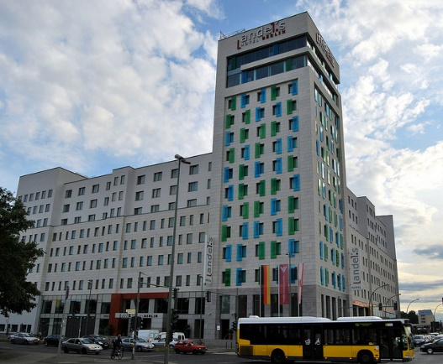
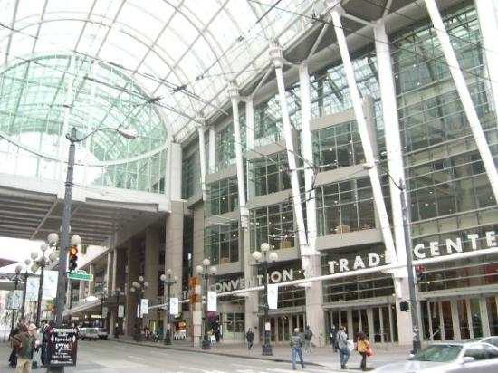

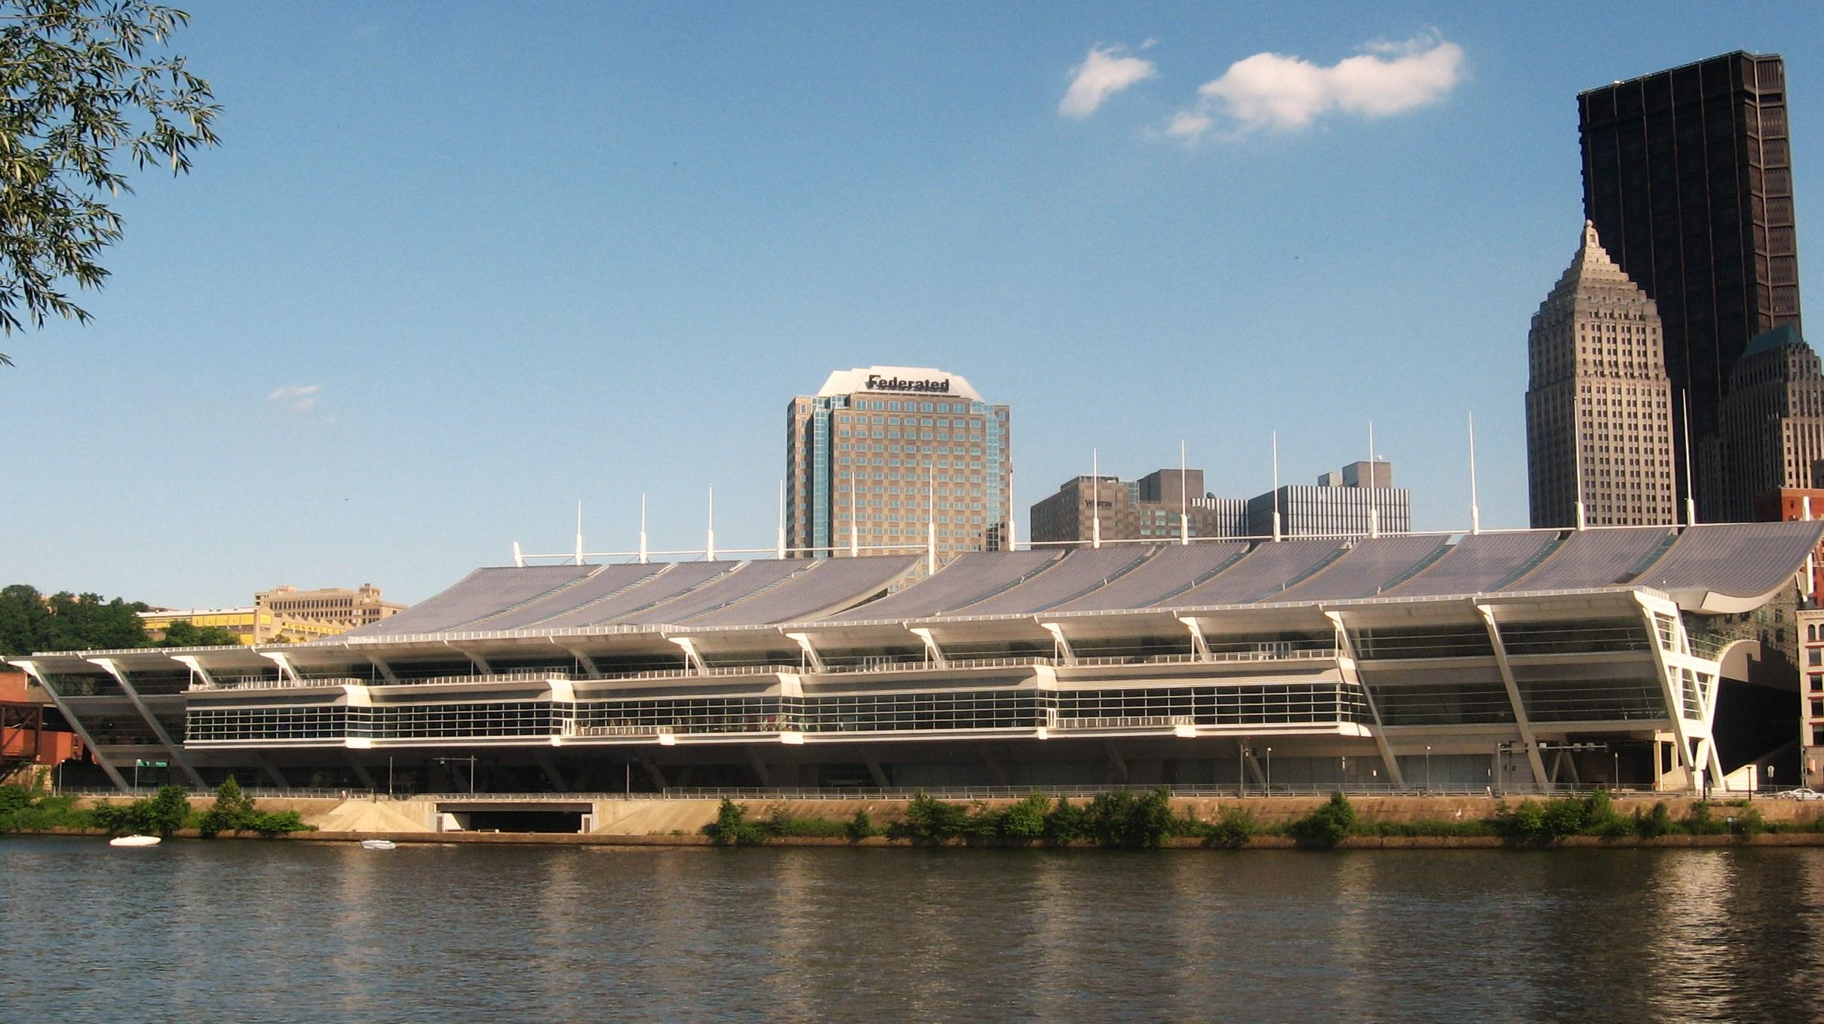
Competition Goals
Evaluate and compare technologies from academia and industry in the same, unfamiliar space.
Bring teams working in this area together in a more effective way.
2014: Berlin
2015: Seattle
2016: Vienna
2017: Pittsburgh

Slide 3
2018: Porto
34 teams submitted abstracts
26 systems officially registered
25 systems showed up in Porto
22 systems were evaluated

Slide 4
Two Categories
2D Category
Report (X,Y) locations
Do not require the deployment of any infrastructure (WiFi and/or IMU based)
3D Category
Report (X,Y,Z) locations
Require custom hardware deployment (UWB, Ultrasound etc.)
Each team can deploy up to 10 anchor devices in the evaluation space

Slide 5
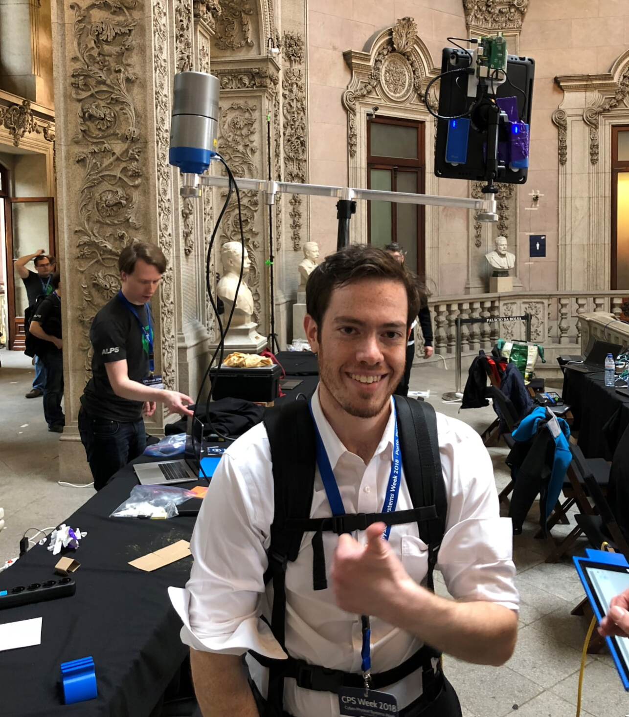
Evaluation Process
LiDAR
System under Test
Day 1: Tuesday
Teams were given 8 hours to setup and calibrate their systems.
Day 2: Wednesday
Each team mounted their systems on our evaluation backpack and continuously logged locations over a predetermined path.
Evaluation Metric
Average localization error across all recorded points along the path.
The lower the error the better.

Slide 6
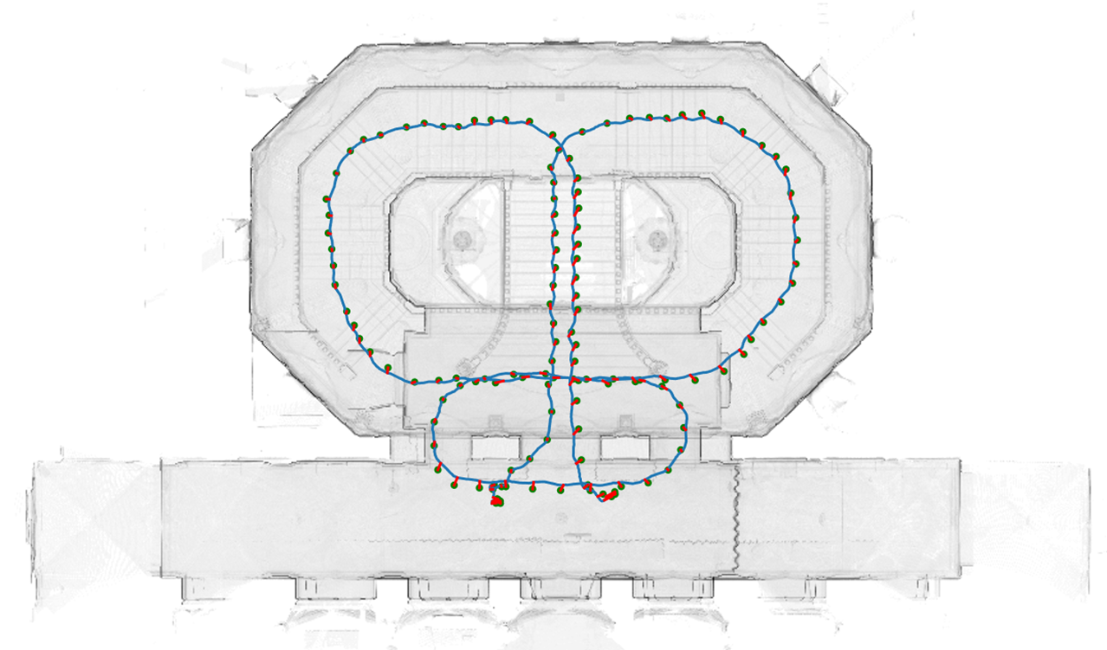
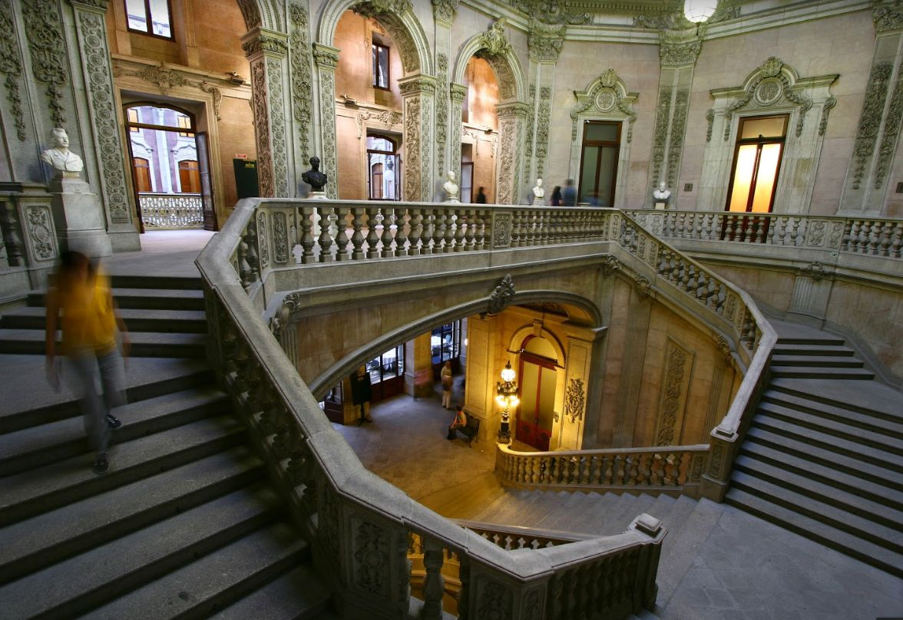
Evaluation Area - Two Floors

Slide 7
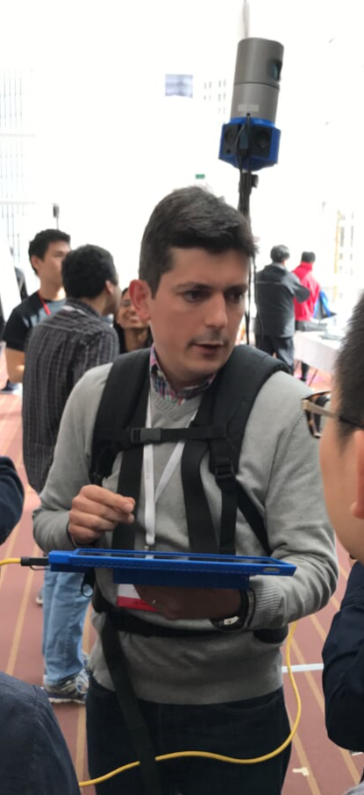
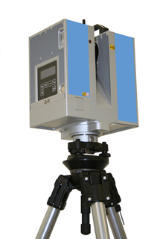
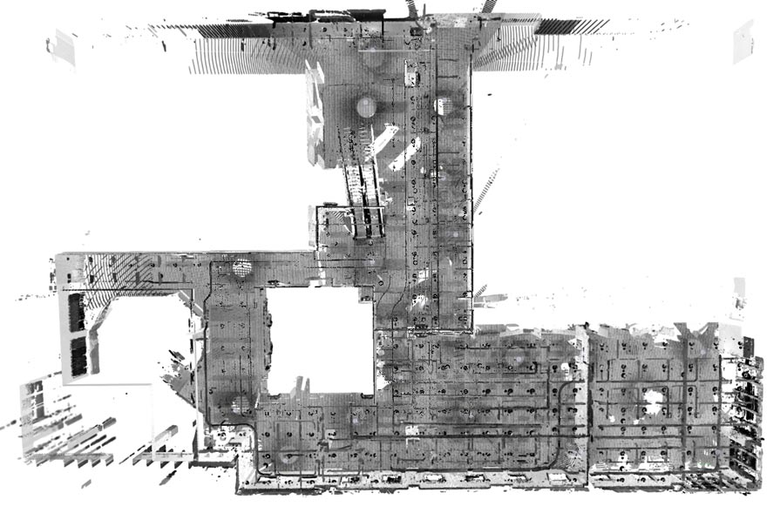
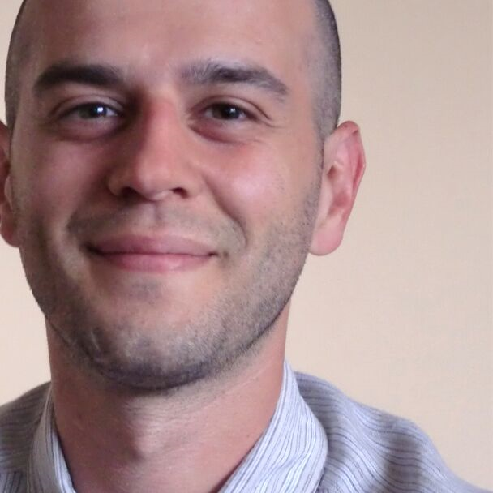
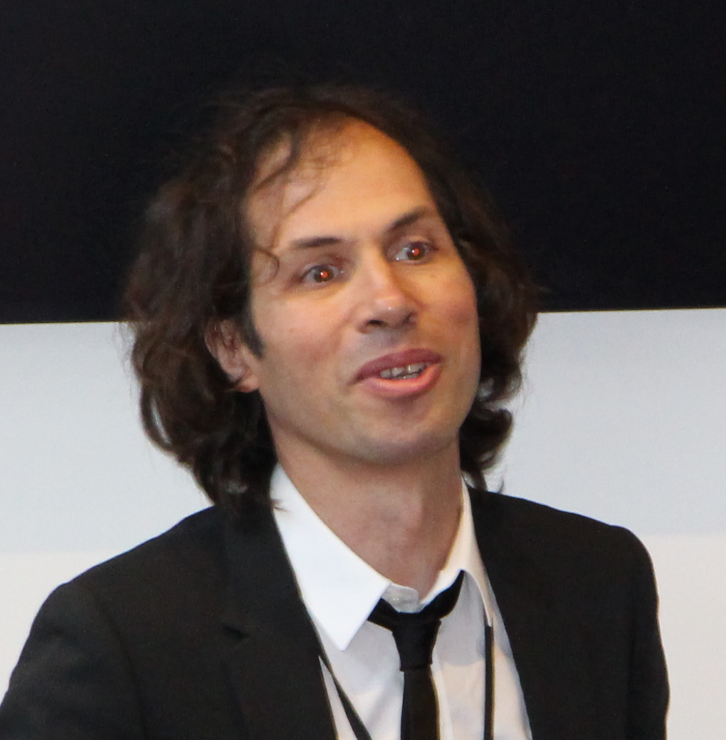
Ground Truth Measurements & Evaluation
High Resolution 3D Acquisition and Registration
Pierluigi Taddei
Carlos Sanchez
Vitor Sequeira
JRC (https://ec.europa.eu/jrc), the winner of the 2015 competition, volunteered to provide its expertise for ground truth measurements.
JRC has been deploying 3D laser scanning technology to verify design information within nuclear facilities for more than 10 years.
The ground truth environment and the test points were acquired using multiple high definition 3D scans using a tripod mounted laser scanner (e.g. ZF 5006) and proprietary software

Slide 8
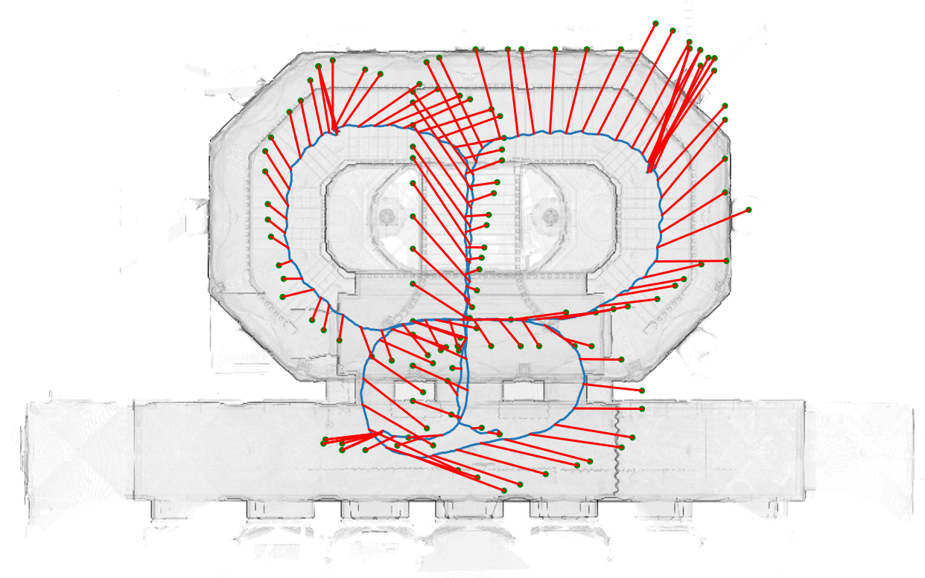
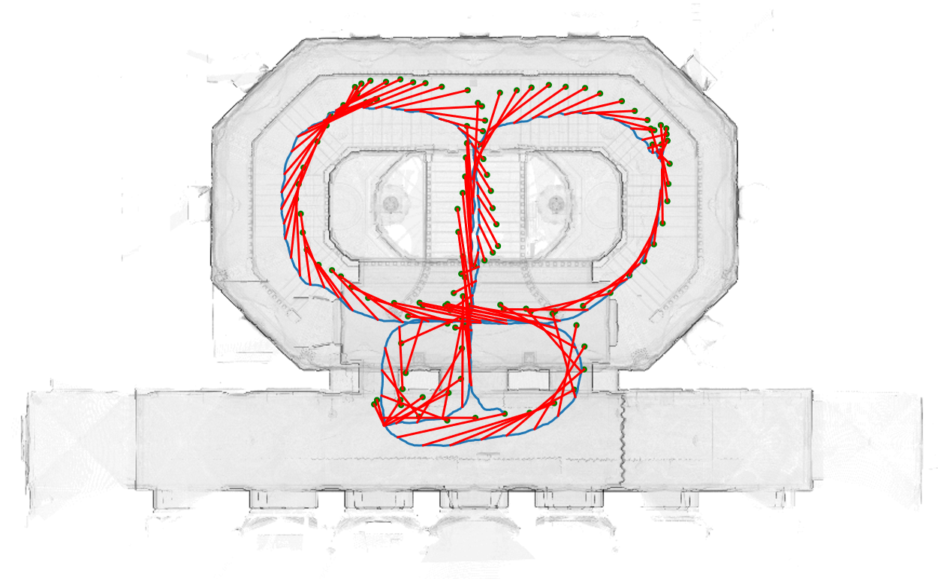
2D Results
Naviguy
Ariel Univ. (Step)
PDR + Fingerprinting
WiFi ToF
Camera+PDR+Finger.
PDR
Camera+PDR
Teams that start with * require initialization.
Naviguy and Ariel Univ. were considered a tie! Ariel University is the winner as Naviguy required initialization while Ariel University did not.

Slide 9
3D Results
Sound
UWB
Camera+
LED + PDR
Atmel
Phase
UWB+
ARKit
Sound+ ARKit
Teams that start with * require initialization. SND Smart Ltd and Yodel Labs are considered a tie!

Slide 10

3D Results
Sound
UWB
Camera+
LED + PDR
Atmel
Phase
UWB+
ARKit
Sound+ ARKit

Slide 11
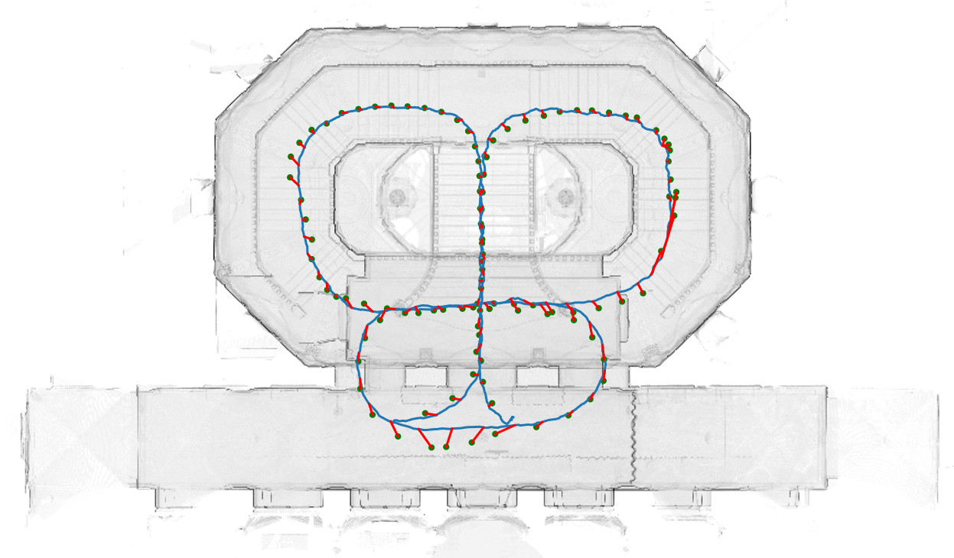
3D Results
Sound
UWB
Camera+
LED + PDR
Atmel
Phase
UWB+
ARKit
Sound+ ARKit

Slide 12
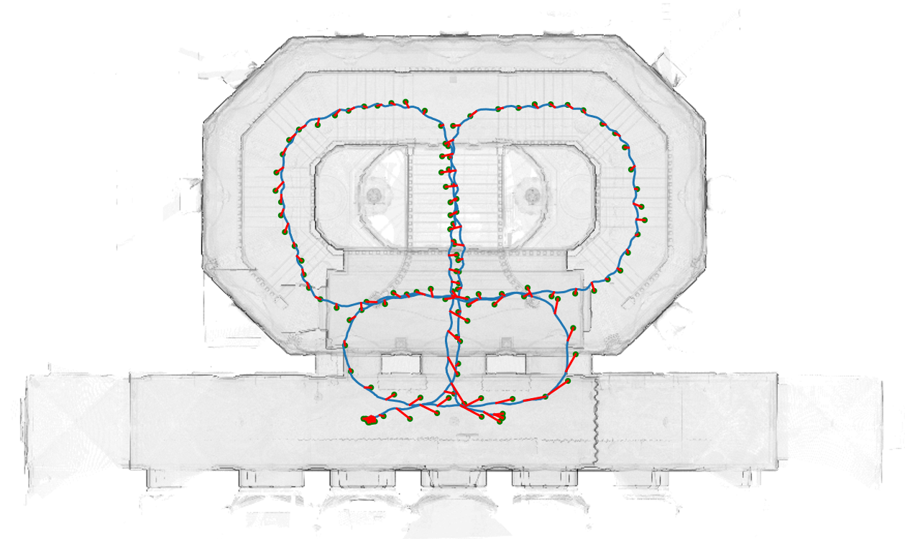
3D Results
Sound
UWB
Camera+
LED + PDR
Atmel
Phase
UWB+
ARKit
Sound+ ARKit

Slide 13
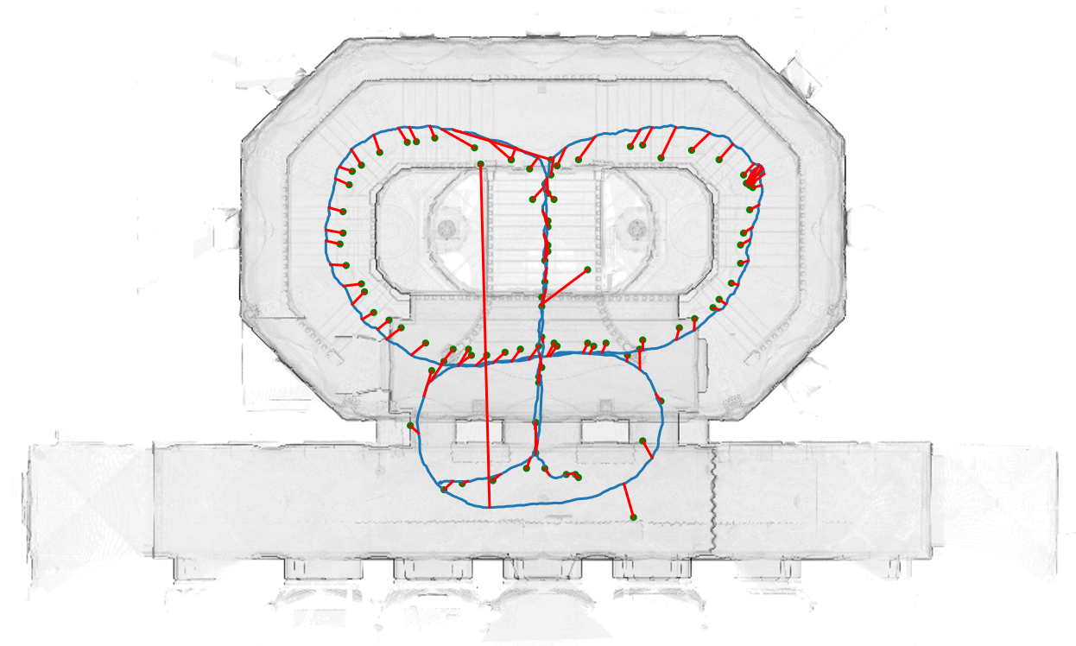
3D Results
Sound
UWB
Camera+
LED + PDR
Atmel
Phase
UWB+
ARKit
Sound+ ARKit

Slide 14
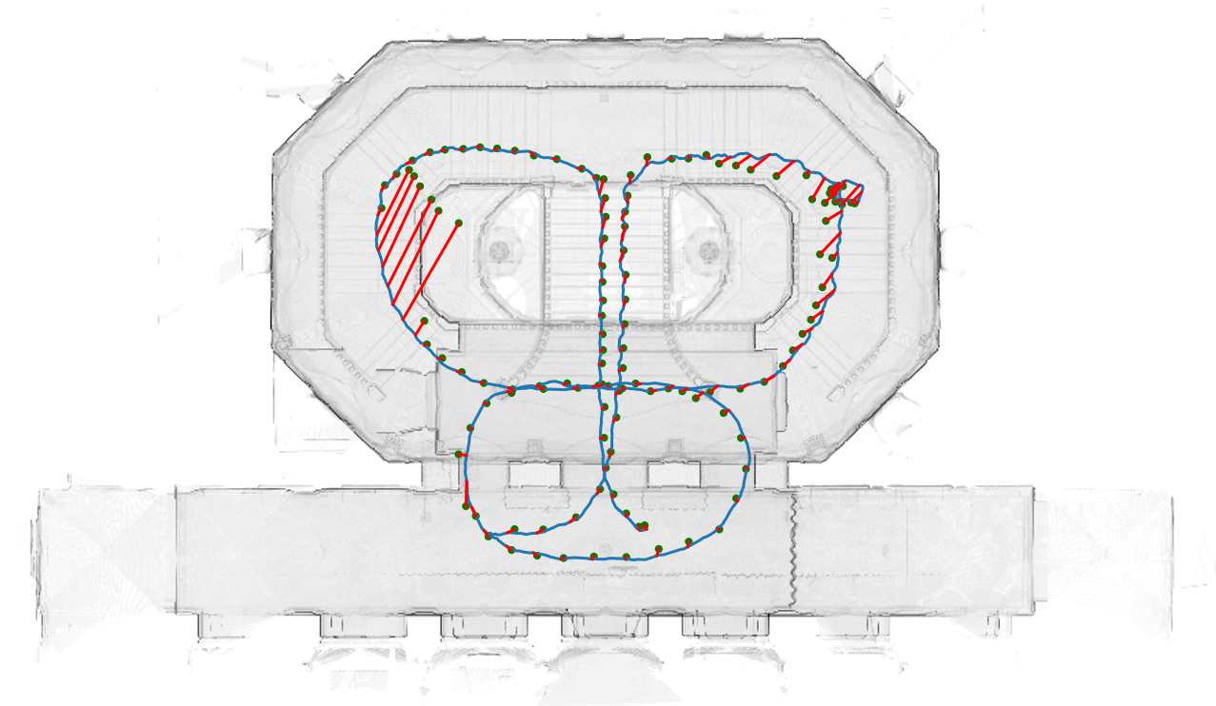
3D Results
Sound
UWB
Camera+
LED + PDR
Atmel
Phase
UWB+
ARKit
Sound+ ARKit

Slide 15
2D Category
3D Category
1st
Steps – An Accurate Relative Positioning Method for First-Responders
Landau et al.
(Ariel University)
Realty and Reality: Where Location Matters
Miller et al.
(CMU)
$1000
2.4m error
0.27m error
2nd
Inertial Sensing Approach for Indoor Localization
Qu et al.
(Naviguy/Tongji University)
NavInThings – An Indoor Localization and Navigation UWB System
Gao et al.
(SND Smart Ltd/ATE Electronics Ltd)
$600
2.3m error
0.40m error
2nd
ALPS: The Acoustic Location Processing System
Lazik et al.
(Yodel Labs)
$600
0.47m error

