Slide 1
Competition Logistics
2018 Microsoft Indoor Localization Competition

Slide 2
Competition Dates - Final
Tuesday April 10th – Wednesday April 11th 2018
First Day (April 10th)
Setup starts early in the morning and ends later in the afternoon
At the end of the evaluation day, all teams have to completely shut down their systems and leave the area. The organizers will take over to mark down the evaluation path. During this time all systems will be off and all contestants will have to leave the evaluation area.
Second Day (April 11th)
Evaluation starts early in the morning and continues throughout the day
Organizers will assign a time slot to each team
The detailed time slots will be announced early April.

Slide 3
Registration
All members of a competing team that want to actively participate to the competition (i.e., attend any of the two days in person), must register for the competition in advance!
Registration is currently open: http://www.cister.isep.ipp.pt/cpsweek2018/reg
All contestants attending the competition should register for the Indoor Localization Competition
Teams/Team members that have not been registered will not be allowed to participate in the competition!
Starting mid March, the competition website will start reflecting the registration status of each participating team

Slide 4
Visa Application Letter
You have the opportunity to request a visa application letter through the registration process
The visa application letter will be processed right after the registration payment has been successfully processed.
http://www.cister.isep.ipp.pt/cpsweek2018/travel

Slide 5
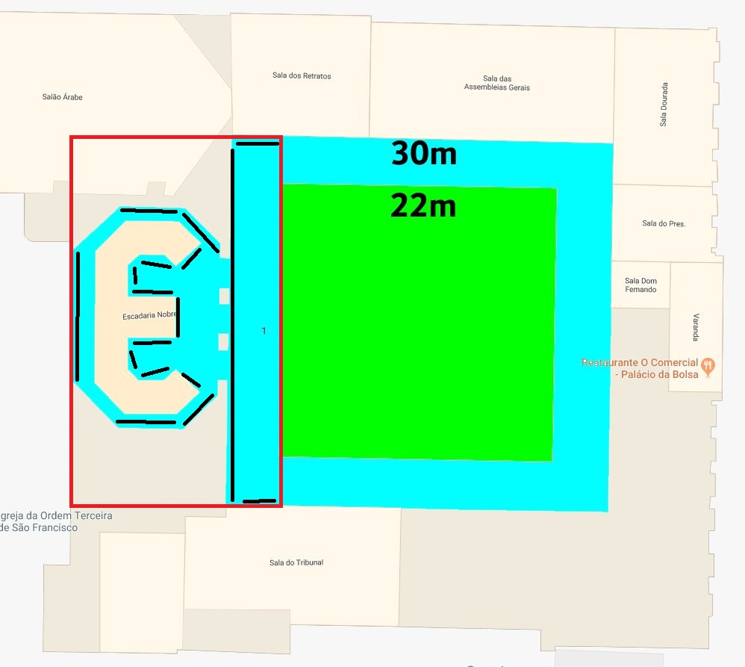
Evaluation area (red box)
Origin Point
(0,0,0)
Covering two floors
Ground floor corridor
Stairs connecting ground floor and first floor
First floor corridor
Origin point is indicated on the lower left corner of the 3rd floor
All systems in the 2D category should report an (X,Y) location with respect to this origin point
All systems in the 3D category should report an (X,Y,Z) location with respect to this origin point
Reported locations should be in meters.
X Dimension
Y Dimension

Slide 6
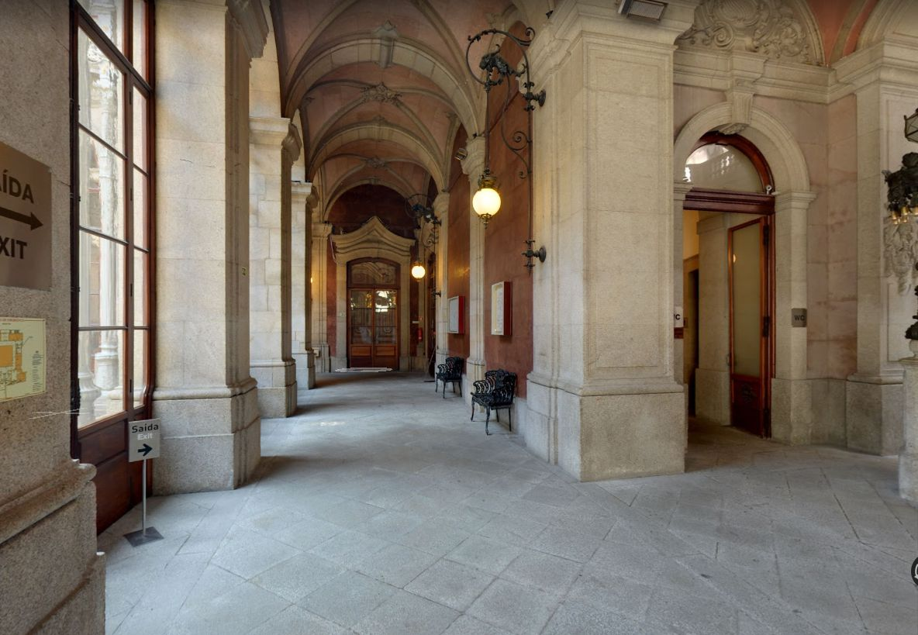

Evaluation area pictures
Ground Floor Corridor
Stairs Areas

Slide 7
Ground Truth Measurements
JRC (https://ec.europa.eu/jrc), the winner of the 2015 competition, has volunteered to provide its expertise for ground truth measurements
The JRC creates tools for Euratom (European Atomic Energy Community) inspectors and the International Atomic Energy Agency (IAEA), which inspects some 700 facilities worldwide each year. For more than a decade, the JRC has deployed 3D laser scanning technology, to verify design information within nuclear facilities.
Before the competition we will acquire the ground truth positions of the markers employing two independent systems both based on time-of-flight laser measurements.

Slide 8
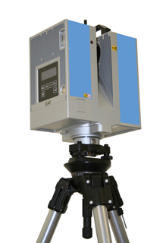
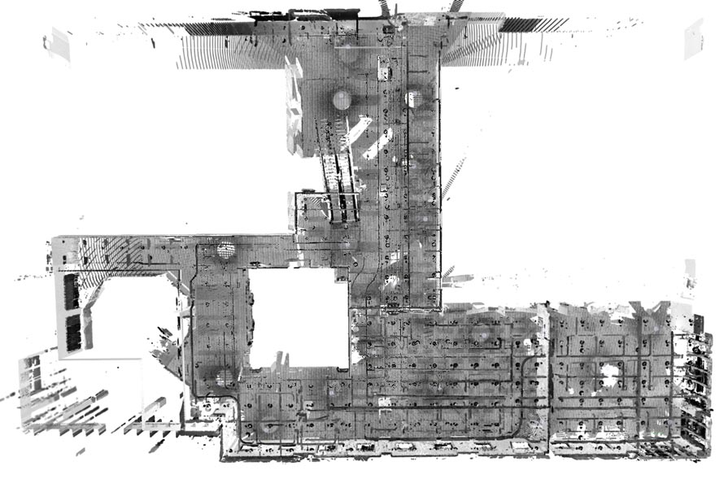
Ground Truth Measurements – System 1
High Resolution 3D Acquisition and Registration
The ground truth environment and the markers location will be acquired using multiple high definition 3D scans using a tripod mounted laser scanner (e.g. ZF 5006).
The single acquisitions will be aligned and the marker positions accurately identified using a proprietary software (JRC 3DLVS).
Robust surface registration using N-points approximate congruent sets
J Yao, MR Ruggeri, P Taddei, V Sequeira
EURASIP Journal on Advances in Signal Processing 2011 DOI:10.​1186/​ 1687-6180-2011-72

Slide 9
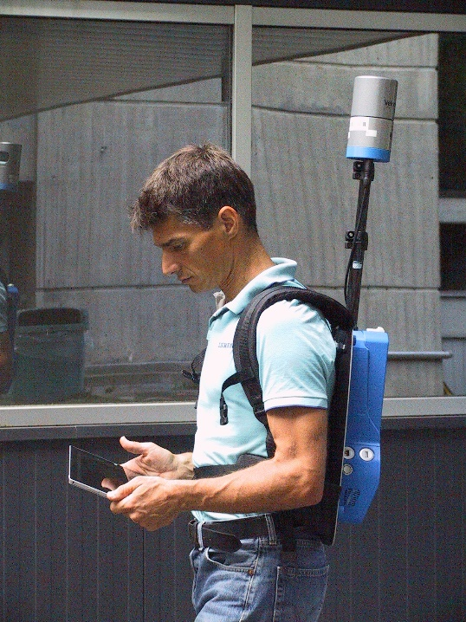
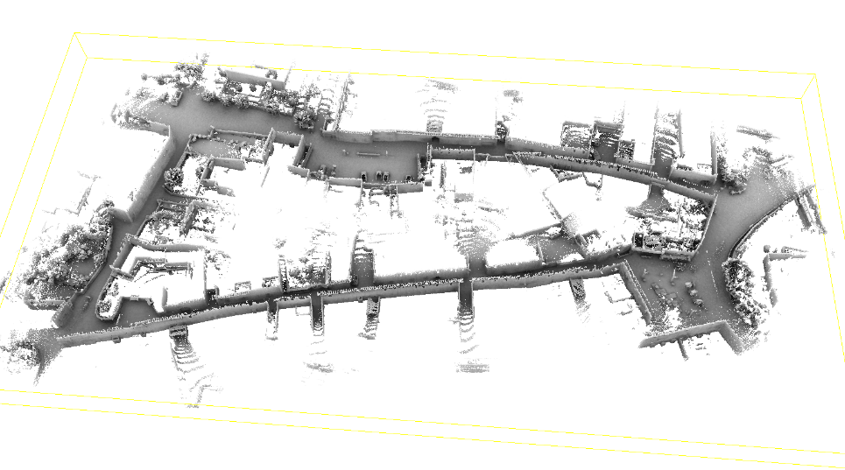
Ground Truth Measurements – System 2
On-the-fly Tracking and Mapping Using a Spinning Laser
A second independent measurement will be done using a backpack mounted spinning laser scanner (e.g. Velodyne VLP-16) while walking in the competition area using a proprietary software (JRC STEAM) and moving on each marker position.
Localization and tracking in known large environments using portable real-time 3Dsensors C.Sánchez, P. Taddei, S. Ceriani, E. Wolfart, V. Sequeira Computer Vision and Image Understanding (2015)
DOI: 10.1016/j.cviu.2015.11.012 to be published
Pose interpolation SLAM for large maps using moving 3D sensors
S. Ceriani, C. Sanchez, P. Taddei, E. Wolfart, V. Sequeira
Intelligent Robots and Systems (IROS)
DOI: 10.1109/IROS.2015.7353456

Slide 10
Hardware Deployment
You will be able to attach your equipment on:
Floors and walls
Ceiling is very tall. If you were planning to deploy hardware on the ceiling, come up with an alternative plan.
When attaching equipment
Use paint-safe tape than can be removed without causing damage to the walls
Don’t even think about drilling holes to attach equipment! I mean it…
This is a historic building. We need to be respectful of it.
Maximum number of deployed anchor points: 10
Absolutely no teams will be allowed to deploy more than 10 anchor points!

Slide 11
Hardware Deployment
If your team has been classified into the 2D category, you will not be allowed to deploy your own hardware (i.e., WiFi APs)
In special cases, the organizers will consider exceptions. To request an exception for your team:
Send an email to dlymper@microsoft.com explaining in detail why you need to deploy your own hardware
You will receive a reply from the organizers with one of the following outcomes:
You are granted the right to deploy your own APs/hardware, and you are still classified as a 2D solution.
You are not granted the right to deploy your own APs/hardware, and you are still classified as an infrastructure-free submission
You are granted the right to deploy your own APs/hardware, but you are now classified as a 3D submission

Slide 12
WiFi APs
All teams that leverage WiFi will have to use the WiFi APs that are already deployed in the conference venue for internet connectivity
All teams that need to deploy their own WiFi APs (assuming they have been granted by the organizers to do so), will be allowed to deploy the same number of APs that are already deployed in the conference venue. This number will become available to the organizers in late March. If a team wants to deploy more APs, then it will be classified in the infrastructure-based teams.

Slide 13
Come prepared!
Make sure you bring everything you need
Paint-safe tape
Ropes
Attachment mechanisms
Laser range finders for ground truth measurements
Tripods
Cables
Power adaptors for your equipment (The competition is in Europe!)
Power outlets will be available throughout the evaluation area
The organizers will not provide any other equipment! It is up to the teams to bring what they need…

Slide 14
Competition Logistics – Setup Day
First Day
Teams setup their equipment and calibrate their systems simultaneously in a predetermined time window
The exact amount of time available for setup will be communicated later (assume at least a 5 hour time window for now)

Slide 15
Competition Logistics – Setup Day
After the end of the first day (setup):
Your deployed hardware will remain at the evaluation area
The deployed hardware must be turned off!
Laptops/phones can be removed from the evaluation area. However, everything else must remain within the evaluation area.
The conference venue is not open to the public after hours, so your hardware will be safe
No other calibration/modification of the deployed system will be allowed after the setup day! Teams that do that will be automatically disqualified!
All contestants will have to leave the evaluation area
The organizers will assume control of the evaluation area to mark the path that will be used for evaluation.

Slide 16
Competition Logistics – Evaluation Day
At the beginning of the evaluation day, the evaluation path will be revealed to all teams
If any team attempts to reverse engineer or manually measure locations of the evaluation path, it will be automatically disqualified!
Each team will be assigned a 15min time window (communicated well in advance)
During this time window, only the system from this team will be active.
The hardware to be localized will be carried/worn by the organizers.
The organizers will also wear the ground truth measurement device that will continuously compute location with sub-cm accuracy

Slide 17
Competition Logistics – Evaluation Day
At the beginning of the evaluation of each system
Organizers will indicate that evaluation begins by simultaneously pressing a button/key on the system under test and on the ground truth measurement system.
This will allow time synchronization between the system under test and the ground truth measurement system.
It is fine if the system under test reports location on a server/laptop further away.
After the initial key press, the system under test is expected to continuously log its location into a file
If your system cannot report location updates at the rate of 1 location update per second or faster, please let the organizers know by emailing: dlymper@microsoft.com. This is not a problem, but we need this information to make sure that enough locations are recorded for every team.
At the end of the evaluation, the team will hand out the file with the estimated locations to the organizers.

Slide 18
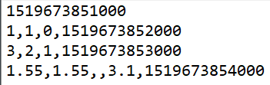
Example Output Location File
First line: UTC timestamp in ms of the time when the button/key was pressed at the start of the evaluation
Location Updates. Each line is comma separated with the following format:
<X in meters>,<Y in meters>,<Z in meters>,<UTC Timestamp in ms>
For 2D systems the Z value will be ignored.

Slide 19
Evaluation Metric
The Euclidean distance between the ground truth coordinates and the estimated by the system under test coordinates in the output file will be computed.
The average Euclidean distance across all evaluation points will be the overall score of each team
The team with the lowest score wins!
In case of a tie, the team with the lowest hardware deployment requirements wins

Slide 20
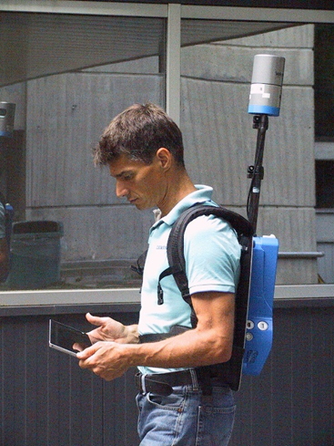
Mounting your location sensor during evaluation
Ground-truth LiDAR sensor
Mount your sensor on the black pole through a standard camera connector clamp
Alternatively, let the organizer carry your location sensor
LiDAR-based ground truth system
No matter how your team wants the organizers to carry your location sensor, the location offset between the ground-truth LiDAR sensor and the location sensor will be recorded to allow us to adjust the recorded locations and ensure best accuracy.

Slide 21
Competition Logistics – What to expect
Expect people and furniture/objects in the evaluation area during both setup time and evaluation!
Multiple people will be in the evaluation area and they will be moving
Placement of furniture/objects can change at any given time during, or after setup day, as well as during the evaluation day.
Given the large number of submissions, there will be interference! Plan ahead!

Slide 22
Awards
The top 3 teams from each of the two categories will be awarded prizes
1st place: $1000
2nd place: $600
3rd place: $400
Results Announcement
A special IPSN session will be held (TBD) where the results of the competition will be announced
The top 3 teams from each category will be given the opportunity to present the details of their work during this session
Be ready to give a 10 min talk about your system if you end up in one of the top 3 places in any of the two competition categories!

Slide 23
Poster Session
Every participating team will have the opportunity to present its approach during the IPSN poster session.
The posters from the competition teams will not be published in the proceedings of the conference unless is the same posters were submitted through the official poster track and were accepted.

