Slide 1


Explainable Recommendation Through Attentive Multi-View Learning
The 33rd AAAI Conference on Artificial Intelligence (AAAI 2019)
Honolulu, Hawaii, USA
Jingyue Gao^{1,2}, Xiting Wang^{2,*}, Yasha Wang¹, Xing Xie²
¹ Peking University, ² Microsoft Research Asia

Slide 2
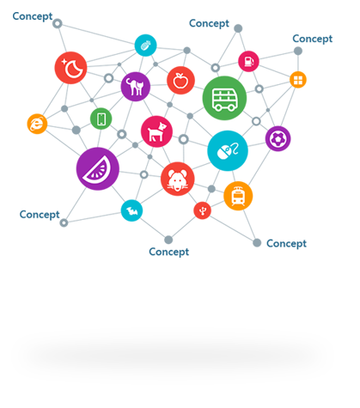
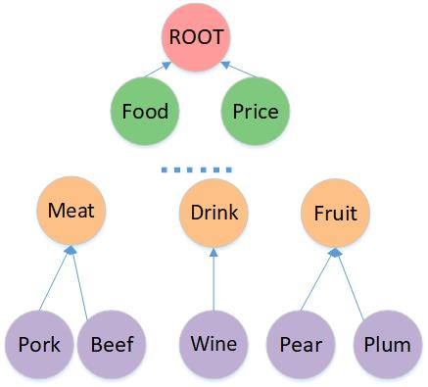

Motivation: An Explainable Deep Model
Build a network based an explainable deep hierarchy to improve accuracy and explainability simultaneously
IsA Relationship
IsA
Microsoft Concept Graph
Feature hierarchy

Slide 3
Challenges
Model multi-level explicit features from noisy and sparse data
Shrimp → Seafood → Meat
Users may be interested in Seafood even if they mainly mention Shrimp and Meat in reviews
Generate explanations from the multi-level structure
Features could be semantically overlapping
Simultaneously putting Shrimp and Seafood in explanations will degrade user experience.

Slide 4
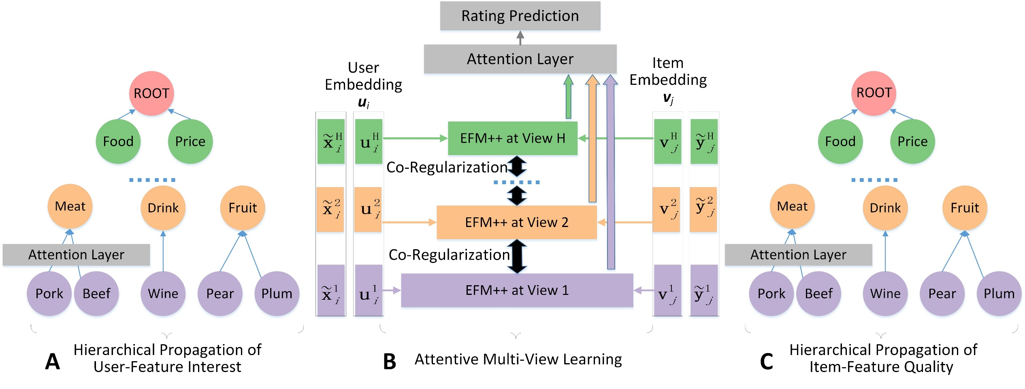
Deep Explicit Attentive Multi-View Learning Model

Slide 5
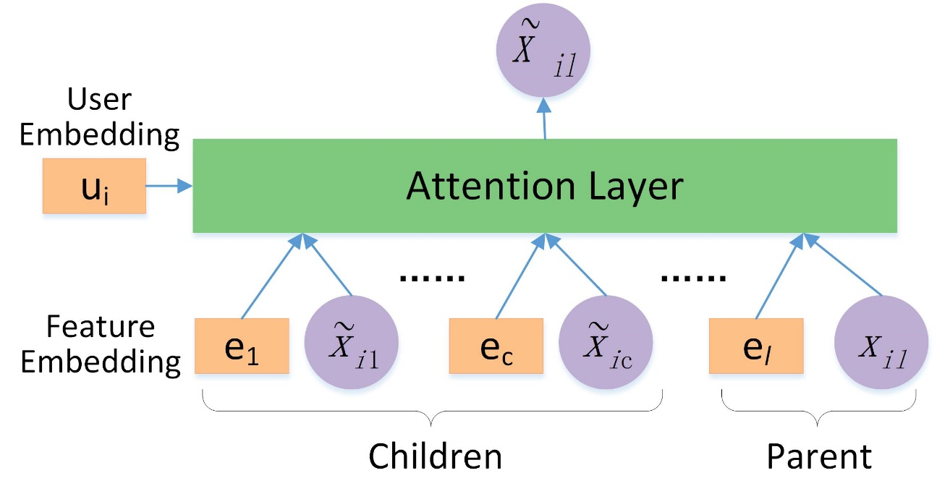
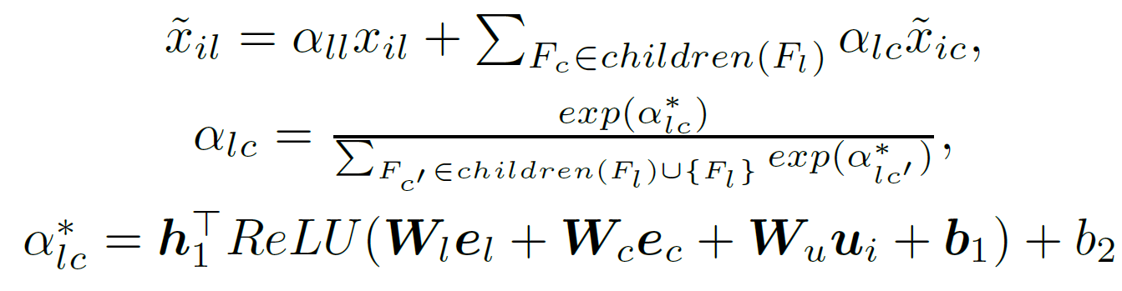
Hierarchical Propagation
Propagate user-feature interest over the hierarchical structure
Feature embedding is trained beforehand using GloVe
to capture both semantic and hierarchical information

Slide 6
Hierarchical Propagation
Propagate user-feature interest over the hierarchical structure

Slide 7
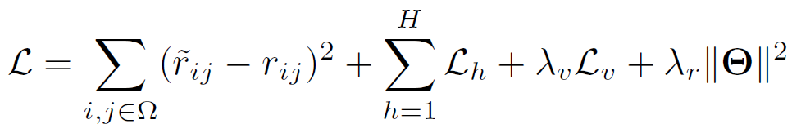
Attentive Multi-View Learning
Prediction loss
Co-regularization loss
Loss in each view
Regularization
Joint learning

Slide 8
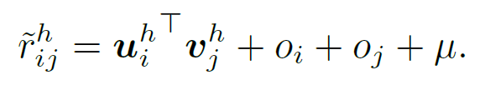
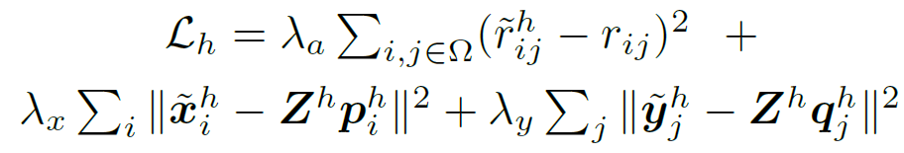

Attentive Multi-View Learning
Features at different hierarchical levels are regarded as different views on user interest and item quality
In each single view, we extend EFM to EFM++ by adding rating biases
Loss in each view

Slide 9
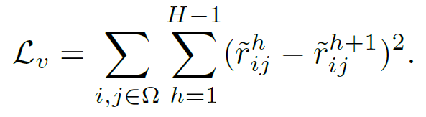
Attentive Multi-View Learning
A common paradigm of Multi-View Learning
Enforce agreement on predictions from multiple views
Co-regularization loss

Slide 10
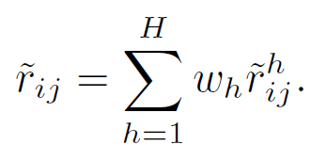
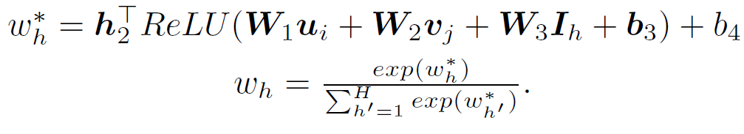
Attentive Multi-View Learning
Predictions from all views are attentively combined for final prediction
Prediction loss

Slide 11
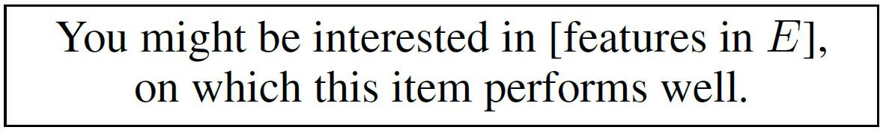
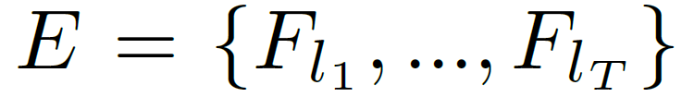

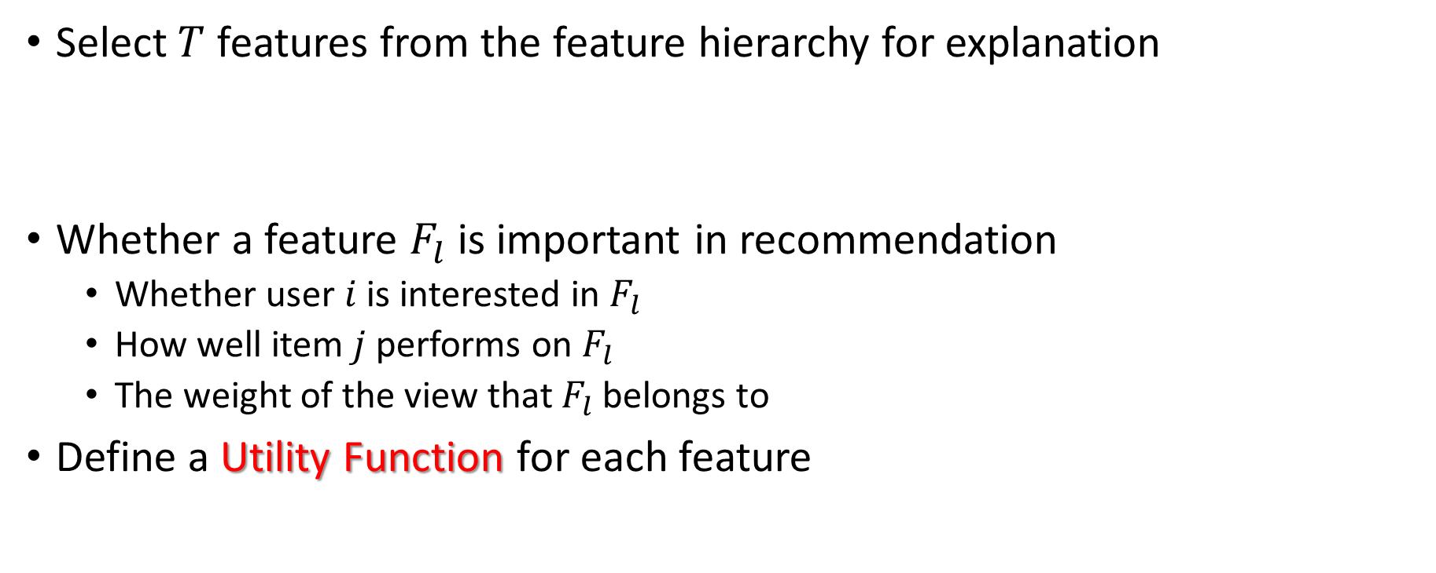
Personalized Explanation Generation
Select $T$ features from the feature hierarchy for explanation
Whether a feature $F_{l}$ is important in recommendation
Whether user $i$ is interested in $F_{l}$
How well item $j$ performs on $F_{l}$
The weight of the view that $F_{l}$ belongs to
Define a Utility Function for each feature

Slide 12
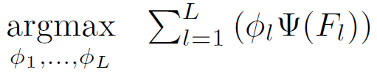
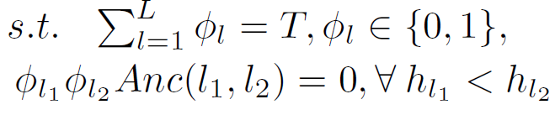
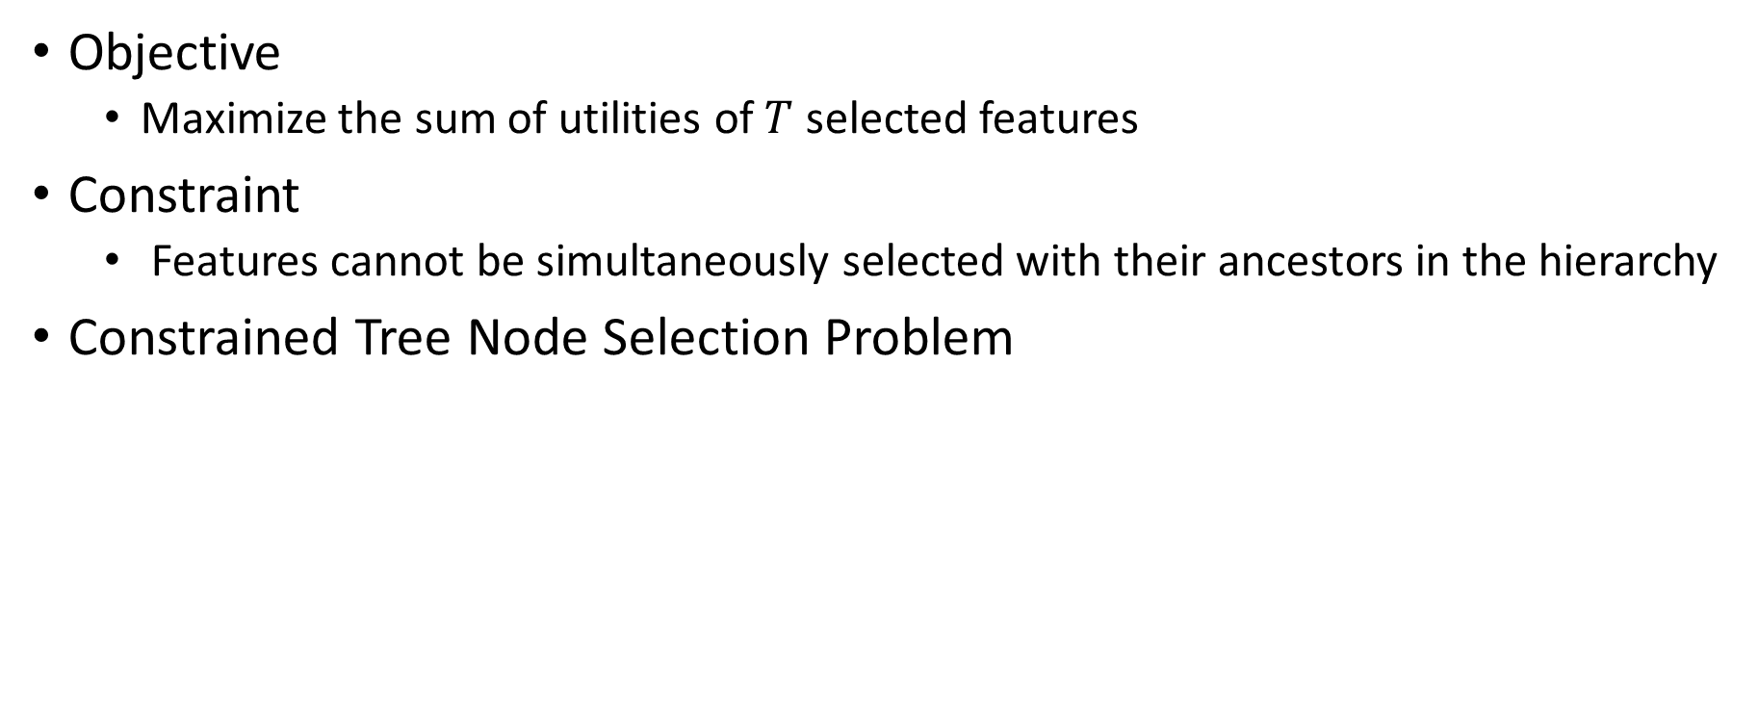
Personalized Explanation Generation
Objective
Maximize the sum of utilities of $T$ selected features
Constraint
Features cannot be simultaneously selected with their ancestors in the hierarchy
Constrained Tree Node Selection Problem

Slide 13
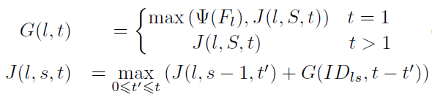
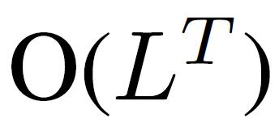
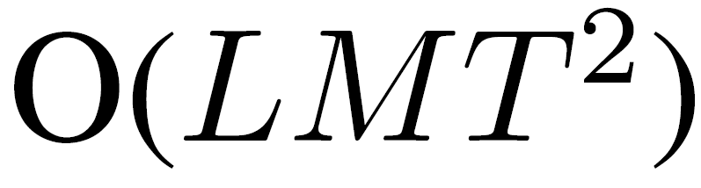
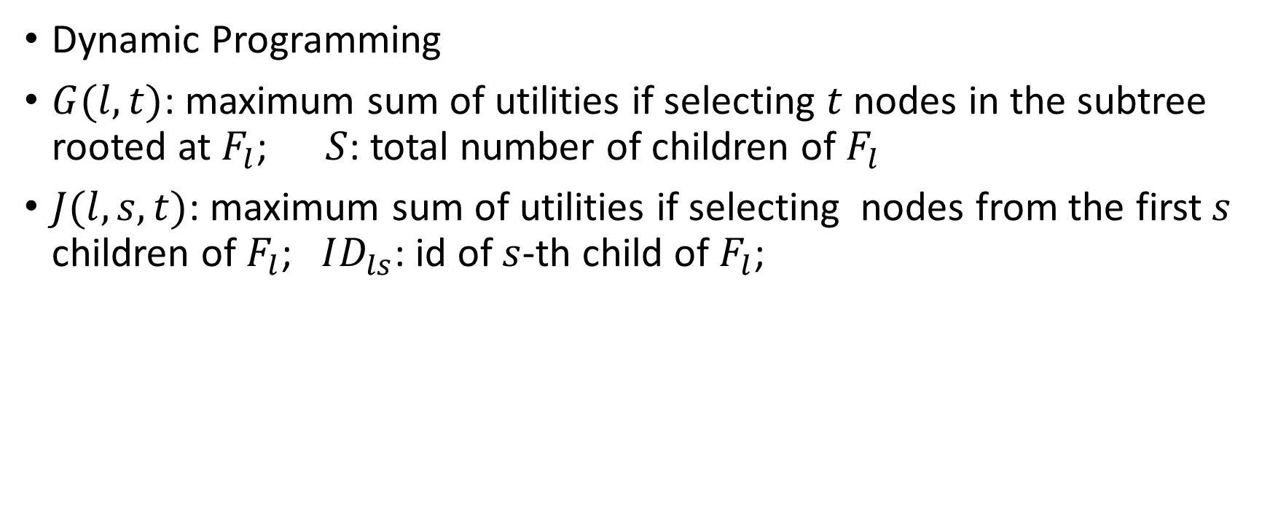
Personalized Explanation Generation
Dynamic Programming
$G(l,t)$: maximum sum of utilities if selecting $t$ nodes in the subtree rooted at $F_{l}$; $S$: total number of children of $F_{l}$
$J(l,s,t)$: maximum sum of utilities if selecting nodes from the first$s$ children of $F_{l}$; $ID_{ls}$: id of $s$-th child of $F_{l}$;
Complexity：
Notes:
L：tree上点的个数
T：要选的feature个数
M：最大孩子数

Slide 14
Evaluation
Study on model accuracy
Parameter sensitivity analysis
Study on explainability

Slide 15
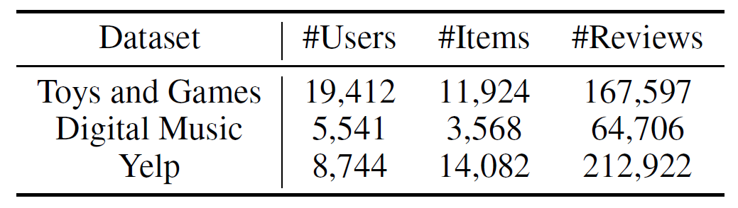

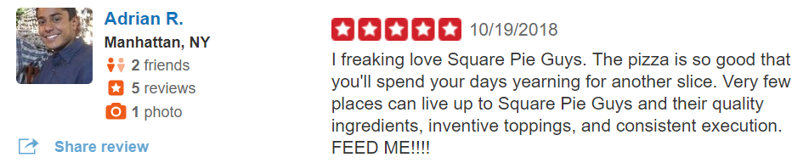
Datasets
Amazon
Tuples: (user, item, rating, review, time)
Amazon
Yelp

Slide 16
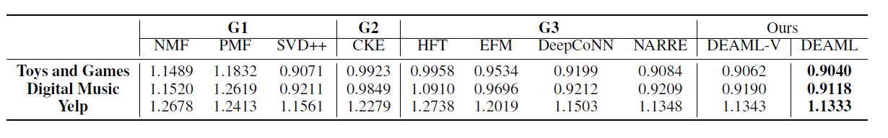
Study on Model Accuracy
G1: only use the observed rating matrix
G2: knowledge-based
G3: leverage textual reviews
EFM: state-of-the-art method for mining feature-level explanations
DeepCoNN, NARRE: deep-learning based
DEAML-V: a variant of our DEAML without attention mechanism

Slide 17
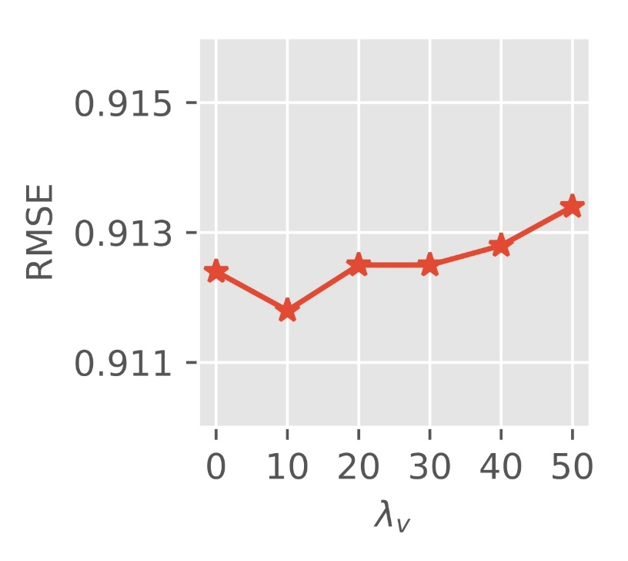
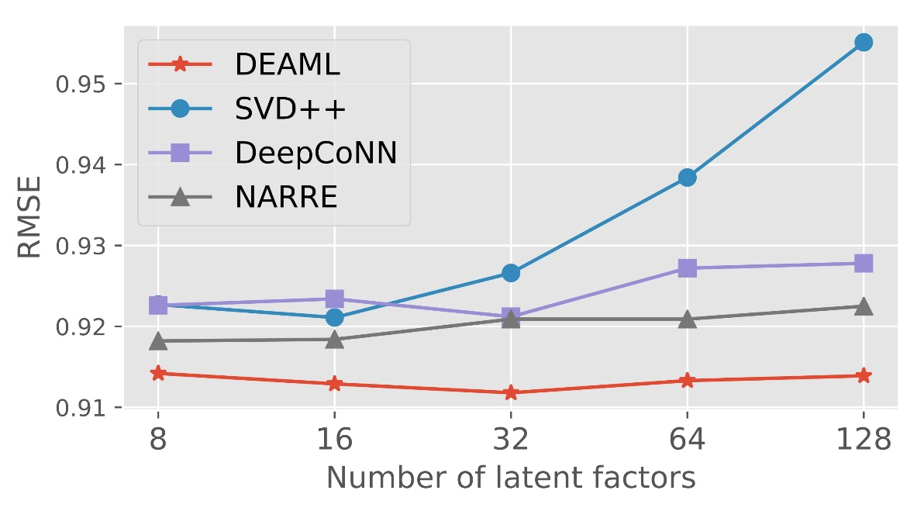
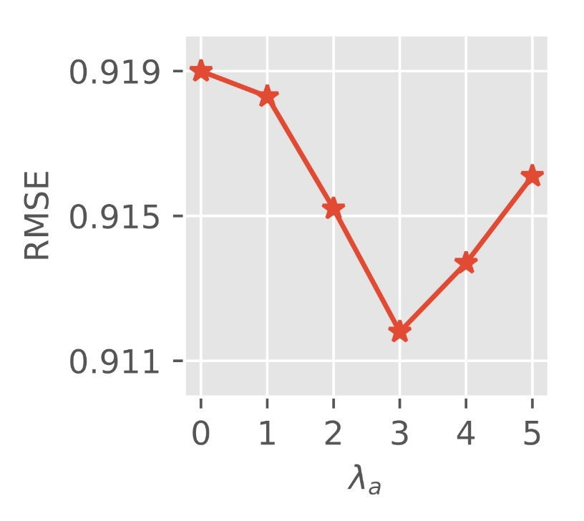

Parameter Sensitivity Analysis
Number of latent factors
Weight $λ_{v}$ of co-regularization
Weight $λ_{a}$ of errors of each review

Slide 18
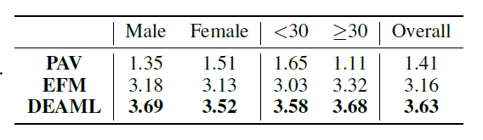
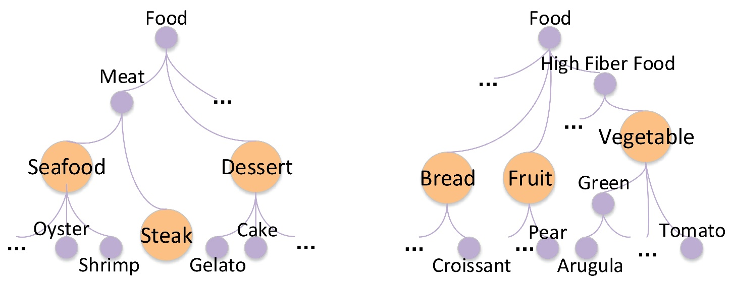
Study on Explainability
Quantitative analysis
Qualitative analysis
Scores (1-5) annotated by users
Visualization of user interest over the feature hierarchy
a 26-year-old female Yelp user
a 30-year-old male Yelp user

Slide 19
Thanks!

