Slide 1



Learning Groupwise Explanations for Black-Box Models
The 30th International Joint Conference on Artificial Intelligence (IJCAI-21)
Jingyue Gao¹, Xiting Wang², Yasha Wang^{1,†}, Yulan Yan³, Xing Xie²
¹ Peking University, ² Microsoft Research Asia, ³ Microsoft Advertising

Slide 2
Outline
Background & Motivation
Method
Experiments

Slide 3
Background
The intricate architectures of SOTA ML models (e.g., DNNs) make their decision processes obfuscated
Users need to understand the model behavior and ensure they are correct and ethical
The Architecture of BERT

Slide 4
Background
Providing explanations for black-box models has attracted increasing attention
Instance-level (local) explanation methods, e.g. LIME, MAPLE,…
Understanding the overall
model behavior
clearly and comprehensively
Understanding each
instance well

Slide 5
Motivation
Two essential user demands
D1: Obtaining a faithful understanding of the overall model behavior with limited cognitive load
Infeasible to examine explanations instance by instance
Global / post-processing methods: fidelity unguaranteed

Slide 6
Motivation
Two essential user demands
D2: Making accurate predictions about the model behavior on unseen instances
Human precision / generalized fidelity
Core: the region where each explanation applies

Slide 7
Motivation
Human cognitive psychology
Instance-level explanations helps the encoding stage
Storage (D1), Retrieval (D2)

Slide 8
Idea: Groupwise Explanations
A principled way to simultaneously fulfill D1 & D2
Groupwise explanation → Region ← Multiple instances

Slide 9
Outline
Background & Motivation
Method
Experiments

Slide 10
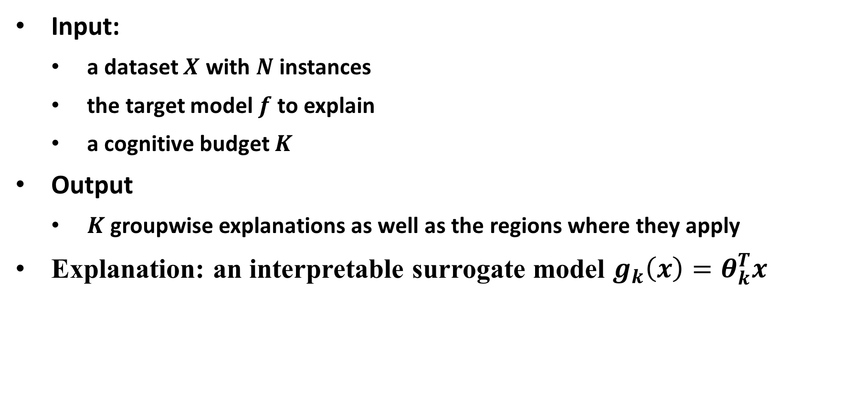
Problem formulation
Input:
a dataset $X$ with $N$ instances
the target model $f$ to explain
a cognitive budget $K$
Output
$K$ groupwise explanations as well as the regions where they apply
Explanation: an interpretable surrogate model $g_{k}\left(x\right)=θ_{k}^{T}x$

Slide 11

LIME
Local explanation method
Construct the neighborhood $N(x)$ of instance $x$ via perturbation
Approximate $f$ with $g$ over $N(x)$

Slide 12
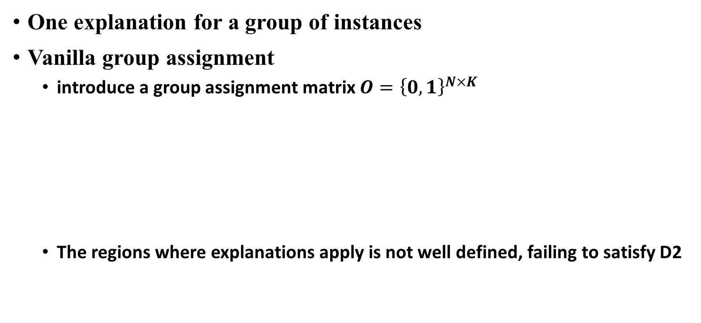
Groupwise Explanation Framework
One explanation for a group of instances
Vanilla group assignment
introduce a group assignment matrix $O={\left\{0,1\right\}}^{N×K}$
The regions where explanations apply is not well defined, failing to satisfy D2

Slide 13
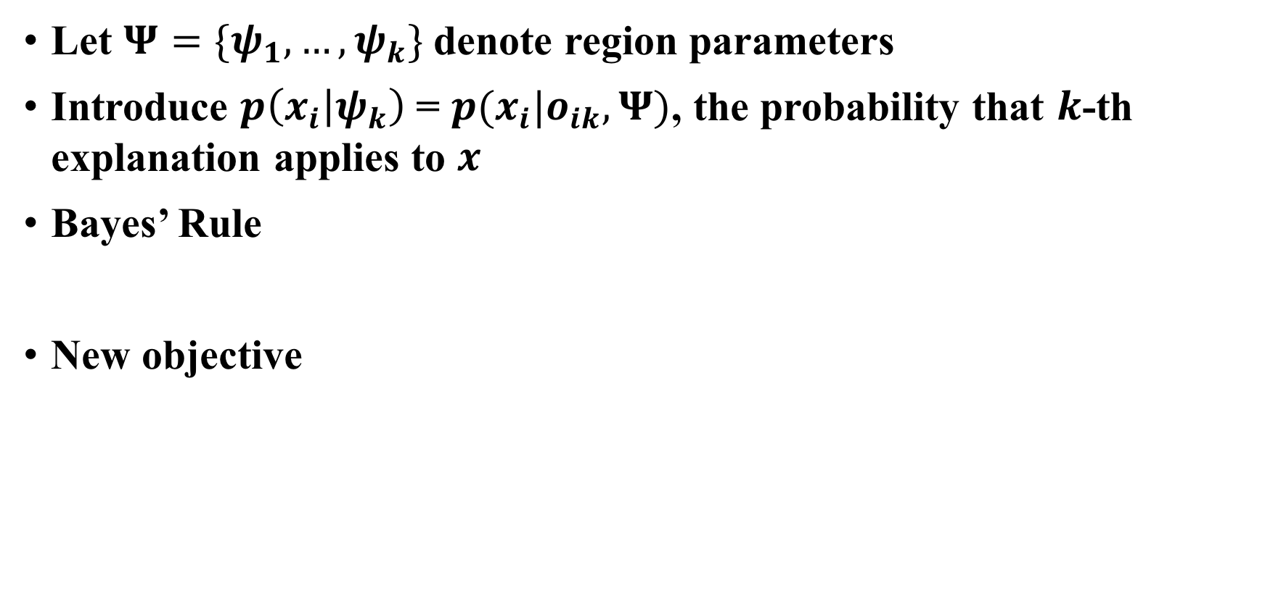
Bayesian Assignment
Let $Ψ=\{ψ_{1},…,ψ_{k}\}$ denote region parameters
Introduce $p\left(x_{i} | ψ_{k}\right)$ = $p(x_{i}|o_{ik}, Ψ)$, the probability that $k$-th explanation applies to $x$
Bayes’ Rule
New objective

Slide 14
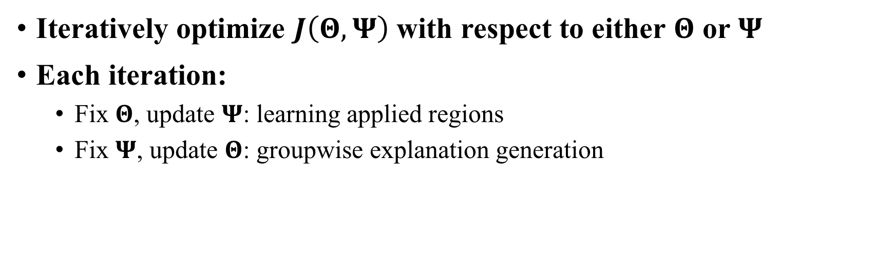
Optimization
Iteratively optimize $J\left(Θ,Ψ\right)$ with respect to either $Θ$ or $Ψ$
Each iteration:
Fix $Θ$, update $Ψ$: learning applied regions
Fix $Ψ$, update $Θ$: groupwise explanation generation

Slide 15
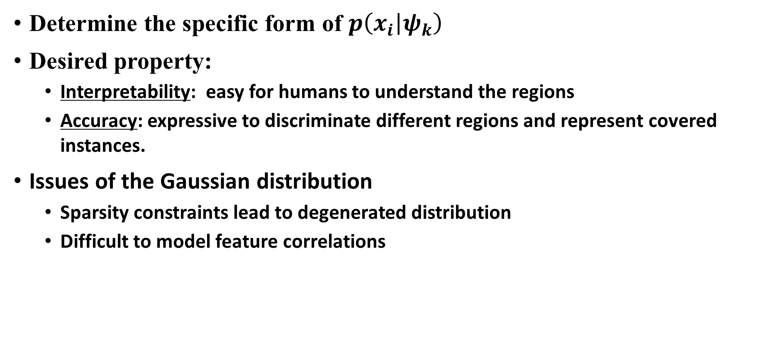
Region formulation
Determine the specific form of $p\left(x_{i} | ψ_{k}\right)$
Desired property:
Interpretability: easy for humans to understand the regions
Accuracy: expressive to discriminate different regions and represent covered instances.
Issues of the Gaussian distribution
Sparsity constraints lead to degenerated distribution
Difficult to model feature correlations

Slide 16
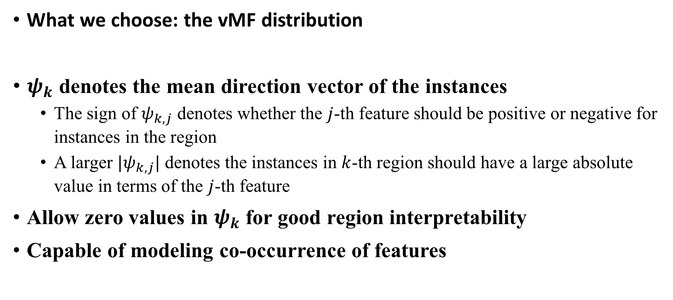
Region formulation
What we choose: the vMF distribution
$ψ_{k}$ denotes the mean direction vector of the instances
The sign of $ψ_{k,j}$ denotes whether the $j$-th feature should be positive or negative for instances in the region
A larger $|ψ_{k,j}|$ denotes the instances in $k$-th region should have a large absolute value in terms of the $j$-th feature
Allow zero values in $ψ_{k}$ for good region interpretability
Capable of modeling co-occurrence of features

Slide 17
Outline
Background & Motivation
Method
Experiments

Slide 18
Settings
Datasets: textual & tabular
Tasks: classification & regression
Target models: BERT & SVR

Slide 19
Overall Performance
Comparison with baselines

Slide 20
Parameter Sensitivity Analysis & User Study

Slide 21
Thanks!

